Slide 1
TILLWARD
01
Tillward
BTC-backed working capital
Repay as customer receipts arrive.
An owner-controlled MUSD workspace on Mezo
Built by ElseMade / Shaly · Mezo Buildathon Wave 2 · November 2026
Notes:
Product definition: docs/PRODUCT.md and docs/PROJECT_BRIEF.md
https://tillward.vercel.app/
Target audience and demand remain unvalidated.

Slide 2
TILLWARD
02
Expenses arrive before receipts.
For an independent agency, studio or seller that holds BTC and collects MUSD.
The receipt counter
Money for expenses.
A share toward debt.
Cash for operations.
Borrowing supplies stable operating money.
Tillward connects repayment to the customer payments that arrive afterward.
Borrow MUSD → choose a share → invoice → repay
Mezo public testnet · test assets only
Notes:
Audience is a hypothesis; no interviews/pilots are claimed.
docs/PRODUCT.md
https://mezo.org/blog/mezo-buildathon-is-underway

Slide 3
TILLWARD
03
You choose how receipts repay the loan.
500 MUSD
Final customer payment
399
100
1
MUSD stays with the business
MUSD repays native debt
MUSD service fee
Fee = 1% of actual hosted repayment, paid from retained funds.
Illustration at 20%, with hosted repayments enabled. Native repayment limits still apply.
Notes:
Fee rules: docs/FEE_COLLECTION_DESIGN.md
Illustrative arithmetic: 399 + 100 + 1 = 500. This slide is not a transaction record.
Maximum owner allocation is 99%; automatic routing is explicit opt-in.

Slide 4
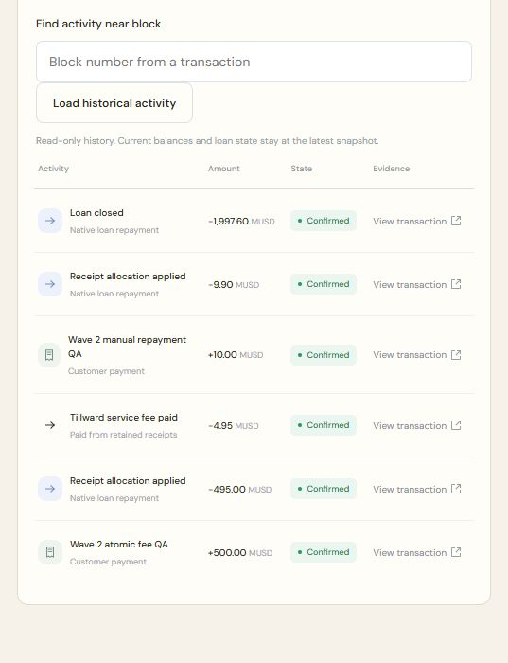
TILLWARD
04
The native lender received the full 495.
500 MUSD receipt
495
MUSD native repayment
4.95
MUSD Tillward fee
0.05
MUSD business balance left
Maximum-allocation QA at 99% · test assets · same-owner payer and test treasury
Notes:
Verified public settlement: https://explorer.test.mezo.org/tx/0xf2c1c33d606b1ebbb5d8d4c975e105caeb356fd9ae0a23e9991969150b0309a4
https://github.com/ShalyX/tillward/blob/main/deployments/wave2-live-fee-proof.json
Screenshot: actual public V2 Activity read November 6. It also includes later manual repayment/closure. Not customer revenue.

Slide 5
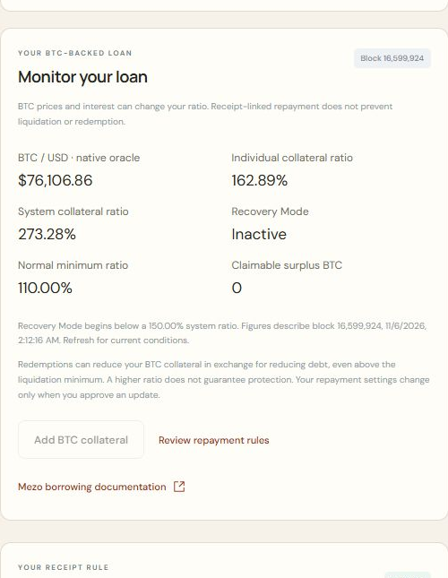
TILLWARD
05
See the loan conditions. Choose the response.
Native conditions
BTC price, ICR/TCR and Recovery Mode.
Owner collateral
A public 0.001 test BTC top-up was verified.
Owner control
Pause automation in Repayment rules.
Manage manual repayment and exit in Manage loan.
Actual public read-only loan conditions; ratios and prices describe the captured block.
Notes:
Actual UI: https://tillward.vercel.app/?account=0x5B4b9C9AD2E5c6Ef55A4186ad82580B61A67c6C5
Collateral proof: https://github.com/ShalyX/tillward/blob/main/deployments/wave2-collateral-topup.json
Native collateral remains exposed to liquidation and redemption. Current conditions are not assurances.

Slide 6
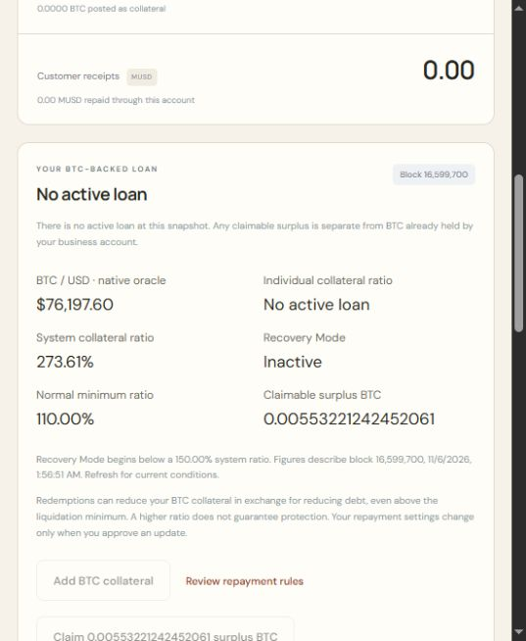
TILLWARD
06
Claim the collateral left after redemption.
0.005532212424520610
test BTC claimed, then returned to its owner
Native surplus pool → business → owner
Positive entitlement became zero.
Exact business credit and owner return were checked onchain.
Controlled own-borrower QA · native surplus claim and separate owner withdrawal · testnet only
Notes:
Claim: https://explorer.test.mezo.org/tx/0xfceb4acb5e2058fe4c1cad47717e318be05ce6f1eaf2cce58e417b1839ee5343
Withdrawal: https://explorer.test.mezo.org/tx/0xa4efb0eab2aa3a332bac7b893614502bad0fe7869f3084232ed26ed17b361017
https://github.com/ShalyX/tillward/blob/main/docs/reviews/WAVE2_PUBLIC_SURPLUS.md
Dedicated QA script signed the product contract calls; browser capture was read-only. The redemption guard is a test fixture, not a product feature. Native protocol fees are separate.

Slide 7
TILLWARD
07
The owner can finish the loan and recover BTC.
0.045 BTC
returned to the owner after native closure
Pause automation → repay 9.9 MUSD manually → close → withdraw BTC
Both keepers monitored. Encrypted off-host state backups.
Isolated same-host runtime restoration passed.
Rabby owner flow verified on public testnet. No additional Tillward fee on manual repayment or closure.
Notes:
https://github.com/ShalyX/tillward/blob/main/docs/reviews/WAVE2_V2_EXIT_VERIFICATION.md
Owner BTC return: https://explorer.test.mezo.org/tx/0x2f9651e470f13d4252c207e7ae2f400df29d2fc7fe1d869e97e3f273ecf6260d
Operations: https://github.com/ShalyX/tillward/blob/main/deployments/wave2-v2-operations-proof.json
Monitoring requires the workstation online; restoration used a namespace on the same VPS. No second-host/host-loss proof is implied.

Slide 8
TILLWARD
08
The next test is business fit.
A working product. Customer acceptance still to validate.
1. Validate seller and payer MUSD acceptance.
2. Measure pilot volume, support time and operating costs.
3. Commission independent review before a mainnet decision.
tillward.vercel.app
github.com/ShalyX/tillward
Shaly / x.com/shalyx_04
Mezo public testnet · no adoption, commercial revenue, independent audit or mainnet-readiness claim
Notes:
Interviews remain held at owner request; previous 5–10 count was our own research target. No pilot participants claimed.
https://github.com/ShalyX/tillward/blob/main/submission/wave2/answers.md
https://github.com/ShalyX/tillward/blob/main/docs/PRODUCTION_ECONOMICS.md

