Slide 1
TILLWARD
01
Tillward
BTC-backed working capital
Repay as customer receipts arrive
An owner-controlled MUSD workspace on Mezo
Built by ElseMade / Mezo Buildathon / Public testnet
Notes:
Product source: docs/PROJECT_BRIEF.md and docs/BRAND.md. Core purpose is BTC-backed business working capital repaid from MUSD customer receipts. Testnet product only.

Slide 2
TILLWARD
02
Business expenses arrive before receipts
For an independent agency or seller
that holds BTC and collects MUSD
Operating expenses come due while customer payments are still outstanding. Borrowing can supply cash, but the business still has to decide when to repay.
Expenses
today
Target audience and demand remain hypotheses to validate with pilots
Notes:
Source: docs/PROJECT_BRIEF.md. This describes a target-user hypothesis and scenario, not measured demand or customer research.

Slide 3
TILLWARD
03
A receipt does two jobs
500 MUSD
Final customer payment
400
100
Remains in the business account
Repays native debt
Recorded testnet receipt with a 20% rule. Withdrawal still respects the cash floor and allocation
Notes:
Recorded integration proof: deployments/public-testnet-proof.json. Separate sample customer paid 500 MUSD, allocation was 100 MUSD, settlement consumed 100 MUSD and reduced native Mezo debt. The 400 MUSD remainder is arithmetic receipt remainder, not necessarily immediately withdrawable.

Slide 4
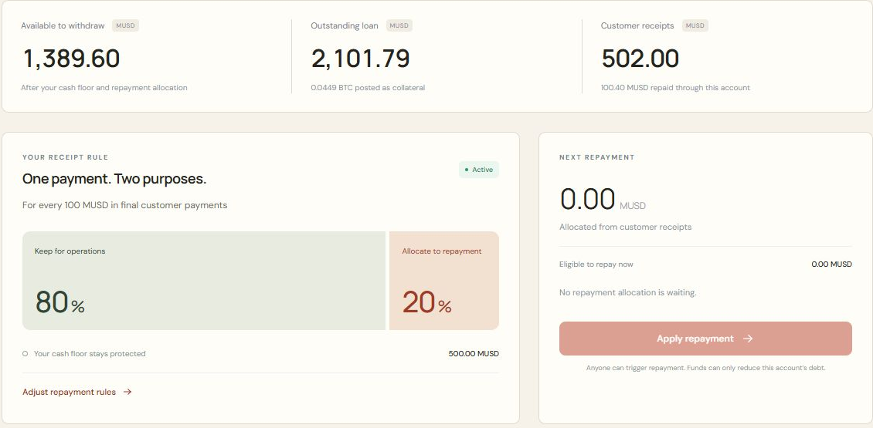
TILLWARD
04
One workspace from loan to repayment
Borrow against BTC
Choose your share
and cash floor
Invoice customers.
Watch receipts
reduce debt.
Public demo captured read-only on 25 October 2026, at Mezo testnet block 16,367,839
Notes:
Screenshot source: outputs/tillward-video/assets/public-desktop-live-overview.png. Cropped to funds and repayment-rule panels without changing content. Public demonstration account 0x5B4b9C9AD2E5c6Ef55A4186ad82580B61A67c6C5 at block 16,367,839. Captured read-only on 25 October 2026 through https://tillward.vercel.app/?account=0x5B4b9C9AD2E5c6Ef55A4186ad82580B61A67c6C5. Receipts 502 MUSD, repayment 100.40 MUSD. These are testnet integration values, not business revenue.

Slide 5
TILLWARD
05
The repayment reaches native Mezo debt
2,000
500
100
MUSD borrowed
MUSD receipt
MUSD repaid
A separate sample customer paid the invoice. Settlement reduced the business account’s native loan debt and burned the matching MUSD.
Historical public testnet integration proof. Sample customer funds came from the test loan
Notes:
Source: deployments/public-testnet-proof.json. Open-loan hash 0xa35727c5d4892916f62ab07d18f6ce0b80b8dc837fc6d4840814e78e66af1429. Settlement: https://explorer.test.mezo.org/tx/0x3d464267e44b119fe4c8f172996775157261dd85ee9cdd598e5b27bb04b0fb0d . Native protocol repository: https://github.com/mezo-org/musd . These are testnet integration figures, not business revenue.

Slide 6
TILLWARD
06
The owner controls the operating room
Repayment share
Choose how much of each final payment goes toward debt.
Cash floor
Reserve a minimum balance for operating expenses.
Pause or close
Pause future allocation, top up, close the loan and recover BTC.
BTC collateral remains exposed to the underlying protocol’s liquidation and redemption mechanics
Notes:
Sources: contracts/RevenueAccount.sol, docs/PROJECT_BRIEF.md, deployments/browser-wallet-proof.json. Only final nonrefundable invoices are within the current scope. Cash-floor protection does not guarantee collateral protection.

Slide 7
TILLWARD
07
The full testnet journey works
0.045 BTC
Three accounts
Returned to the owner after loan closure
Auto-enrolled by the
hosted testnet keeper
Rabby in Chrome completed borrowing, invoice payment, repayment, top-up and full exit. Independent chain checks matched the debt, token burn and BTC return.
Browser QA payer was the owner. Separate-customer proof is recorded in the original integration
Notes:
Source: deployments/browser-wallet-proof.json and deployments/keeper-enrollment-proof.json. Rabby QA account 0x791fFc8A7420dBB0ed5D9F28E811ec7576936433. Full closure and recovery of all 0.045 test BTC independently checked net of gas. Three enrolled accounts do not imply three borrowers or customer adoption.

Slide 8
TILLWARD
08
A working product, ready for pilot feedback
The next question is customer fit
Find BTC-holding agencies and sellers already collecting MUSD. Validate how they choose repayment shares and cash floors, then test the workflow in their day-to-day operations.
github.com/ShalyX/tillward
tillward.vercel.app
Shaly / x.com/shalyx_04
Mezo testnet only. No customer adoption or mainnet readiness claimed
Notes:
Pilot plan is proposed, not completed. Public repository URL must be verified by release owner before submission. Full restore drill, external monitoring and independent security audit remain operational/mainnet gates.

