Slide 1

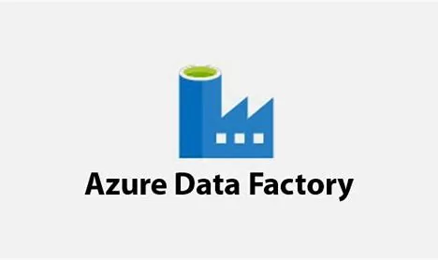


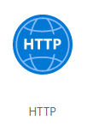
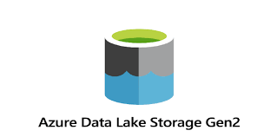



DATA ARCHITECTURE
Data Ingestion
Reporting
Transformation
Data Source
Transformed Data
Raw Data Storage
Serving

