Slide 1

LaLigaBuzz

Slide 2
Introduction
The Primera División, commonly known as La Liga and as La Liga Santander for sponsorship reasons with Santander, is the top professional association football division of the Spanish Football League system. Administrated by the Liga de Fútbol Profesional (LFP), La Liga is contested by 20 teams, with the three lowest-placed teams relegated to the Segunda División and replaced by the top two teams in that division plus the winner of a play-off.

Slide 3
La Liga Popularity

Slide 4
Project Idea
LaLigaBuzz is a website consists of
Latest La Liga news
All La Liga team information per season as well as position by players in the teams
All players’ who play in La Liga details per season ( goal, cards etc. )
Image galleries of recent incidents around La Liga
Scheduled match fixtures
Updated point table of the latest season

Slide 5
Tools
Main Languages: HTML, CSS, PHP
Additional Language: JavaScript
Database: MySQL
Cross-Platform: XAMMP

Slide 6
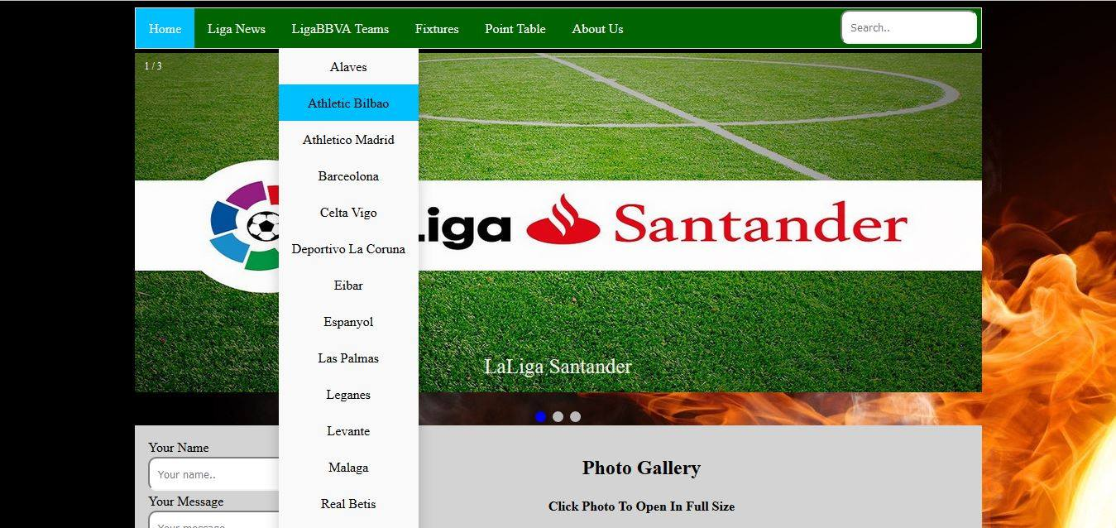
Home Page

Slide 7
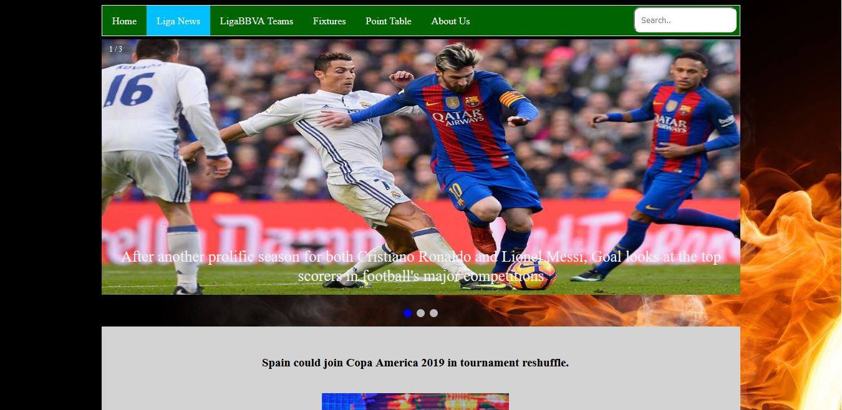
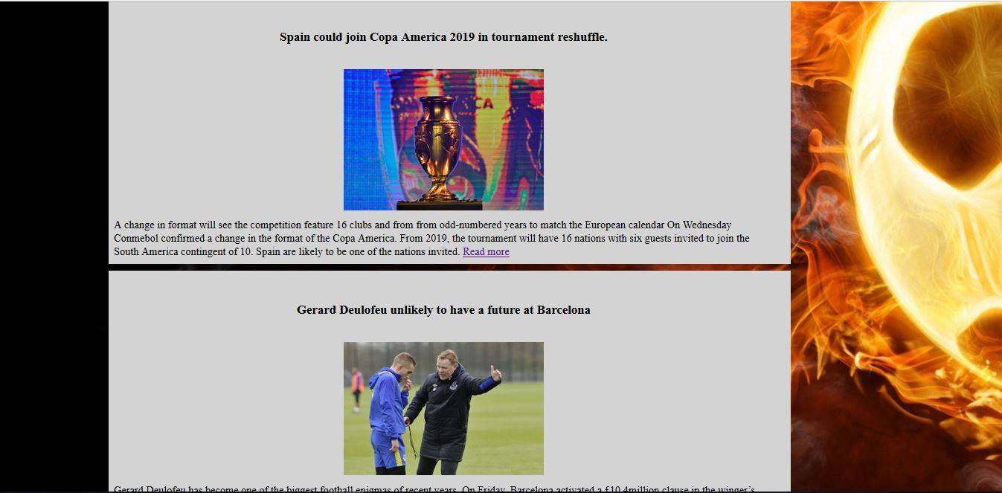
La Liga News
LaLigaBuzz will provide latest transfer rumors, La Liga team talk, players opinions & other affairs.

Slide 8
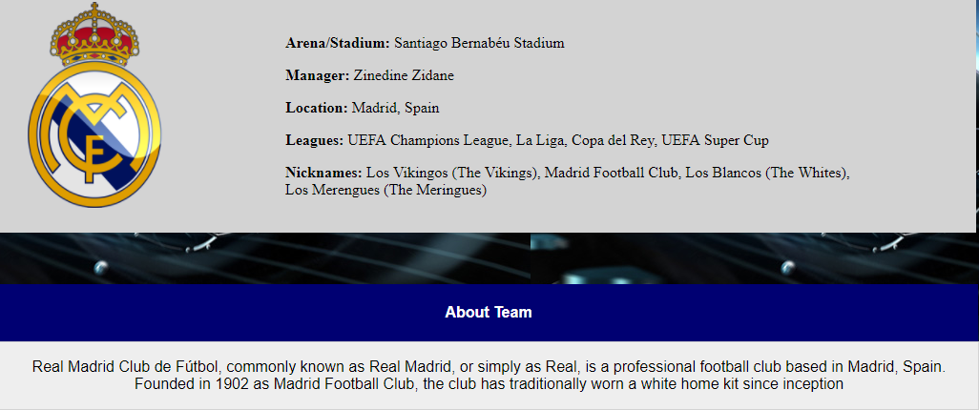
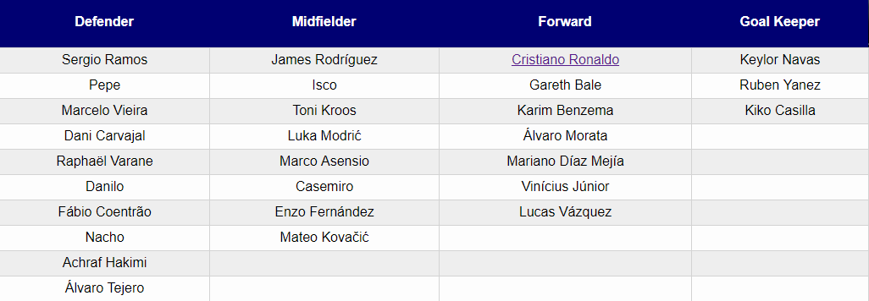
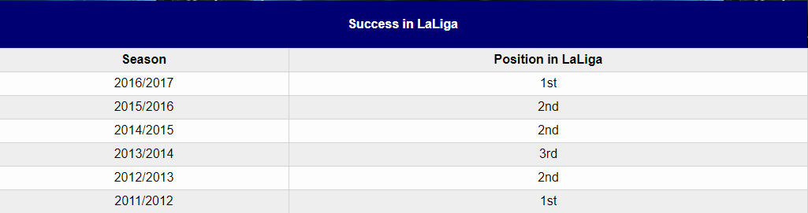
Team Details

Slide 9
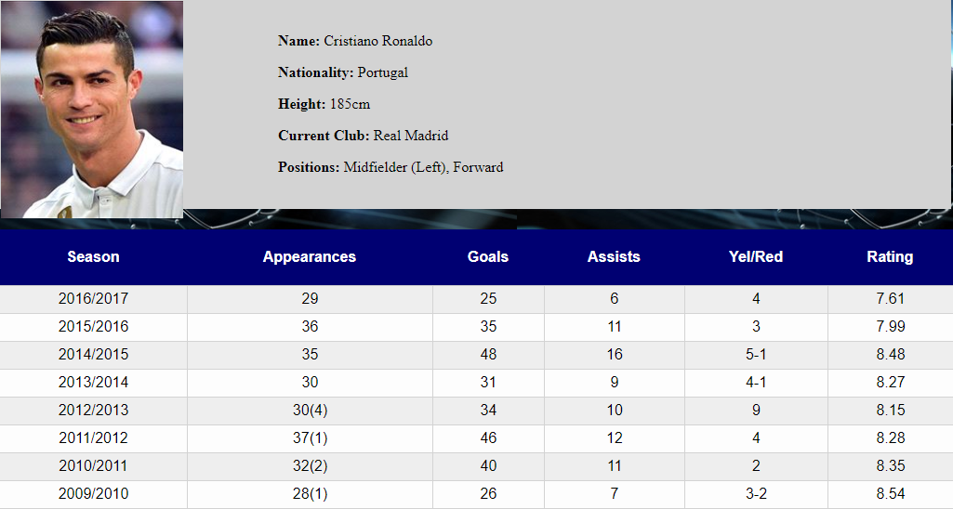
Player Profile
Per season player statistics including goals, appearances, cards are given in this section

Slide 10
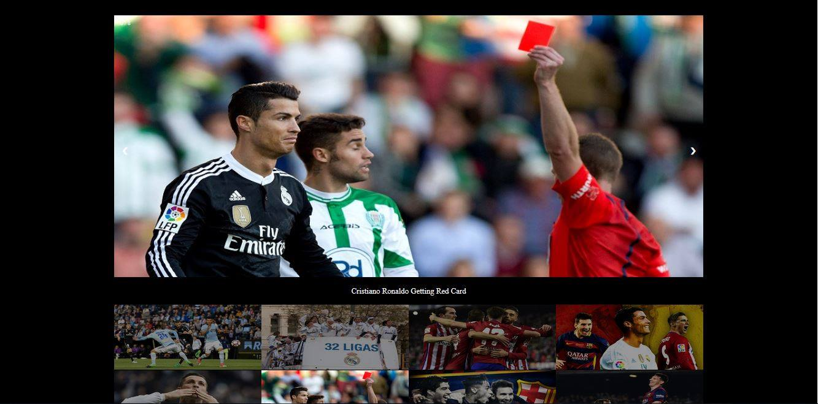
Image Galleries

Slide 11
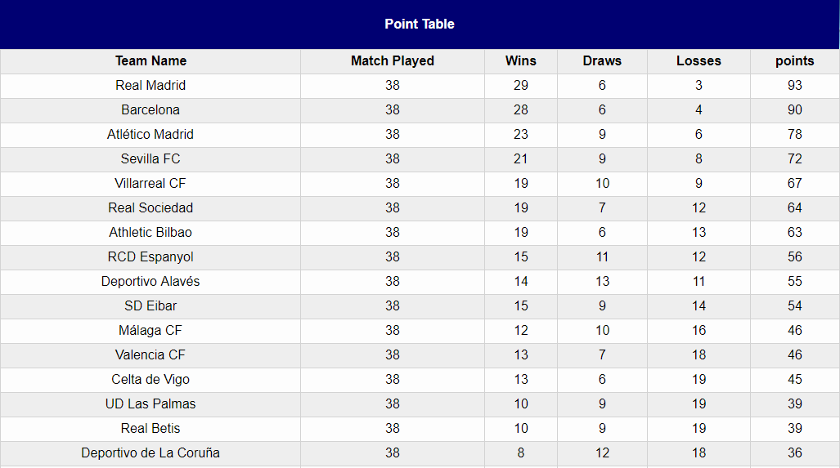
Point Table
All 20 teams matched played, wins, loses, draws & total points are well designed in this website.

Slide 12
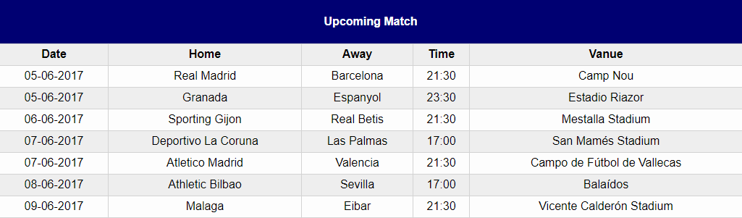
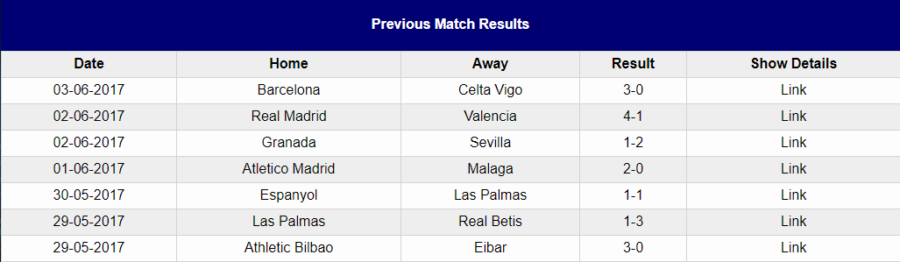
Fixture

Slide 13
Future Plans
Online live streaming
Online voting system
Pundits opinions across the world
Live blog about the league
Add players/teams social media in league news directly
Cover other leagues’ information

Slide 14
Remarks
LaLigaBuzz will become a cup of tea for all the football fans in near future as it holds all the speculations about Liga BBVA in a nutshell.
This website will be developed to become one of best football websites of our country in upcoming years. This is just a prototype which is in development. We hope that we will get assistance & positive views from our viewers.

Slide 15
Thank You Questions?

