Slide 1
Pregnancy Health Care

Slide 2
Pregnancy Health Care
Why Pregnancy Health Care?
To provide best health care in the internet world to the expected mothers in this critical time
To decrease the hassle of searching nearest hospital & blood banks in crucial times
To raise awareness among the new mothers about their health
Helping them to interact with expert doctors for best solutions of their complications

Slide 3
Pregnancy Health Care
Project Summary
Pregnancy week counter
Expected delivery date around the actual delivery date
BMI calculator to calculate the weight status per week
The food caloric chart to keep track of the food budget
Detailed information to find any kind of complications and their solutions
A forum to interact with doctors and other registered women
Provided hospitals’ locations and contact numbers
Provided location and contact numbers of the blood banks & blood donors
A safety alarm to notify the husbands or other family members

Slide 4
Pregnancy Health Care
Project Requirements
Programming Language: Java
IDE: Android Studio
Database: SQLite

Slide 5
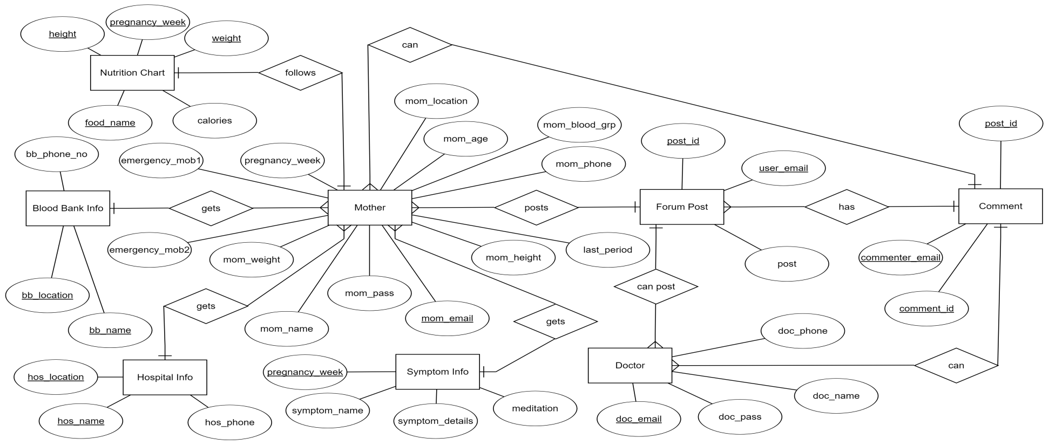
Pregnancy Health Care
Entity Relationship Diagram

Slide 6
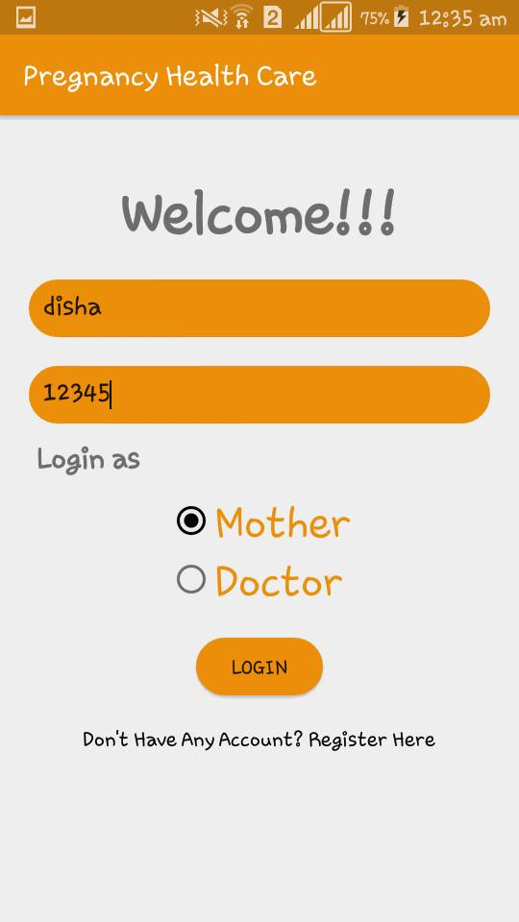
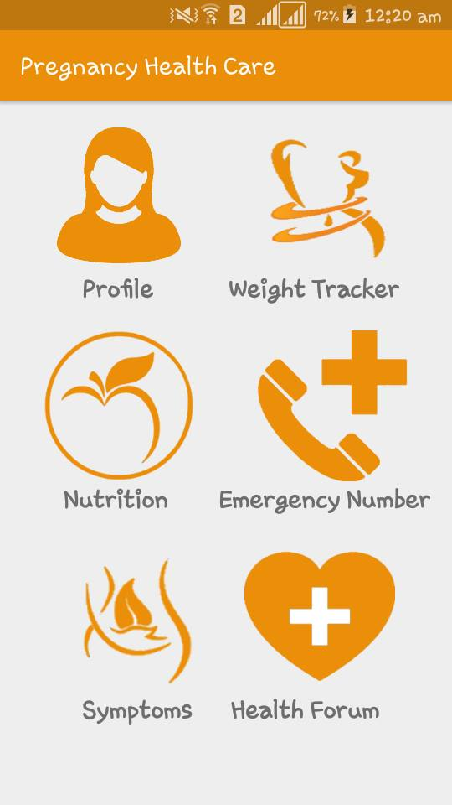
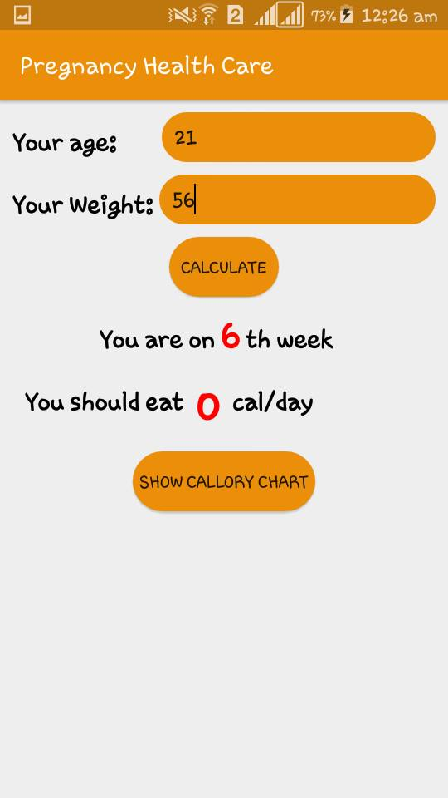
Pregnancy Health Care
Project Demonstration

Slide 7
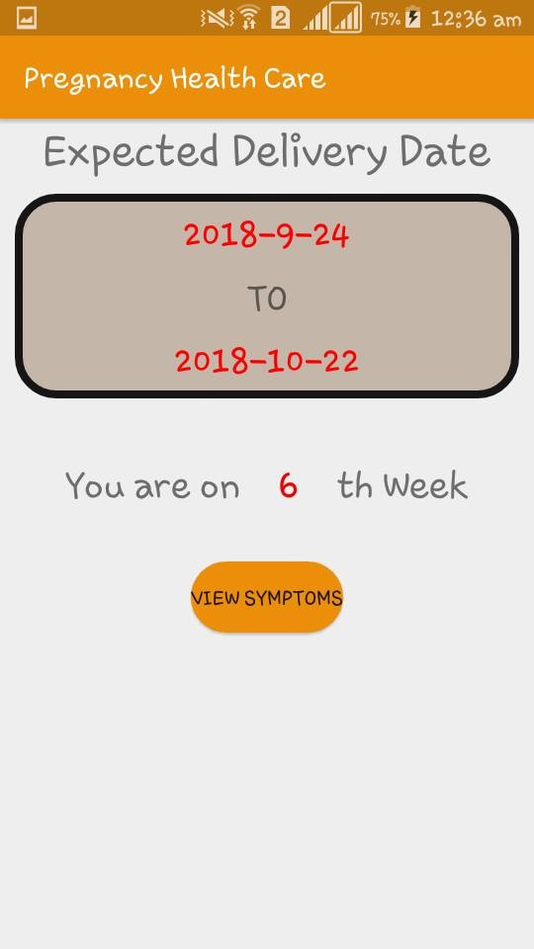
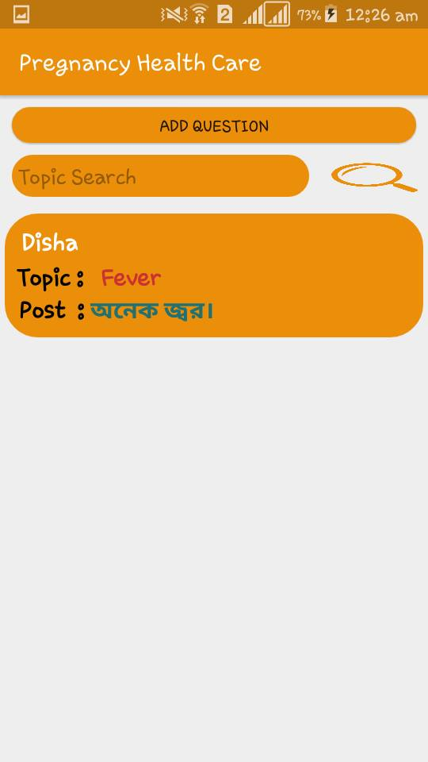
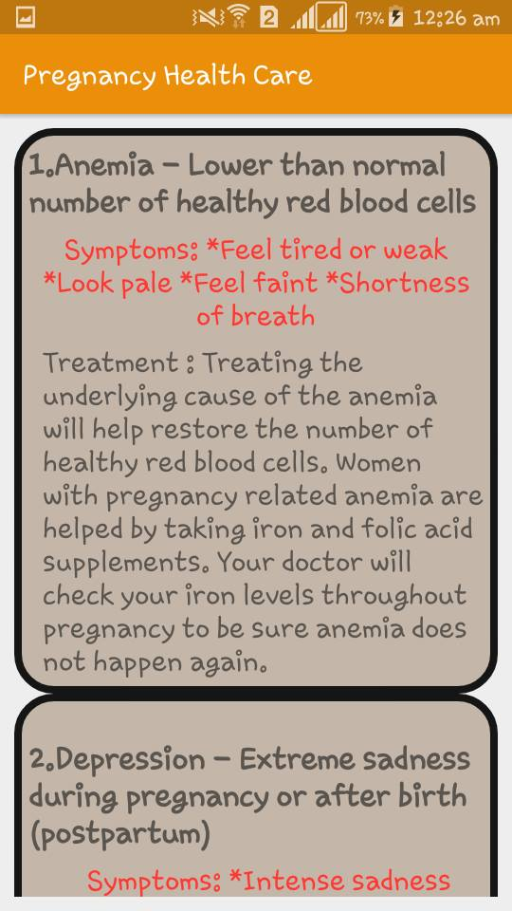
Pregnancy Health Care
Project Demonstration (Cont.)

Slide 8
Pregnancy Health Care
Future Plan
Will try to add more features and fix bugs
Make the interface more attractive
Upload the application in playstore
Opportunities for the best uses will be provided

