Slide 1

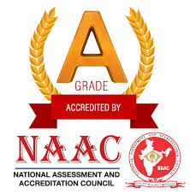
Late Purushottam Hari (Ganesh) Patil Shikshan Sanstha’s
Mauli Group of Institution’s
College of Engineering and Technology Shegaon.
Project Name:
Design And Implementation of Disease Prediction in Crops Using Deep Learning
Submitted By :
1. Sham A. Johari
2. Prerna S. Dabhade
3. Pallavi G. Tayde
4. Megha R. Chopade
5. Sanjay V. Junare
Guided By : Dr. P. M. Hasabnis
Department of Computer Science and Engineering
Session:2023-24

Slide 2
CONTENTS
Introduction
Literature Review
Technologies
UML Diagram
Implementation Techniques
Advantages
Result
Conclusion
Project Plan

Slide 3
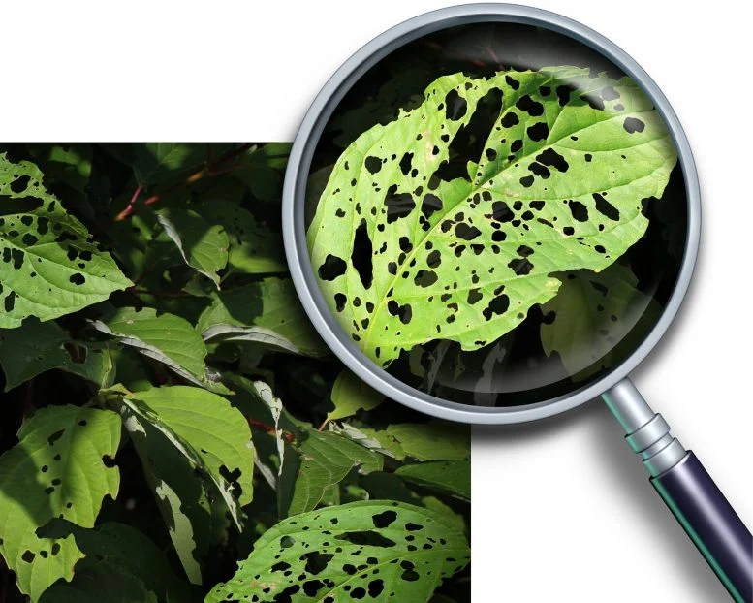
INTRODUCTION
In the ever-evolving field of agriculture, predicting and preventing crop diseases is a pivotal task for ensuring global food sustainability.
The objective is to construct a powerful predictive model that enables early detection and proactive management.
We aspire to develop a robust predictive model that empowers farmers with timely information, enabling proactive disease management.

Slide 4
LITERATURE REVIEW
Authors | Title of Paper | Remark
Kalpesh Shinde and Anand Khatri (2022) | “Crop Prediction and Plant Leaf Disease Prediction Using Deep Learning ” | This paper gives appropriate idea to identify plant leaf sickness.
Omkar Kurkute and Nikhil Raje (2020) | “Plant Diseases Detection Using Deep Learning” | Plant leaf images will be used to check for plant diseases in early stages.
Rajab Ali and Depali Nayak (2019) | “Crop Diseases Detection using Deep Convolutional Neural Networks” | This paper proposed Crop Disease Detection using CNN System based on Deep Learning.

Slide 5
TECHNOLOGIES
Hardware : Computer System, Strong Internet Connection.
Software : Operating System: Windows 10 /11.
IDE: Jupyter Notebook, PyCharm & Android Studio.

Slide 6


UML DIAGRAM
Disease Prediction System
Select Image
Upload Image
Preprocess the image
Build VGG model
User
System Expert
Train model
Extract features
Predict Output
Get Results

Slide 7
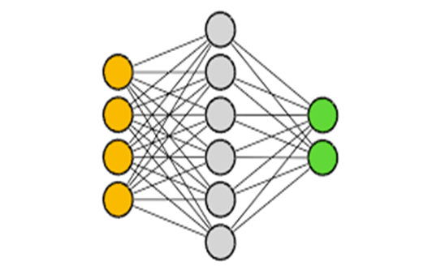
IMPLEMENTATION TECHNIQUE
CNN
ResNet
Xception
VGG

Slide 8
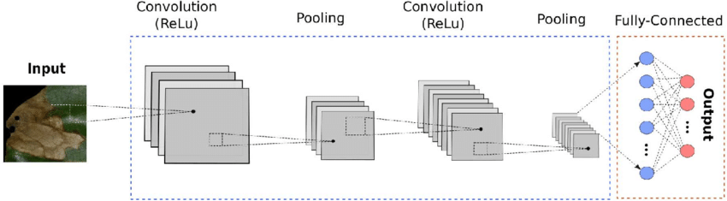
CNN
Convolutional Neural Network in crop disease identification signifies a transformative approach in precision agriculture.
In this context, the application of CNNs involves training the model on diverse images of crops affected
by various diseases.
By leveraging deep learning, CNNs can process vast datasets of crop images, learning complex features that distinguish between healthy and diseased plants.
Fig: Architecture of CNN

Slide 9
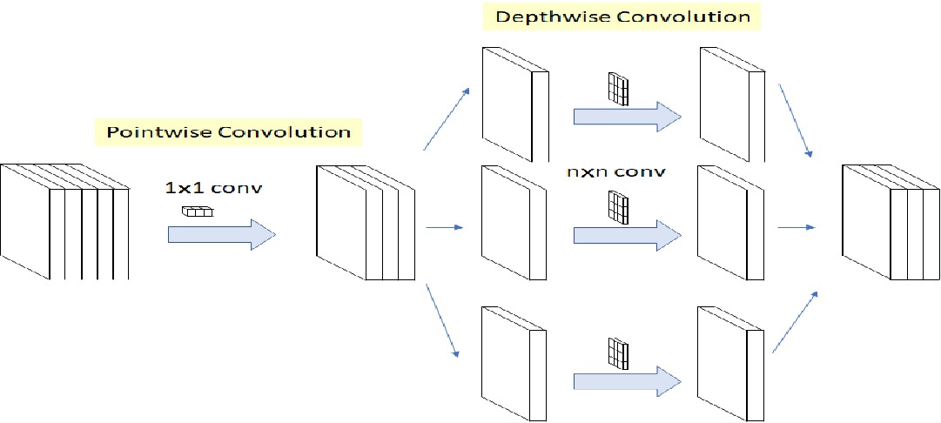
XCEPTION
By utilizing a pre-trained Xception model on a diverse dataset of plant images, the network can learn intricate patterns associated with various crop diseases.
This process adapts the pre-trained features to the unique characteristics of agricultural images, enhancing the model's predictive accuracy.
The Xception model in crops disease prediction facilitates more efficient and accurate identification of diseases in plants, offering farmers valuable insights for timely intervention and improved crop management practices.
Fig : Depthwise Convolution in Xception

Slide 10
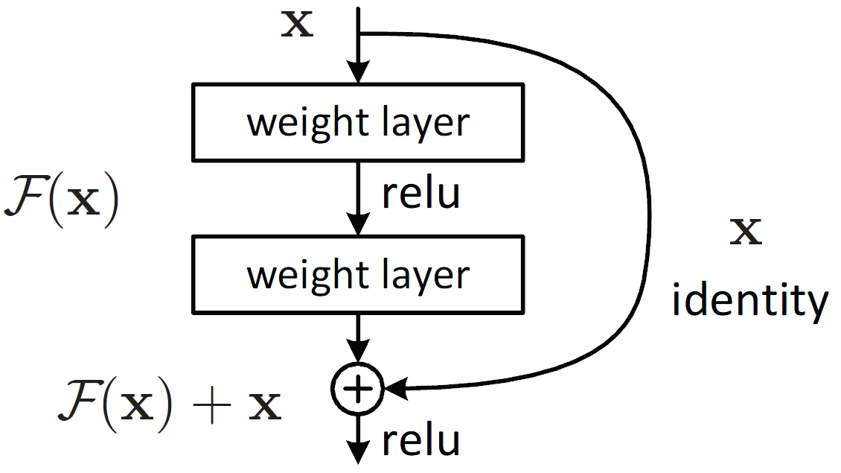
RESNET
Employing ResNet in crops disease prediction underscores its potential to enhance the precision of identification models, making it a valuable tool for the agriculture industry.
This approach facilitates early detection and enables farmers to take timely measures for disease management, thereby minimizing crop losses and promoting sustainable agriculture practices.
By leveraging the residual connections, the model can effectively capture and learn both low-level and high-level features, contributing to more accurate predictions.
Fig: Building Block in ResNet

Slide 11
VGG
This application of VGG in crop disease prediction holds the potential to enhance the accuracy and efficiency of identification, providing farmers with valuable insights for proactive disease management.
In the context of crop disease prediction, VGG can be employed to analyze plant images and discern patterns associated with various diseases.
By fine-tuning the pre-trained VGG model on a dataset of crop images, the network can learn to recognize disease-specific features, contributing to accurate classification.

Slide 12
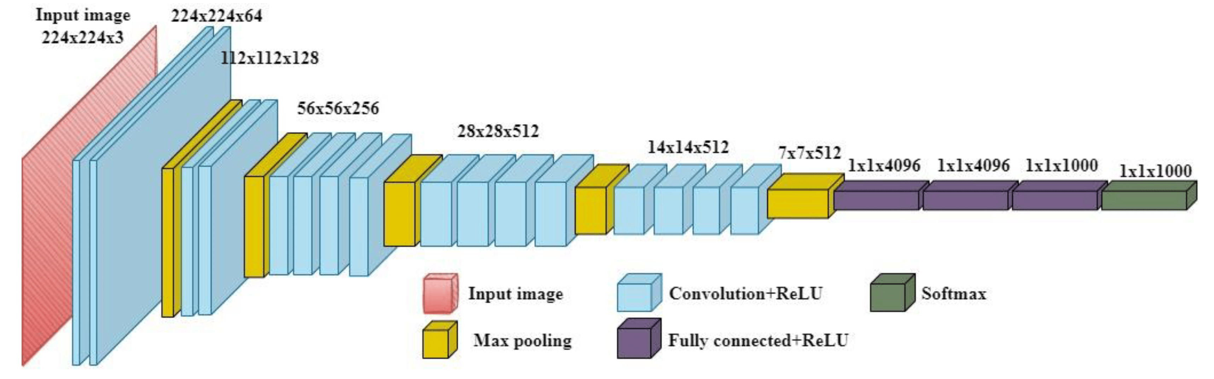
Fig: Architecture of VGG16

Slide 13
ADVANTAGES
Global Food Security
Early Disease Detection
Timely Intervention
Accessibility for Farmers
Crop Yield Optimization

Slide 14
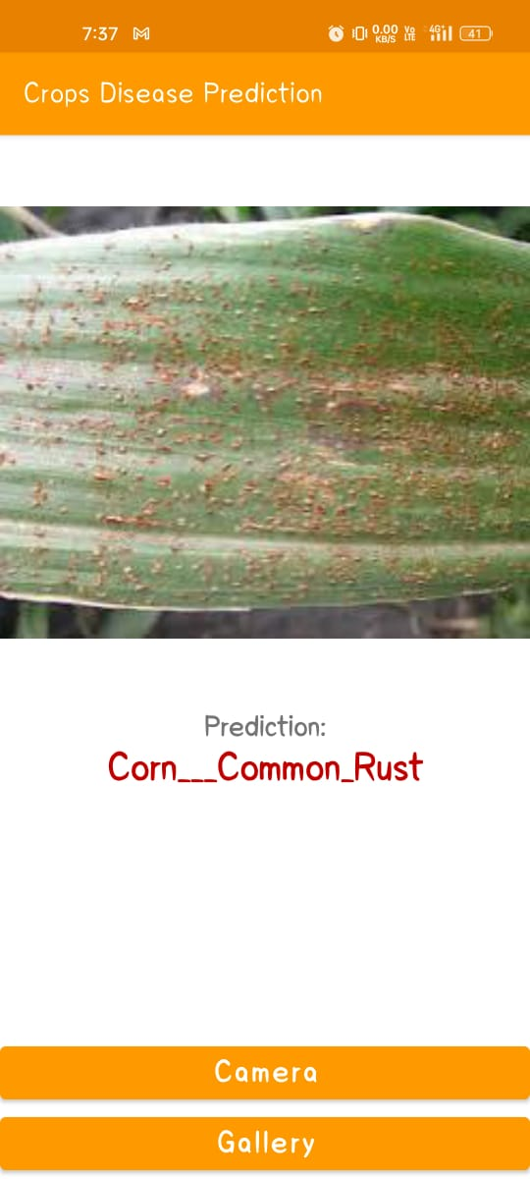
RESULT

Slide 15
CONCLUSION
Through advanced technologies such as machine learning, remote sensing, and data analytics, researchers and farmers can forecast disease outbreaks with greater accuracy than ever before.
This proactive approach enables timely interventions, such as targeted pesticide application, crop rotation, or genetic resistance breeding, ultimately reducing yield losses and economic burden on farmers.
Embracing crop disease prediction not only safeguards agricultural productivity but also fosters sustainable farming practices, contributing to global food stability and resilience in the face of evolving environmental challenges.

Slide 16
Conducted research on project topic
Created the dataset using augmentation techniques
Trained models for disease prediction
Developed GUI based on model with higher accuracy
Creation of application- Crops Disease Predictor
PROJECT PLAN

Slide 17
THANK YOU !!!!

