Slide 1
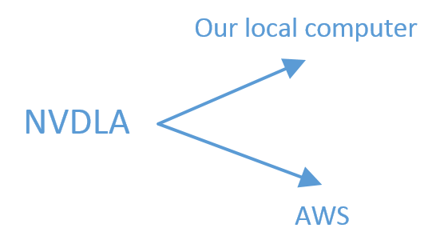
Course
Take a long time
Cost a lot
Neural networks contain a lot of information. Numerous parameters make networks very big.
NVDLA is a kind of accelerator. When simulate it on computer, it will be run on virtual platform which will take many resources. The system(linux kernel) is also one reason make the process very slow.

Slide 2
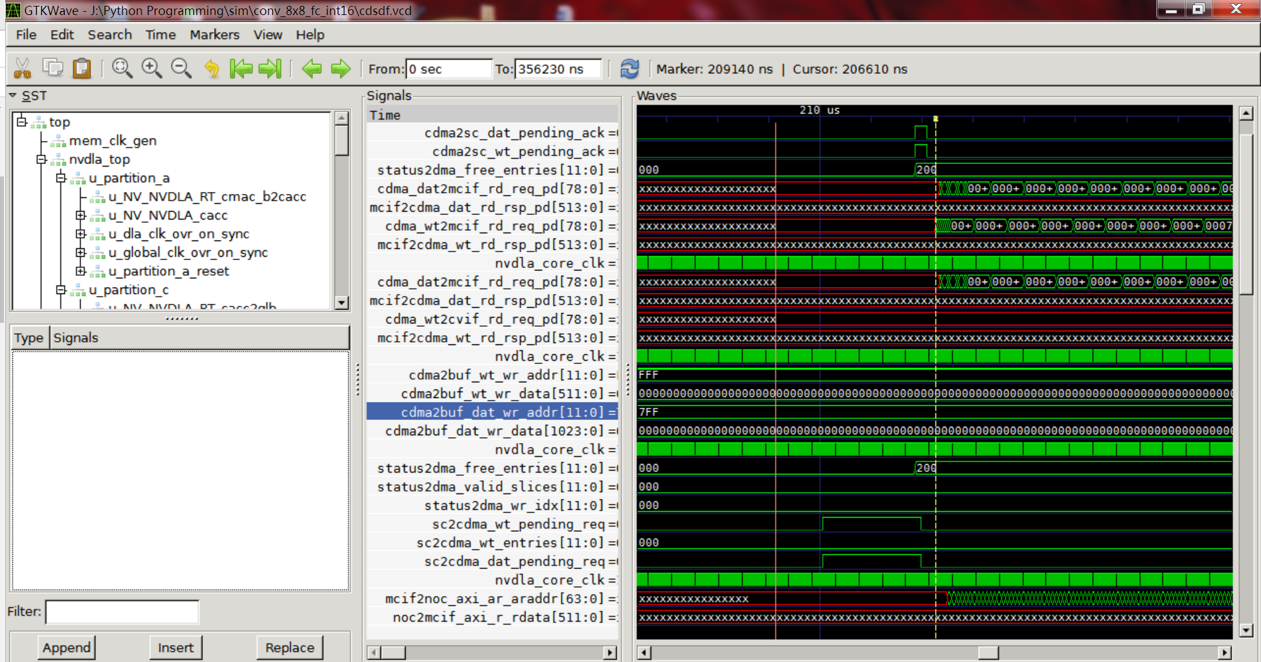

Slide 3
Introduction to this technology
NVDLA
Our method

Slide 4
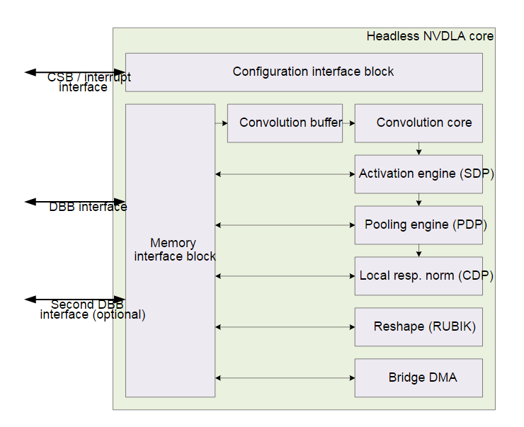
NVDLA core block diagram
yolo v3

Slide 5
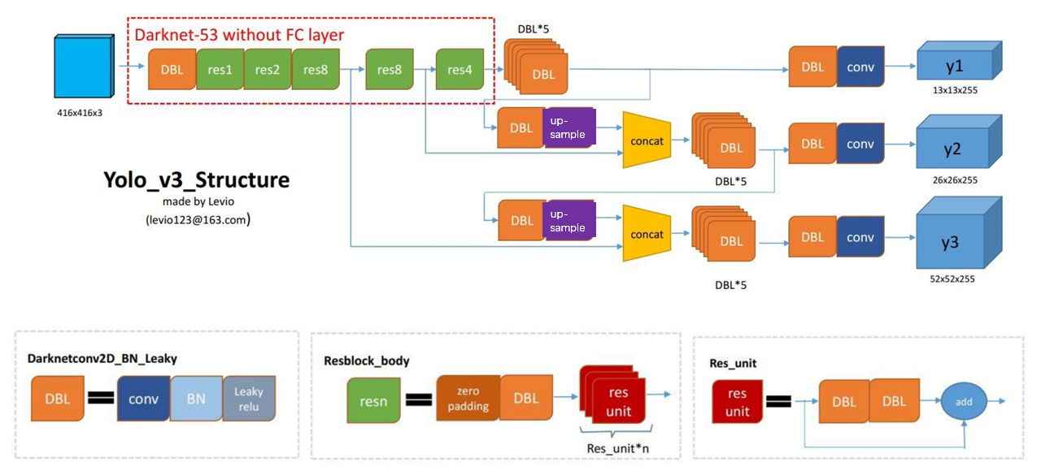
CONV. BN. ReLU. ResNet. Up-sampling. Concatenation
Source:
https://blog.csdn.net/leviopku/article/details/82660381

Slide 6
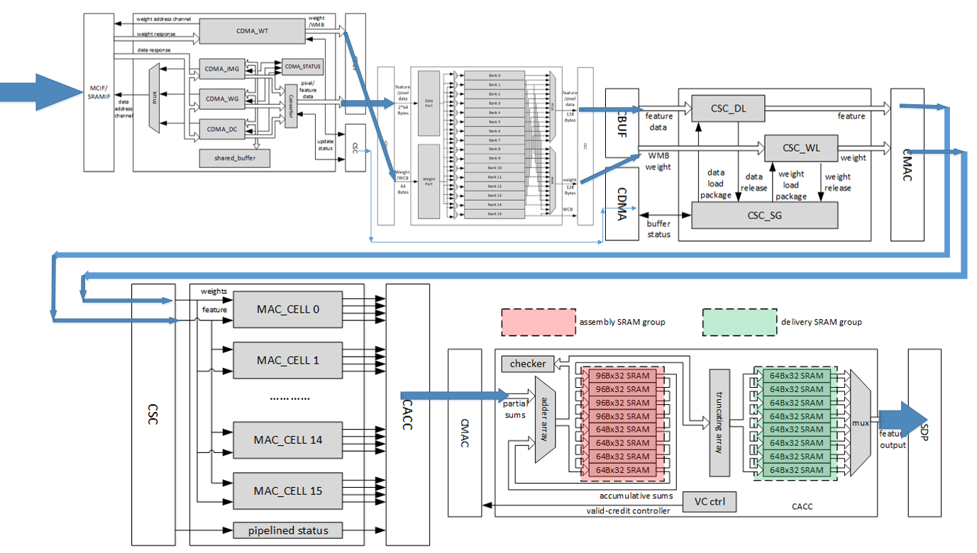

Slide 7
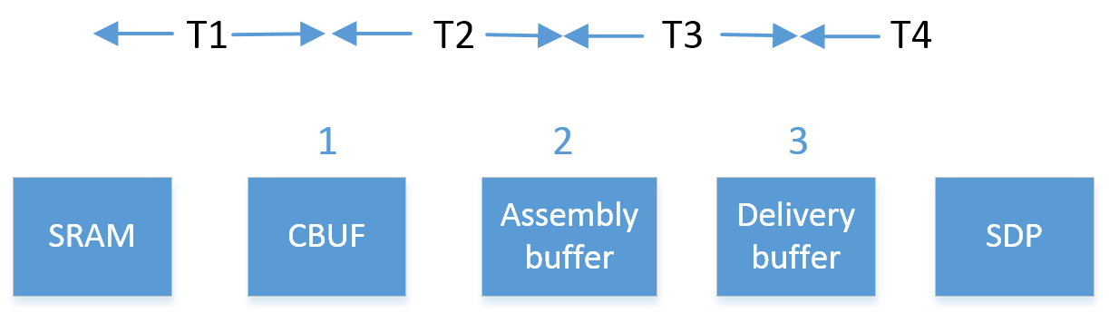
Our method
CSC
CMAC
Adder
Interface
CDMA
Truncation
Set all hardware parameters configurable to get the optimal configuration information fastly.

Slide 8
SRAM size: From 6MB to 4MB
YOLOV3 RESULT TABLE (int8)
CASES | CMAC CELLS | SRAM SIZE (MB) | NVDLA Inference Time and Data Transfer Time (Milliseconds) | Up-samling Time (CPU) (Milliseconds) | Total Inference Time (Milliseconds)
1 | 8 | 6 | 9.67 | 5.07 | 14.74
2 | 16 | 6 | 8.79 | 2.18 | 10.97
3 | 32 | 6 | 8.07 | 2.11 | 10.18
4 | 16 | 4 | 51.16 | 2.18 | 53.34
In case 4:
The data transfer process elongated, which makes the computing units wait for the data transferring.

Slide 9
SRAM size: From 4MB to 2MB
FASTER RCNN RESULT TABLE
CASES | CMAC CELLS | SRAM SIZE (MB) | TOTAL Inference Time (Milliseconds)
1 | 8 | 4 | 19.41
2 | 16 | 4 | 18.12
3 | 8 | 2 | 60.24

Slide 10
Verification: yolo v3
The time consumed by different layers is added together to get the total inference time: 0.0515s
total_time = 0.0012056780555555556 +0.009336928703703697 + 0.006109037037037037 + 0.006215587351851845 + ......
Totally 75 values

Slide 11
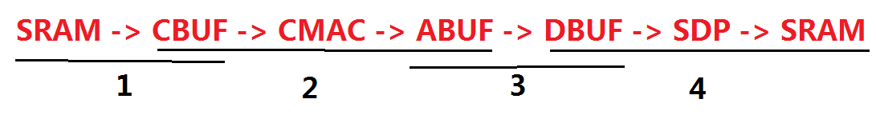
Verification: First layer
Time: 0.0012056780555555556s
Size : 0.495941162109375 MB
4153344(input feature map) + 6912(weights)
DRAM -> SRAM: 0.00001583933 s
SRAM -> CBUF: 17 chunks
One CBUF chunk:

Slide 12

Verification: an example
Fully connected layer:
Input_feature_map: 8*8*32
Kernel_size: 8*8*32 kernel_number: 16
Precision: int16 Total_input_bits: 557056
557056
557056
768
512
DRAM->SRAM
SRAM->CBUF
CBUF->ABUF
ABUF->DBUF
DBUF->SDP->SRAM
seconds
1.584e-5
2.356e-7
2.481e-7
6.296e-9
1.481e-9
0
1.584e-5
1.608e-5
1.633e-5
1.633e-5
1.633e-5

