Slide 1
1. Modified one error
2. Added the 8 MAC cells result
3. Have tried to change the SRAM size

Slide 2
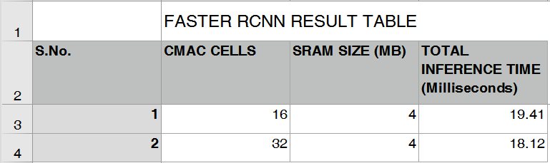
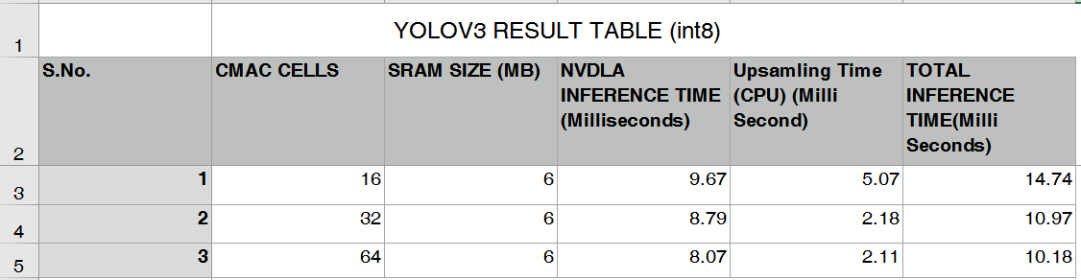
ERROR:

Slide 3
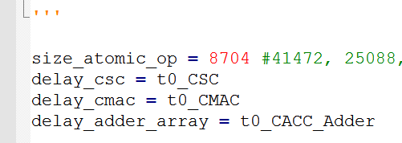
CMAC CELLS
(1*1*64 + 1*1*64*16)*8
input
weights
precision
9.67
If only one MAC CELL in there
64 multipliers for int16
As for int8, we should calculate 2 times multiplications
(1*1*64 + 1*1*64*2)*8 for int8

Slide 4
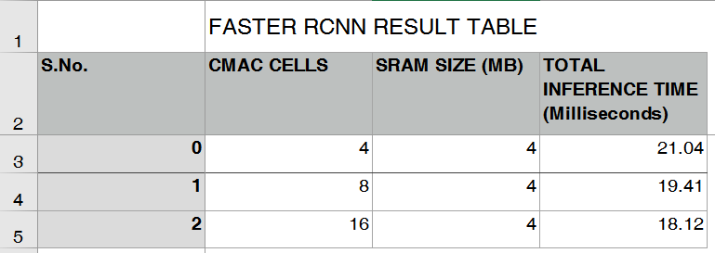
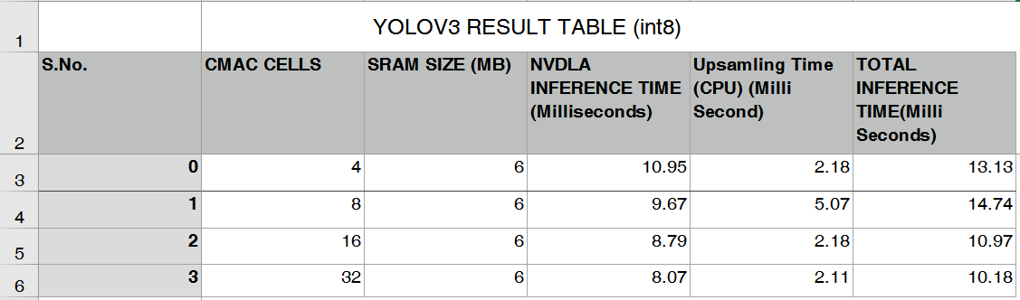
Results:

Slide 5
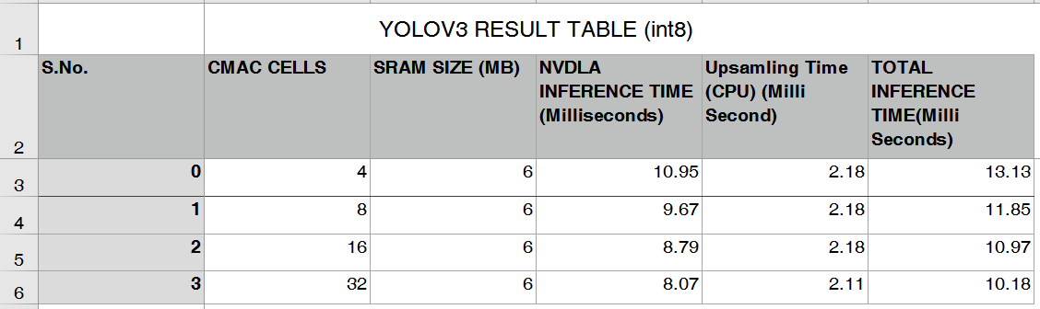
SRAM size:
Yolo v3:
From 6MB to 4MB
4
51.58

Slide 6
Verification:
The time consumed by different layers is added to get the total inference time.
total_time = 0.0012056780555555556 +0.009336928703703697 + 0.006109037037037037 + 0.006215587351851845 + 0.006109037037037037......

Slide 7
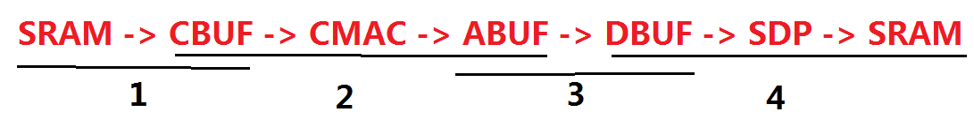
Verification: first layer
0.0012056780555555556s
size : 0.495941162109375 MB
4153344(input feature map) + 6912(weights)
DRAM -> SRAM: 23759.0 ms
SRAM -> CBUF: 17 chunks
One CBUF chunk:

Slide 8

Verification: an example
Fully connected layer:
Input_feature_map: 8*8*32
Kernel_size: 8*8*32 kernel_number: 16
Precision: int16 Total_input_bits: 557056
DRAM->SRAM
SRAM->CBUF
CBUF->ABUF
ABUF->DBUF
DBUF->SDP->SRAM
ms
0.9665
0.2355
0.3904
0.0063
0.0096
0
0.9665
1.202
1.5924
1.5987
1.6083

