Slide 1
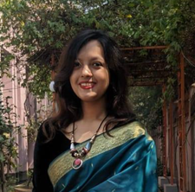

Farhatun Shama
Undergraduate Student
CSE, KUET
Contact
About Me
Mobile
0123456789
Email
shama@gmail.com
Address
KUET,Khulna-9203
Github https://github.com/Shama-33
I am currently a student with a deep interest in the field of AI.
Academic Qualification
BSC in Computer Science and Engineering
2020-
Current CGPA: 3.84
Khulna University of Engineering and Technology
HSC
2019
GPA 5
Viqarunnisa Noon School and College , Dhaka
Programming Language
C
C++
C#
Java
Python
ASP.net
SSC
2017
GPA 5
Viqarunnisa Noon School and College,Dhaka

Slide 2

Language Proficiency
English
Bangla
Projects
Fitness Tracker and Easy Doctor Appointment App
Android studio,Java,Firebase, sensors
A Social Media Website similar to Reddit
ASP.net, Webform, SQL, SSMS
Interested In
Machine Learning
Natural Language Processing
Computer Vision
Complaining Task Distribution App for Smart City
Android Studio, Java, Firebase, Machine Learning, Teachable Machine, CNN
Achievements
References
Dean’s Award
2020-2021
2021-2022
Dr K. M. Azharul Hasan Professor Department of Computer Science and Engineering Khulna University of Engineering & Technology | Sunanda Das Asst. Professor Department of Computer Science and Engineering Khulna University of Engineering & Technology
Hobbies
Singing
Reading

