Slide 1
3D Treasure Hunt
CSE 4208 : Computer Graphics Laboratory
Presented To
Dr. Sk. Md. Masudul Ahsan
Professor
Department of CSE, KUET
Md. Badiuzzaman Suvo
Lecturer
Department of CSE, KUET
Presented By
Farhatun Shama
Roll: 1907033
Group: A1
Year: 4th
Semester: 2nd

Slide 2
Outline
Objectives
Introduction
Description
Game States
Keyboard Interaction
Conclusion
Video Demonstration

Slide 3
Objectives
To implement object selection using ray-sphere intersection
To demonstrate transformations in different coordinate systems
To design and implement user-interactive gameplay mechanics
To handle lighting, textures, and animations effectively in 3D environments.

Slide 4
Introduction
3D Treasure Hunt is a thrilling 3D adventure game with an interactive environment.
Players progress by solving puzzles and finding hidden keys.
Multiple rooms featuring unique challenges and environments.
Incorporates interactive object selection and manipulation.
Includes dynamic object animations like moving cars and floating ghosts.
Utilizes advanced lighting and textures for realistic visual effects.

Slide 5
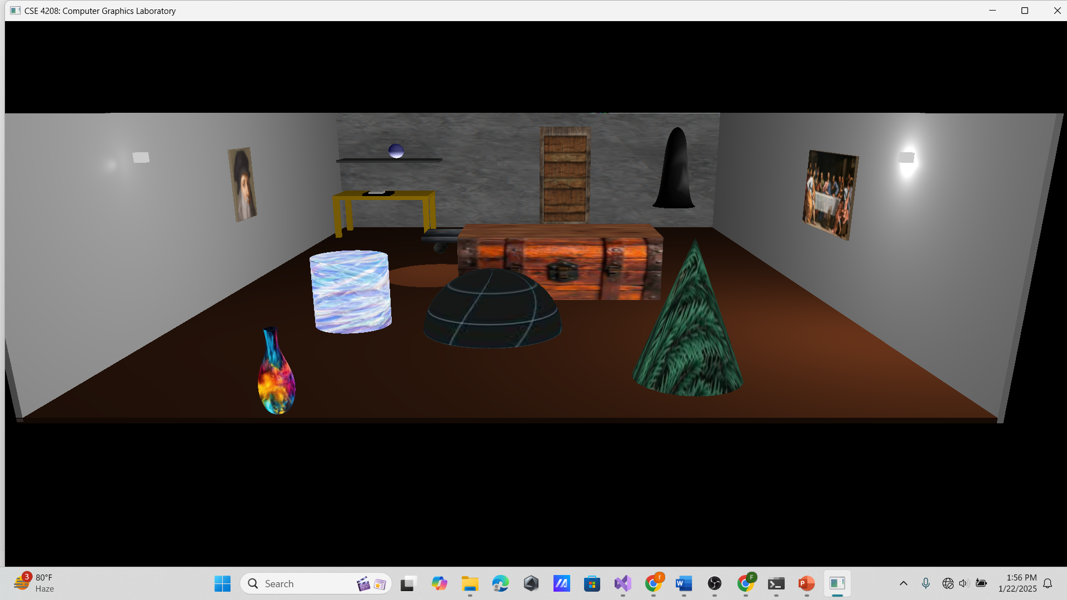
Description
Room 1: Contains selectable objects
Figure 1: initial room

Slide 6
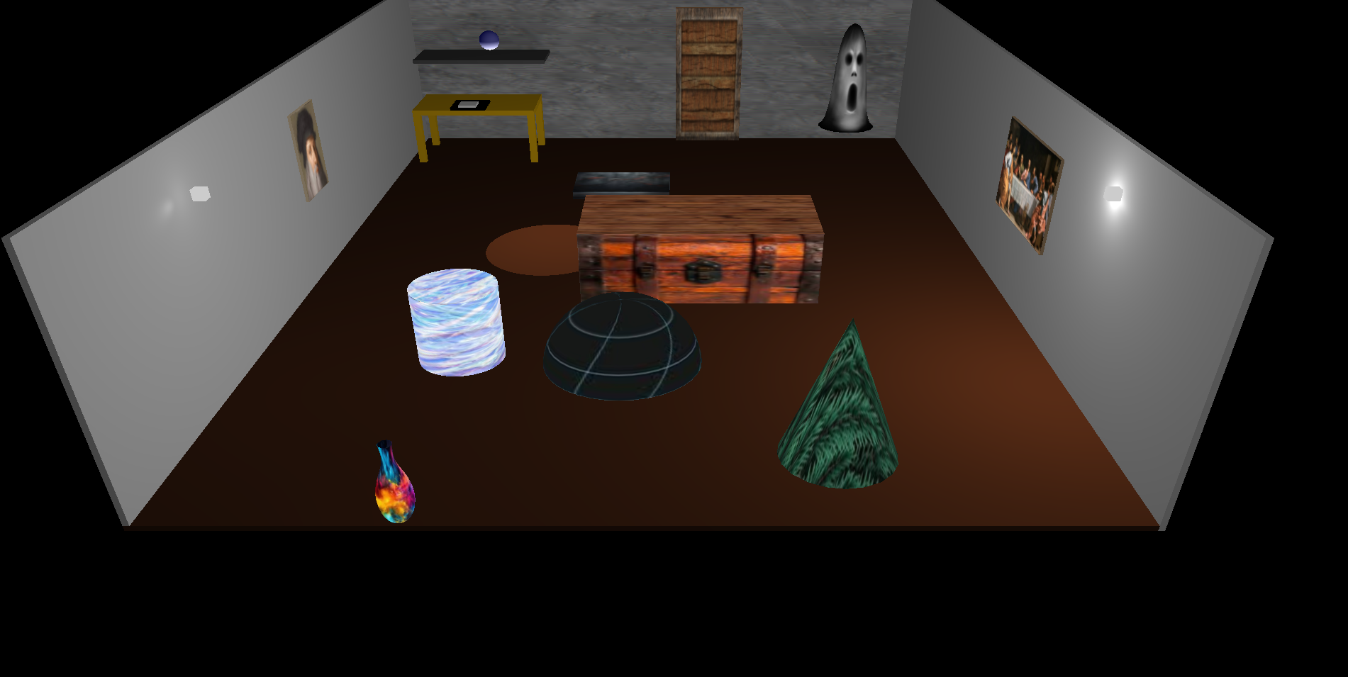
Description (Cont’d)
Room 1: from a different view point
Figure 2: initial room from above

Slide 7
Description (Cont’d)
Room 1: Objects
Textured objects using cube, cylinder, cone and sphere
A moving ghost and a vase using curve
A moving car with rotating wheels
Static and blinking lights

Slide 8
Description (Cont’d)
Room 1: functionalities
Click Detection: Mouse input captures screen coordinates.
Ray Casting: Converts screen coordinates to world coordinates using the view and projection matrices.
Ray-Sphere Intersection: Checks for collision between the ray and the bounding sphere of each object.

Slide 9
Description (Cont’d)
Room 1: functionalities (Cont’d)
Object Highlighting: Selected object lifts upward as visual feedback.
Key Detection: Objects with keys trigger a state change.
Room Transition: Key discovery initiates transition to the next room after a delay.

Slide 10
Description (Cont’d)
Room 1: Animations
Car Animation: Moves back and forth within a specified range with rotating wheels.
Ghost Animation: Floats vertically in a sinusoidal motion along with rotation.
Light Interaction: Lights alternate flickering for a realistic, spooky effect.
Door Opening: User can open the door by pressing ‘O’.

Slide 11
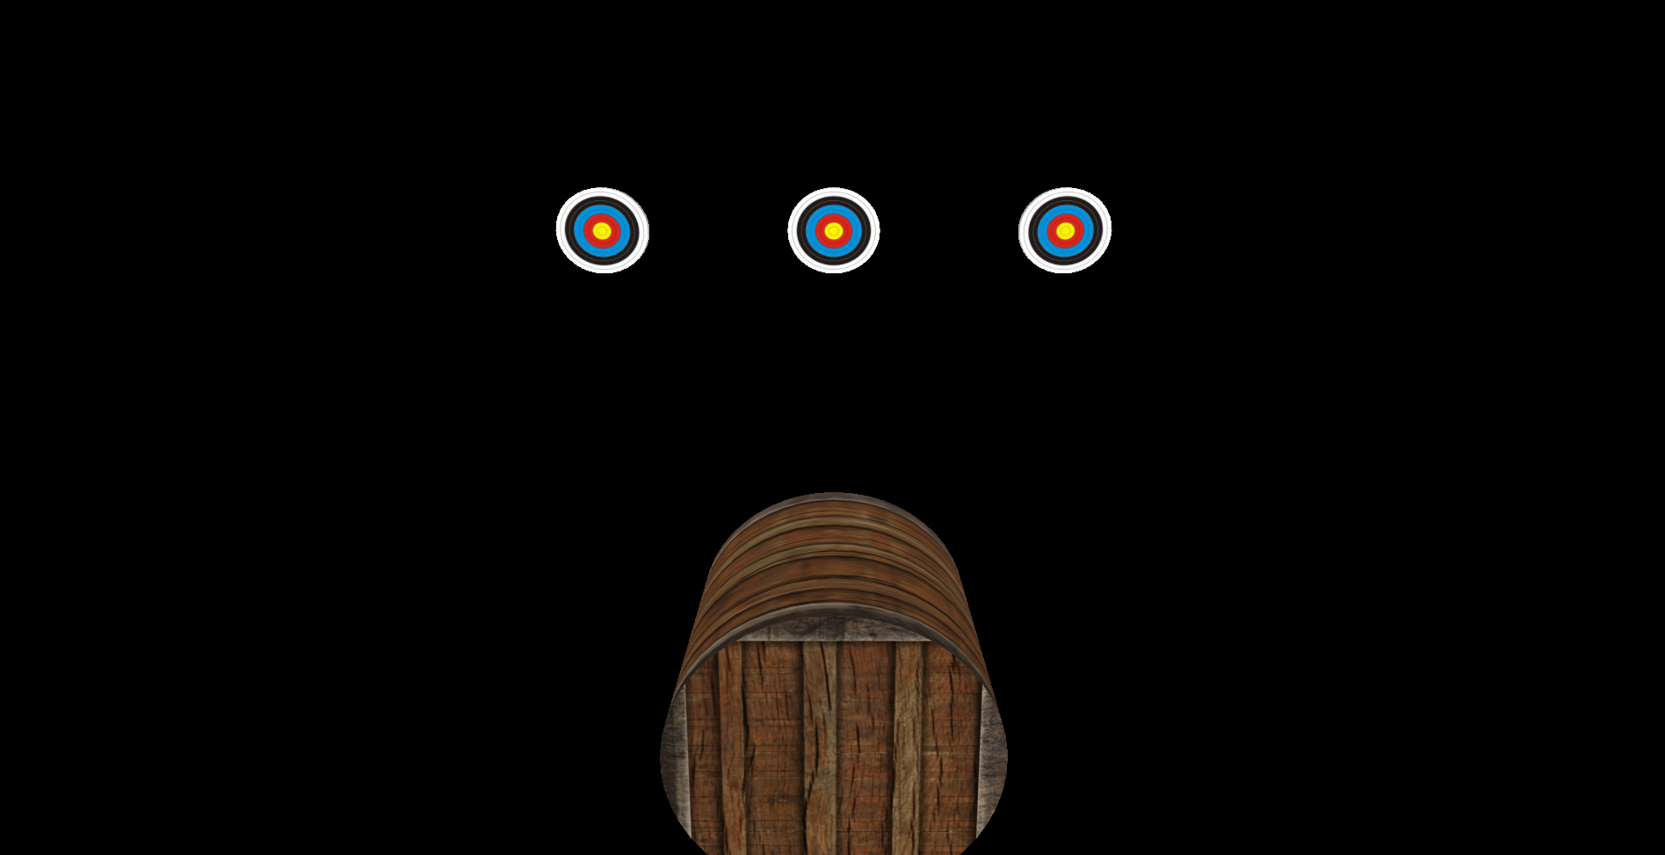
Description (Cont’d)
Room 2: Hit Static Targets
Figure 3: Shooting room (Level 1)

Slide 12
Description (Cont’d)
Room 2: Objects
Arrow Object
Positioned initially near the player's view.
Moves straight toward the targets upon shooting.
Static Cylinder Targets
Positioned at varying distances along the z-axis.

Slide 13
Description (Cont’d)
Room 2: Functionality
Mouse click initiates arrow shooting.
Direction determined based on the mouse click position (ray casting).
Checks for arrow hitting the target using bounding sphere intersection.
Player earns 10 points for each target hit.
Missed shots reset the arrow's position for retry.
Game is over in case of timeout.

Slide 14
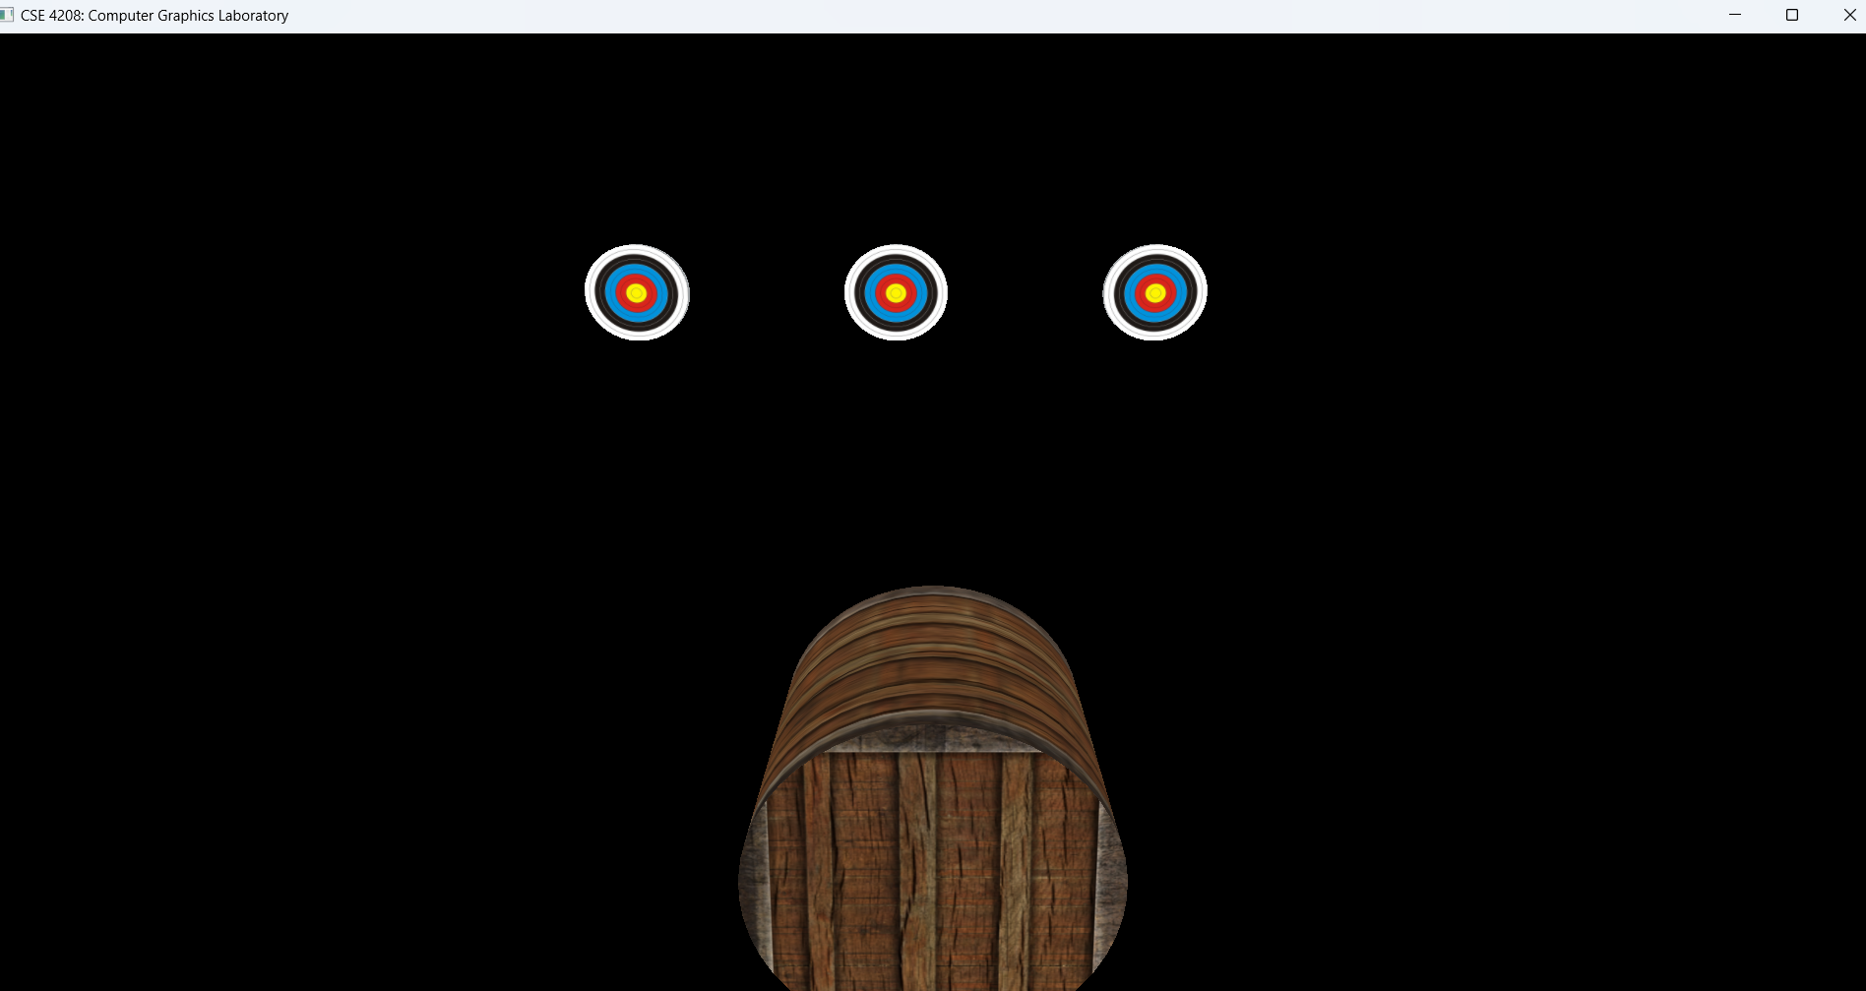
Description (Cont’d)
Room 2: Hit Dynamic Targets
Figure 4: Shooting room (Level 2)

Slide 15
Description (Cont’d)
Room 2: Objects (dynamic)
Arrow Object
Same as previous level
Static Cylinder Targets
Positioned at varying distances along the z-axis.
Move horizontally in a sinusoidal pattern along the x-axis.
Requires precise aim

Slide 16
Game States
1.Win State
All targets hit successfully.
Render animated gold treasure (sphere).
Lose State
Time runs out or all targets missed.
Render an object to demonstrate .

Slide 17
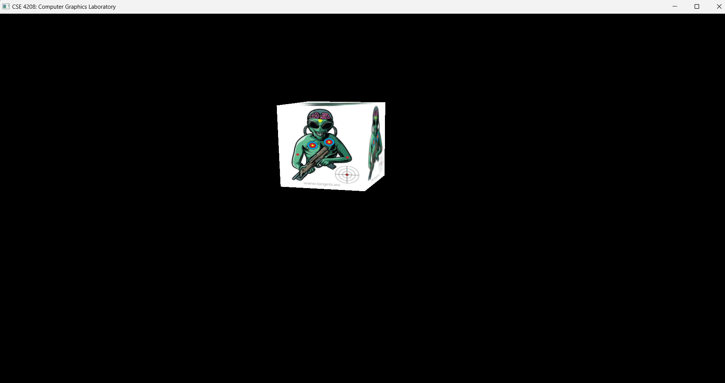

Game States
Figure 5: Lose State
Figure 6: Win State

Slide 18
Keyboard Interaction
W, A, S, D: Move the camera forward, left, backward, and right, respectively.
Q, E: Adjust the camera's height.
R: Reset
H, F, T, G: Move the eye/camera position along X, Z, and Y axes
1 to 7: Lighting Control
B,V: Blending – Fragment and vertex shader respectively
O: Open door

Slide 19
Conclusion
Developed an engaging and interactive 3D game.
Incorporated object selection, coordinate transformations, and dynamic animations.
Designed rooms with unique challenges like static and moving targets.
Achieved a balance between gameplay mechanics and visual aesthetics.

Slide 20
Thank You

