Slide 1




NEXT GEN EMPLOYABILITY PROGRAM
Creating a future-ready workforce
Team Members
College Name
Student Name :S.Shama Fathima
Student ID : 960221104108
Arunachala College of Engineering for Women

Slide 2

CAPSTONE PROJECT SHOWCASE
Project Title
Car Rentals Application with Django Framework
Abstract | Problem Statement | Project Overview | Proposed Solution | Technology Used | Modelling & Results | Conclusion

Slide 3
Abstract
The car rentals application, developed with Django, offers a user-friendly web interface for vehicle rental management. It enables customers to browse, reserve, and manage bookings, while administrators can oversee the fleet, pricing, and rentals. Key features include user authentication, advanced search filters, and a responsive frontend using HTML, CSS, and JavaScript. The Django backend ensures data integrity with ORM for database management. This application optimizes the vehicle rental process, providing a scalable, secure, and maintainable solution for online car rental services.
Source :

Slide 4
Problem Statement
Develop a Django-based car rentals web app allowing user registration, car browsing, booking, and admin management. Users can register, log in, and browse cars by model, location, and price. They can book cars for specified dates, with availability checks to prevent overlaps. A user dashboard displays booking history and allows profile management. Admins manage car listings, bookings, and user accounts via an admin panel. The app employs Django's ORM for database management, ensuring security and scalability. Key features include search functionality, responsive design, and secure payment integration. The goal is a user-friendly, secure, and efficient car rentals platform deployed with comprehensive documentation.
Source :

Slide 5
Project Overview
Car rentals web app using Django for user registration, car browsing, booking, and admin management.
Features include user authentication, detailed car listings (make, model, price), and a booking system.
User dashboard displays booking history; admin panel manages listings, bookings, and user accounts.
Focus on responsive design, secure payment integration, and comprehensive documentation. Deliverables: Fully functional web app deployed on hosting platform with clear setup instructions.
Source :

Slide 6
Proposed Solution
The proposed solution is to develop a car rentals web application using Django, focusing on user experience and administrative functionality. Users can register, log in, and browse a database of cars with detailed listings. A booking system allows users to select rental dates and reserve cars. The user dashboard provides booking history and profile management. An admin panel enables management of car listings, bookings, and user accounts. Technologies will include Django framework, SQLite database, HTML/CSS/JavaScript for frontend, and Django ORM for database interactions. The solution aims for responsive design, secure payment integration, and comprehensive documentation to ensure a reliable and user-friendly car rentals platform.
Source :

Slide 7
Develop a car rentals web app using Django for user authentication, car listings, and booking functionalities.
Users can register, log in, and view detailed car listings with filtering options. Implement a booking system allowing users to select rental dates and reserve cars, with real-time availability checks.
Provide user dashboards for managing profiles and viewing booking history. Admin panel enables car management, booking monitoring, and user account administration.
Utilize Django ORM for database interactions, SQLite for development, and responsive HTML/CSS/JavaScript for frontend.
Integrate secure payment gateways and document the project comprehensively for deployment and maintenance.
Source :

Slide 8
The solution aims to deliver a robust and scalable car rentals platform that meets the needs of both users and administrators. By leveraging Django's powerful features and adhering to best practices in web development, the application will offer a seamless and secure experience for renting cars online. Testing and validation will be conducted to ensure reliability, security, and performance before deployment to a production environment. The end goal is to provide a reliable and user-friendly solution for car rentals, addressing key functionalities and considerations for a successful web application.
Source :

Slide 9
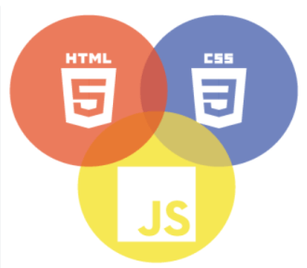

Technology Used
Front-end
Back-end
Source :

Slide 10
Modelling & Results
The modeling for the car rentals web app involves designing data models using Django's ORM: User Model: Includes fields for username, email, password (hashed), and profile details. Car Model: Represents rental cars with attributes like make, model, year, price, availability status, and foreign key relationships. Booking Model: Links users to specific cars with rental dates, managing booking details and availability. Results will feature a user-friendly interface for browsing and booking cars, secure user authentication, and a responsive design. The ORM simplifies database interactions, ensuring data integrity. Testing validates system reliability and security, guaranteeing a robust car rentals platform.
Source :

Slide 11
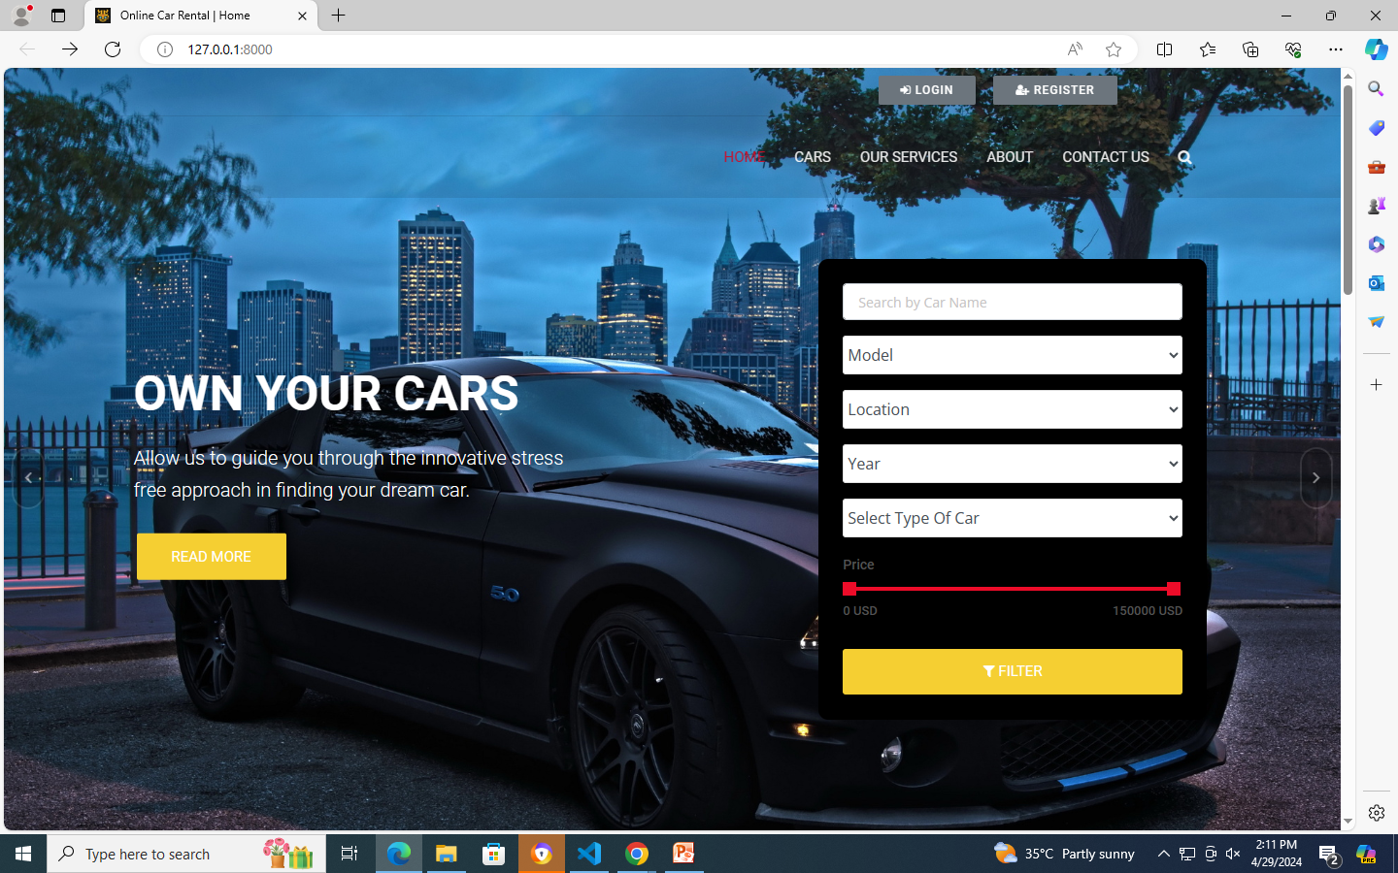
Homepage

Slide 12
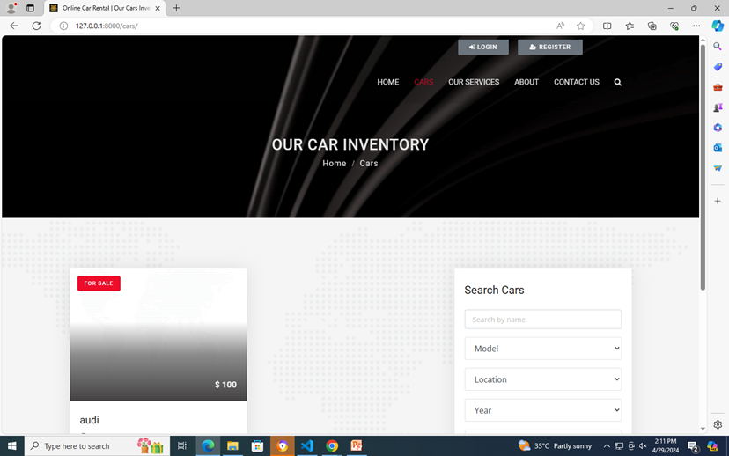
Cars Page

Slide 13
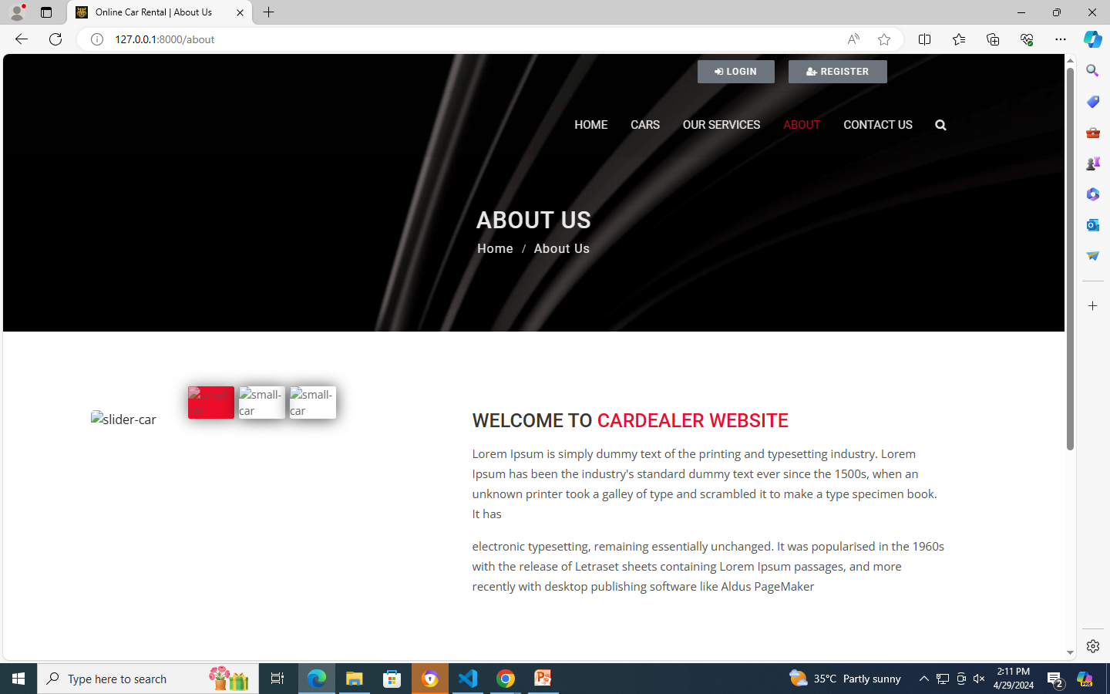
About-Us-Page

Slide 14
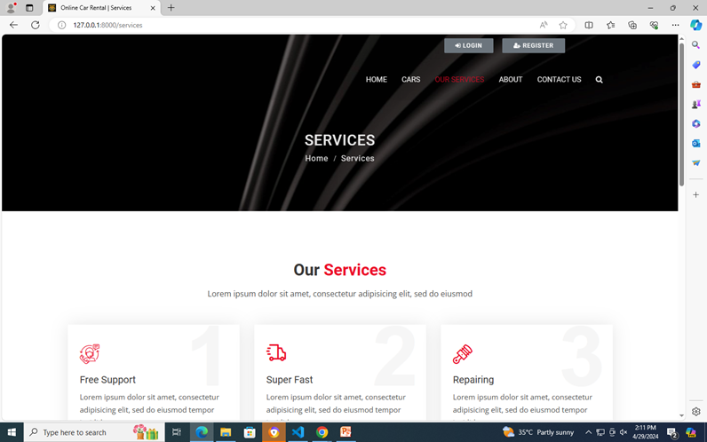
Service-Page

Slide 15
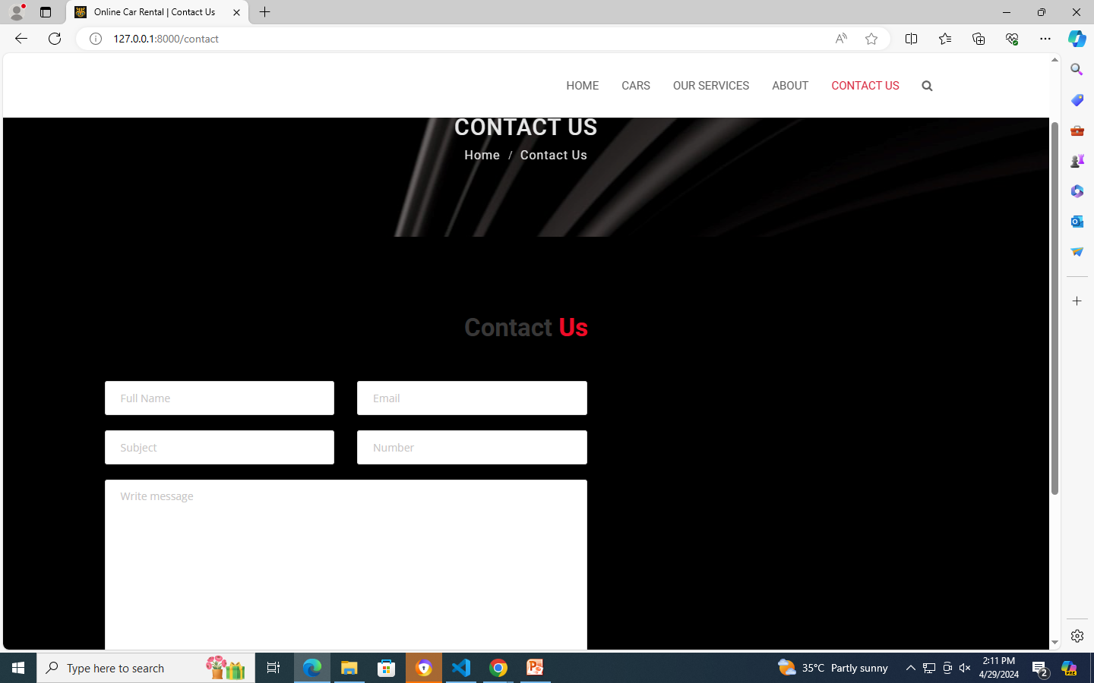
Contact-Page

Slide 16
Future Enhancements:
Future enhancements for the car rentals web app could include: Advanced Search and Filter Options: Enhance car browsing with more detailed search criteria such as fuel type, transmission, or specific features. User Ratings and Reviews: Allow users to rate and review rented cars, providing valuable feedback for other users. Integration of Location Services: Implement location-based services to suggest nearby rental locations or facilitate car delivery options. Dynamic Pricing and Discounts: Introduce dynamic pricing based on demand and seasonality, along with discounting mechanisms for loyal customers. Mobile App Development: Expand the platform with a dedicated mobile app for on-the-go bookings and notifications. Enhanced Analytics and Reporting: Incorporate analytics to track user behavior, popular car choices, and booking trends for business insights.

Slide 17
Conclusion
The car rentals web application developed using Django demonstrates a strong focus on user experience and security. By prioritizing user-centric design, the platform offers intuitive interfaces for browsing cars, making bookings, and managing profiles. Security measures such as secure user authentication, real-time availability checks, and reliable payment integration ensure a safe environment for users. The use of Django's ORM for database management ensures scalability, allowing the application to handle increased user traffic and data efficiently. Comprehensive documentation accompanying the project facilitates deployment and future enhancements. Looking ahead, the project presents potential for advanced features like enhanced search options, user ratings, and mobile app integration to further enrich the user experience and expand functionality.
Source :

Slide 18
Thank You!
Notes:
Thank You !!

