Slide 1
P2P Invoice Exception Intelligence
AI-assisted exception detection and triage for Procure-to-Pay — a portfolio project

Slide 2
Executive Summary
• Analysed 251,734 real purchase-order line items from the BPI Challenge 2019 SAP event log.
• 34.1% of cases trigger at least one of six rule-based exceptions, representing EUR 520,734,872 of net order value.
• Median cycle time from PO creation to invoice clearing is 77.0 days (90th percentile: 126.2 days).
• A Claude vision prototype extracted key fields from 40 real scanned receipts at 81.2% average normalised accuracy — promising, but not yet reliable enough to remove human review.
• Recommendation: pilot an AI-assisted triage layer that drafts exception summaries and root causes for human AP reviewers — not an auto-approval system.

Slide 3
Procure-to-Pay and Why Exceptions Matter
• Procure-to-Pay (P2P) covers the flow from raising a purchase order through goods/service receipt, invoice receipt, and payment clearing.
• Three-way matching compares the Purchase Order, the Goods Receipt, and the Invoice before payment is released — it is a core financial control against overpayment and fraud.
• Exceptions (price/quantity changes, payment blocks, sequence breaks, repeated invoices) slow down the process, increase manual rework for AP teams, and create audit and compliance exposure.
• This project mines a real SAP event log to find where exceptions actually occur, then prototypes a generative-AI layer to help AP analysts triage them faster.

Slide 4
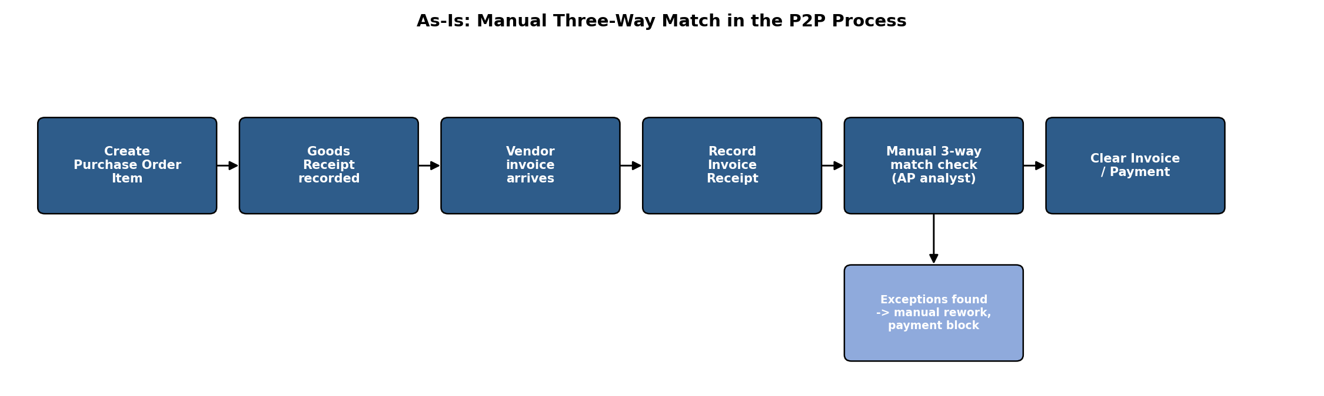
As-Is: Manual Three-Way Match
Goods receipt, invoice receipt, and matching are reconciled manually by the AP analyst today.

Slide 5
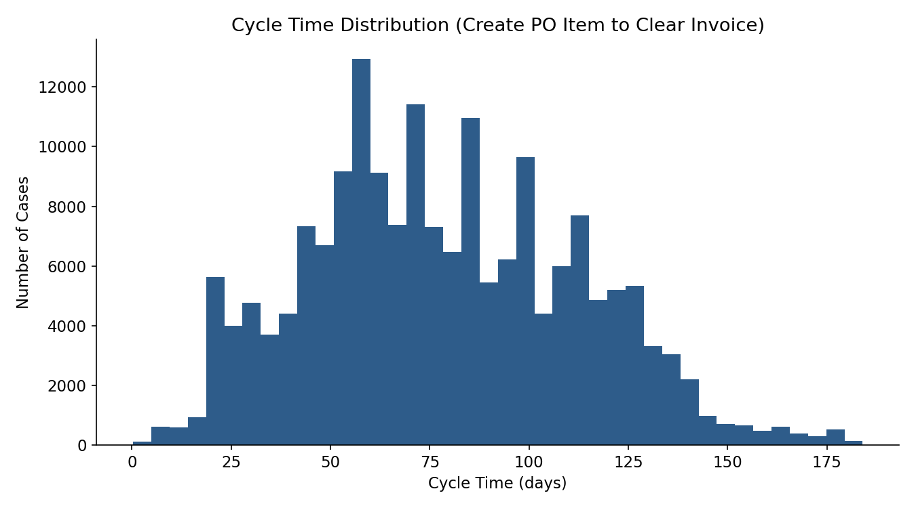
What the Data Shows: 34.1% Exception Rate Across 251,734 Cases
Cycle time is right-skewed: most items clear quickly, but a long tail drives the 90th-percentile exception rule (E6).

Slide 6
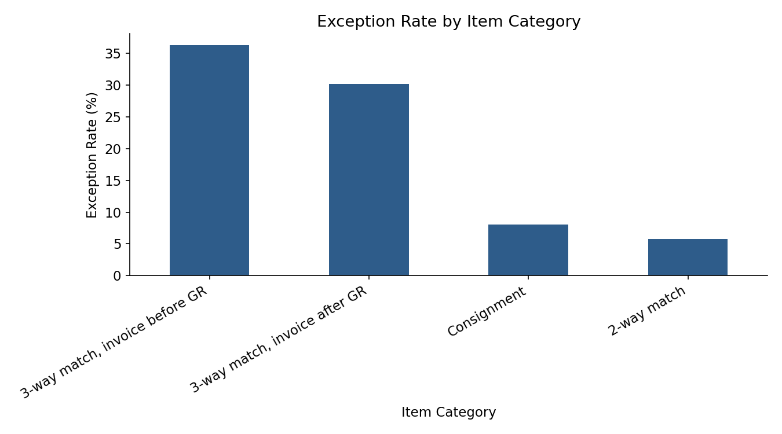
Exception Hotspots Concentrate in a Small Set of Categories and Vendors
See the Vendor Hotspots sheet in the Excel workbook for the full vendor-level breakdown.

Slide 7
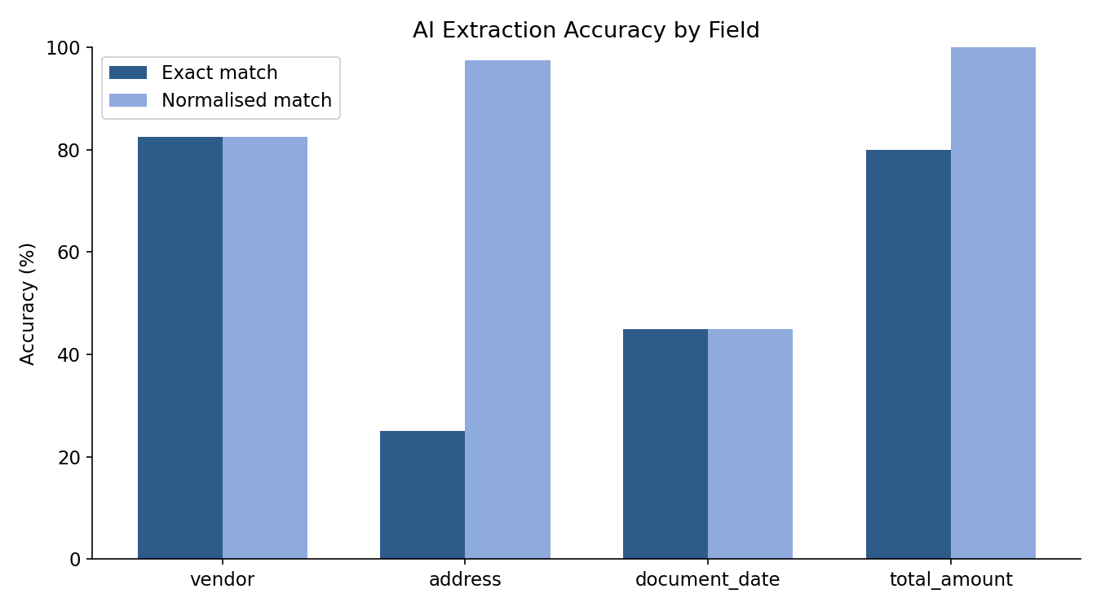
GenAI Document Extraction: Strong on Totals, Weaker on Document Date
Tested on 40 real scanned receipts (ICDAR-SROIE) with ground-truth labels; document date accuracy was the weakest field at 45.0%.

Slide 8
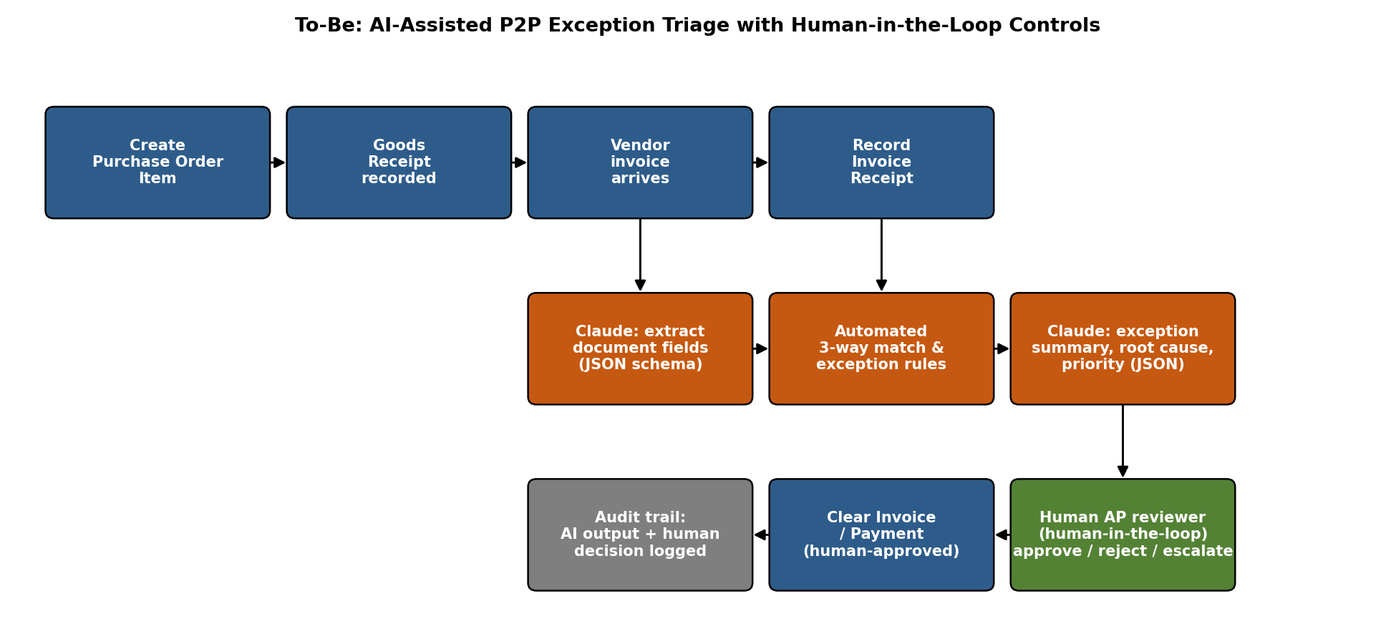
To-Be: AI-Assisted Triage with Human-in-the-Loop Controls
Claude drafts the exception summary and root cause; a human AP reviewer approves, rejects, or escalates every case.

Slide 9
Controls and Risks
• Hallucination: the triage prompt instructs the model to answer 'insufficient information' rather than guess, and is restricted to facts present in the case's own event history.
• Data privacy: document images and event data are processed only through the Anthropic API under the project's own key; no data is used to train models; API keys are never logged or committed.
• Audit trail: every AI output (extraction JSON, triage JSON) is cached and stored alongside the case ID so a reviewer can trace exactly what the model saw and said.
• Segregation of duties: the AI never clears an invoice or removes a payment block — it only drafts a recommendation that a human reviewer must action.

Slide 10
Implementation Roadmap: Pilot to Scale
• Pilot (0-3 months): run AI-assisted triage alongside existing manual review for one vendor category; track reviewer agreement with AI root-cause suggestions.
• [Illustrative assumption] If reviewers accept AI-drafted summaries for ~60% of cases without edits, analyst time per exception could fall meaningfully — this is an assumption to validate in the pilot, not a measured result.
• Scale (3-9 months): extend to all 3-way-match categories, add a feedback loop so rejected AI suggestions are logged and reviewed for prompt improvements.
• Throughout: keep a human-in-the-loop approval step and an audit log at every stage.

Slide 11
Appendix: Data Sources and Method
• BPI Challenge 2019 event log - 4TU.ResearchData, DOI 10.4121/uuid:d06aff4b-79f0-45e6-8ec8-e19730c248f1 (real, anonymised SAP purchase-order data).
• ICDAR-SROIE 2019 scanned receipts - real receipt images with ground-truth key-information labels, used here as invoice-like documents (not purchase invoices) for the extraction test.
• Method: pandas for process mining and exception-rule computation; Claude (claude-haiku-5-5 by default) for document extraction and exception triage; openpyxl / python-pptx for reporting.
• Limitations: exception rules are a starting set, not an exhaustive AP control framework; GenAI accuracy was measured on a small sample; see the Explanation Guide for full limitations.

