Slide 1



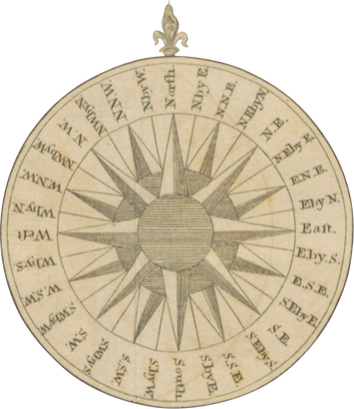


Titanic
Report of
Shamama Firdaus

Slide 2

Objective
The survival rate of passengers during the Titanic crash.

Slide 3


Insights 1
Presentations are communication tools that can be used as speeches, reports, and more.
Insights 2
Presentations are communication tools that can be used as speeches, reports, and more.
Insights 3
Presentations are communication tools that can be used as speeches, reports, and more.

Slide 4
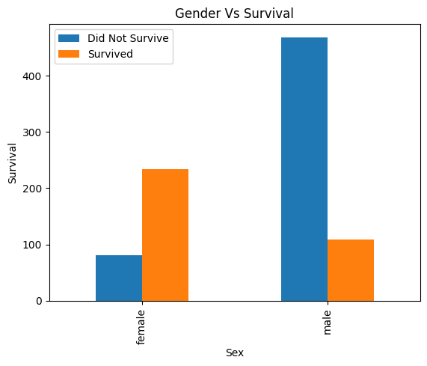
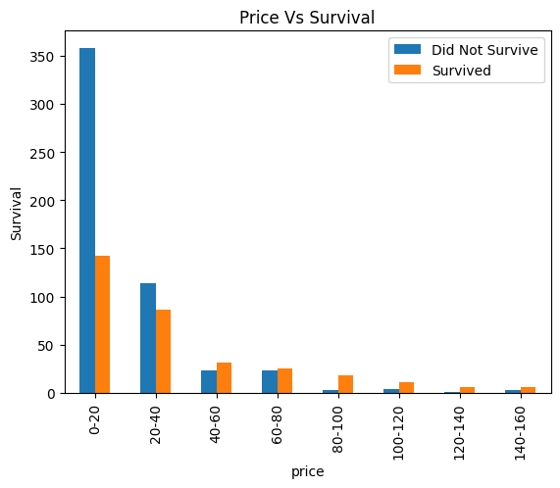
Female passengers had a significantly higher survival rate than male passengers,
There is a noticeable trend showing that passengers who paid higher fares had better survival rates,

Slide 5
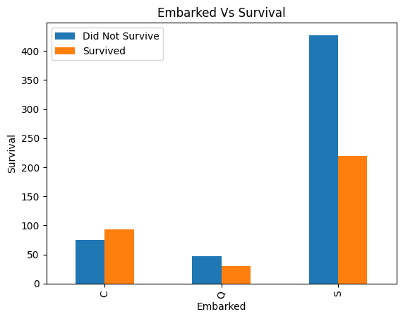
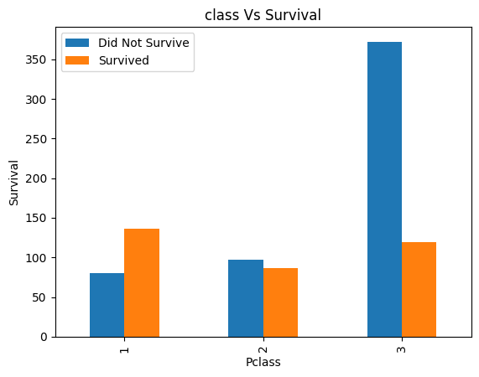
Passengers who boarded from different cities showed different survival rates. It seems passengers from city ‘C’ survived more.
Passengers who were in high class cabinets survived more.

Slide 6
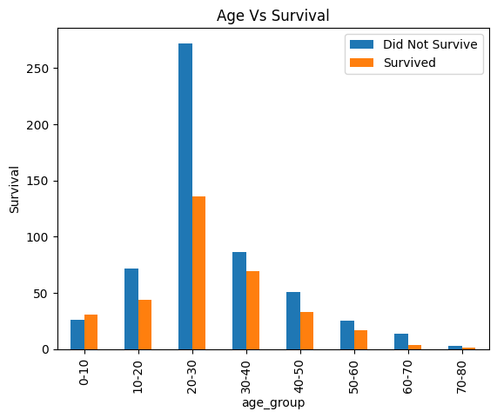

Younger passengers, particularly children (0-10 years), had a higher survival rate. This could indicate that the survival rate diminishes with age, particularly after the 30-40 age bracket

Slide 7
Thank you!

