Slide 1
DEV-009
Test-Driven Development

Slide 2

Introduction
Sergey Kichuk
skichuk@luxoft.com
http://luxoft-training.ru
http://luxoft-training.com

Slide 3
TRAINING ROADMAP: OVERVIEW
Section 1. Introduction to Software Testing
Section 2. Test-Driven Development Approach
Section 3. Test-Driven Development Patterns
Section 4. Techniques of Test-Driven Development
Section 5. Test-Driven Development Anti-patterns
This training covers major aspects of a Test-Driven Development Approach. The goal is starting students on the road to using the TDD approach.
This training is targeted to regular developers
Pre-requisites:
Good knowledge of C++/C#/Java/Python
Good knowledge of object- oriented approach

Slide 4
TRAINING ROADMAP: STRUCTURE
8-hour sessions
15-30 mins breaks every 1.5 – 2 hours
In-class individual practice
In-class group workshops
Homework

Slide 5
SECTION 1: Introduction to Software Testing

Slide 6
Introduction to Software Testing: Roadmap
What exactly is the testing of software?
What will we discover when testing?
Testing Classifications
Software Testing Principles

Slide 7
Introduction to Software Testing: Roadmap
What exactly is the testing of software?
What will we discover when testing?
Testing Classifications
Software Testing Principles

Slide 8
Introduction to Software Testing: What exactly is the testing of software?
The cost of a missed bug can be very large
The space probe "Voyager" was sent to the Sun to collect samples of the solar wind. Due to an error in the software, the probe fell on the star
Mars Rover Spirit was almost lost due to temporary files not being removed from the flash memory. Fortunately, NASA was able to remotely delete the temporary files

Slide 9
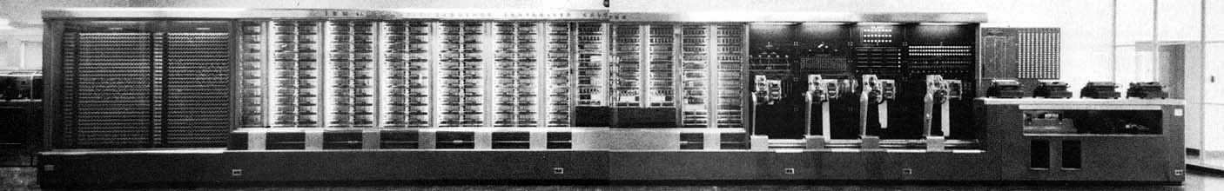
Introduction to Software Testing : What exactly is the testing of software?
The first mention of “Bug”:
Mark II Aiken Relay Calculator

Slide 10
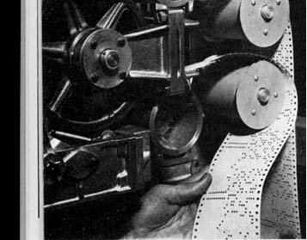
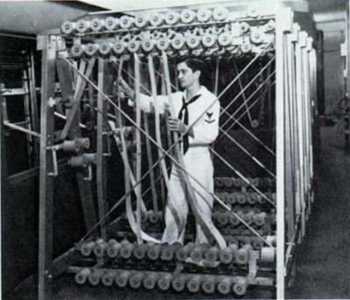
Introduction to Software Testing : What exactly is the testing of software?
The first mention of “Bug”:
September 9, 1945 showed a failure during testing of the system performance ...

Slide 11

Introduction to Software Testing : What exactly is the testing of software?
The first mention of “Bug”:
The cause of the malfunction was a moth (trapped in relay 70 of panel F). The moth was found by the reserve officer, future programming “Grandmother” and Rear Admiral of the US Army - one of the authors of COBOL language, Grace Murray Hopper

Slide 12
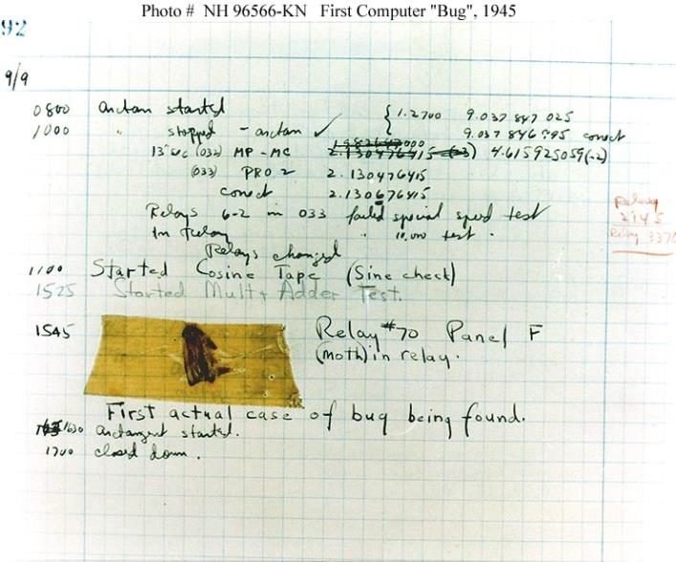
Introduction to Software Testing : What exactly is the testing of software?
The bug was glued into the log of the work and it was written:
"The first actual case of a bug being found»

Slide 13
Introduction to Software Testing : What exactly is the testing of software?
But this is just a legend!

Slide 14
Introduction to Software Testing : What exactly is the testing of software?
The History of testing:
In In the 50's there were testers. They tested systems before production
In the 70’s the science of software engineering earnestly began. At this time, Glenford Maer gave a definition of testing that is considered a “classic” to this day
In the early 90's the arrival of the toolkit for software testing
Mass interest in testing due to Y2K problem

Slide 15
Introduction to Software Testing : What exactly is the testing of software?
Testing is the process of demonstrating that there are no errors in the program
The purpose of the test is to show that the program performs the expected functions correctly
Testing is a process that shows that the program does what is expected of it
Try or False?

Slide 16
Introduction to Software Testing : What exactly is the testing of software?
Testing is the process of demonstrating that there are no errors in the program
The purpose of the test is to show that the program performs the expected functions correctly
Testing is a process that shows that the program does what is expected of it
False

Slide 17
Introduction to Software Testing : What exactly is the testing of software?
Testing is the process of executing a program with the intent of finding errors.

Slide 18
Introduction to Software Testing : What exactly is the testing of software?
Swebook:
Software testing consists of the dynamic verification in which a program provides expected behaviors on a finite set of test cases (suitably selected from the usually infinite execution domain)
Notes:
Dynamic: This term means that testing always implies executing the program on selected inputs. To be precise, the input value alone is not always sufficient to specify a test, since a complex, nondeterministic system might react to the same input with different behaviors, depending on the system state. In this KA, however, the term “input” will be maintained, with the implied convention that its meaning also includes a specified input state in those cases for which it is important. Static techniques are different from and complementary to dynamic testing. Static techniques are covered in the Software Quality KA. It is worth noting that terminology is not uniform among different communities and some use the term “testing” also in reference to static techniques.
Finite: Even in simple programs, so many test cases are theoretically possible that exhaustive testing could require months or years to execute. This is why, in practice, a complete set of tests can generally be considered infinite, and testing is conducted on a subset of all possible tests, which is determined by risk and prioritization criteria. Testing always implies a tradeoff between limited resources and schedules on the one hand and inherently unlimited test requirements on the other.
Selected: The many proposed test techniques differ essentially in how the test set is selected, and software engineers must be aware that different selection criteria may yield vastly different degrees of effectiveness. How to identify the most suitable selection criterion under given conditions is a complex problem; in practice, risk analysis techniques and software engineering expertise are applied.
Expected: It must be possible, although not always easy, to decide whether the observed outcomes of program testing are acceptable or not; otherwise, the testing effort is useless. The observed behavior may be checked against user needs (commonly referred to as testing for validation), against a specification (testing for verification), or, perhaps, against the anticipated behavior from implicit requirements or expectations (see Acceptance Tests in the Software Requirements KA).

Slide 19
Introduction to Software Testing : What exactly is the testing of software?
Probe:
The function takes three arguments - the length of the side (a,b,c) of the triangle. The function must report the type of triangle (equilateral, etc.)
What parameters will be at the input and what do we expect at the output?

Slide 20
Introduction to Software Testing : What exactly is the testing of software?
Please fill in the following table:
# | a | b | c | Result
… | … | … | … | …

Slide 21
Introduction to Software Testing : What exactly is the testing of software?
The Simple Triangle

Slide 22
Introduction to Software Testing : What exactly is the testing of software?
The Equilateral Triangle

Slide 23
Introduction to Software Testing : What exactly is the testing of software?
The isosceles triangle

Slide 24
Introduction to Software Testing : What exactly is the testing of software?
Zero side

Slide 25
Introduction to Test-Driven Development : What exactly is the testing of software?
The side less than zero

Slide 26
Introduction to Software Testing : What exactly is the testing of software?
The triangle is degenerate

Slide 27
Introduction to Software Testing : What exactly is the testing of software?
The triangle does not exists

Slide 28
Introduction to Software Testing : What exactly is the testing of software?
All sides are zero

Slide 29
Introduction to Software Testing : What exactly is the testing of software?
Lengths of sides - floating-point numbers

Slide 30
Introduction to Software Testing : What exactly is the testing of software?
Not all parameters defined

Slide 31
Introduction to Software Testing : What exactly is the testing of software?
Parameters are not numbers

Slide 32
Introduction to Software Testing : What exactly is the testing of software?
“Testing can not prove the correctness of the program, but it can show that it has errors”
Edsger Wybe Dijkstra

Slide 33
Introduction to Software Testing : What exactly is the testing of software?
Which test will be successful?
Bug not found
Test failed
Bug found
Test successful

Slide 34
Introduction to Software Testing: Roadmap
What exactly is the testing of software?
What will we discover when testing?
Testing Classifications
Software Testing Principles

Slide 35
Introduction to Software Testing : What will we discover when testing?
The Accident (Visible error)

Slide 36
Introduction to Software Testing : What will we discover when testing?
Mismatch (internal error)

Slide 37
Introduction to Software Testing : What will we discover when testing?
The Defect (cause of error)

Slide 38
Introduction to Software Testing : What will we discover when testing?
The Accident
Mismatch
The Defect

Slide 39
Introduction to Software Testing: Roadmap
What exactly is the testing of software?
What will we discover when testing?
Testing Classifications
Software Testing Principles

Slide 40
Introduction to Software Testing : Testing Classifications
By Automation:
Manual Testing
Automatic Testing
Notes:
Manual testing involves testing by a real person. It is more intelligent because a person can reveal hidden errors based on intuition and experience.
However, manual testing takes more time and unlike manual, automatic testing can perform large numbers of tests simultaneously (and quite quickly).
However, with automatic testing the intellectuality of testing is significantly reduced.
Unlike manual, automatic testing can perform large amounts of tests, and quite quickly.
However, the intellectuality of testing is significantly reduced.

Slide 41
Introduction to Software Testing : Testing Classifications
By Knowledge of the internal structure of the Module/Program:
The Black Box
The White Box
Notes:
The Black Box:
This Testing is based on the specification of system or component.
The system is a "black box" whose behavior can only be determined by examining input / output data. The main task is to select input data for which the output does not match the expected.
The tester does not need to know the language in which the program is written and/or to delve into the essence of the code - and based on specification can identify many common errors. However, a deeper analysis of the program for black box testing is not available.
The White Box:
Creating tests based on the structure of the system and its implementation.
Typically, this is used for small software components. It detects errors in the implementation of the component. It is easy to automate and reveals a lot of code errors but it has a drawback - it's difficult to use!

Slide 42
Introduction to Software Testing : Testing Classifications
By The Level of Testing:
Unit testing
Component
Integration
System
Alpha
Beta
Notes:
By the level of testing can be divided into unit (is testing individual classes, modules, forms), component (the same, but for the components), integration (checks teamwork tested individual modules and components), system (involved in checking a whole system), alpha (is testing an almost complete system in a lab), beta (open testing of an almost complete application)

Slide 43
Introduction to Software Testing : Testing Classifications
By the Properties of the Test Object:
Usability
Performance
Reliability
Compatibility
Notes:
And the last classification is based on the properties of the testing object.
Testing of interfaces (usability), testing of system performance (how the system behaves under high loads), reliability testing (how it behaves in case of failures), and compatibility testing (how it behaves with other programs and various equipment).

Slide 44
Introduction to Software Testing: Roadmap
What exactly is the testing of software?
What will we discover when testing?
Testing Classifications
Software Testing Principles

Slide 45
Introduction to Software Testing : Software Testing Principles
A necessary part of a test case is a definition of the expected output or result

Slide 46

Introduction to Software Testing : Software Testing Principles
We see what we want to see ...

Slide 47
Introduction to Software Testing : Software Testing Principles
We see what we want to see ...

Slide 48
Introduction to Software Testing : Software Testing Principles
We see what we want to see ...

Slide 49

Introduction to Software Testing : Software Testing Principles
A programmer should avoid attempting to test his or her own program
The problem of the "destructive eye“ (The problem of misunderstanding the specification)

Slide 50
Introduction to Software Testing : Software Testing Principles
carefully check the results of each test

Slide 51
Introduction to Software Testing : Software Testing Principles
Tests should be written both for input conditions that are expected and correct, and for input conditions that are not expected and are not correct

Slide 52
Introduction to Software Testing : Software Testing Principles
The behavior of the program should be predictable in both expected and unexpected situations

Slide 53
Introduction to Software Testing : Software Testing Principles
Avoid throwaway test cases unless the program is truly a throwaway program

Slide 54
Introduction to Software Testing : Software Testing Principles
Do not plan a testing effort under the tacit assumption that no errors will be found

Slide 55
Introduction to Software Testing: Review
What exactly is the testing of software?
What will we discover when testing?
Testing Classifications
Software Testing Principles

Slide 56
SECTION 2: Test-Driven Development Approach

Slide 57
Test-Driven Development Approach: Roadmap
Definition of Test-Driven Development
Workflow of Test-Driven Development Process
Unit test Framework – Introduction
TDD Kata

Slide 58
Test-Driven Development Approach: Roadmap
Definition of Test-Driven Development
Workflow of Test-Driven Development Process
Unit test Framework – Introduction
TDD Kata

Slide 59
Test-Driven Development Approach: Definition of Test-Driven Development
The standard process of software development:

Slide 60
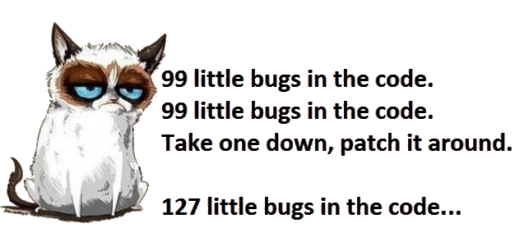
Test-Driven Development Approach: Definition of Test-Driven Development

Slide 61
Test-Driven Development Approach: Definition of Test-Driven Development
Test-Driven development (TDD) is a software development process that relies on the repetition of a very short development cycle: requirements are turned into very specific test cases, then the software is improved to pass the new tests, only. This is opposed to software development that allows software to be added that is not proven to meet requirements

Slide 62
Test-Driven Development Approach: Definition of Test-Driven Development
Test-Driven development is related to the test-first programming concepts of extreme programming, begun in 1999, but more recently has created more general interest in its own right

Slide 63
Test-Driven Development Approach: Definition of Test-Driven Development
Test-Driven Development using:
The Black Box testing
The Unit testing
Test-Driven Development can be using in:
Testing of small piece of program (Module)
Integration Testing
System Testing

Slide 64
Test-Driven Development Approach: Definition of Test-Driven Development
What is a unit?
The Function
The Class
The Component
Unit

Slide 65
Test-Driven Development Approach: Definition of Test-Driven Development
What is unit test?
A piece of code that call unit code (function/class/component) and verify actual result with expected result
If actual and expected result is equal the test will passed, otherwise it fails
Unit test
Unit

Slide 66
Test-Driven Development Approach: Roadmap
Definition of Test-Driven Development
Workflow of Test-Driven Development Process
Unit test Framework – Introduction
TDD Kata

Slide 67
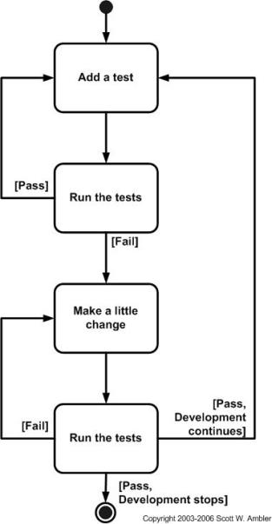
Test-Driven Development Approach: Workflow of Test-Driven Development process
Test-First process:
Notes:
http://agiledata.org/essays/tdd.html

Slide 68
Test-Driven Development Approach: Workflow of Test-Driven Development process
There are two levels of TDD:
Acceptance TDD (ATDD). With ATDD you write a single acceptance test, or behavioral specification depending on your preferred terminology, and then just enough production functionality/code to fulfill that test. ATDD is also called Behavior Driven Development (BDD).
Developer TDD. With developer TDD you write a single developer test, sometimes inaccurately referred to as a unit test, and then just enough production code to fulfill that test.. Developer TDD is often simply called TDD.
Notes:
http://agiledata.org/essays/tdd.html
There are two level of TDD:
Acceptance TDD (ATDD). With ATDD you write a single acceptance test, or behavioral specification depending on your preferred terminology, and then just enough production functionality/code to fulfill that test. The goal of ATDD is to specify detailed, executable requirements for your solution on a just in time (JIT) basis. ATDD is also called Behavior Driven Development (BDD).
Developer TDD. With developer TDD you write a single developer test, sometimes inaccurately referred to as a unit test, and then just enough production code to fulfill that test. The goal of developer TDD is to specify a detailed, executable design for your solution on a JIT basis. Developer TDD is often simply called TDD.

Slide 69
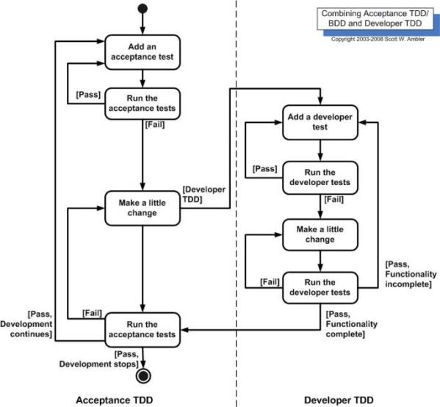
Test-Driven Development Approach: Workflow of Test-Driven Development process
There are two level of TDD
Notes:
http://agiledata.org/essays/tdd.html

Slide 70
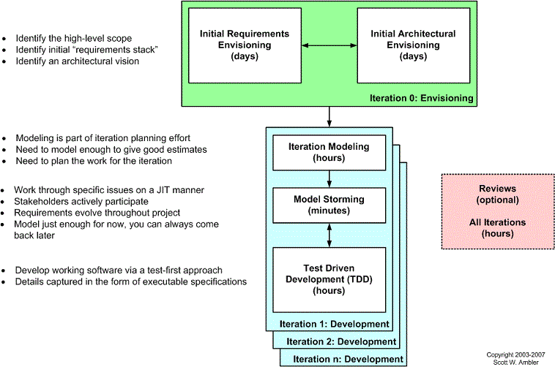
Test-Driven Development Approach: Workflow of Test-Driven Development process
Scaling TDD via Agile Model-Driven Development (AMDD):
Notes:
http://agiledata.org/essays/tdd.html

Slide 71
Test-Driven Development Approach: Workflow of Test-Driven Development process
Comparing TDD and AMDD
TDD | AMDD
It shortens the programming feedback loop | It shortens the modeling feedback loop
It provides detailed specification (tests) | It is better for thinking through bigger issues
It promotes the development of high-quality code | It promotes high-quality communication with your stakeholders and other developers
It provides concrete evidence that your software works | It supports your team, including stakeholders, in working toward a common understanding
It “speaks” to programmers | It speaks to business analysts, stakeholders, and data professionals
It provides very finely grained concrete feedback on the order of minutes | It enables verbal feedback on the order minutes
helps to ensure that your design is clean by focusing on creation of operations that are callable and testable | It provides an opportunity to think through larger design/architectural issues before you code
It is non-visually oriented | It is visually oriented
It support evolutionary development | It supports evolutionary development.
Notes:
http://agiledata.org/essays/tdd.html

Slide 72
Test-Driven Development Approach: Roadmap
Definition of Test-Driven Development
Workflow of Test-Driven Development Process
Unit test Framework – Introduction
TDD Kata

Slide 73
Test-Driven Development Approach: Unit test Framework – Introduction
Most popular framework for unit testing
Platform | Framework
C++ | Google Test Framework, CppUnit, UnitTest++
Java | Junit
.NET | Microsoft Test, Nunit
Python | Unittesting, Doctest
JavaScript | Under node.js: Unit.js, Mocha ; YUI Test
Notes:
Full list: https://en.wikipedia.org/wiki/List_of_unit_testing_frameworks

Slide 74
Test-Driven Development Approach: Unit test Framework – Introduction
The unit test structure:
Called before all tests from the fixture
Test Fixture
***
Called before each test
Setup Fixture method
Called after all tests from the fixture
TearDown Fixture method
Called after each test
Setup test method
TearDown test method
test1 method
Unit test method
test2 method

Slide 75
Test-Driven Development Approach: Unit test Framework – Introduction
The unit test method structure
Arrange
Act
Assert
Notes:
http://wiki.c2.com/?ArrangeActAssert
Arrange all necessary preconditions and inputs.
Act on the object or method under test.
Assert that the expected results have occurred.

Slide 76
Test-Driven Development Approach: Unit test Framework – Introduction
Unit test sample:
@Test
public void Sub4and2ShouldBe2() {
//Arrange
Alu alu = new Alu();
int a = 4;
int b = 2;
int expected = 2;
//Act
int actual = alu.sub(a,b);
//Assert
assertEquals(expected, actual);
}
@Test(expected = ArithmeticException.class)
public void Divide2To0ShouldBeException() {
//Arrange
Alu alu = new Alu();
int a = 2;
int b = 0;
//Act
alu.div(a, b);
}
}
public class FirstTest {
@Test
public void Add1to2ShouldBe3() {
//Arrange
Alu alu = new Alu();
int a = 1;
int b = 2;
int expected = 3;
//Act
int actual = alu.add(a, b);
//Assert
assertEquals(expected,actual);
}

Slide 77
Test-Driven Development Approach: Roadmap
Definition of Test-Driven Development
Workflow of Test-Driven Development Process
Unit test Framework – Introduction
TDD Kata

Slide 78
Test-Driven Development Approach: TDD Kata
Before you start:
Try not to read ahead
Do one task at a time. The trick is to learn to work incrementally.

Slide 79
Test-Driven Development Approach: TDD Kata
import static org.junit.Assert.*;
import org.junit.Test;
import org.w3c.dom.ranges.RangeException;
public class CalcTest {
@Test
public void EmptyStringShouldBe0() {
Calc calc = new Calc();
int expected = 0;
int actual = calc.sum("");
assertEquals(expected,actual);
}
}
public class Calc {
public int sum(String expression) {
throw new UnsupportedOperationException();
}
}
Notes:
Java version

Slide 80
Test-Driven Development Approach: TDD Kata
Create a simple String calculator with a method int Add(string numbers)The method can take 0, 1 or 2 numbers, and will return their sum (for an empty string it will return 0) for example “” or “1” or “1,2”

Slide 81
Test-Driven Development Approach: TDD Kata
Create a simple String calculator with a method int Add(string numbers)The method can take 0, 1 or 2 numbers, and will return their sum (for an empty string it will return 0) for example “” or “1” or “1,2”
Start with the simplest test case of an empty string and move to 1 and 2 numbers
Remember to solve things as simply as possible so that you force yourself to write tests you did not think about
Remember to refactor after each passing test

Slide 82
Test-Driven Development Approach: TDD Kata
Allow the Add method to handle an unknown amount of numbers

Slide 83
Test-Driven Development Approach: TDD Kata
Allow the Add method to handle new lines between numbers (instead of commas)
the following input is ok: “1\n2,3” (will equal 6)
the following input is NOT ok: “1,\n”

Slide 84
Test-Driven Development Approach: TDD Kata
Support different delimiters
to change a delimiter, the beginning of the string will contain a separate line that looks like this: “//[delimiter]\n[numbers…]” for example “//;\n1;2” should return three where the default delimiter is ‘;’
the first line is optional – all existing scenarios should still be supported

Slide 85
Test-Driven Development Approach: TDD Kata
Calling Add with a negative number will throw an exception “negatives not allowed” - and the negative that was passed. If there are multiple negatives, show all of them in the exception message

Slide 86
Test-Driven Development Approach: TDD Kata
Numbers bigger than 1000 should be ignored, so adding 2 + 1001 = 2

Slide 87
Test-Driven Development Approach: TDD Kata
Delimiters can be of any length with the following format: “//[delimiter]\n” for example: “//[***]\n1***2***3” should return 6

Slide 88
Test-Driven Development Approach: TDD Kata
Allow multiple delimiters like this: “//[delim1][delim2]\n” for example “//[*][%]\n1*2%3” should return 6

Slide 89
Test-Driven Development Approach: TDD Kata
Make sure you can also handle multiple delimiters with length longer than one char

Slide 90
Test-Driven Development Approach: TDD Kata
Did you like it?
How much time did you spend using the debugger?
Comments, suggestions?

Slide 91
Test-Driven Development Approach: Review
Definition of Test-Driven Development
Workflow of Test-Driven Development Process
Unit test Framework – Introduction
TDD Kata

Slide 92
SECTION 3: Test-Driven Development Patterns

Slide 93
Test-Driven Development Patterns: Roadmap
Red-Green-Refactor
Simplest tests
Unit test name Conventions
F.I.R.S.T Principles of Unit Testing
Inheritance & unit test
Legacy code & unit test

Slide 94
Test-Driven Development Patterns: Roadmap
Red-Green-Refactor
Simplest tests
Unit test name Conventions
F.I.R.S.T Principles of Unit Testing
Inheritance & unit test
Legacy code & unit test

Slide 95
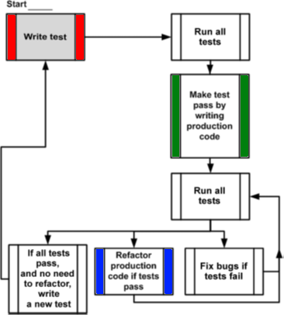
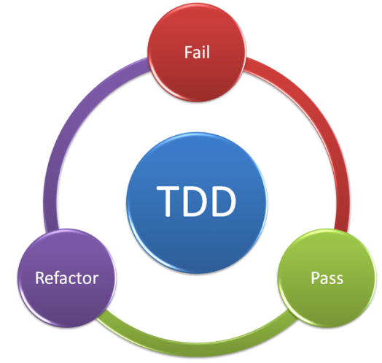
Test-Driven Development Patterns: Red-Green-Refactor

Slide 96
Test-Driven Development Patterns: Red-Green-Refactor
Three Laws of TDD:
You must write a failing test before you write any production code.
You must not write more of a test than is sufficient to fail, or fail to compile.
You must not write more production code than is sufficient to make the currently failing test pass.

Slide 97
Test-Driven Development Patterns: Roadmap
Red-Green-Refactor
Simplest tests
Unit test name Conventions
F.I.R.S.T Principles of Unit Testing
Inheritance & unit test
Legacy code & unit test

Slide 98
Test-Driven Development Patterns: Simplest Test
AAA patterns
Only one assert
No if
No for, while or other loop
Test objectives should be clear

Slide 99
Test-Driven Development Patterns: Simplest Test
Sample of simplest test
public void GetMinimum_UnsortedIntegerArray_ReturnsSmallestValue()
{
var unsortedArray = new int[] {7,4,9,2,5}; // Arrange
var minimum = Statistics.GetMinimum(unsortedArray); // Act
Assert.AreEqual(2, minimum); // Assert
}

Slide 100
Test-Driven Development Patterns: Simplest Test
Here are some guidelines you can follow when writing unit tests:
Keep the number of assertions per unit test to a minimum
Avoid assertion-less tests
Don’t repeat assertions that have been covered in existing tests
Assertions should be situated in the unit tests proper, rather than pulled out into helper methods
The code for arrange, act and assert should be on their own lines, ideally with a new line between each
Notes:
https://dzone.com/articles/the-anatomy-of-good-unit-testing-with-examples-in
Here are some guidelines you can follow when writing unit tests:
Keep the number of assertions per unit test to a minimum. A single unit test is testing one thing. Multiple assertions in a single test are fine, but if it’s logical to split the assertions into separate tests, then it’s best to do so.
Avoid assertion-less tests. These are tests that don’t contain any assertions (or verifications in the case of implementation tests), and are used to test that something works without throwing an exception.
Don’t repeat assertions that have been covered in existing tests. If a unit test asserts that a result is not null, or that a collection has exactly one item, then subsequent unit tests don’t need to repeat such assertions before asserting additional state.
Assertions should be situated in the unit tests proper, rather than pulled out into helper methods. If checking the state is a bit complicated and common across many tests, it’s good to write a helper method to check the state. It’s easy to then put the assertions within that helper method, though we find unit tests more readable if they contain the assertions which could check a boolean returned by the helper method.
The code for arrange, act and assert should be on their own lines, ideally with a new line between each. If you’re asserting that a method returns true, it can be tempting to perform that method call right inside the assert statement. I find unit tests clearer when these are kept separate.

Slide 101
Test-Driven Development Patterns: Roadmap
Red-Green-Refactor
Simplest tests
Unit test name Conventions
F.I.R.S.T Principles of Unit Testing
Inheritance & unit test
Legacy code & unit test

Slide 102
Test-Driven Development Patterns: Unit test name Conventions
Following are 7 popular unit tests naming conventions:
MethodName_StateUnderTest_ExpectedBehavior
IsAdult_AgeLessThan18_False
WithdrawMoney_InvalidAccount_ExceptionThrown
AdmitStudent_MissingMandatoryFields_FailToAdmit
Notes:
https://dzone.com/articles/7-popular-unit-test-naming

Slide 103
Test-Driven Development Patterns: Unit test name Conventions
Following are 7 popular unit tests naming conventions:
MethodName_ExpectedBehavior_StateUnderTest
isAdult_False_AgeLessThan18
withdrawMoney_ThrowsException_IfAccountIsInvalid
admitStudent_FailToAdmit_IfMandatoryFieldsAreMissing

Slide 104
Test-Driven Development Patterns: Unit test name Conventions
Following are 7 popular unit tests naming conventions:
test[Feature being tested]
testIsNotAnAdultIfAgeLessThan18
testFailToWithdrawMoneyIfAccountIsInvalid
testStudentIsNotAdmittedIfMandatoryFieldsAreMissing

Slide 105
Test-Driven Development Patterns: Unit test name Conventions
Following are 7 popular unit tests naming conventions:
Feature to be tested
IsNotAnAdultIfAgeLessThan18
FailToWithdrawMoneyIfAccountIsInvalid
StudentIsNotAdmittedIfMandatoryFieldsAreMissing

Slide 106
Test-Driven Development Patterns: Unit test name Conventions
Following are 7 popular unit tests naming conventions:
Should_ExpectedBehavior_When_StateUnderTest
Should_ThrowException_When_AgeLessThan18
Should_FailToWithdrawMoney_ForInvalidAccount
Should_FailToAdmit_IfMandatoryFieldsAreMissing

Slide 107
Test-Driven Development Patterns: Unit test name Conventions
Following are 7 popular unit tests naming conventions:
When_StateUnderTest_Expect_ExpectedBehavior
When_AgeLessThan18_Expect_isAdultAsFalse
When_InvalidAccount_Expect_WithdrawMoneyToFail
When_MandatoryFieldsAreMissing_Expect_StudentAdmissionToFail

Slide 108
Test-Driven Development Patterns: Unit test name Conventions
Following are 7 popular unit tests naming conventions:
Given_Preconditions_When_StateUnderTest_Then_ ExpectedBehavior
When_AgeLessThan18_Expect_isAdultAsFalse
Given_UserIsAuthenticated_When_InvalidAccountNumberIsUsedTo WithdrawMoney_Then_TransactionsWillFail

Slide 109
Test-Driven Development Patterns: Roadmap
Red-Green-Refactor
Simplest tests
Unit test name Conventions
F.I.R.S.T Principles of Unit Testing
Inheritance & unit test
Legacy code & unit test

Slide 110
Test-Driven Development Patterns: F.I.R.S.T Principles of Unit Testing
Fast:
Unit tests should be fast
All of these including setup, the actual test and tear down should execute really fast (milliseconds) as you may have thousands of tests in your entire project
Notes:
https://github.com/ghsukumar/SFDC_Best_Practices/wiki/F.I.R.S.T-Principles-of-Unit-Testing

Slide 111
Test-Driven Development Patterns: F.I.R.S.T Principles of Unit Testing
Isolated/Independent
The whole test must be based on AAA pattern
Each unit test should have a single reason to fail
You must design your tests to be independent not only of external factors, but of each other as well
Each unit test should instead stand on its own as a complete case that documents one discrete behavior
Notes:
https://pragprog.com/magazines/2012-01/unit-tests-are-first

Slide 112
Test-Driven Development Patterns: F.I.R.S.T Principles of Unit Testing
Isolated/Independent
public class BadTest {
private int value;
@Test
public void NotIsolatedTest1() {
Alu alu = new Alu();
value = alu.add(1, 2);
assertEquals(3, value);
}
@Test
public void NotIsolatedTest2() {
Alu alu = new Alu();
int actual = alu.sub(value, 2);
assertEquals(1,actual);
}
What is wrong?
Notes:
Discuss with students this sample code. In this code you can see two tests which shared variable. Not guarantee that first run test with name NotIsolated1 and them – test NotIsolated2

Slide 113
Test-Driven Development Patterns: F.I.R.S.T Principles of Unit Testing
Repeatable:
A test method should NOT depend on any data in the environment/instance in which it is running
Deterministic results - should yield the same results every time and at every location where they run No dependency on date/time or random functions output.
Each test should setup or arrange it's own data What if a set of tests need some common data? Use Data Helper classes that can setup this data for re-usability
Notes:
https://github.com/ghsukumar/SFDC_Best_Practices/wiki/F.I.R.S.T-Principles-of-Unit-Testing

Slide 114
Test-Driven Development Patterns: F.I.R.S.T Principles of Unit Testing
Self Validating:
No manual inspection required to check whether the test has passed or failed
Notes:
https://github.com/ghsukumar/SFDC_Best_Practices/wiki/F.I.R.S.T-Principles-of-Unit-Testing

Slide 115
Test-Driven Development Patterns: F.I.R.S.T Principles of Unit Testing
Thorough and Timely:
Should cover every use case scenario and NOT just aim for 100% coverage.
Should try to aim for Test Driven Development (TDD) so that code does not need re-factoring later
Notes:
https://github.com/ghsukumar/SFDC_Best_Practices/wiki/F.I.R.S.T-Principles-of-Unit-Testing

Slide 116
Test-Driven Development Patterns: Roadmap
Red-Green-Refactor
Simplest tests
Unit test name Conventions
F.I.R.S.T Principles of Unit Testing
Inheritance & unit test
Legacy code & unit test

Slide 117
Test-Driven Development Patterns: Inheritance & unit testing
public class Alu {
public int add(int a, int b) {
return a + b;
}
public int sub(int a,int b) {
return a - b ;
}
public int div(int a,int b) {
return a/b;
}
public int mul(int a,int b) {
return a*b]
}
}
public class ExtendAlu extends Alu {
public float sin(int x) {
return sin(x);
}
public float cos(int x) {
return cos(x);
}
}
How many methods should be tested?
Notes:
The ExtendAlu class should test all methods, including base class methods, because the subclass is a new class in which the methods of the base class can be overloaded, which will require additional testing of the methods of the base class

Slide 118
Test-Driven Development Patterns: Roadmap
Red-Green-Refactor
Simplest tests
Unit test name Conventions
F.I.R.S.T Principles of Unit Testing
Inheritance & unit test
Legacy code & unit test

Slide 119
Test-Driven Development Patterns: Legacy code & unit test
What is legacy code?
Legacy code is basically any existing code — it doesn’t matter how old it is. But the older it is, the less likely you are to be familiar with it — even if you wrote it. And you want to be able to modify it with confidence that you won’t break existing functionality

Slide 120
Test-Driven Development Patterns: Legacy code & unit test
Do we need to write unit tests for legacy code?
No, if only use this code in your project
Yes, if your try refactoring this code
Yes, If will write new features for legacy code with following approaches:
Sprout method
Wrap Method

Slide 121
Test-Driven Development Patterns: Legacy code & unit test
Sprout Method
The Unit Test for new function
The Old Legacy Code
The new function code
Call from legacy
Notes:
See for detail: https://danlimerick.wordpress.com/2012/04/25/tdd-when-up-to-your-neck-in-legacy-code/

Slide 122
Test-Driven Development Patterns: Legacy code & unit test
Wrap Method
The new function
The Old Legacy Code
The Unit Test for new function
Notes:
See for detail:https://danlimerick.wordpress.com/2012/04/25/tdd-when-up-to-your-neck-in-legacy-code/

Slide 123
Test-Driven Development Patterns: Review
Red-Green-Refactor
Simplest tests
Unit test name Conventions
F.I.R.S.T Principles of Unit Testing
Inheritance & unit test
Legacy code & unit test

Slide 124
SECTION 4: Techniques of Test-Driven Development

Slide 125
Techniques of Test-Driven Development : Roadmap
The Multilayer Architecture Pattern
Techniques for development of Application Programming Interface
Testing with Stub, Fake and Mock

Slide 126
Techniques of Test-Driven Development : Roadmap
The Multilayer Architecture Pattern
Techniques for development of Application Programming Interface
Testing with Stub, Fake and Mock

Slide 127
Techniques of Test-Driven Development : The Multilayer Architecture Pattern
User Interface
Business Logic
Data Access Layer
Hardware Abstract Layer

Slide 128
Techniques of Test-Driven Development : The Multilayer Architecture Pattern
User Interface – Interaction with external user (human or program system)
Business Logic – Implements program functions (Use Case)
Data Access Layer – Manipulate with data source
Hardware Abstract Layer – Manipulate with hardware device (for embedded system)

Slide 129
Techniques of Test-Driven Development : The Multilayer Architecture Pattern
Layer | For which tasks to use unit tests
User Interface | Validation user input, State machine of interaction protocol, user output
Business Logic | User scenarios (BDD), complex algorithms
Data Access Layer | Prepare a commands for manipulating with data source, serialization and deserialization business entities to relationship table
Hardware Abstract Layer | State machine of hardware protocol, interaction with low-level API

Slide 130
Techniques of Test-Driven Development : Roadmap
The Multilayer Architecture Pattern
Techniques for development of Application Programming Interface
Testing with Stub, Fake and Mock

Slide 131
Techniques of Test-Driven Development : Techniques for development of Application Programming Interface
No first code for implementing API, only test!
Create simple design with empty interfaces, classes and so on
Create a unit test in which you use your future interfaces or classes to solve the required tasks. Imagine that you have already defined the methods of interfaces and classes. Just call them, as you deem convenient

Slide 132
Techniques of Test-Driven Development : Techniques for development of Application Programming Interface
Example task:
We need to develop an autopilot for quadrocopter
We have the following objects:
Fly Controller (for managing engine)
GPS module for geo-location
Compass

Slide 133
Techniques of Test-Driven Development : Techniques for development of Application Programming Interface
Example task:
We are going to implement auto takeoff. The Quadrocopter can takeoff only user has completed calibration and GPS signal is good

Slide 134
Techniques of Test-Driven Development : Techniques for development of Application Programming Interface
public class Quadrocopter {
}
public class FlyController {
}
public class Compass {
}
public class GpsModule {
}
First code:

Slide 135
Techniques of Test-Driven Development : Techniques for development of Application Programming Interface
Define tests for auto takeoff:
TakeoffNotAvailableInBadGpsSignal
TakeoffNotAvailabeIfCompassNotCalbration
NormalTakeoff

Slide 136
Techniques of Test-Driven Development : Techniques for development of Application Programming Interface
If takeoff not available we will throw exception which is superclass DroneException
Your must define class DroneException inherits from main exception java/net/C++ class
Your must define class GpsException inherits from DroneDisableException

Slide 137
Techniques of Test-Driven Development : Techniques for development of Application Programming Interface
public class GpsException extends DroneException {
}
public class AutopilotTestCase {
@Test(expected = GpsException .class)
public void TakeoffNotAvailableInBadGpsSignal() {
GpsModule gps = new GpsModule();
Compass compass = new Compass();
FlyController controller = new FlyController();
Quadrocopter drone = new Quadrocopter(gps, compass, controller);
drone.TakeOff();
}
}

Slide 138
Techniques of Test-Driven Development : Techniques for development of Application Programming Interface
Write the test “TakeoffNotAvailabeIfCompassNotCalbration”. We need to compass calibration and turn the motors on to maximum power, if compass work correctly
You need answer for following questions:
What exception will throw if compass not calibration?

Slide 139
Techniques of Test-Driven Development : Techniques for development of Application Programming Interface
public class CompassException extends DroneException {
}
@Test(expected = CompassException.class)
public void TakeoffNotAvailabeIfCompassNotCalbration() {
GpsModule gps = new GpsModule();
Compass compass = new Compass();
FlyController controller = new FlyController();
Quadrocopter drone = new Quadrocopter(gps, compass, controller);
drone.TakeOff();
}

Slide 140
Techniques of Test-Driven Development : Techniques for development of Application Programming Interface
The class AutopilotTestCase needs to refactor:
Duplicate code

Slide 141
Techniques of Test-Driven Development : Techniques for development of Application Programming Interface
@Test(expected = GpsException.class)
public void TakeoffNotAvailableInBadGpsSignal() {
Quadrocopter drone = new Quadrocopter(gps, compass, controller);
drone.TakeOff();
}
@Test(expected = CompassException.class)
public void TakeoffNotAvailabeIfCompassNotCalbration() {
Quadrocopter drone = new Quadrocopter(gps, compass, controller);
drone.TakeOff();
}
}
public class AutopilotTestCase {
private GpsModule gps;
private Compass compass;
private FlyController controller;
@Before
public void InitTest()
{
gps = new GpsModule();
compass = new Compass();
controller = new FlyController();
}

Slide 142
Techniques of Test-Driven Development : Techniques for development of Application Programming Interface
And write the test “NormalTakeoff”. This test validate normal takeoff
What will we check in this test? // For answer see next slide
@Test
public void NormalTakeoff() {
Quadrocopter drone = new Quadrocopter(gps, compass, controller);
drone.TakeOff();
//...?....
}

Slide 143
Techniques of Test-Driven Development : Techniques for development of Application Programming Interface
Can we development this application? We haven`t implemented GpsModule, Compass and FlyController classes
“Yes” – We can use:
Stub
Mock

Slide 144
Techniques of Test-Driven Development : Roadmap
The Multilayer Architecture Pattern
Techniques for development of Application Programming Interface
Testing with Stub, Fake and Mock

Slide 145
Techniques of Test-Driven Development : Testing with Stub, Fake and Mock
Problem unit testing with black-box:
The module is black-box, we don`t known its internal structure
The module can no return any value as result
The module interaction with low-level function or other module
The low-level module is not yet developed
Unit test
Module under test
Low-level module

Slide 146
Techniques of Test-Driven Development : Testing with Stub, Fake and Mock
Stub objects provide a valid response, but it's static -- no matter what input you pass in, you'll always get the same response
Fake objects act like the real object, but they go about it in a simpler way -- such as a DAO that uses a Map to store data instead of a real database
Mock objects are used in mock test cases -- they validate that certain methods are called on those objects

Slide 147
Techniques of Test-Driven Development : Testing with Stub, Fake and Mock
Stub objects
public class StubCompass extends Compass {
@Override
public boolean IsCalibration() {
return true;
}
}

Slide 148
Techniques of Test-Driven Development : Testing with Stub, Fake and Mock
public class FakeCompass extends Compass {
private boolean horCalibrate = false;
private boolean vertCalibrate = false
@Override
public boolean IsCalibration() {
return horCalibrate && vertCalibrate;
}
@Override
public void HorizontalCalibration() {
horCalibrate = true;
}
@Override
public void VerticalCalibration() {
vertCalibrate = true;
}
}
Fake objects

Slide 149
Techniques of Test-Driven Development : Testing with Stub, Fake and Mock
Mock objects:
Behavior is configured declaratively
Allows to simulate any situation occurring at the lower level - from normal operation, to simulation of errors
The test checks whether the module called the lower-level function and with which parameters

Slide 150
Techniques of Test-Driven Development : Testing with Stub, Fake and Mock
Mock Frameworks
Techonology | Mock Frameworks
C++ | Google Mock Framework
NET | Moq, Nsubstitute
JAVA | Mockito, Spock

Slide 151
Techniques of Test-Driven Development : Testing with Stub, Fake and Mock
Test “NormalTakeoff” with mock object:
public class AutopilotTestCase {
private GpsModule gps;
private @Mock Compass compass;
private FlyController controller;
@Test
public void NormalTakeoff() {
Quadrocopter drone = new Quadrocopter(gps, compass, controller);
compass = Mockito.mock(Compass.class);
Mockito.when(compass.IsCalibration()).thenReturn(true);
drone.TakeOff();
Mockito.verify(compass).HorizontalCalibration();
Mockito.verify(compass).VerticalCalibration();
}
Setup behavior of mock
Asserts of this test

Slide 152
Techniques of Test-Driven Development : Review
The Multilayer Architecture Pattern
Techniques for development of Application Programming Interface
Testing with Stub, Fake and Mock

Slide 153
SECTION 5: Test-Driven Development Anti-patterns

Slide 154
Test-Driven Development Anti-patterns: Roadmap
Anti-patterns catalog
Basic mistakes

Slide 155
Test-Driven Development Anti-patterns: Roadmap
Anti-patterns catalog
Basic mistakes

Slide 156
Test-Driven Development Anti-patterns: Anti-patterns catalog
Second Class Citizens
The Free Ride / Piggyback
The Local Hero
The Hidden Dependency
Chain Gang
The Mockery
The Silent Catcher
The Inspector
Excessive Setup
Hack
The Test With No Name
The Slow Poke
The Butterfly
The Flickering Test
Wait and See
Inappropriately Shared Fixture
The Giant
The Sleeper, aka Mount Vesuvius
The Dead Tree
Wet Floor
The Cuckoo
The Secret Catcher
The Environmental Vandal

Slide 157
Test-Driven Development Anti-patterns: Anti-patterns catalog
The Turing Test
The Forty Foot Pole Test
Line Hitter
The Conjoined Twins

Slide 158
Test-Driven Development Anti-patterns: Anti-patterns catalog
Second Class Citizens
The test code isn't as well refactored as production code, containing a lot of duplicated code, making it hard to maintain tests

Slide 159
Test-Driven Development Anti-patterns: Anti-patterns catalog
The Free Ride / Piggyback
Rather than write a new test case method to test another/distinct feature/functionality, a new assertion (and its corresponding actions i.e. Act steps from AAA) rides along in an existing test case

Slide 160
Test-Driven Development Anti-patterns: Anti-patterns catalog
Happy Path
The test stays on happy paths (i.e. expected results) without testing for boundaries and exceptions.

Slide 161
Test-Driven Development Anti-patterns: Anti-patterns catalog
The Local Hero
A test case that is dependent on something specific to the development environment it was written on in order to run. The result is the test passes on development boxes, but fails when someone attempts to run it elsewhere

Slide 162
Test-Driven Development Anti-patterns: Anti-patterns catalog
The Hidden Dependency
Closely related to the local hero
A unit test that requires some existing data to have been populated somewhere before the test runs
If that data wasn’t populated, the test will fail and leave little indication to the developer what it wanted, or why… forcing them to dig through acres of code to find out where the data it was using was supposed to come from

Slide 163
Test-Driven Development Anti-patterns: Anti-patterns catalog
Chain Gang
A couple of tests that must run in a certain order, i.e. one test changes the global state of the system (global variables, data in the database) and the next test(s) depends on it
You often see this in database tests. Instead of doing a rollback in teardown(), tests commit their changes to the database

Slide 164
Test-Driven Development Anti-patterns: Anti-patterns catalog
The Mockery
Sometimes mocking can be good, and handy. Sometimes developers can lose themselves in their effort to mock out what actually isn’t being tested
A unit test contains so many mocks, stubs, and/or fakes that the system under test isn’t even being tested at all, instead data returned from mocks is what is being tested

Slide 165
Test-Driven Development Anti-patterns: Anti-patterns catalog
The Silent Catcher
A test that passes if an exception is thrown even if the exception that actually occurs is one that is different than the one the developer intended.

Slide 166
Test-Driven Development Anti-patterns: Anti-patterns catalog
The Inspector
A unit test that violates encapsulation in an effort to achieve 100% code coverage, but knows so much about what is going on in the object that any attempt to refactor will break the existing test and require any change to be reflected in the unit test

Slide 167
Test-Driven Development Anti-patterns: Anti-patterns catalog
Excessive Setup
A test that requires a huge setup in order to even begin testing. Sometimes several hundred lines of code are used to prepare the environment for one test, with several objects involved, which can make it difficult to really ascertain what is tested due to the “noise” of all of the setup going on

Slide 168
Test-Driven Development Anti-patterns: Anti-patterns catalog
Hack
A test which has to use insane, illegal or otherwise unhealthy ways to perform its task like: Reading private fields or extending a class to access protected fields/methods or having to put the test in a certain package to access package global fields/methods
Some developers don’t agree that this is anti-pattern. What about you?

Slide 169
Test-Driven Development Anti-patterns: Anti-patterns catalog
The Test With No Name
The test that gets added to reproduce a specific bug in the bug tracker and whose author thinks does not warrant a name of its own. Instead of enhancing an existing, lacking test, a new test is created called testForBUG123. Two years later, when that test fails, you may need to first try and find BUG-123 in your bug tracker to figure out the test's intent

Slide 170
Test-Driven Development Anti-patterns: Anti-patterns catalog
The Slow Poke
A unit test that runs incredibly slow. When developers kick it off, they have time to go to the bathroom, grab a smoke, or worse, kick the test off before they go home at the end of the day

Slide 171
Test-Driven Development Anti-patterns: Anti-patterns catalog
The Butterfly
You have to test something which contains data that changes all the time, like a structure which contains the current date, and there is no way to nail the result down to a fixed value. The ugly part is that you don't care about this value at all. It just makes your test more complicated without adding any value

Slide 172
Test-Driven Development Anti-patterns: Anti-patterns catalog
The Flickering Test
A test which just occasionally fails, not at specific times, and is generally due to race conditions within the test

Slide 173
Test-Driven Development Anti-patterns: Anti-patterns catalog
Wait and See
A test that runs some set up code and then needs to 'wait' a specific amount of time before it can 'see' if the code under test functioned as expected. A test Method that uses Thread.sleep() or equivalent is most certainly a "Wait and See" test

Slide 174
Test-Driven Development Anti-patterns: Anti-patterns catalog
Inappropriately Shared Fixture
Several test cases in the test fixture do not even use or need the setup/teardown. Partly due to developer inertia to create a new test fixture... easier to just add one more test case to the pile

Slide 175
Test-Driven Development Anti-patterns: Anti-patterns catalog
The Giant
A unit test that, although it is validly testing the object under test, can span thousands of lines and contain innumerable test cases. This can be an indicator that the system under tests is a God Object

Slide 176
Test-Driven Development Anti-patterns: Anti-patterns catalog
The Sleeper, aka Mount Vesuvius
A test that is destined to FAIL at some specific time and date in the future. This often is caused by incorrect bounds checking when testing code which uses a Date or Calendar object. Sometimes, the test may fail if run at a very specific time of day, such as midnight.

Slide 177
Test-Driven Development Anti-patterns: Anti-patterns catalog
The Dead Tree
A test which a stub was created, but the test wasn't actually written..
assertEquals(1 + 1, 2);

Slide 178
Test-Driven Development Anti-patterns: Anti-patterns catalog
Wet Floor
The test creates data that is persisted somewhere, but the test does not clean up when finished. This causes tests (the same test, or possibly other tests) to fail on subsequent test runs
In our case, the test left a file lying around in the "temp" directory, with permissions from the user that ran the test the first time

Slide 179
Test-Driven Development Anti-patterns: Anti-patterns catalog
The Cuckoo
A unit test which sits in a test case with several others, and enjoys the same (potentially lengthy) setup process as the other tests in the test case, but then discards some or all of the artifacts from the setup and creates its own

Slide 180
Test-Driven Development Anti-patterns: Anti-patterns catalog
The Secret Catcher
A test that at first glance appears to be doing no testing, due to absence of assertions. But "The devil is in the details".. the test is really relying on an exception to be thrown and expecting the testing framework to capture the exception and report it to the user as a failure

Slide 181
Test-Driven Development Anti-patterns: Anti-patterns catalog
The Environmental Vandal
A 'unit' test which for various 'requirements' starts spilling out into its environment, using and setting environment variables / ports. Running two of these tests simultaneously will cause 'unavailable port' exceptions etc.
These tests will be intermittent, and leave developers saying things like 'just run it again'

Slide 182
Test-Driven Development Anti-patterns: Anti-patterns catalog
The Turing Test
A test case automatically generated by some expensive tool that has innumerable asserts gleaned from the class under test using some too-clever-by-half data flow analysis.
Lulls developers into a false sense of confidence that their code is well tested, absolving them from the responsibility of designing and maintaining high quality tests.
If the machine can write the tests for you, why can't it pull its finger out and write the app itself!

Slide 183
Test-Driven Development Anti-patterns: Anti-patterns catalog
The Forty Foot Pole Test
Afraid of getting too close to the class they are trying to test, these tests act at a distance, separated by countless layers of abstraction and thousands of lines of code from the logic they are checking. As such they are extremely brittle, and susceptible to all sorts of side-effects that happen on the epic journey to and from the class of interest

Slide 184
Test-Driven Development Anti-patterns: Anti-patterns catalog
Line Hitter
At first glance the tests cover everything and code coverage tools confirm it 100%, but in reality they only hit code without any output analyses.

Slide 185
Test-Driven Development Anti-patterns: Anti-patterns catalog
The Conjoined Twins
Tests that people are calling "Unit Tests" but are really integration tests since they are not isolated from dependencies (file configuration, databases, services; in other words, parts not being tested as people got complacent and did not isolate) and fail due to dependencies that should have been stubbed or mocked

Slide 186
Test-Driven Development Anti-patterns: Roadmap
Anti-patterns catalog
Basic mistakes

Slide 187
Test-Driven Development Anti-patterns: Basic mistakes
No tests
Manual (missing) Assertions
Redundant Assertions
Using wrong Assertions
Only Easy/Happy Path Tests
Complex Tests
External Dependencies
Catching Unexpected Exception
Mixing Production and test code
Notes:
https://www.slideshare.net/jirikiml/test-Anti-patterns

Slide 188
Test-Driven Development Anti-patterns: Basic mistakes
No tests
public class Anti-patterns {
@Test
@Ignore
public void test() {
//TO DO
}
}

Slide 189
Test-Driven Development Anti-patterns: Basic mistakes
Manual (missing) Assertions
Sysout instead of assert
The secret catcher //see later
@Test
public void ManualAssertion()
{
Alu alu = new Alu();
int actual = alu.add(3, 2);
System.out.println(actual);
}

Slide 190
Test-Driven Development Anti-patterns: Basic mistakes
Redundant Assertions
Always true or always false assertions
Introduced by mistake or debugging purpose
@Test
public void RedundantAssertion() {
FooProducer fp = new FooProducer();
Foo actual = fp.CreateFoo();
assertEquals(actual.a, 2);
assertEquals(actual.b, 3);
}
@Test
public void RedundantFixAssertion() {
FooProducer fp = new FooProducer();
Foo expected = new Foo();
expected.a = 2;
expected.b = 3;
Foo actual = fp.CreateFoo();
assertEquals(actual,expected);
}
Fix
Notes:
https://www.slideshare.net/jirikiml/test-Anti-patterns

Slide 191
Test-Driven Development Anti-patterns: Basic mistakes
Using Wrong Assert:
There is more than assertTrue
Use assert as keyword programming language
Notes:
https://www.slideshare.net/jirikiml/test-Anti-patterns

Slide 192
Test-Driven Development Anti-patterns: Basic mistakes
Only Easy/Happy Path Tests
Only expected behavior is tested
Only easy to verify things are tested
Anti-patterns: The Liar, The Dogger, Success Against All Odds
Notes:
https://www.slideshare.net/jirikiml/test-Anti-patterns

Slide 193
Test-Driven Development Anti-patterns: Basic mistakes
Complex Test
Same rules like for production code
Not use AAA patterns
Anti-patterns: Excessive setup, The Giant, The Mockery, The Nitpicker, The Stranger, The Free Ride, The One, The Slow Poke
Notes:
https://www.slideshare.net/jirikiml/test-Anti-patterns

Slide 194
Test-Driven Development Anti-patterns: Basic mistakes
External Dependencies
External dependencies that code may need to rely on to work correctly
Dependencies between tests – one test prepares data for other one
Dependencies to object internal state
Anti-patterns: The Inspector, Generous Leftovers, The Local Hero, The Operating System Evangelist, The Sequencer, Hidden Dependency, The Peeping Tom
Notes:
https://www.slideshare.net/jirikiml/test-Anti-patterns

Slide 195
Test-Driven Development Anti-patterns: Basic mistakes
Catching Unexpected Exceptions
Test success even if exception is thrown
Anti-patterns: The Liar, The Greedy Catcher
Notes:
https://www.slideshare.net/jirikiml/test-Anti-patterns

Slide 196
Test-Driven Development Anti-patterns: Basic mistakes
Mixing Production and Test Code
More complex packaging
Ability to test package private methods
Notes:
https://www.slideshare.net/jirikiml/test-Anti-patterns

Slide 197
Test-Driven Development Anti-patterns: Review
Anti-patterns catalog
Basic mistakes

Slide 198
DEV-009
Test Driven Development

