Slide 1
UNIT-4
Prepared by:
Manjula L, Assistant Professor
Dept. of CSE, MSRIT
Text Book: Horowitz, Sahni, Anderson-Freed: Fundamentals of Data Structures in C, 2nd Edition, Universities Press, 2008.

Slide 2
Contents
Trees: Introduction
Binary Trees
Binary Tree Traversals
Additional Binary Tree Operations
Threaded Binary Trees
Heaps
Binary Search Trees
Selection Trees
Forests
Representation of Disjoint Sets
Counting Binary Trees

Slide 3
Trees: Introduction
Tree data structure is a hierarchical structure that is used to represent and organize data in a way that is easy to navigate and search. It is a collection of nodes that are connected by edges and has a hierarchical relationship between the nodes.
The topmost node of the tree is called the root, and the nodes below it are called the child nodes. Each node can have multiple child nodes, and these child nodes can also have their own child nodes, forming a recursive structure.

Slide 4
Tree Example
A tree is a finite set of one or more nodes such that:
There is a specially designated node called the root.
The remaining nodes are partitioned into n>=0 disjoint sets T1, ..., Tn, where each of these sets is a tree.
We call T1, ..., Tn the subtrees of the root.

Slide 5
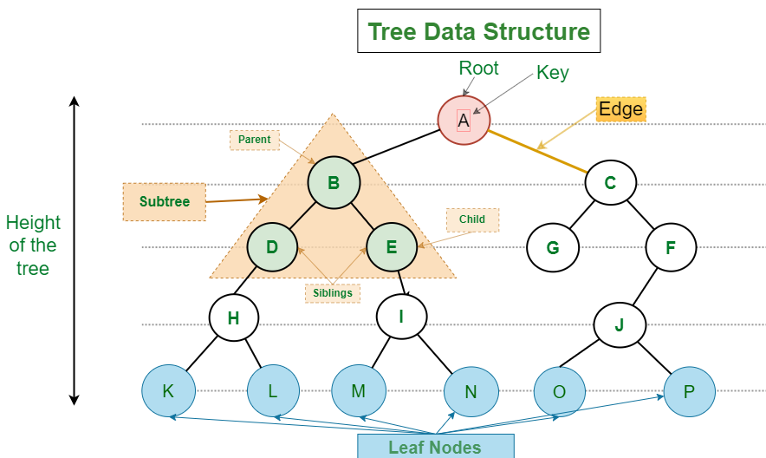

Slide 6
Basic Terminologies In Tree Data Structure:
Parent Node: The node which is a predecessor of a node is called the parent node of that node. {B} is the parent node of {D, E}.
Child Node: The node which is the immediate successor of a node is called the child node of that node. Examples: {D, E} are the child nodes of {B}.
Root Node: The topmost node of a tree or the node which does not have any parent node is called the root node. {A} is the root node of the tree. A non-empty tree must contain exactly one root node and exactly one path from the root to all other nodes of the tree.
Leaf Node or External Node: The nodes which do not have any child nodes are called leaf nodes. {K, L, M, N, O, P, G} are the leaf nodes of the tree.

Slide 7
Basic Terminologies In Tree Data Structure:
Ancestor of a Node: Any predecessor nodes on the path of the root to that node are called Ancestors of that node. {A,B} are the ancestor nodes of the node {E}
Descendant: Any successor node on the path from the leaf node to that node. {E,I} are the descendants of the node {B}.
Sibling: Children of the same parent node are called siblings. {D,E} are called siblings.
Level of a node: The count of edges on the path from the root node to that node. The root node has level 1.
Internal node: A node with at least one child is called Internal Node.
Neighbour of a Node: Parent or child nodes of that node are called neighbors of that node.
Subtree: Any node of the tree along with its descendant.

Slide 8
Representation of Trees
1. List Representation
2. Left Child right sibling representation
3. Representation of degree 2 trees

Slide 9
List Representation
List Representation
( A ( B ( E ( K, L ), F ), C ( G ), D ( H ( M ), I, J ) ) )
The root comes first, followed by a list of sub-trees

Slide 10
List Representation
A
 | 0
B
F | 0
C
G | 0
D
I
J | 0
E
K
L | 0
H
M | 0
This node structure consumes more memory

Slide 11
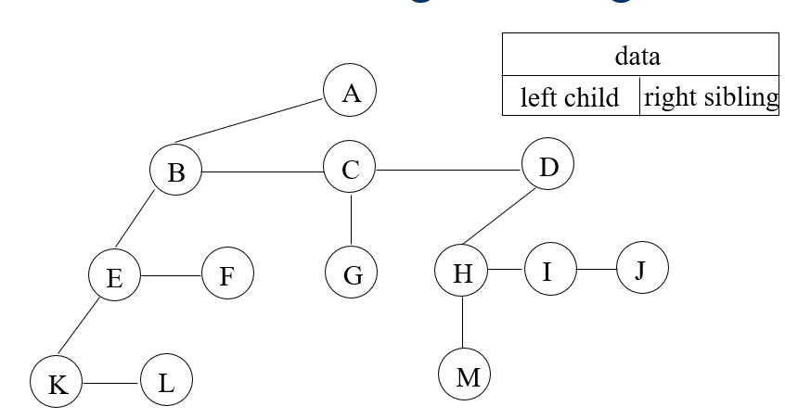
Left Child - Right Sibling representation

Slide 12
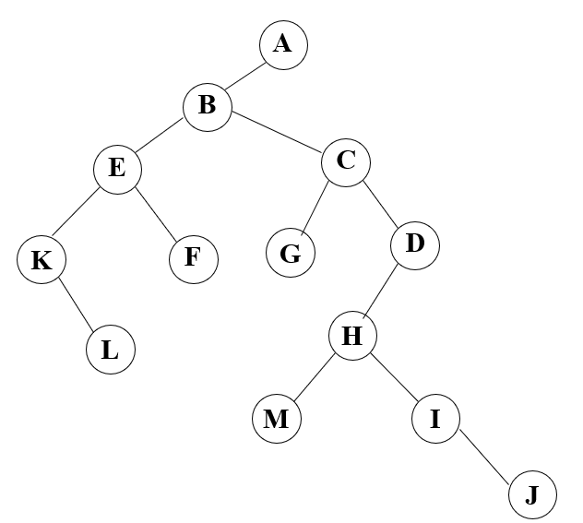
Representation of degree- two
To obtain the degree- two representation of a tree, rotate the right sibling pointers in a left child-right siblings tree clockwise by 45 degrees.

Slide 13
Binary Trees
A binary tree is a finite set of nodes that is either empty or consists of a root and two disjoint binary trees called the left subtree and the right subtree.
Any tree can be transformed into binary tree.
by left child-right sibling representation
The left subtree and the right subtree are distinguished.
A Binary tree is represented by a pointer to the topmost node (commonly known as the “root”) of the tree. If the tree is empty, then the value of the root is NULL.
Each node of a Binary Tree contains the following parts:
Data
Pointer to left child
Pointer to right child

Slide 14
ADT Binary_tree(abbreviation BinTree) is
objects: a finite set of nodes either empty or consisting of a root node, left Binary_Tree, and right Binary_Tree.
Functions:
for all bt, bt1, bt2 ∈ BinTree, item ∈ element
Bintree Create()::= creates an empty binary tree
Boolean IsEmpty(bt)::= if (bt==empty binarytree) return TRUE else return FALSE
BinTree MakeBT(bt1, item, bt2)::= return a binary tree whose left subtree is bt1, whose right subtree is bt2, and whose root node contains the data item

Slide 15
Bintree Lchild(bt)::= if (IsEmpty(bt)) return error else
return the left subtree of bt
element Data(bt)::= if (IsEmpty(bt)) return error else return the data in the root node of bt
Bintree Rchild(bt)::= if (IsEmpty(bt)) return error else return the right subtree of bt

Slide 16
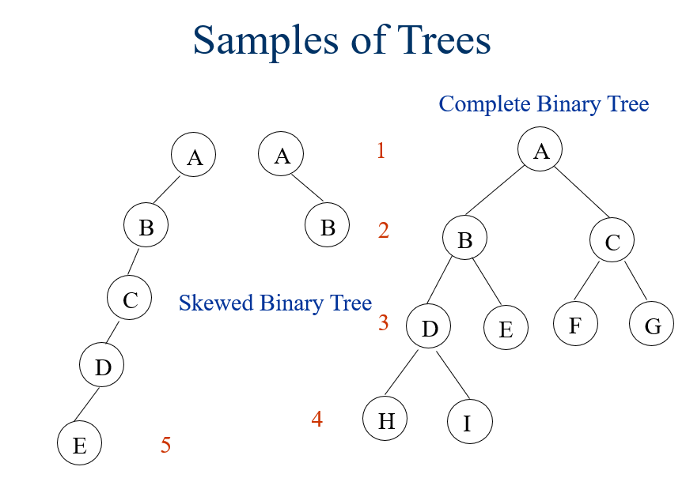

Slide 17
Properties of Binary Trees
1. Maximum Number of Nodes in BT
The maximum number of nodes on level i of a binary tree is 2^{i-1}, i>=1.
The maximum number of nodes in a binary tree of depth k is 2^{k}-1, k>=1.
2. Relation between number of leaf nodes and degree-2 nodes:
For any nonempty binary tree, T, if n0 is the number of leaf nodes and n2 the number of nodes of degree 2, then n0=n2+1
Prove by induction.

Slide 18
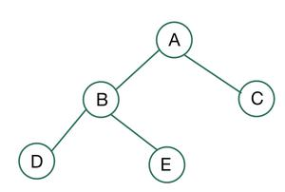
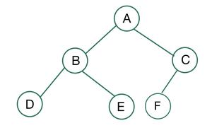
Difference between Full and Complete Binary Tree
A full binary tree is a binary tree in which all of the nodes have either 0 or 2 offspring. In other terms, a full binary tree is a binary tree in which all nodes, except the leaf nodes, have two offspring.
A binary tree is said to be a complete binary tree if all its levels, except possibly the last level, have the maximum number of possible nodes, and all the nodes in the last level appear as far left as possible.

Slide 19
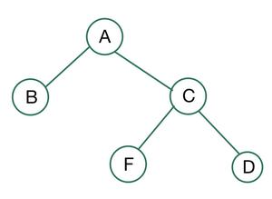
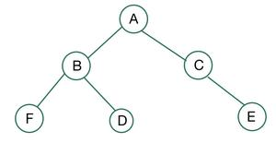
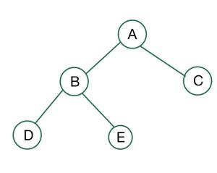
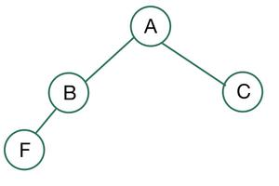

Slide 20
Binary tree Representation
Array
Linked List

Slide 21
Array
If a complete binary tree with n nodes (depth = log n + 1) is represented sequentially, then for any node with index i, 1<=i<=n, we have:
parent(i) is at i/2 if i!=1. If i=1, i is at the root and has no parent.
left_child(i) ia at 2i if 2i<=n. If 2i>n, then i has no left child.
right_child(i) ia at 2i+1 if 2i +1 <=n. If 2i +1 >n, then i has no right child.

Slide 22
Sequential Representation
[1]
[2]
[3]
[4]
[5]
[6]
[7]
[8]
[9]
A
B
C
D
E
F
G
H
I
(1) waste space
(2) insertion/deletion
problem
A
[1]
[2]
[3]
[4]
[5]
[6]
[7]
[8]
[9]
.
[16]
A
B
--
C
--
--
--
D
--
.
E
B
A
C
B
C
D
D
E
F
G
E
H
I

Slide 23
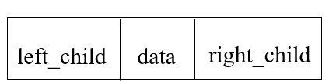
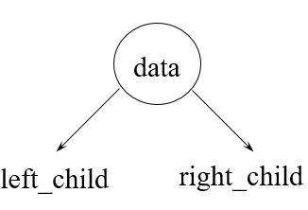
Linked List
typedef struct node *tree_pointer;
typedef struct node
{
int data;
tree_pointer left_child, right_child;
};

Slide 24
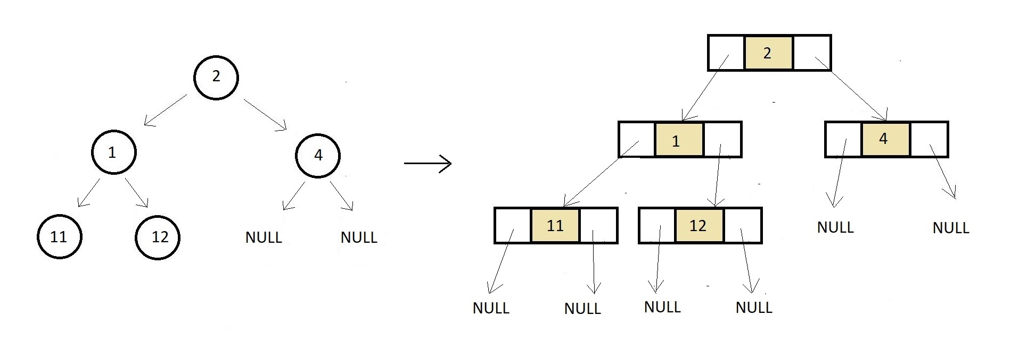

Slide 25
Binary Tree Traversals
Tree traversal (also known as tree search and walking the tree) is a form of graph traversal and refers to the process of visiting (e.g. retrieving, updating, or deleting) each node in a tree data structure, exactly once. Such traversals are classified by the order in which the nodes are visited.
Let L, V, and R stand for moving left, visiting the node, and moving right.
There are six possible combinations of traversal LVR, LRV, VLR, VRL, RVL, RLV
Adopt convention that we traverse left before right, only 3 traversals remain LVR, LRV, VLR
inorder, postorder, preorder

Slide 26
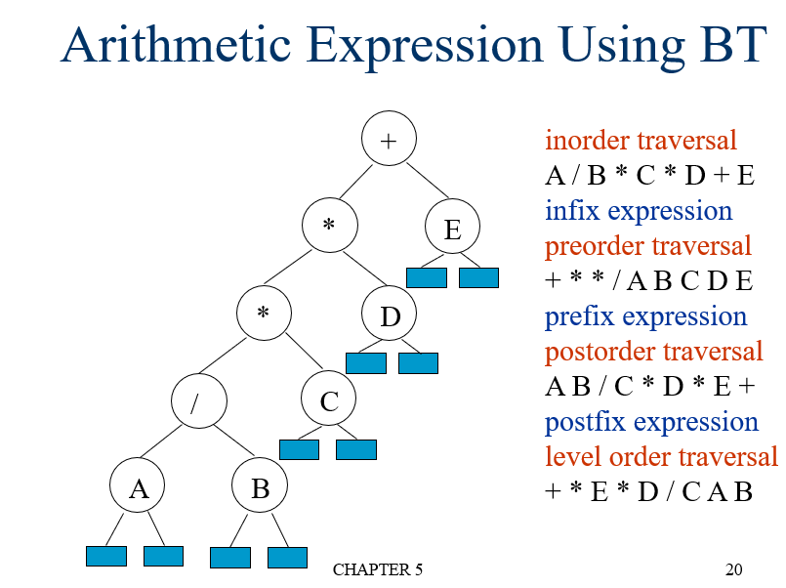

Slide 27
Inorder Traversal (recursive version)
void inorder(tree_pointer ptr)
/* inorder tree traversal */
{
if (ptr) {
inorder(ptr->left_child);
printf(“%d”, ptr->data);
indorder(ptr->right_child);
}
}

Slide 28
Preorder Traversal (recursive version)
void preorder(tree_pointer ptr)
/* preorder tree traversal */
{
if (ptr) {
printf(“%d”, ptr->data);
preorder(ptr->left_child);
predorder(ptr->right_child);
}
}

Slide 29
Postorder Traversal (recursive version)
void postorder(tree_pointer ptr)
/* postorder tree traversal */
{
if (ptr) {
postorder(ptr->left_child);
postdorder(ptr->right_child);
printf(“%d”, ptr->data);
}
}

Slide 30
Inorder Traversal – Iterative Method
Create an empty stack (say S).
Initialize the current node as root.
Push the current node to S and set current = current->left until current is NULL
If current is NULL and the stack is not empty then:
Pop the top item from the stack.
Print the popped item and set current = popped_item->right
Go to step 3.
If current is NULL and the stack is empty then we are done

Slide 31
void iter_inorder(tree_pointer node)
{
int top= -1; /* initialize stack */
tree_pointer stack[MAX_STACK_SIZE];
for (;;) {
for (; node; node=node->left_child)
push(node);/* add to stack */
node= pop(); /* delete from stack */
if (!node) break; /* empty stack */
printf(“%d”, node->data);
node = node->right_child;
}
}

Slide 32
Trace Operations of Inorder Traversal

Slide 33
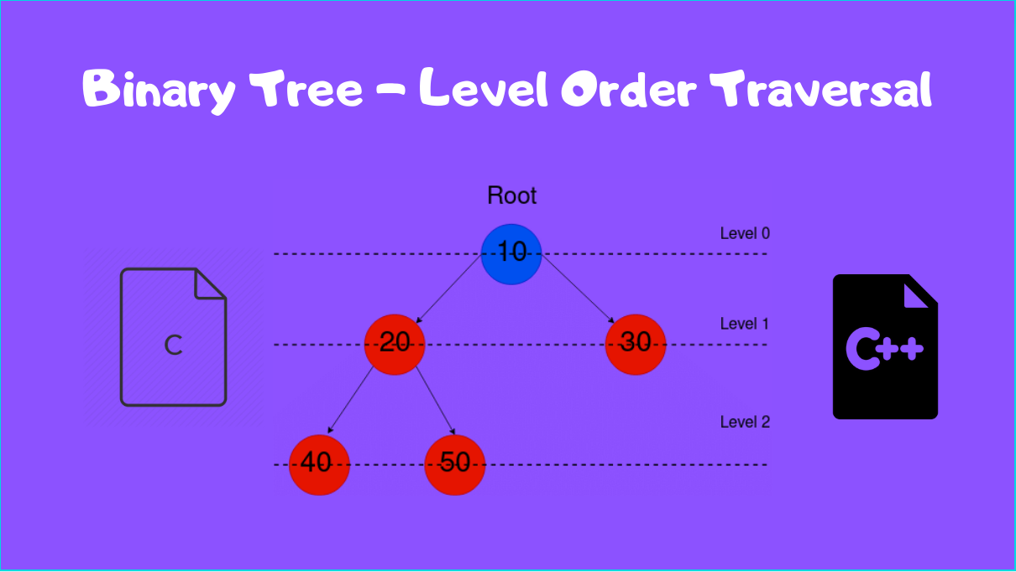
Level order traversal
Level order traversal is actually a Breadth First Search, which is not recursive by nature. Breadth-first search can be used to solve many problems in graph theory, for example: Finding all nodes within one connected component.

Slide 34
void level_order(tree_pointer ptr)
/* level order tree traversal */
{
int front = rear = 0;
tree_pointer queue[MAX_QUEUE_SIZE];
if (!ptr)
return; /* empty queue */
addq(ptr);
for (;;) {
ptr = deleteq();

Slide 35
if (ptr)
{
printf(“%d”, ptr->data);
if (ptr->left_child)
addq(ptr->left_child);
if (ptr->right_child)
addq(ptr->right_child);
}
else
break;
}
}

Slide 36
Copying Binary Trees
tree_poointer copy(tree_pointer original)
{
tree_pointer temp;
if (original) {
MALLOC(temp,sizeof(*temp));
temp->left_child=copy(original->left_child);
temp->right_child=copy(original->right_child);
temp->data=original->data;
return temp;
}
return NULL;
}

Slide 37
Equality of Binary Trees
int equal(tree_pointer first, tree_pointer second)
{
/* function returns FALSE if the binary trees first and second are not equal, otherwise it returns TRUE */
return ((!first && !second) || (first && second &&(first->data == second->data) && equal(first->left_child, second->left_child) &&
equal(first->right_child, second->right_child)))
}

Slide 38
Satisfiability Problem
Variables of a given Boolean formula can be assigned in such a way as to make the formula evaluate to true.
Is there an assignment to make an expression true?
Ex: x1 ˄ (x2˅ x3)
What values of x1,x2 and x3 makes the expression output true.

Slide 39
Set of expressions that we can form using these variables(x1….xn) and operators (¬,˅,˄) is defined by following rules:
A variable is an expression.
If x and y are expressions, then ¬x, x∧y, x∨y are expressions.
Parentheses can be used to alter the normal order of evaluation (¬ > ∧ > ∨).

Slide 40
(x₁ ∧ ¬x₂) ∨ (¬ x₁ ∧ x₃) ∨ ¬x₃
(t,t,t)
(t,t,f)
(t,f,t)
(t,f,f)
(f,t,t)
(f,t,f)
(f,f,t)
(f,f,f)
2^{n} possible combinations
for n variables
∨
∨
¬
∧
∧
X₃
X₁
¬
¬
X₃
X₂
X₁
postorder traversal (postfix evaluation)

Slide 41
node structure
left_child data value right_child
typedef emun {not, and, or, true, false } logical; typedef struct node *tree_pointer; typedef struct node
{ tree_pointer list_child; logical data; short int value; tree_pointer right_child; } ;

Slide 42
for (all 2^{n} possible combinations) { generate the next combination; replace the variables by their values; evaluate root by traversing it in postorder; if (root->value) { printf(<combination>); return; } } printf(“No satisfiable combination \n”);
First version of satisfiability algorithm

Slide 43
void post_order_eval(tree_pointer node) { /* modified post order traversal to evaluate a propositional calculus tree */ if (node) { post_order_eval(node->left_child); post_order_eval(node->right_child); switch(node->data) { case not: node->value = !node->right_child->value; break;
Post-order-eval function

Slide 44
case and: node->value = node->right_child->value && node->left_child->value; break; case or: node->value = node->right_child->value | | node->left_child->value; break; case true: node->value = TRUE; break; case false: node->value = FALSE; } } }

Slide 45
Threaded Binary Trees
A threaded binary tree is a type of binary tree data structure where the empty left and right child pointers in a binary tree are replaced with threads that link nodes directly to their in-order predecessor or successor, thereby providing a way to traverse the tree without using recursion or a stack.
If ptr->left_child is null,
replace it with a pointer to the node that would be visited before ptr in an inorder traversal
If ptr->right_child is null,
replace it with a pointer to the node that would be visited after ptr in an inorder traversal

Slide 46
A Threaded Binary Tree
root
A
dangling
B
C
dangling
D
E
F
G
inorder traversal:
H, D, I, B, E, A, F, C, G
H
I

Slide 47
Data Structures for Threaded BT
left_thread left_child data right_child right_thread
TRUE
●
●
FALSE
TRUE: thread
FALSE: child
typedef struct threaded_tree *threaded_pointer;
typedef struct threaded_tree
{ short int left_thread;
threaded_pointer left_child;
char data;
threaded_pointer right_child;
short int right_thread; };

Slide 48
Memory Representation of A Threaded BT
root
--
f
f
f
A
f
f
B
f
f
C
f
f
D
f
t
E
t
t
F
t
t
G
t
t
H
t
t
I
t

Slide 49
Next Node in Threaded BT
threaded_pointer insucc(threaded_pointer tree)
{
threaded_pointer temp;
temp = tree->right_child;
if (!tree->right_thread)
while (!temp->left_thread)
temp = temp->left_child;
return temp;
}

Slide 50
Inorder Traversal of Threaded BT
void tinorder(threaded_pointer tree)
{
/* traverse the threaded binary tree inorder */
threaded_pointer temp = tree;
for (;;) {
temp = insucc(temp);
if (temp==tree) break;
printf(“%3c”, temp->data);
}
}
O(n)

Slide 51
Binary Search Tree
Lab program:
Write a C program for the following operations:
a) Write a function to construct binary search tree.
b) Write a function to perform Binary search tree traversal using:
i) In-order traversal
ii) Pre-order traversal
iii) Post-order traversal

Slide 52
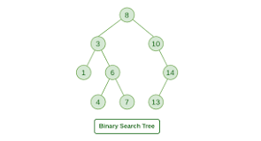
Binary Search Tree
In computer science, a binary search tree (BST), also called an ordered or sorted binary tree, is a rooted binary tree data structure with the key of each internal node being greater than all the keys in the respective node's left subtree and less than the ones in its right subtree.

Slide 53
Examples of Binary Search Trees
20
30
60
12
25
5
40
70
10
15
22
2
65
80

Slide 54
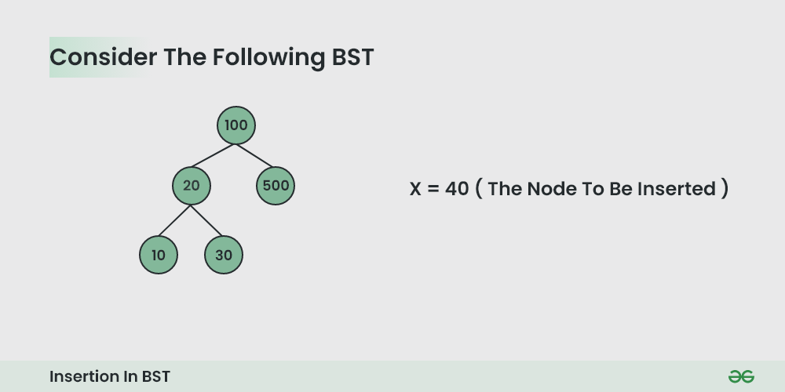
Inserting into Binary tree

Slide 55
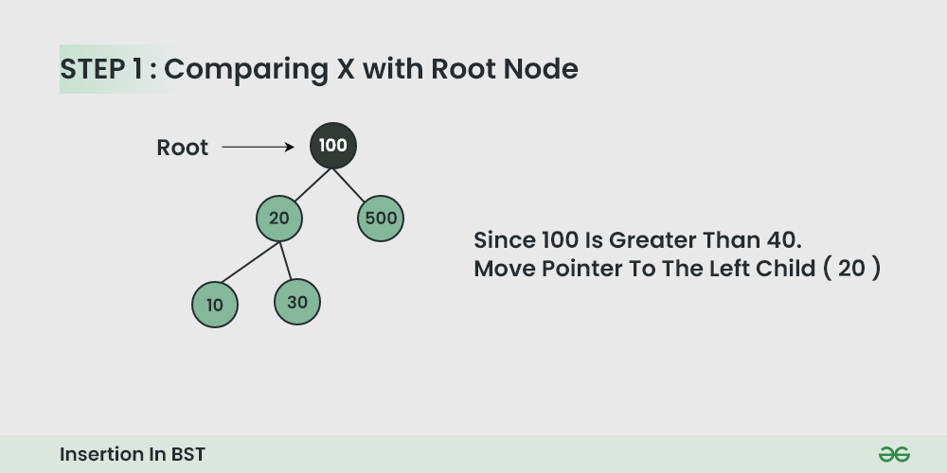

Slide 56
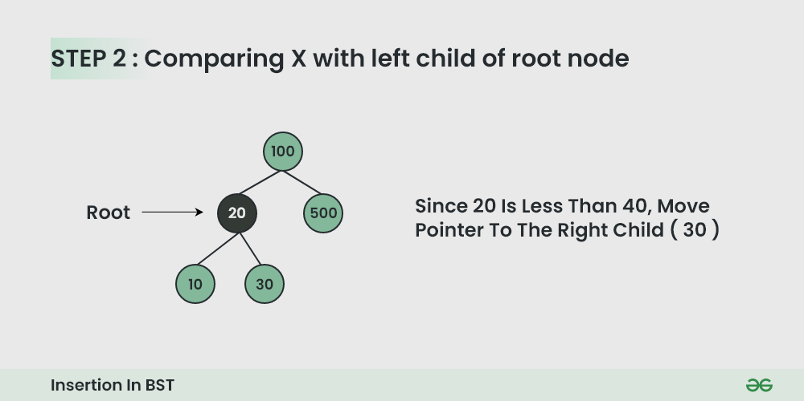

Slide 57
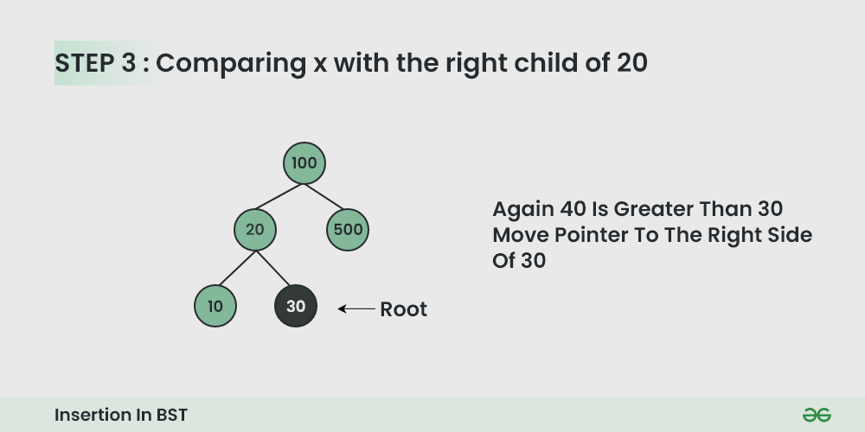

Slide 58
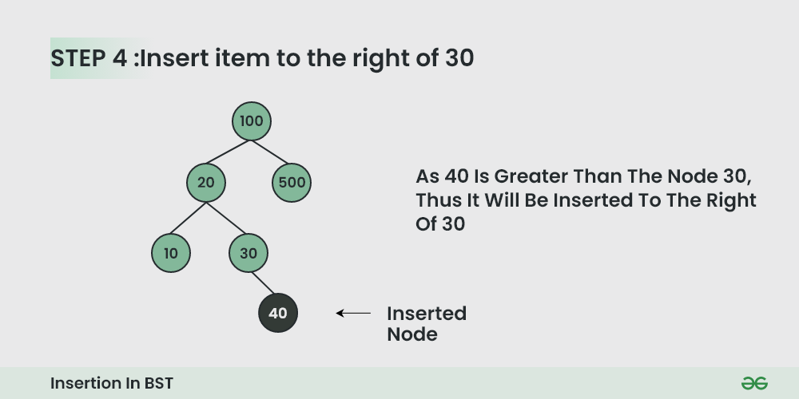

Slide 59
Program Code
#include <stdio.h>
#include <stdlib.h>
//create node structure
struct node
{
int key;
struct node *left, *right;
};

Slide 60
struct node* newNode(int item) // create node memory
{
struct node* temp = (struct node*)malloc(sizeof(struct node));
temp->key = item;
temp->left = temp->right = NULL;
return temp;
}
void inorder(struct node* root) // in-order traversal
{
if (root != NULL) {
inorder(root->left);
printf("%d ", root->key);
inorder(root->right);
}
}

Slide 61
// a new node with given key in BST
struct node* insert(struct node* node, int key)
{
// If the tree is empty, return a new node
if (node == NULL)
return newNode(key);
// Otherwise, recur down the tree
if (key < node->key)
node->left = insert(node->left, key);
else if (key > node->key)
node->right = insert(node->right, key);
// Return the (unchanged) node pointer
return node;
}

Slide 62
int main()
{
/* Let us create following BST
struct node* root = NULL;
root = insert(root, 50);
insert(root, 30);
insert(root, 20);
insert(root, 40);
insert(root, 70);
insert(root, 60);
insert(root, 80);
// Print inorder traversal of the BST
inorder(root);
return 0;
}
50
/ \
30 70
/ \ / \
20 40 60 80

Slide 63
struct node* search(struct node* root, int key)
{
// Base Cases: root is null or key is present at root
if (root == NULL || root->key == key)
return root;
// Key is greater than root's key
if (root->key < key)
return search(root->right, key);
// Key is smaller than root's key
return search(root->left, key);
}

Slide 64
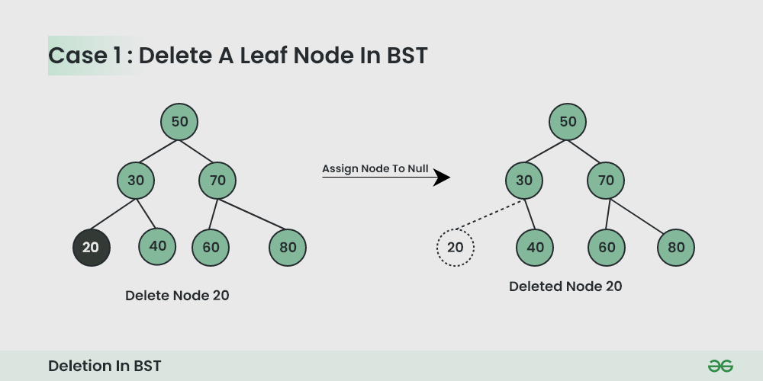
Deletion in Binary Search Tree (BST)

Slide 65
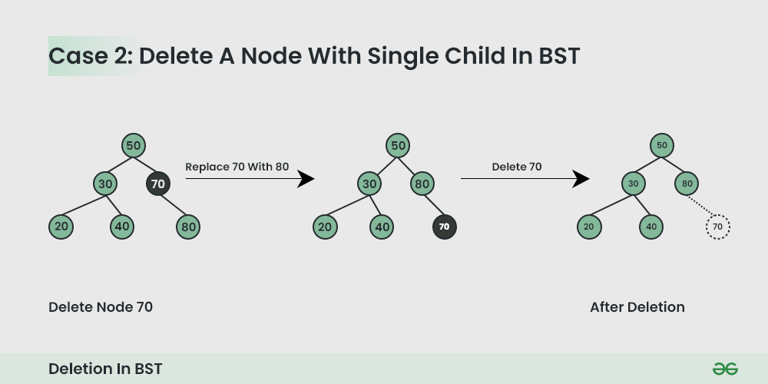

Slide 66
