Slide 1
Introduction to Git & GitHub
Distributed Version Control System

Slide 2
Introduction to Git
Git is a Distributed Version Control tool that supports distributed non-linear workflows by providing data assurance for developing quality software.
Primarily used to manage project, comprising a set of code/text files that may change.
There are two types of VCS:
Centralized Version Control System (CVCS)
Distributed Version Control System (DVCS)

Slide 3
Features of Git
Free and open source: No need to purchase Git. You can modify the source code as per your requirement.
Scalable: As and when the number of collaborators increases, the Git can easily handle this change.
Reliable: Since every contributor has its own local repository, on the events of a system crash, the lost data can be recovered from any of the local repositories.
Secure: Git uses the SHA1 (Secure Hash Function) to name and identify objects within its repository.
Supports non-linear development: Git supports rapid branching and merging.
Easy Branching: Easy to create, delete, and merge branches. Feature branches provide an isolated environment for every change to your codebase.

Slide 4
Git Tutorial
Some of the basic operations in Git are:
Initialize
Add
Commit
Pull
Push
Some advanced Git operations are:
Branching
Merging
Rebasing

Slide 5
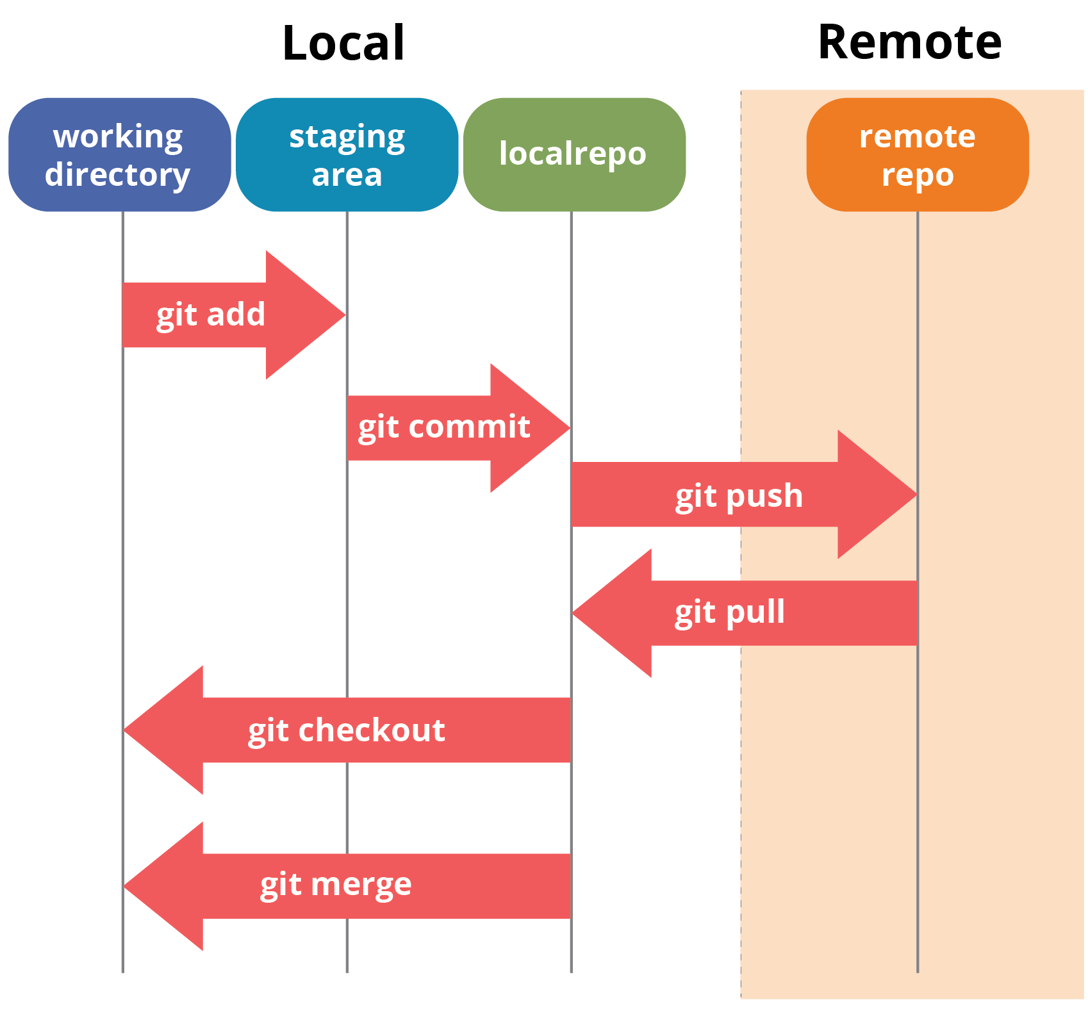
Git Tutorial

Slide 6
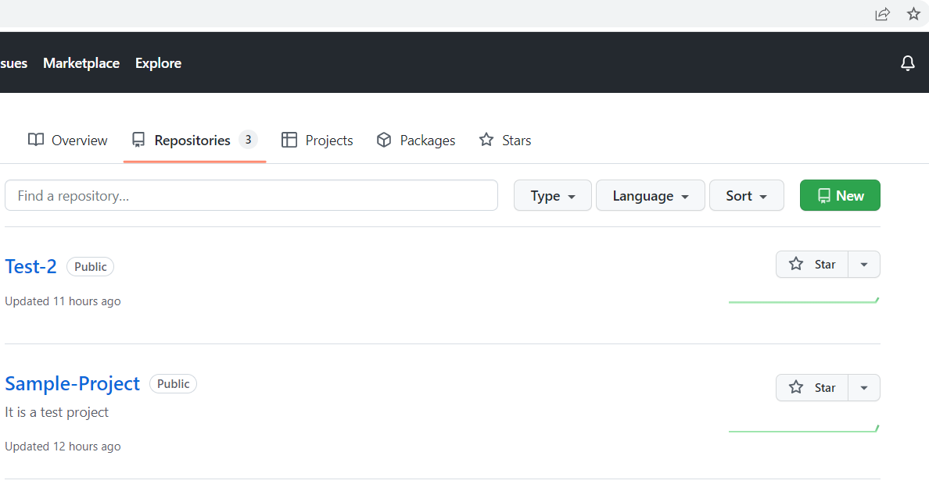
Remote Repository in GitHub
Create a new repository in GitHub.

Slide 7
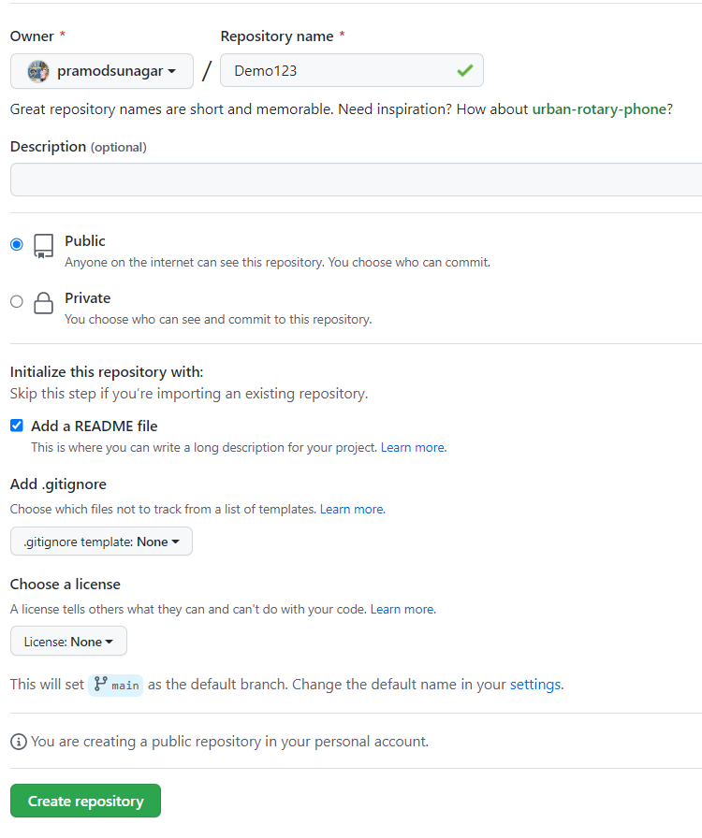
Remote Repository in GitHub
Add an unique Repository name.
Select README for any info on the project.
Choose other settings as per the requirements.
Click on Create Repository

Slide 8
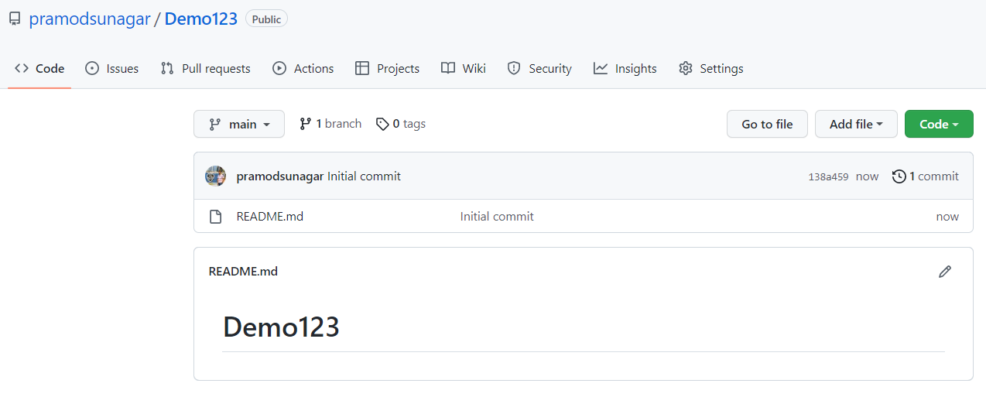
Remote Repository in GitHub
Remote repository will be created in GitHub.

Slide 9
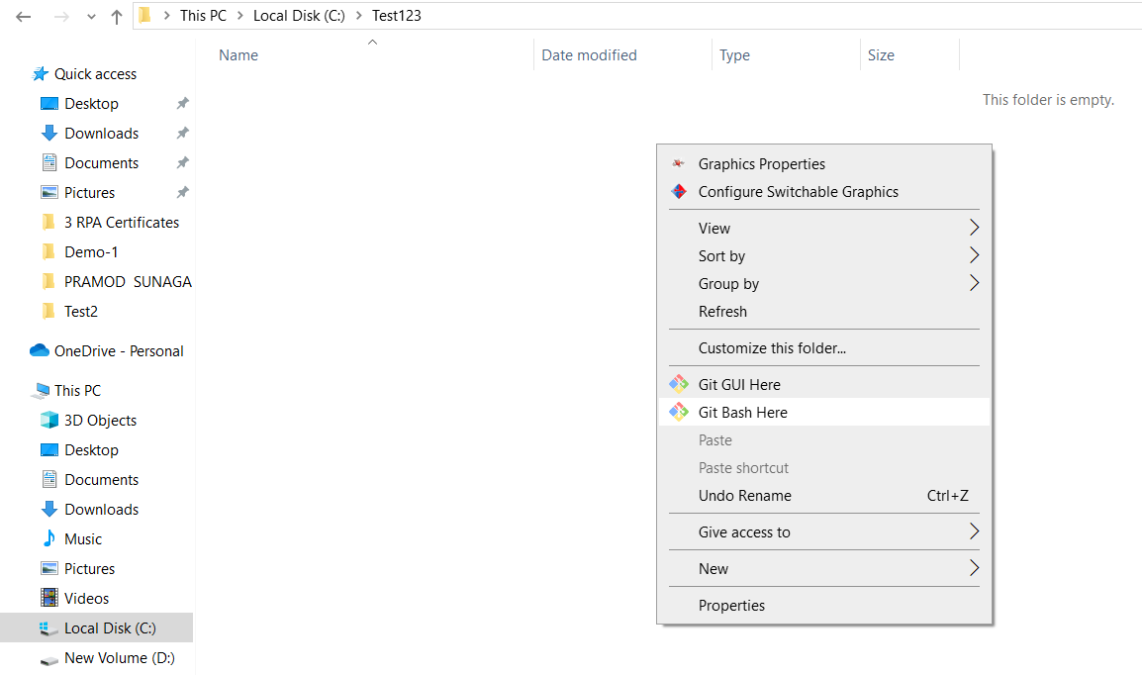
Git Commands
Download and install the Git from https://gitforwindows.org/
Create a folder in one drive and right click and select Git Bash Here.

Slide 10
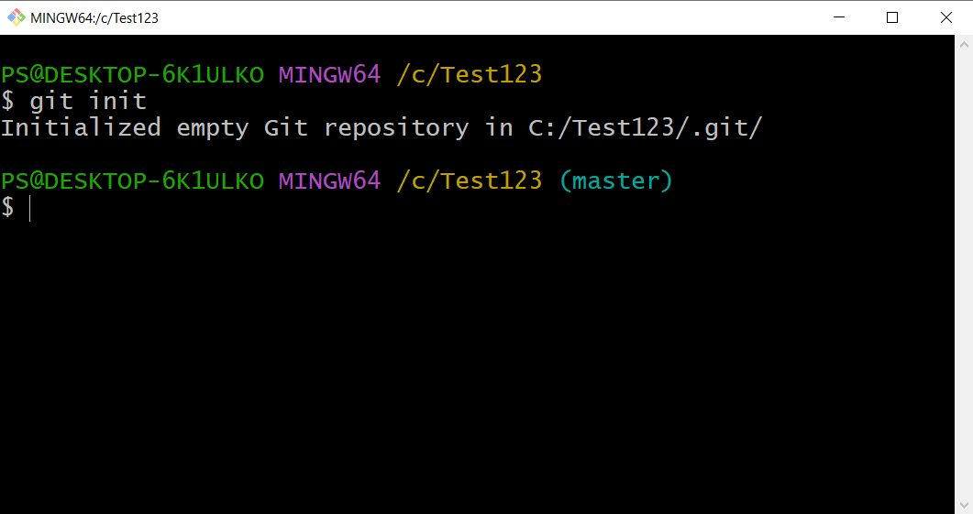
Git Commands
Initialize: The git init creates an empty Git repository or re-initializes an existing one. It basically creates a .git directory with sub directories and template files.

Slide 11
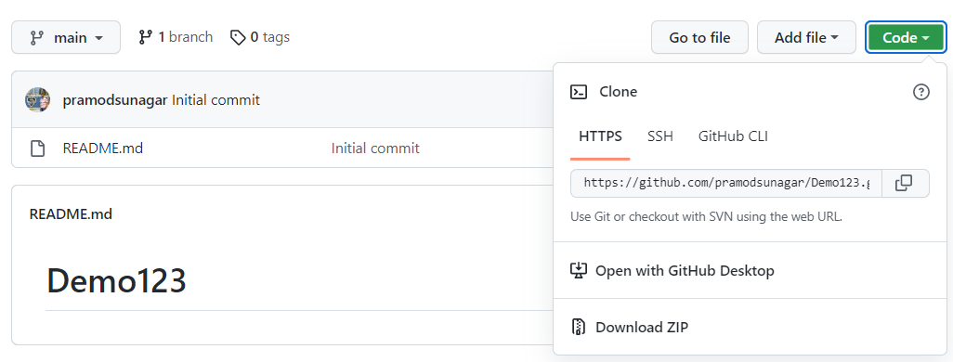
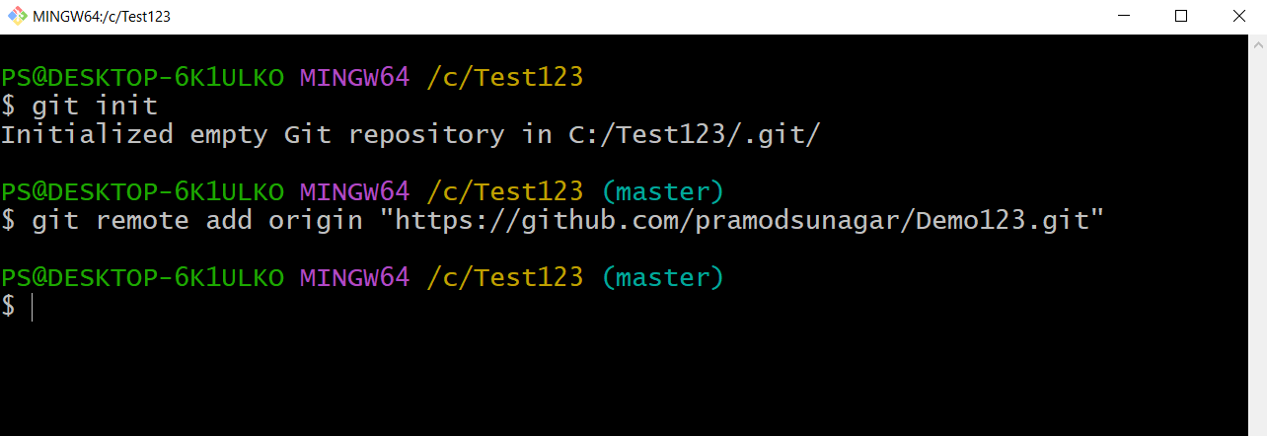
Git Commands
Link to remote repo:
Copy the web URL of the remote repo to link to local repo.
git remote add origin “https://github.com/pramodsunagar/Demo123.git”

Slide 12
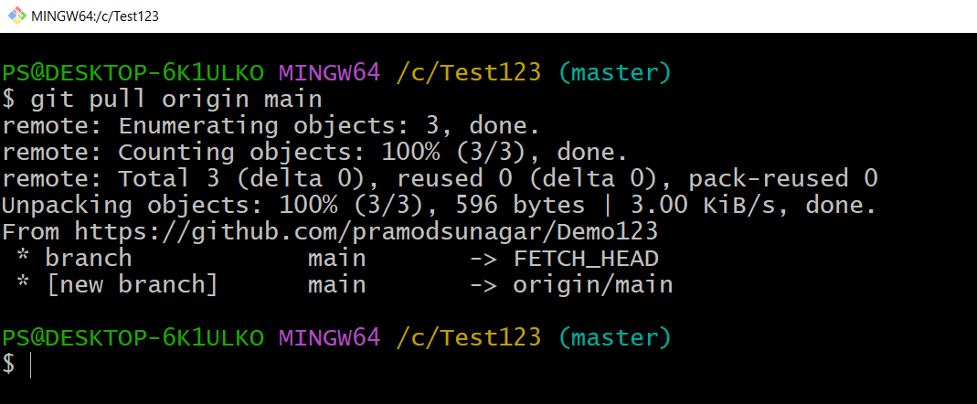
Git Commands
git pull: The git pull origin main command syncs all the files from remote repo to local repo.

Slide 13
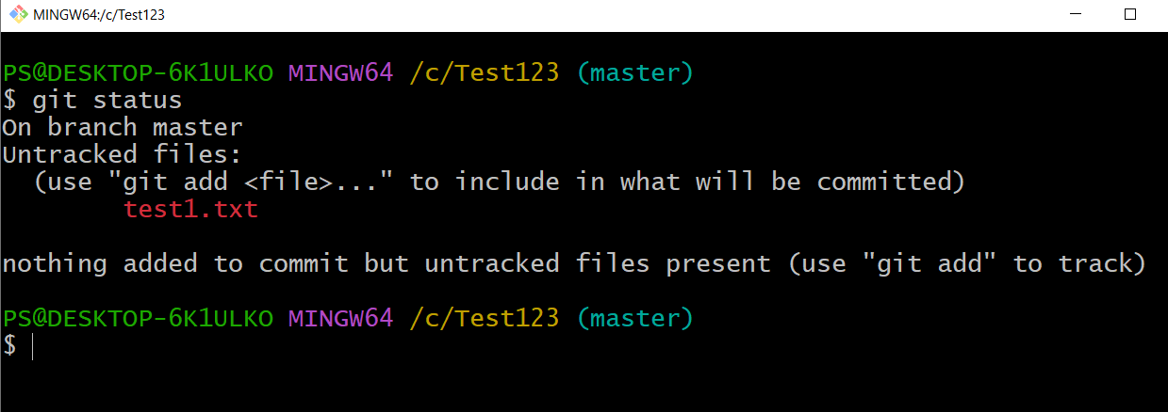
Git Commands
git status: The git status command lists all the modified files which are ready to be added to the local repository.

Slide 14
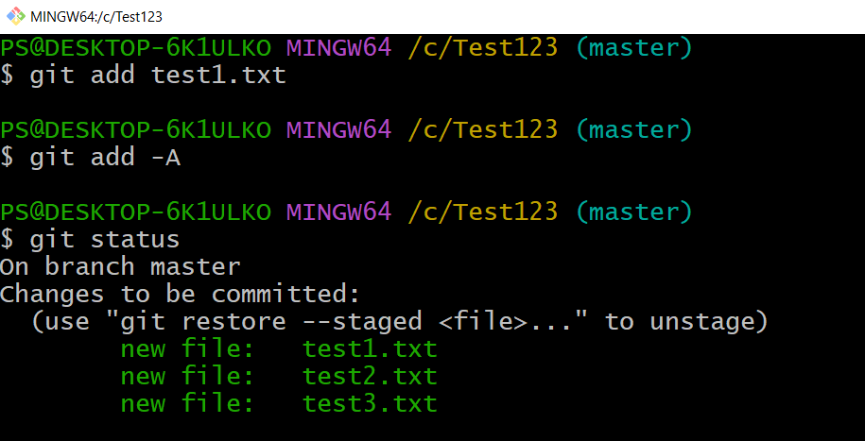
Git Commands
git add: This command updates the index using the current content found in the working tree and then prepares the content in the staging area for the next commit.

Slide 15
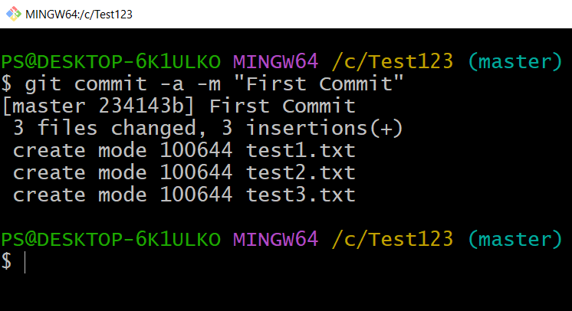
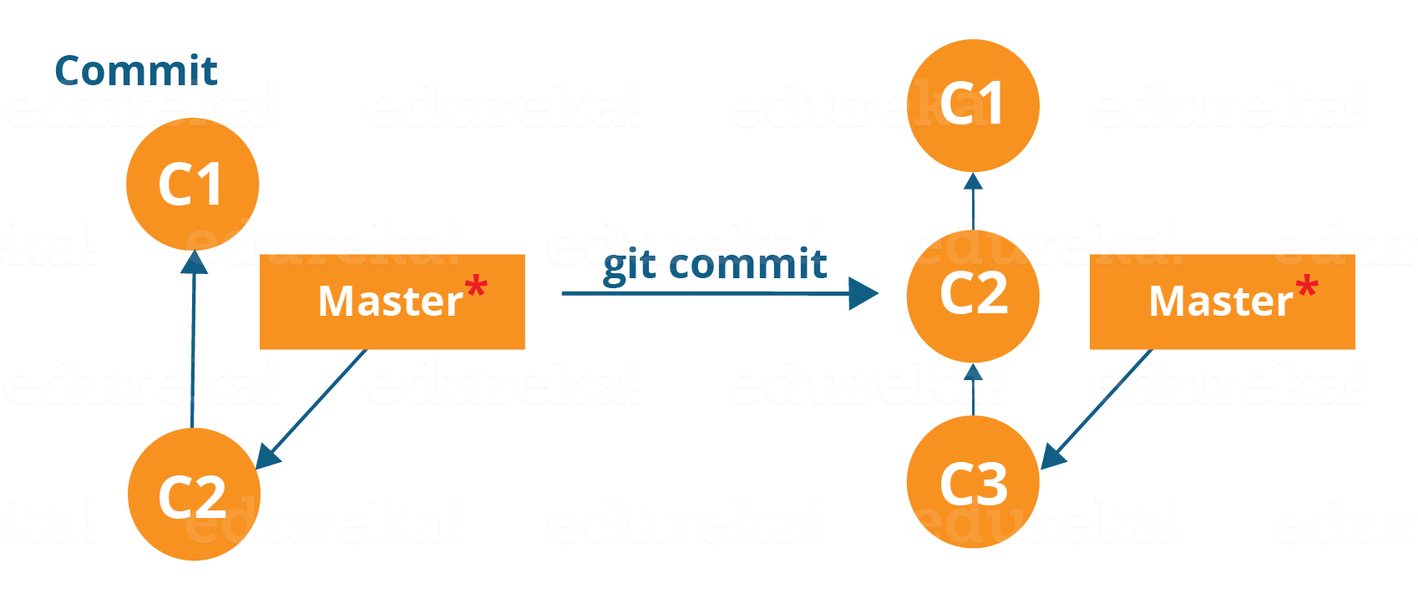
Git Commands
git commit: This will commit the staged snapshot.
git commit –a –m “Message”

Slide 16
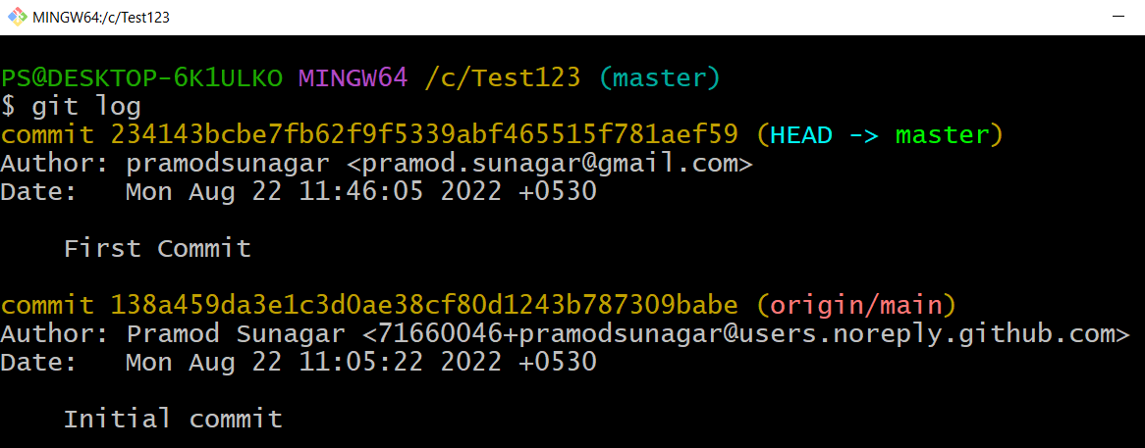
Git Commands
git log

Slide 17
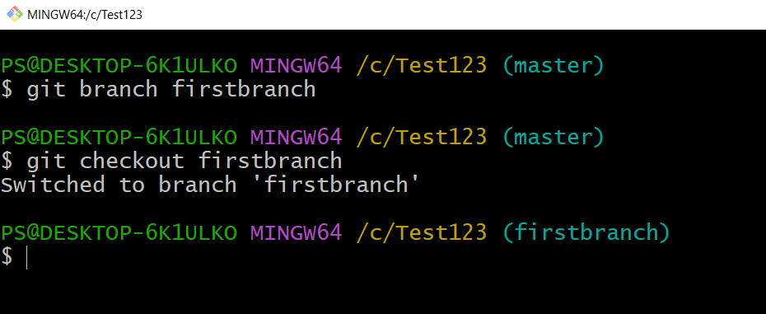
Git Commands
To create a new branch
git branch firstbranch
To move to another branch
git checkout firstbranch

Slide 18
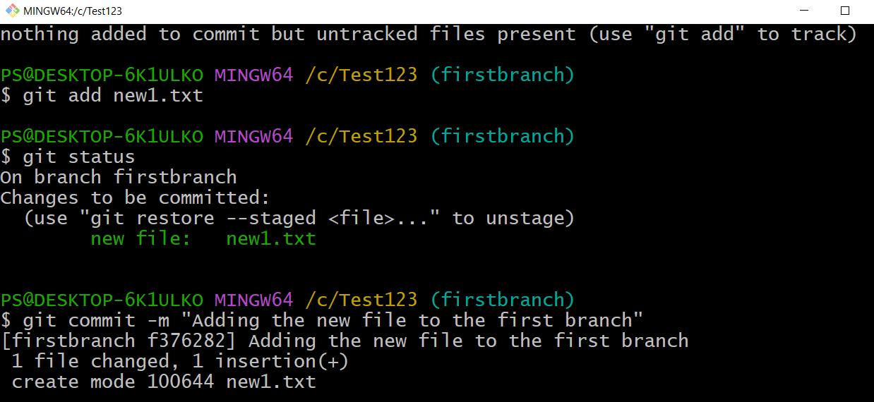
Git Commands
To show merging
Create a file in new branch and commit

Slide 19
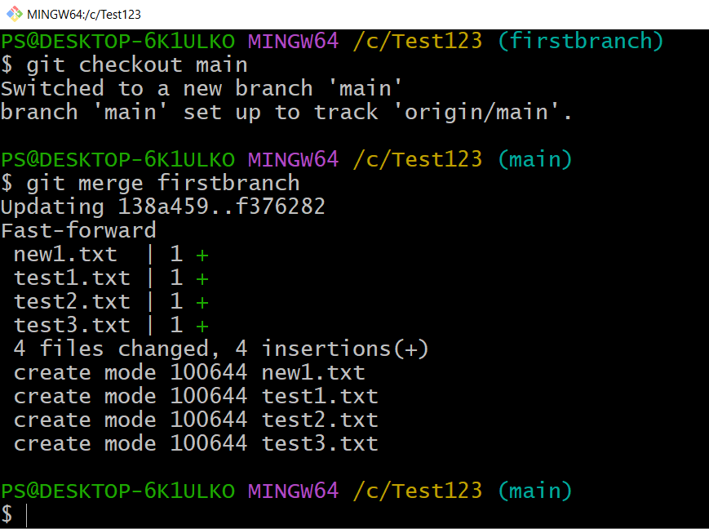
Git Commands
To show merging
Go to main branch
git merge firstbranch

Slide 20
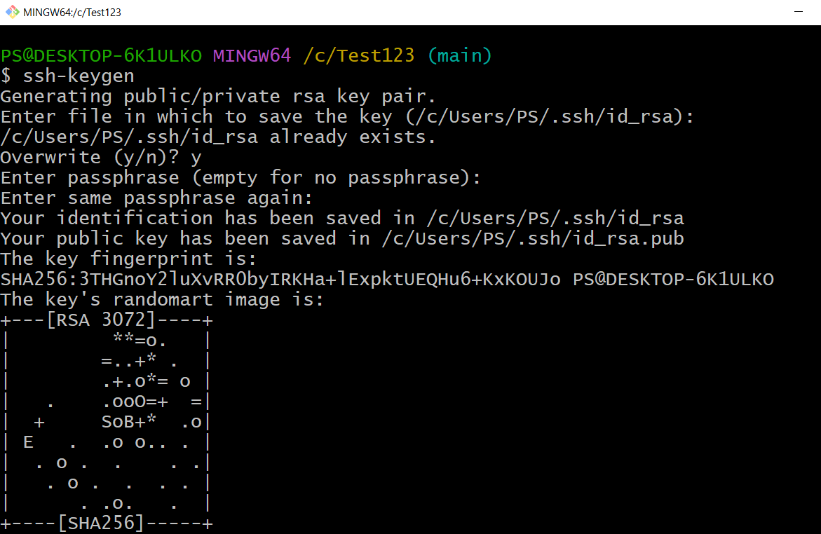
Pushing the files to Github repository
To sync the files of local repo to remote repo, create a ssh key.
ssh-keygen

Slide 21
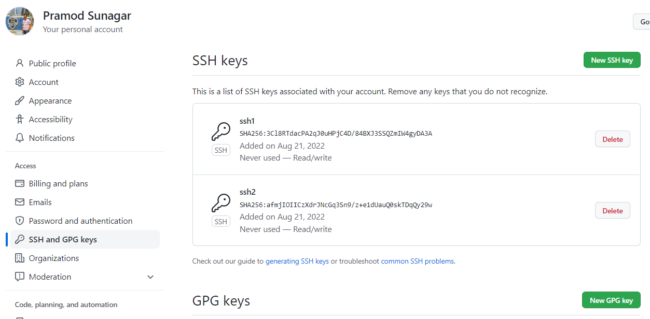
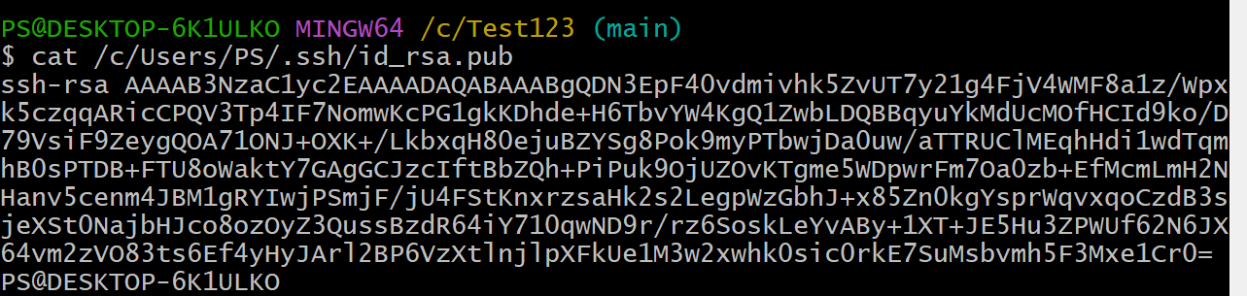
Pushing the files to Github repository
To add the ssh key go to github account.
go to setting
go to SSH and GPG Keys
Click on new ssh key
Add title and copy the ssh keys from the command prompt to the ssh key and save.

Slide 22
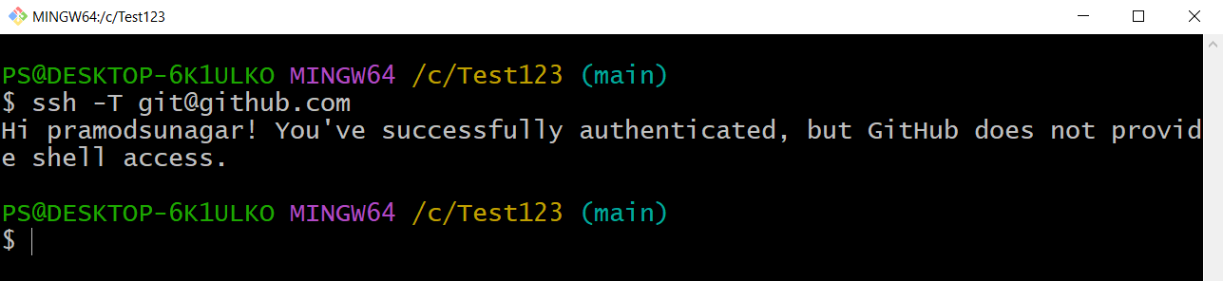
Pushing the files to Github repository
To authenticate the SSH Key type
ssh -T git@github.com

Slide 23
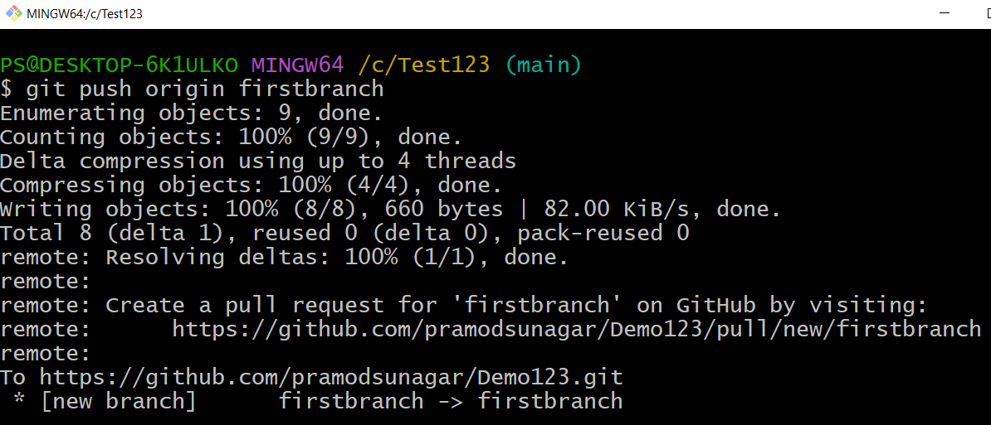
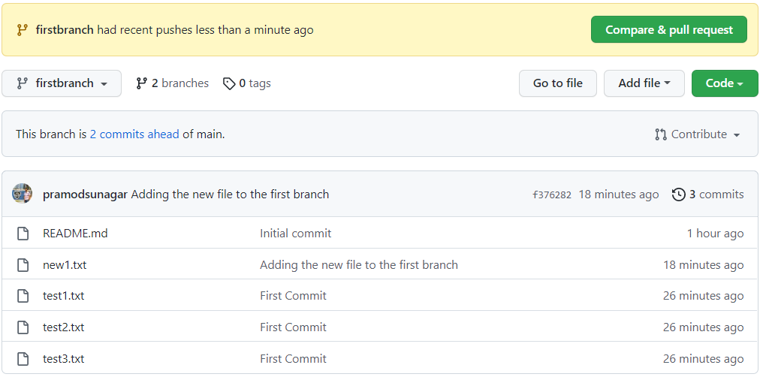
Pushing the files to Github repository
Push all the files
git push origin firstbranch
git push origin main

Slide 24
Thank You

