Slide 1
MINI-PROJECT-REVIEW-II
On
“CAR PRICE PREDICTION ANALYSIS”
DEEKSHITH N :4AD22CI009
PRASHANTH SINGH H S :4AD22CI040
SHAMANTH M :4AD22CI047
AKASH A S :4AD22CI400
Under the guidance of
Prof . VANITHA NAIK
Assistant Professor
Dept. of CSE-AI & ML
ATMECE, Mysuru
ATME COLLEGE OF ENGINEERING
DEPARTMENT OF CSE-AIML

Slide 2
CONTENTS
Introduction
Existing System, Problem Statement, Proposed System
Literature Survey
System Requirements
System Methodology/Flow Diagram
Implementation
Conclusion
Future Scope
References

Slide 3
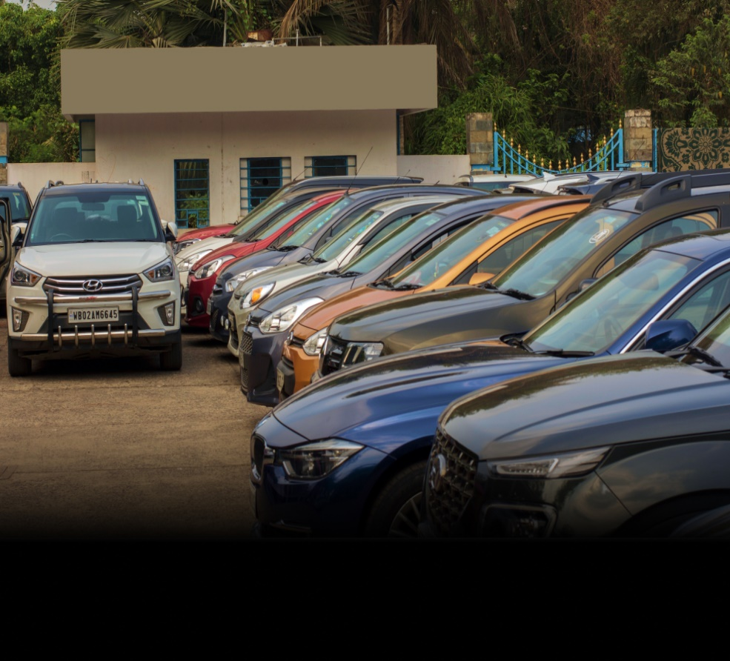
Introduction
The process of buying and selling used cars has become increasingly dynamic, with buyers seeking value for money and sellers aiming for competitive pricing.
Accurate price estimation plays a vital role in bridging the gap between buyers and sellers, ensuring fair and transparent transactions.
Factors such as car brand, model, year of manufacture, mileage, and overall condition significantly influence the market value of a vehicle.
Machine learning techniques offer innovative solutions by analyzing these factors to predict car prices with high accuracy.

Slide 4
Existing System
In the current used car market, pricing relies heavily on traditional valuation methods, often performed manually or using basic statistical tools.
These methods may not account for the intricate relationships between different factors like mileage, car age, and brand, leading to inaccurate and inconsistent pricing.
Problem Statement
Accurately predicting the price of a used car is a complex task due to the numerous factors involved. Manual methods or basic tools often result in significant errors, either undervaluing or overvaluing vehicles.
This inconsistency poses challenges for both buyers and sellers, impacting market trust and efficiency.
Proposed System
The proposed system leverages advanced machine learning algorithms to develop a reliable and accurate car price prediction model. By analyzing historical data and utilizing features such as brand, model, mileage, and year of manufacture, the system aims to predict car prices more accurately. It integrates a user-friendly web interface using Flask, allowing users to input car details and receive real-time price predictions.

Slide 5
LITERATURE SURVEY
Title: "Machine Learning Techniques to Predict the Price of Used Cars: Predictive Analytics in Retail Business"
Authors: Chejarla Venkat Narayana, Syed Bademiya, Chinta Lakshmi Likhitha, Karre Kusumanjali
Year: 2021
Summary: This paper develops a predictive model for used car price estimation using Linear Regression, Decision Tree, and Random Forest. Random Forest achieves the best accuracy (85%). Preprocessing steps like outlier removal and feature scaling enhance model performance.
Title: "An Automated Car Price Prediction System Using Effective Machine Learning Techniques"
Authors: Santosh Kumar Satapathy, Rutvikraj Vala, & Shiv Virpariya
Year: 2022
Summary: This paper presents a system for predicting second-hand car prices using machine learning models like XGBoost and Random Forest, achieving up to 92.66% accuracy. The model is integrated into a user-friendly web application hosted on Heroku.

Slide 6
Title: "Prediction of Used Car Prices Using Artificial Neural Networks and Machine Learning"
Authors: Janke Varshitha, K. Jahnavi, & Dr. C. Lakshmi
Year: 2020
Summary: This paper investigates various machine learning models, including Linear Regression, Lasso Regression, Ridge Regression, Random Forest, and Deep Neural Networks (10 layers), for predicting used car prices. Random Forest achieved the highest efficiency (RMSE: 0.746, R²: 0.917), followed by Deep Neural Networks (RMSE: 0.766, R²: 0.842). The study emphasizes data preprocessing and normalization to improve model accuracy.
Title: "An Effective Pre-Owned Car Price Prediction Based on Multi Linear Regression Technique"
Authors: Aman Kumar, Dheeraj Singh, Keshav Chauhan, & Guru Prasad M. S.
Year: 2021
Summary: This paper utilizes the Multi Linear Regression technique for predicting the prices of pre-owned cars. It emphasizes the importance of preprocessing steps, such as managing missing data and encoding categorical variables, to enhance model performance. The proposed approach demonstrates efficiency in providing accurate price predictions for used cars.

Slide 7
SYSTEM REQUIREMENTS
Software Requirements:
Programming Language: Python
Web Framework: Flask
Libraries: Pandas, NumPy, scikit-learn, Matplotlib, Seaborn, & others
Frontend: HTML, CSS, JavaScript (for testing on any modern browser)
IDE: PyCharm, VS Code, or Jupyter Notebook
Version Control: Git, GitHub
OS: Cross-platform (Windows, macOS, Linux)
Hardware Requirements:
Processor: Intel i3 or higher
RAM: 4 GB (8 GB recommended)
Storage: 20 GB free space
OS: Windows 10, macOS, or Linux
Internet: For dependencies and updates

Slide 8
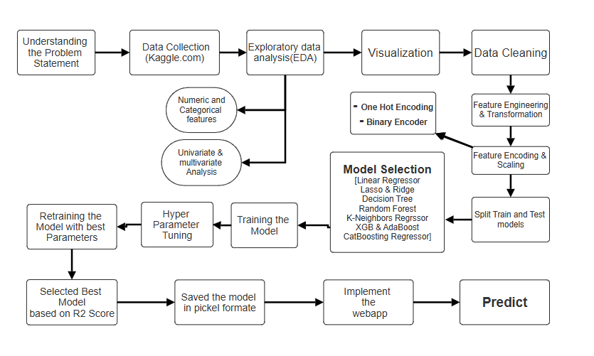
FLOW DIAGRAM

Slide 9
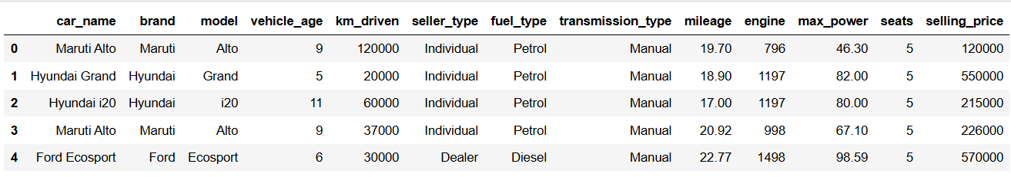
IMPLEMENTATION
The dataset, sourced from Kaggle, provides detailed information on used cars, including features such as car name, brand, model, vehicle age, kilometers driven, seller type, fuel type, transmission type, mileage, engine capacity, maximum power, number of seats, and selling price. These attributes are crucial for analyzing the factors influencing car prices.

Slide 10
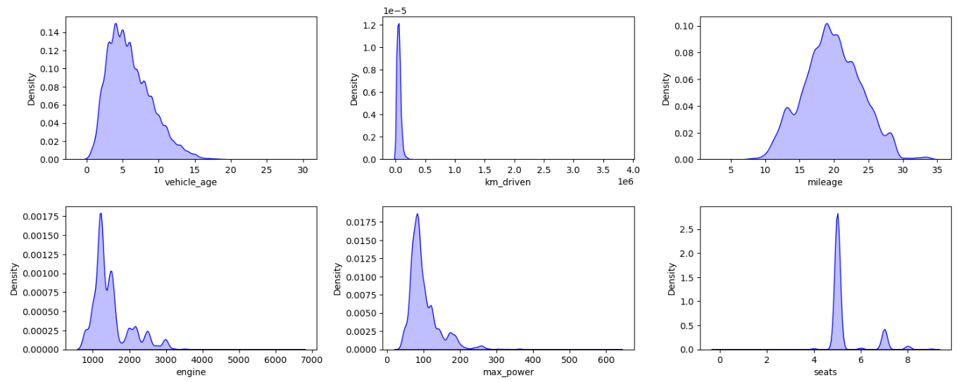
Km_driven, max_power, selling_price, and engine are right skewed and postively skewed.
Outliers in km_driven, engine, selling_price, and max power.

Slide 11
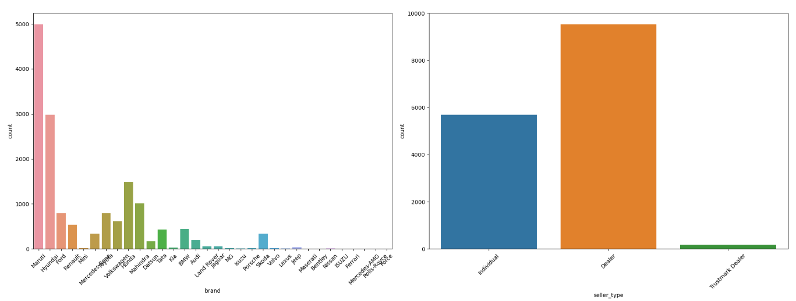
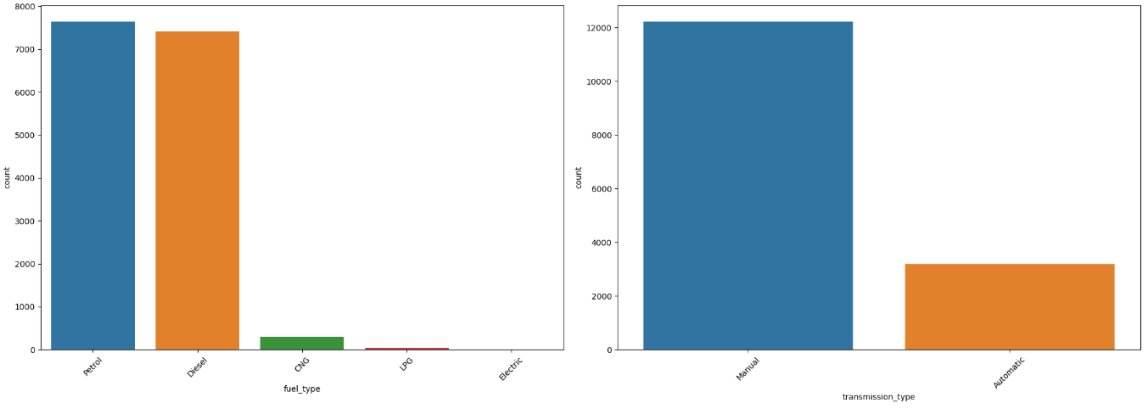

Slide 12
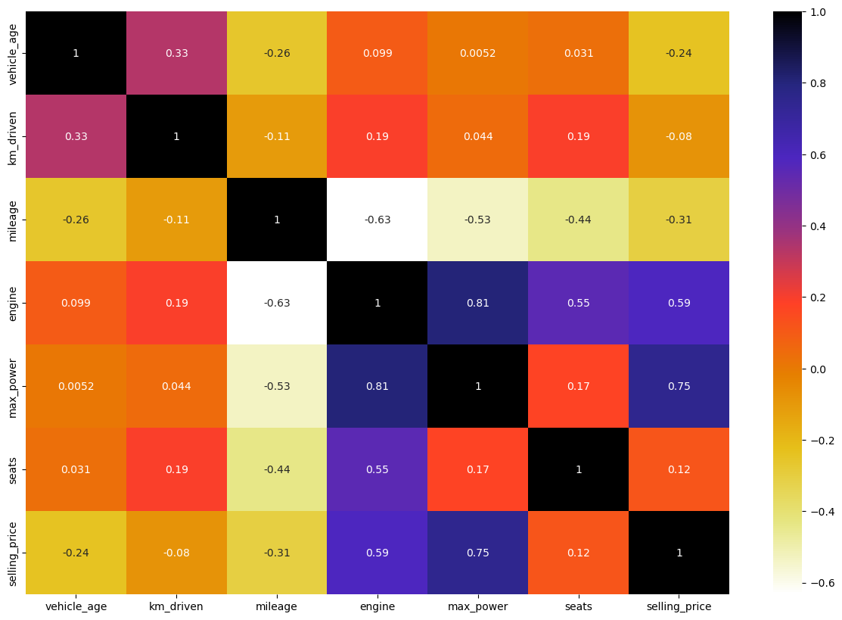
Heatmap for Multivariate Analysis

Slide 13
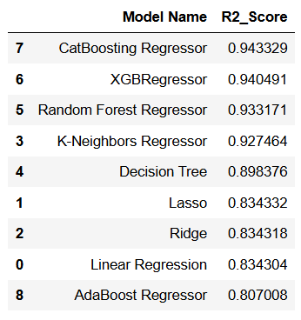
Model Selection
Here should understand the Various Regression models with default values from these models we can choose top 4 with Highest Accuracy score and proceed with HyperParameter Tuning.
The table shows the performance comparison of various regression models based on their R2 Score. The models include CatBoost Regressor, XGBRegressor, Random Forest Regressor, and others. Among these, the CatBoost Regressor achieves the highest R2 score of 0.9433, followed closely by XGBRegressor with 0.9405, demonstrating their superior accuracy in predicting car prices. These results highlight the effectiveness of ensemble methods like CatBoost and XGBoost over traditional models such as Linear Regression and Decision Trees, which have lower R2 scores.

Slide 14
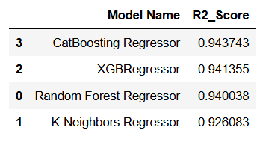
Retraining the Model with best Parameters
This table compares the performance of four regression models using the R2R^2 R2-Score. The CatBoosting Regressor achieves the highest accuracy with an R2R^2 R2-Score of 0.9437, followed closely by XGBoost (0.9414) and Random Forest (0.9400). The K-Neighbors Regressor has the lowest R2R^2R2-Score of 0.9261, indicating slightly less accurate predictions.
Best Model is CATBoost Regressor with 94.54% R2 Score

Slide 15
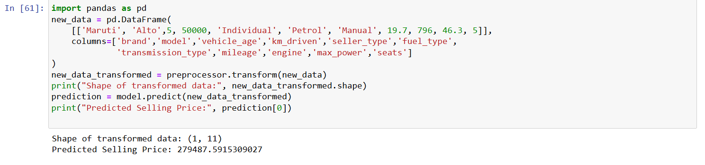
Final Result
We are using the CatBoosting Regressor model for car price prediction because it outperforms other models in terms of R² score and error values. To demonstrate its application, let's take an example where we input details of a Maruti Alto, which is 5 years old, has 50,000 kilometers driven, and is sold by an individual. Additional features like fuel type, transmission, mileage, engine size, and power are also provided. After applying necessary preprocessing steps to the input data, the model predicts the car's selling price to be ₹279,487.59. This example showcases how the trained model can effectively predict prices based on various car attributes.

Slide 16
CONCLUSION
In this project, we have successfully developed a car price prediction model using various machine learning algorithms. The model performance was evaluated using metrics like R2 score, and the results indicated that ensemble methods such as CatBoost Regressor and XGBRegressor outperformed traditional regression models like Linear Regression and Decision Trees, achieving higher accuracy. The project demonstrates the potential of machine learning in automating and enhancing the process of used car price prediction, providing valuable insights for both buyers and sellers in the automotive market.
FUTURE SCOPE
Model Enhancement
Real-Time Predictions
Data Expansion
Addressing Imbalanced Data
Price Trend Analysis

Slide 17
References
    C. V. Narayana, S. Bademiya, C. L. Likhitha, and K. Kusumanjali, "Machine Learning Techniques to Predict the Price of Used Cars: Predictive Analytics in Retail Business," 2021.
    S. K. Satapathy, R. Vala, and S. Virpariya, "An Automated Car Price Prediction System Using Effective Machine Learning Techniques," 2022.
    J. Varshitha, K. Jahnavi, and C. Lakshmi, "Prediction of Used Car Prices Using Artificial Neural Networks and Machine Learning," 2020.
    A. Kumar, D. Singh, K. Chauhan, and G. P. M. S., "An Effective Pre-Owned Car Price Prediction Based on Multi Linear Regression Technique," 2021.
    Annina S., M. S. D., and R. B., "An Overview of Machine Learning and its Applications," International Journal of Electrical Sciences & Engineering (IJESE), 2015, pp. 22-24.

Slide 18
K. Storchmann, "On the depreciation of automobiles: An international comparison," Department of Economics, Yale University, 2004, pp. 372-373.
S. Gupta, "Regression vs. Classification in Machine Learning," Oct. 6, 2021. [Online]. Available: https://www.springboard.com/blog/data-science/regression-vs-classification/. [Accessed: Mar. 6, 2022].
J. Frost, "Overfitting Regression Models," Statistics by Jim, 2022. [Online]. Available: https://statisticsbyjim.com/regression/overfitting-regression-models/. [Accessed: Apr. 18, 2022].
Skikit-learn, "Supervised learning." [Online]. Available: https://scikit-learn.org/stable/supervised_learning.html#supervised-learning. [Accessed: Mar. 12, 2022].
A. Jain, "A Complete Tutorial on Ridge and Lasso Regression in Python," Jan. 28, 2016. [Online]. Available: https://www.analyticsvidhya.com/blog/2016/01/ridge-lasso-regression-python-complete-tutorial/. [Accessed: Mar. 12, 2022].

Slide 19


