Slide 1
Development-of-Novel-Quantum-Algorithms: Exponential quantum speedup in simulating coupled classical oscillators
Shamarita Deb, Priyabrata Bag

Slide 2
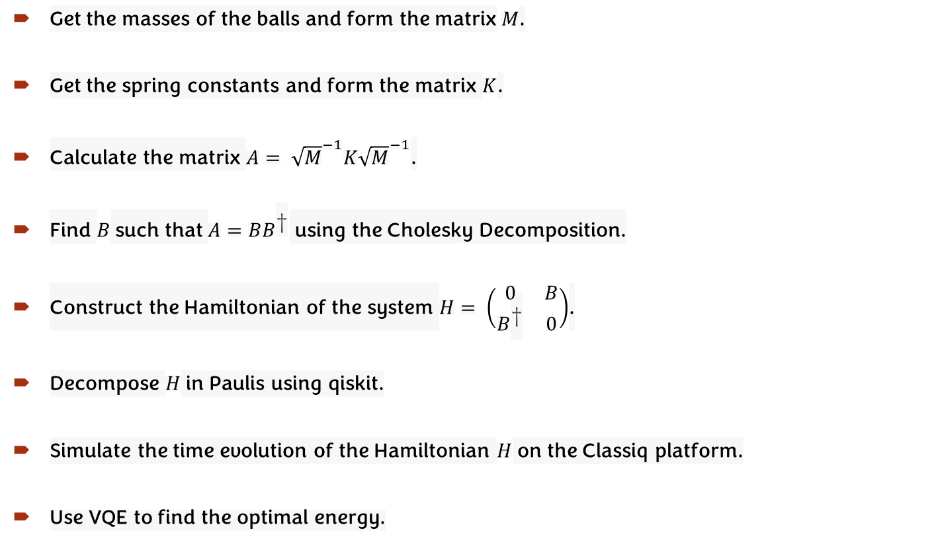
Algorithm
Get the masses of the balls and form the matrix$M$.
Get the spring constants and form the matrix $K$.
Calculate the matrix $A= {\sqrt{M}}^{−1}K{\sqrt{M}}^{−1}$.
Find $B$ such that $A=BB^{\text{†}}$ using the Cholesky Decomposition.
Construct the Hamiltonian of the system $H= \left(\begin{matrix}0 & B \\ B^{\text{†}} & 0\end{matrix}\right)$.
Decompose $H$ in Paulis using qiskit.
Simulate the time evolution of the Hamiltonian $H$ on the Classiq platform.
Use VQE to find the optimal energy.

Slide 3
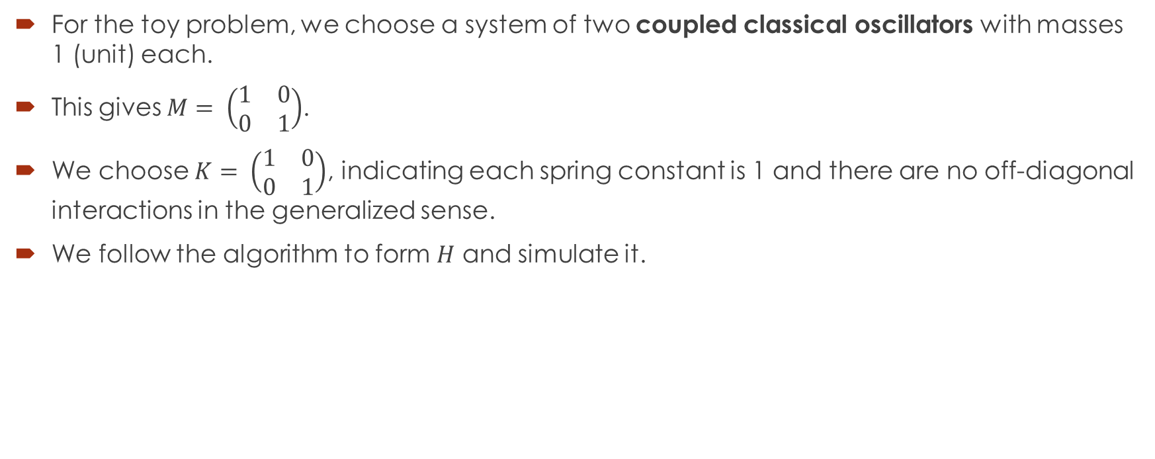
Toy Problem
For the toy problem, we choose a system of two coupled classical oscillators with masses 1 (unit) each.
This gives $M= \left(\begin{matrix}1 & 0 \\ 0 & 1\end{matrix}\right)$.
We choose $K= \left(\begin{matrix}1 & 0 \\ 0 & 1\end{matrix}\right)$, indicating each spring constant is 1 and there are no off-diagonal interactions in the generalized sense.
We follow the algorithm to form $H$ and simulate it.

Slide 4
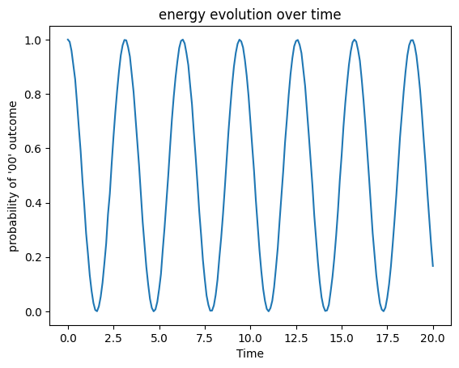
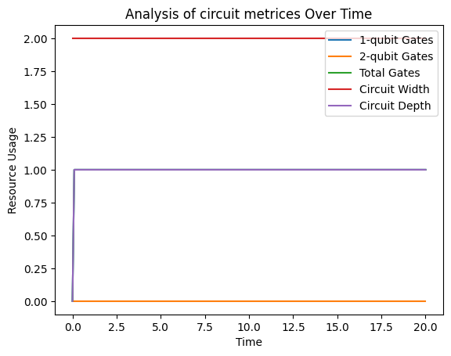
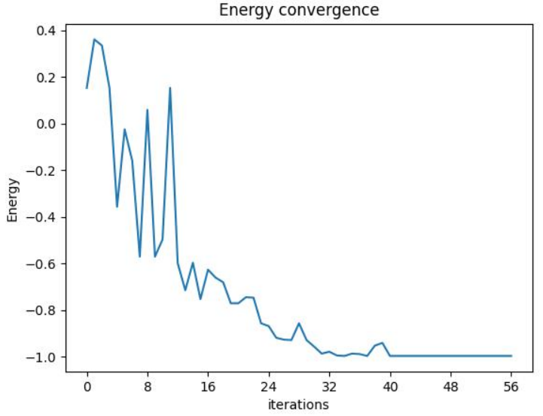
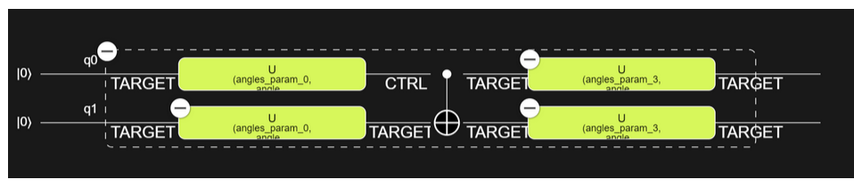
Toy Problem

Slide 5
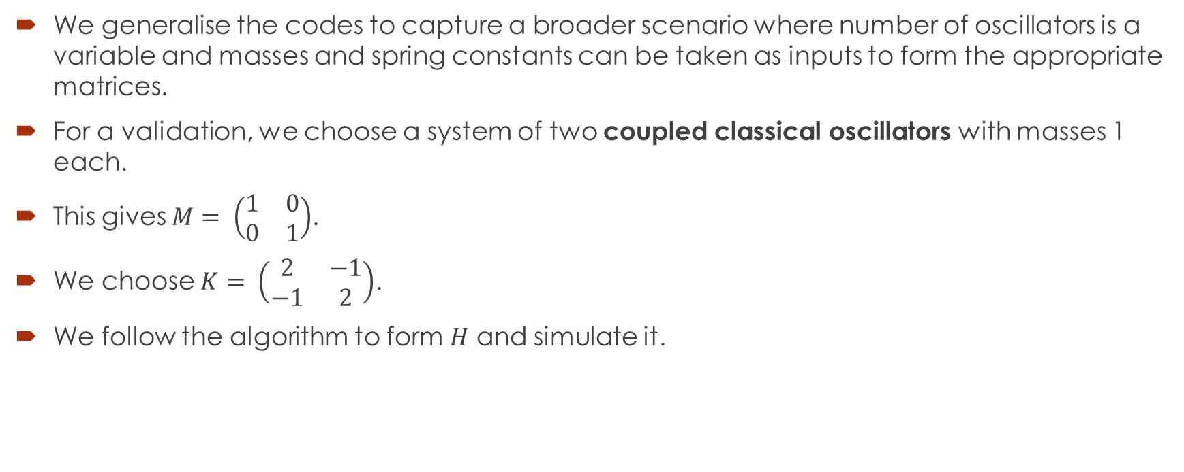
General Problem
We generalise the codes to capture a broader scenario where number of oscillators is a variable and masses and spring constants can be taken as inputs to form the appropriate matrices.
For a validation, we choose a system of two coupled classical oscillators with masses 1 each.
This gives $M= \left(\begin{matrix}1 & 0 \\ 0 & 1\end{matrix}\right)$.
We choose $K= \left(\begin{matrix}2 & −1 \\ −1 & 2\end{matrix}\right)$.
We follow the algorithm to form $H$ and simulate it.

Slide 6
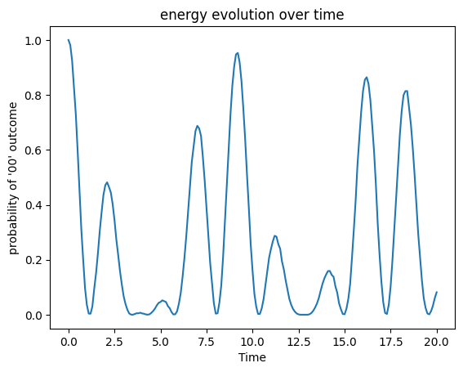
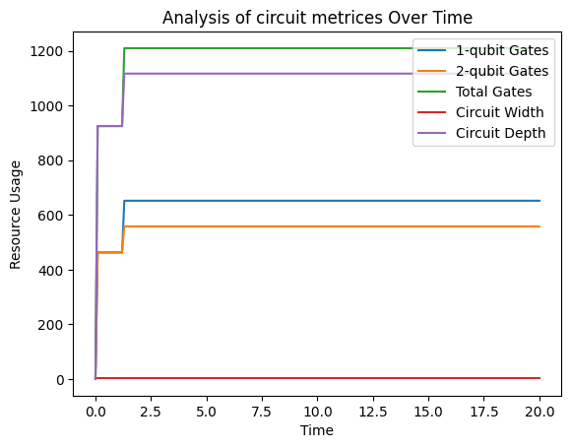
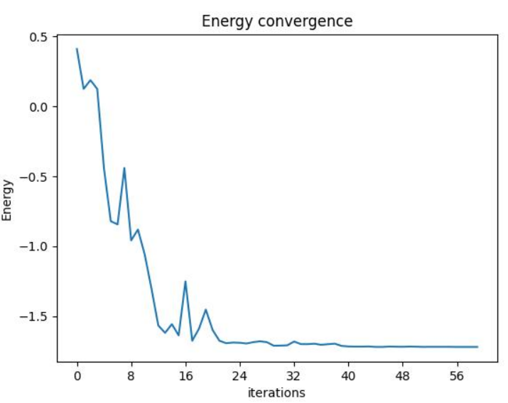
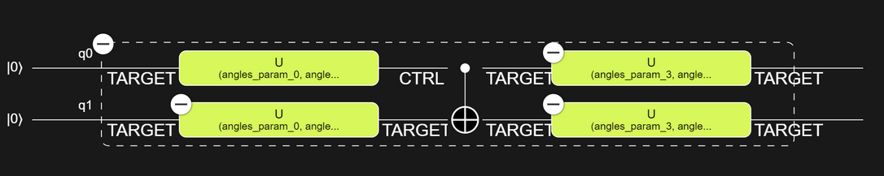
General Problem

Slide 7
Future Application
This model also has potential in following applications
circuits with capacitors and inductors
models of neuron activity
vibrations in molecules
materials and mechanical structures
glued tree

Slide 8
Limitations
This model has the following limitations:
not implemented in hardware
optimization of used resources
extension to higher dimension form 1D
Some of these limitations are achievable in due times

Slide 9
References
[Reference to the Theoretical Results] https://journals.aps.org/prx/abstract/10.1103/PhysRevX.13.041041
[Classiq Documentation on Glued Trees Algorithm] https://docs.classiq.io/latest/explore/algorithms/glued_trees/glued_trees/?h=tr#quantum-algorithm
[Classiq Documentation on VQE] https://docs.classiq.io/latest/explore/community/basic_examples/vqe/vqe/
[Reference to Womanium Logo] https://github.com/womanium-quantum
[Reference to the Image of Coupled Oscillators] https://rjallain.medium.com/the-physics-of-coupled-oscillators-ce2005f9bccd

Slide 10
Thank you

