Slide 1

Movie Recommendation Engine
Md. Shamaun Nabi (18201050)
Md. Musfiqur Rahman (18201054)
Al Amin (18201063)

Slide 2
INTRODUCTION
This data set contains information about movies. Which is collected from The Movie Database (TMDb), including user ratings and revenue.

Slide 3
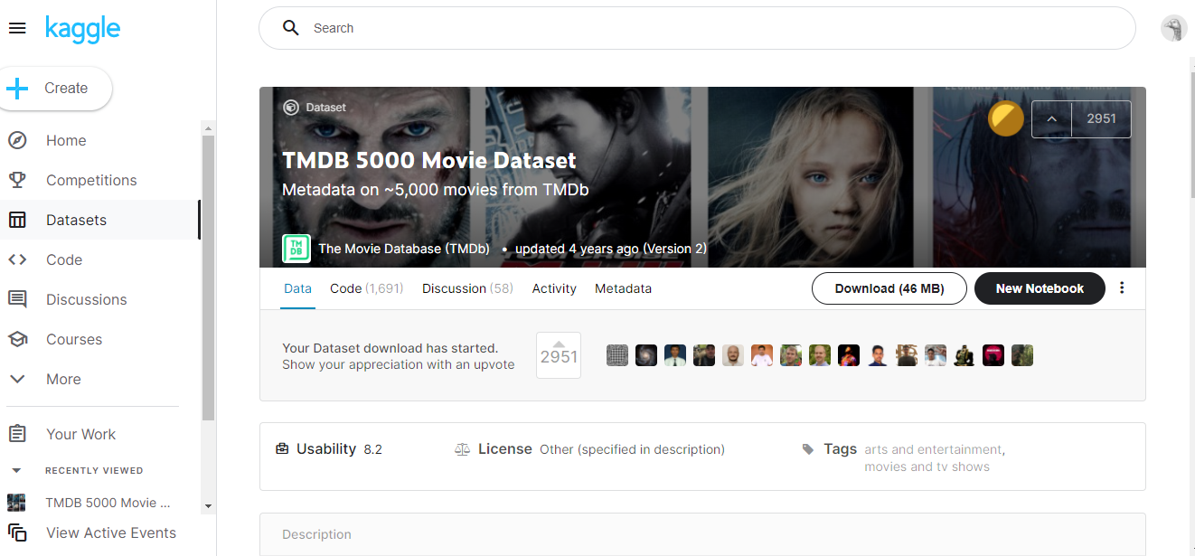
Dataset

Slide 4
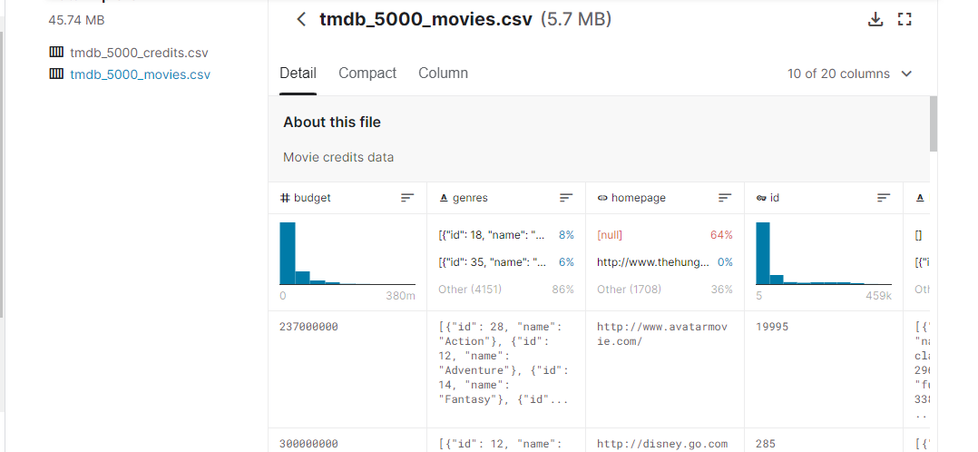
Dataset Description

Slide 5
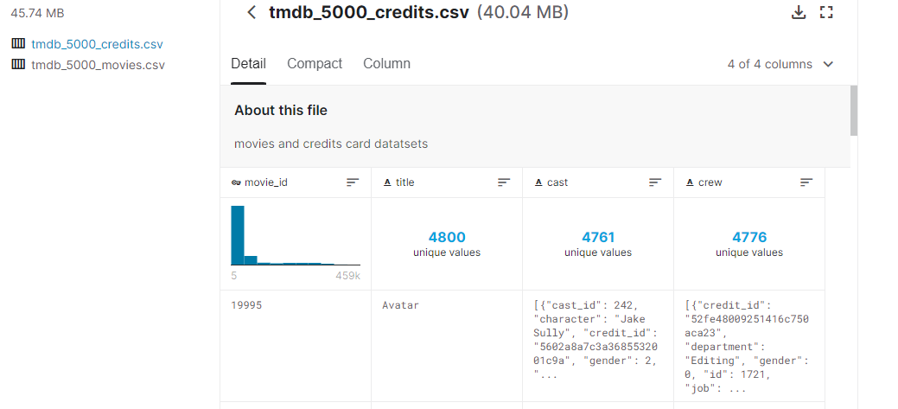
Dataset Des. Cont..

Slide 6
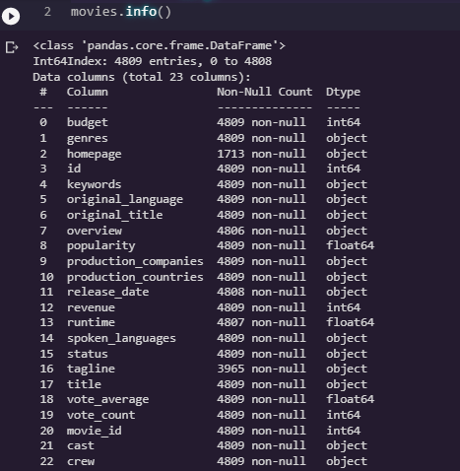
Dataset Des. Cont..
Genres
Id
Keywords
Overview
Title
Cast
Crew

Slide 7
THANKS

