Slide 1

Confidential - Microsoft Internal Only

Slide 2

Use cases: Real Time Actions (Supply Chain Agent)
Partner: Airowire Networks Pvt Limited
Hackathon Team
Aditya Hiremath
Prerana Jatti
Shambhavi Patil
Chandana H
Kiran S Mahindrakar
Confidential - Microsoft Internal Only

Slide 3
Solution Overview
Feature | What is this feature | Solution / Offer
Logistics Distribution Investigation | Analyze delays, operational risks, and inventory exposure using evidence-based business rules. | Supply Chain Intelligence & Response Platform
 |  | 🏭 Manufacturing & Logistics 📊 Operations Dashboard
 |  | ⚠ Risk Assessment Engine 📦 Inventory Analysis
 |  | o Approval Workflow

Slide 4
Reference Architecture
https://learn.microsoft.com/en-us/azure/architecture/browse/
User Experience
React dashboard: overview, investigation, risk evidence, approval status
Supply Chain Intelligence & Response Platform is a rule-based, evidence-grounded decision-support system. A React console calls a Python FastAPI backend that applies transparent business rules to data in a Fabric Lakehouse (or a local fallback), keeping consequential actions under human control.
Data Agent
M365 Copilot only if custom actions are confirmed
Key Architectural Components
FastAPI backend exposes health, overview, asset listing and investigation
endpoints.
Deterministic rule engine returns rule IDs, observed values, thresholds and severity; no ML model.
Fabric Lakehouse / OneLake holds raw and cleaned data; local CSV/Parquet is the fallback.
Human approval and audit: recommendations only; no action is claimed as executed.
Application & Intelligence
FastAPI endpoints, data retrieval, rule-based risk aggregation
Data Foundation
Fabric Lakehouse / OneLake; local CSV/Parquet fallback
Governance
Source evidence, timestamps, thresholds, human approval, audit
Confidential - Microsoft Internal Only

Slide 5
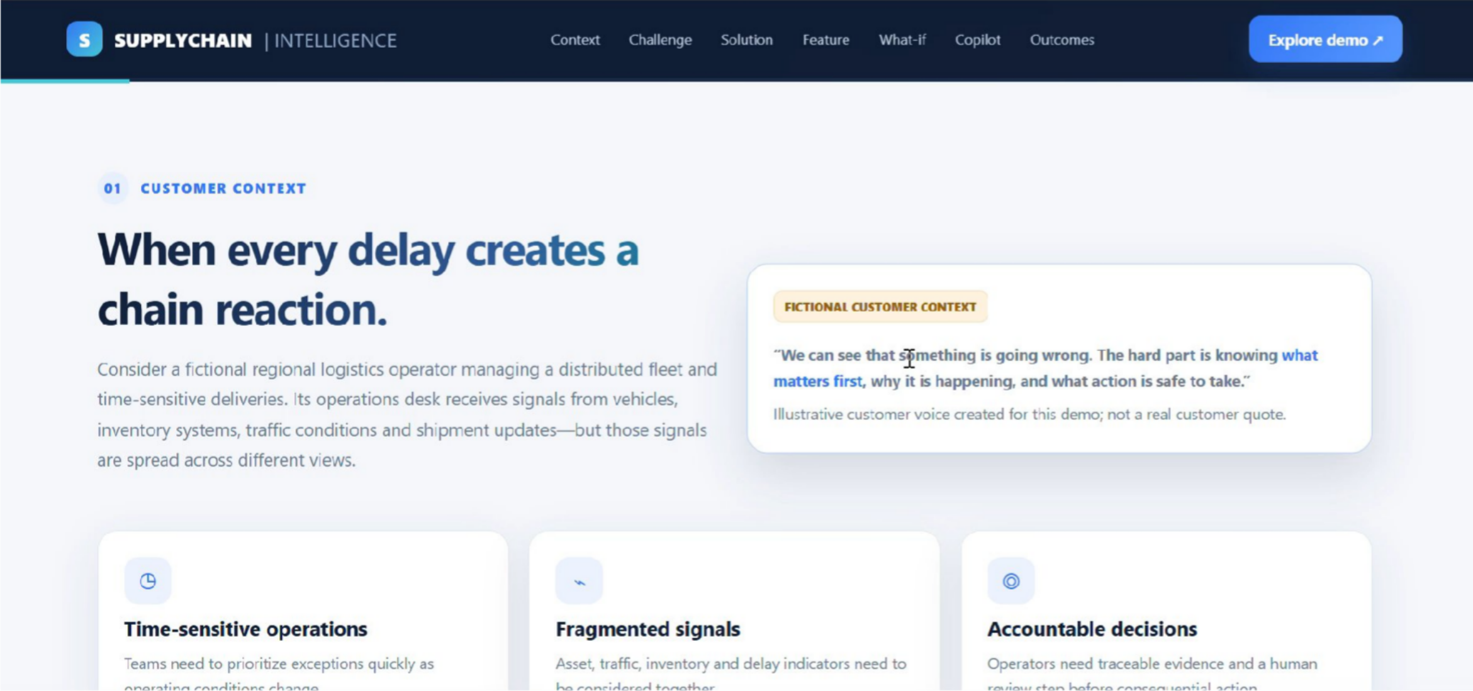
Solution Demonstration video
< add mp4 video here and separately upload in tech data folder >
Confidential - Microsoft Internal Only

Slide 6






Supply Chain Intelligence & Response Platform
Microsoft
Contact: Chandana H
Business Challenge
Operations teams struggle to trace logistics disruptions, inventory and demand exposure, and operational risk across disconnected data, which delays decisions and leaves no evidence trail.
Technical Solution – Supply Chain Intelligence & Response
A rule-based, evidence-grounded decision-support system: a React console and Python FastAPI backend apply transparent rules to Fabric Lakehouse data and recommend actions for human approval.
Industry | Target Users
Manufacturing & logistics operations
Users: operations teams, analysts
Logistics disruption investigation
Illustrative: Kaggle logistics data
Technical Components
Python FastAPI backend
Rule-based risk engine
Optional Copilot Studio agent
Workloads
Logistics delay investigation
Rule-based risk assessment
Inventory vs demand checks
Recommendations & approval
Azure Cost
Capacity / SKU: F2
1-year RI - $156/month | $1,872/year
PAYG equivalent if continuously active - $262.80/month |
$3,153.60/year
Azure Pricing Calculator
Reference Architecture
How it works
Customer Deployments
Kaggle logistics dataset Raw CSV kept unchanged
1
Step 1 – Connect: ingest Kaggle data into a Fabric Lakehouse.
Illustrative scenario – hackathon demo
Step 2 – Define: configurable thresholds and rule IDs.
Illustrative logistics operations team
FabCon to Frontier Hackathon
Fabric Lakehouse / OneLake
Raw and cleaned tables; local fallback
2
Use case:
Investigate logistics delays with evidence-backed rules.
Deterministic rules & thresholds
3 Step 3 – Build: FastAPI services
FastAPI services
Step 4 – Govern: human approval for consequential actions.
Expected value:
Potential faster, explainable investigations; no measured savings claimed.
Live customer references & measured outcomes: None yet; demo uses Kaggle data, not live company data.
4
Recommendations with human approval Evidence, severity & audit trail
5
Step 5 – Operate: validate, demo and submit with a fallback.
Source: FabCon to Frontier execution plan. Kaggle data is not live company data; Fabric and Copilot availability require validation.

Slide 7

Team Microsoft
< this is optional and it will be used for marketing purpose by Tech-data and Microsoft Team >
Confidential - Microsoft Internal Only

