Slide 1
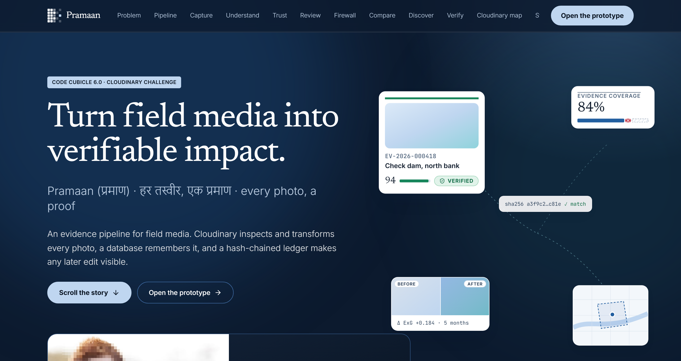
CODE CUBICLE 6.0 · CLOUDINARY TRACK (PS-02)
Pramaan (प्रमाण)
Proof for Every Photo: The Verifiable Field Media Pipeline
An evidence pipeline that turns unstructured field photos into cryptographic, explainable proof for CSR, climate & public infrastructure monitoring. Every photo carries an unbroken chain of custody from capture to report.
CORE IMPLEMENTATION STACK
Next.js 15 (App Router) · Cloudinary AI · Supabase PostGIS · LangGraph + Gemini
INTEGRITY GUARANTEE
8-Signal Explainable Trust Engine · Generative Firewall · Tamper-Evident Ledger

Slide 2
THE PROBLEM · GROUND REALITY
Visual claims without cryptographic custody fail under scrutiny.
Over ₹35,000 Cr in annual Indian CSR and ₹1.4 lakh Cr in public rural schemes rely on field photos that anyone can restage, recycle, or rephotograph off a screen.
01 / THE DATA LOSS
Context-Stripped Ingestion
Field photos arrive via consumer messaging apps that automatically strip EXIF timestamps and GPS coordinates.
Without device-level binding, photos cannot prove where or when they were captured. Auditors are forced to accept unauthenticated image files with zero chain of custody.
RESULT: Metadata vacuum at the point of origin
02 / THE FRAUD ADAPTATION
Photos of Photographs
When India enforced geotagged photo monitoring for MGNREGS, ₹2,600 Cr in fake wage claims were uncovered in Rajasthan in just 7 months.
Fraud then adapted: field operators photographed laptop screens displaying old photos. By July 2025, the Ministry ordered emergency manual verification due to screen recaptures.
RESULT: Re-photographed media bypasses naive checks
03 / THE REGULATORY RISK
Mandated Impact Audits
Companies Act Rule 8(3) mandates independent impact assessments for major CSR projects, yet 42% of non-profits face soaring audit demands without verifiable media pipelines.
Simultaneously, India's DPDP Act requires strict beneficiary consent, making unredacted community photos a serious regulatory compliance liability.
RESULT: Institutional compliance exposure

Slide 3
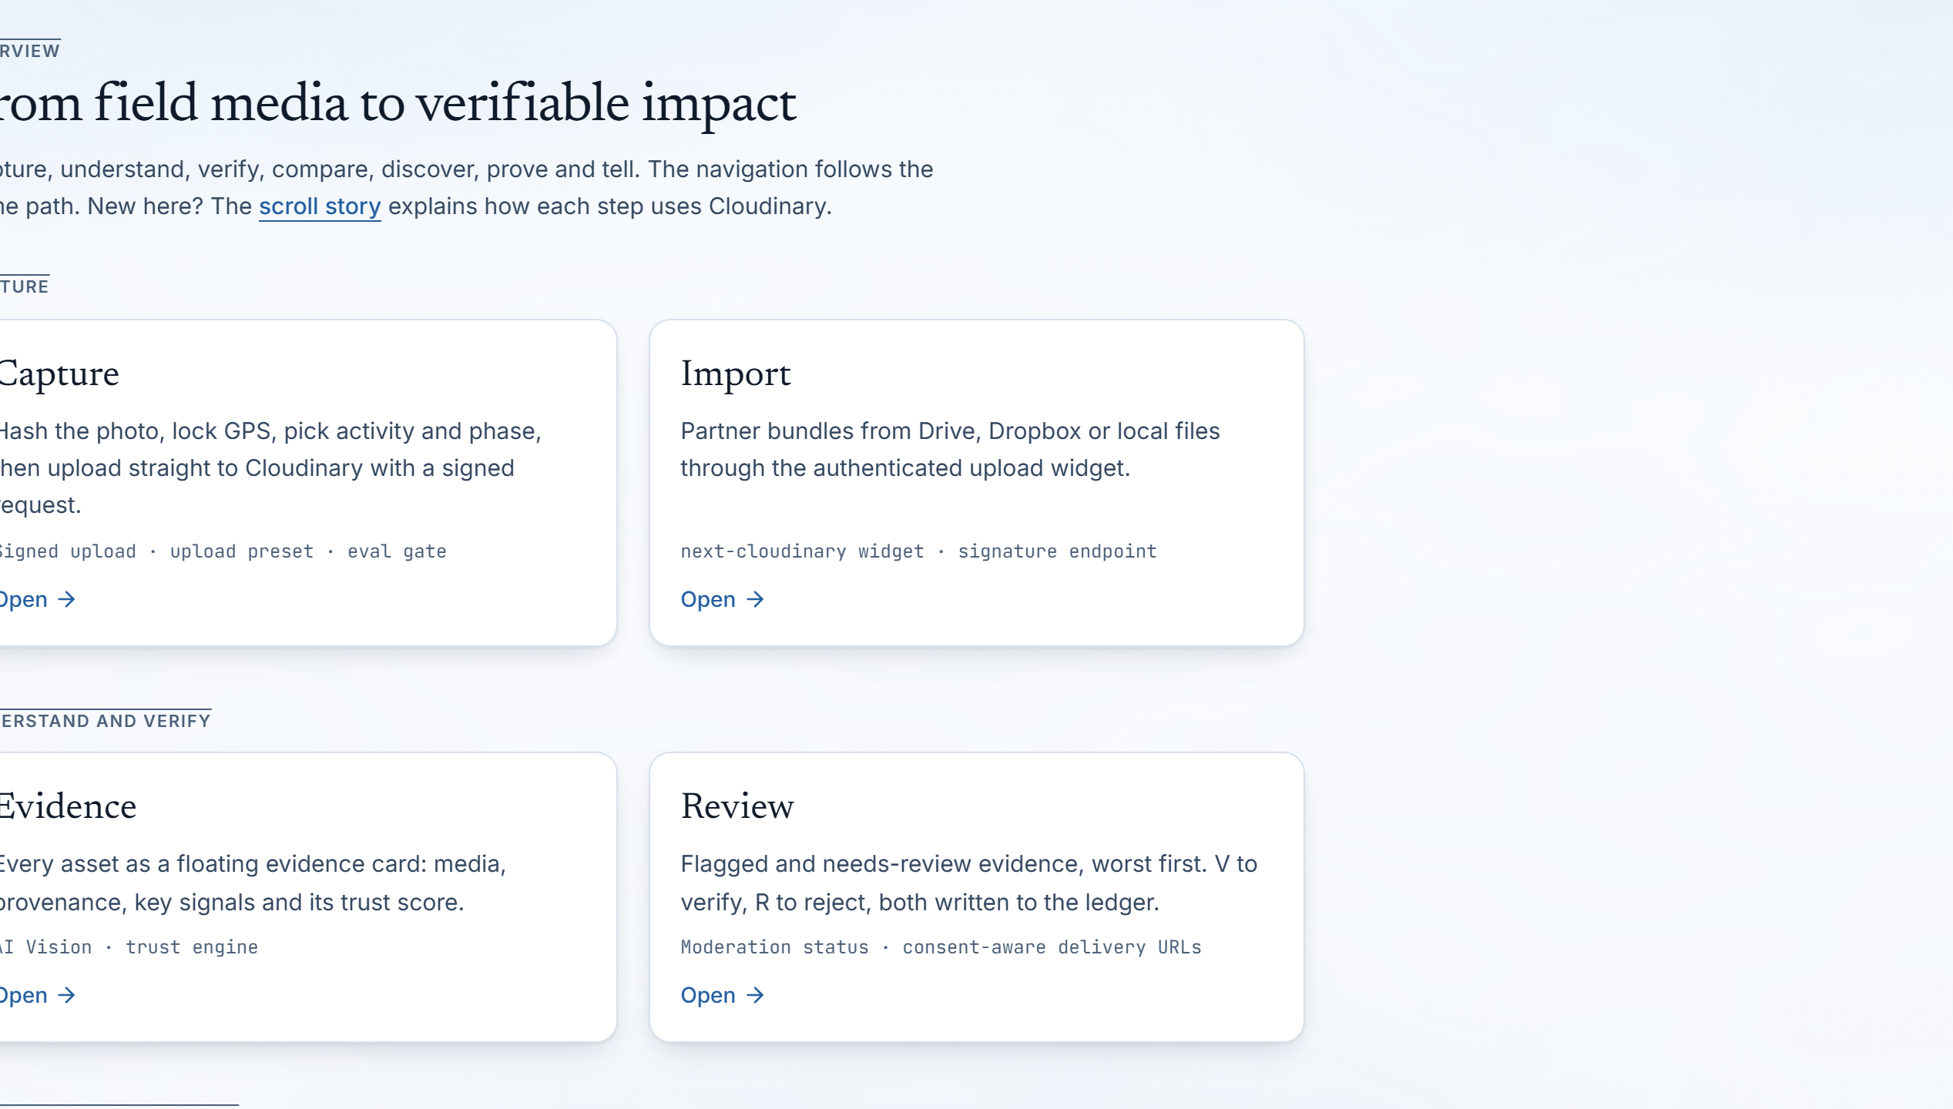
OUR SOLUTION · THE EVIDENCE PIPELINE
From field capture to cited report: every pixel traceable.
Pramaan establishes an unbroken cryptographic chain of custody, ensuring only authentic, in-geofence, non-synthetic media supports institutional impact claims.
01 / CAPTURE
Client-Side Binding & Gating
Device records SHA-256 and locks GPS before direct upload; Cloudinary eval gate rejects corrupted or non-compliant files before storage.
02 / PERCEPTION
Deterministic Visual Analysis
Cloudinary webhook extracts EXIF, computes 64-bit pHash, detects faces for privacy, and queries AI Vision JSON schemas for activity match.
03 / VERIFICATION
Explainable Trust Engine
8 weighted signals score evidence (0-100). Dual hard caps isolate duplicates (pHash <= 4), screen recaptures, and out-of-geofence submissions.
04 / PROVENANCE
Tamper-Evident Ledger & QR
Every decision, derivative, and citation is recorded in a SHA-256 hash-chained ledger. External auditors verify lineage via QR link.

Slide 4
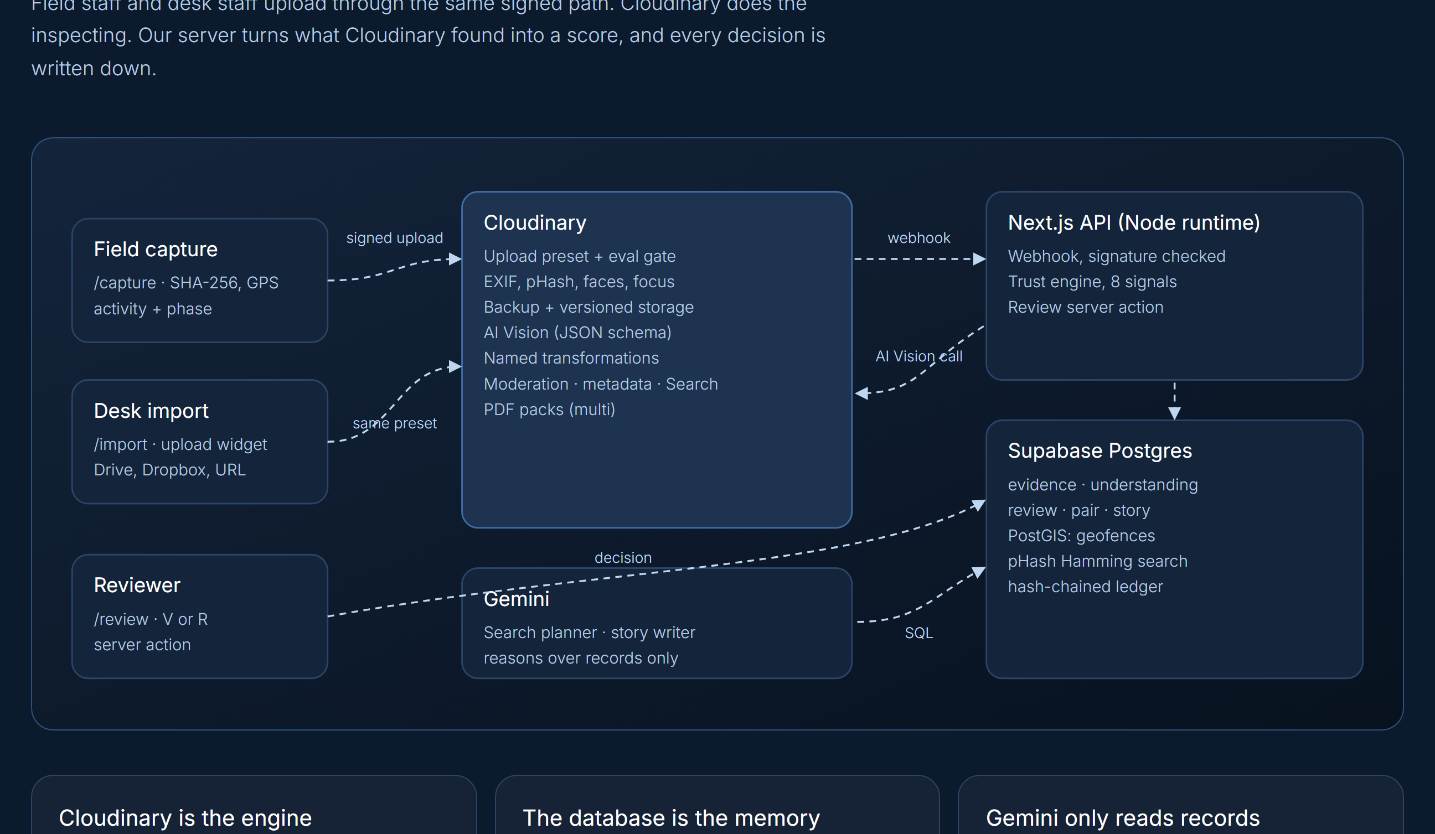
SYSTEM ARCHITECTURE · TECHNICAL IMPLEMENTATION
Perception, reasoning, and custody operating in strict isolation.
Cloudinary inspects and transforms; Supabase enforces spatial boundaries and cryptographic custody; Gemini reasons strictly over structured records.
INGESTION & PERCEPTION
Cloudinary Media Engine
Signed direct uploads restricted to upload presets. Cloudinary computes 64-bit perceptual hash, extracts EXIF, detects faces, and executes AI Vision with JSON schemas.
VERIFICATION & CUSTODY
PostGIS & Trust Engine
Next.js executes 8-signal scoring math. Supabase PostGIS verifies geofence containment with 150 m tolerance. Bitwise popcount pHash matching detects reused media. All events written to SHA-256 ledger.
AGENTIC REASONING
LangGraph & Gemini
Gemini acts as an auditor, not an evidence generator. Orchestrated by LangGraph with human-in-the-loop checkpoints, generating impact reports citing evidence IDs.

Slide 5
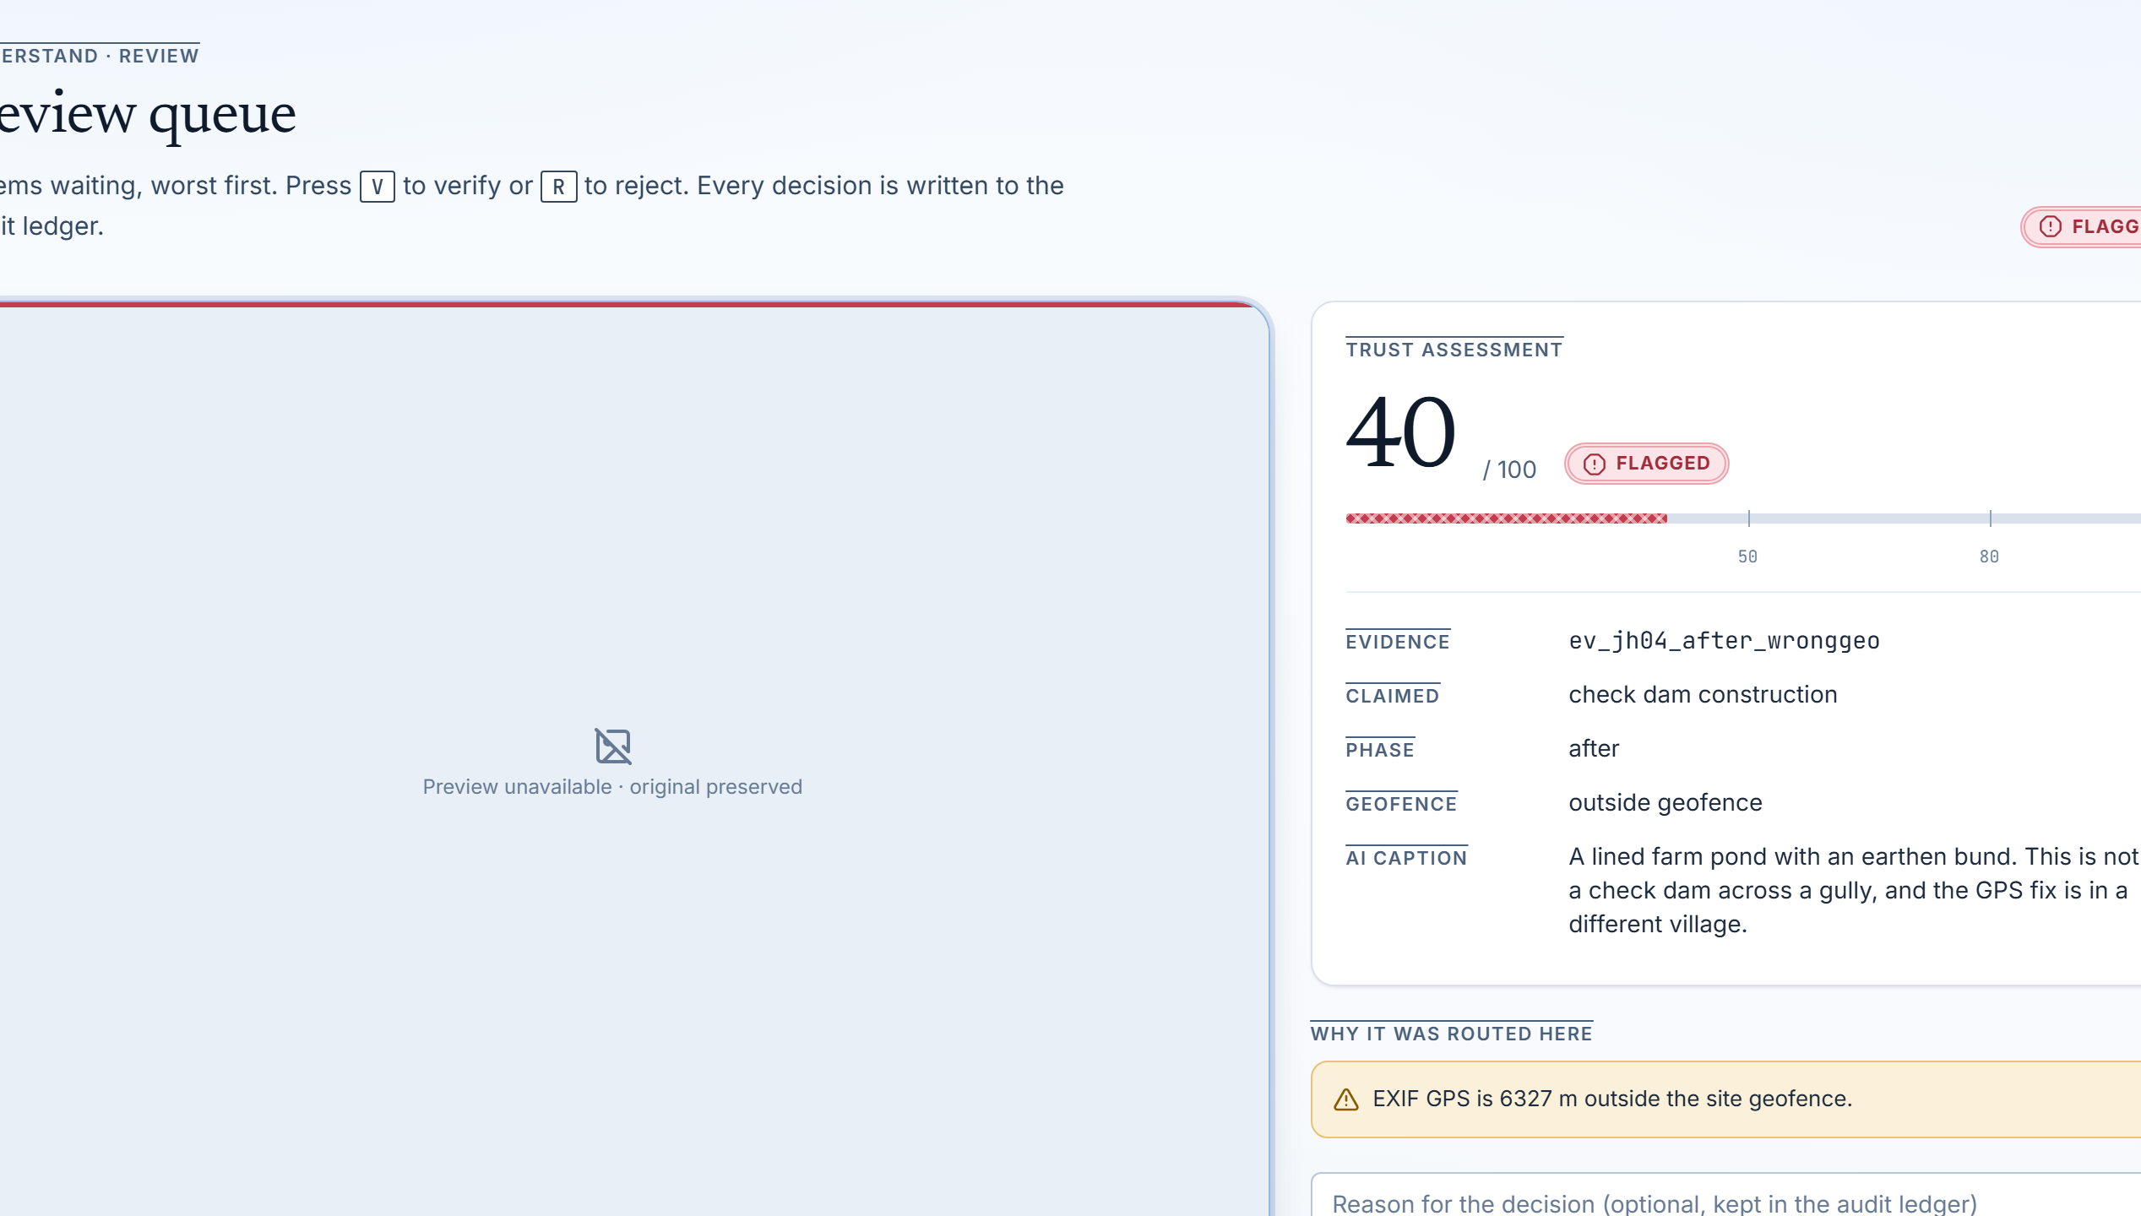
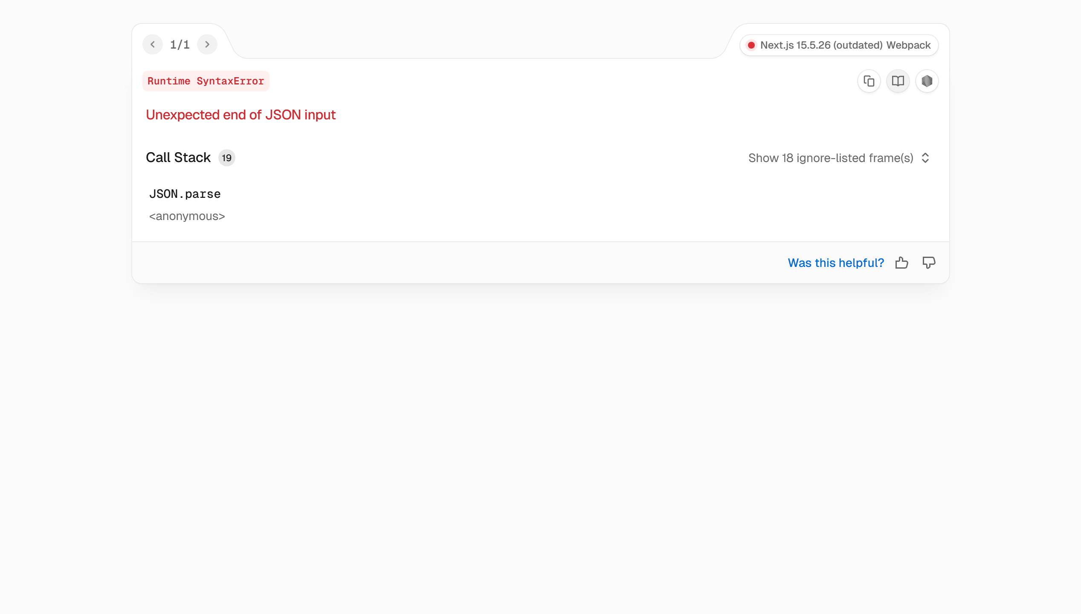
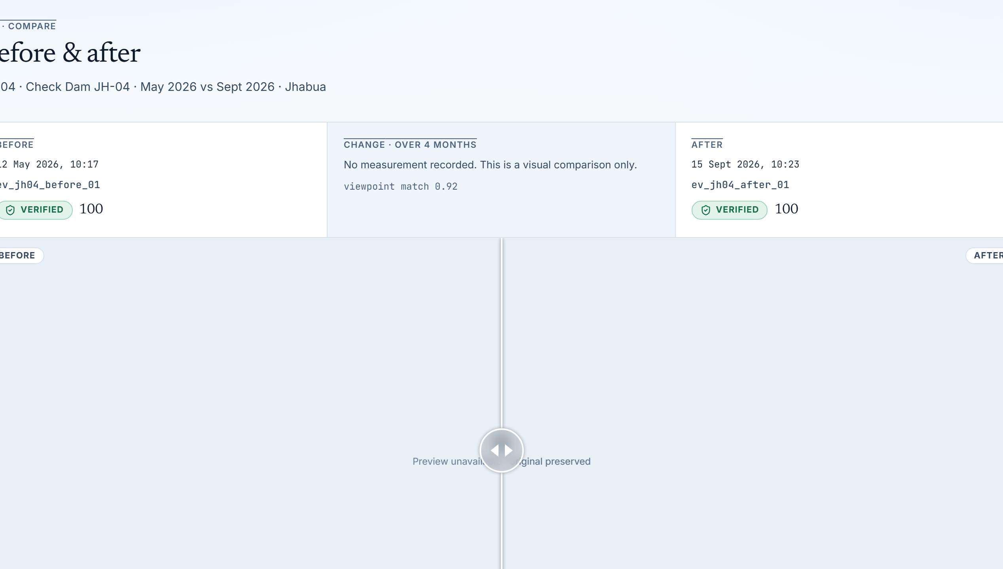
CORE PRODUCT EXPERIENCE · HUMAN VERIFICATION
Explainable trust scoring replaces black-box guessing.
Reviewers inspect flagged media with transparent signal breakdowns, impact claims reflect verified evidence, and temporal change is proven through baseline alignment.
STEP 01 / MODERATION
Review Queue & Hard Flags
Evidence ev_jh04_after_wronggeo flagged with Trust Score 40. Alert: 'EXIF GPS is 6,327 m outside site geofence.' Hotkeys V (verify) and R (reject) commit decisions directly to audit ledger.
STEP 02 / CLAIMS
Impact Claims Coverage
Claims scored solely against verified proof. Check dam construction: Strong (5/5 verified). Water retention: Moderate (4/6). Bank vegetation: Weak (2/6). Unverified and flagged photos are mathematically excluded.
STEP 03 / TEMPORAL PROOF
Before & After Alignment
Interactive comparison slider locks baseline dry gully (May 2026) against completed post-monsoon check dam (Sep 2026) from identical surveyed vantage. Proves physical structure and water impoundment over time.

Slide 6
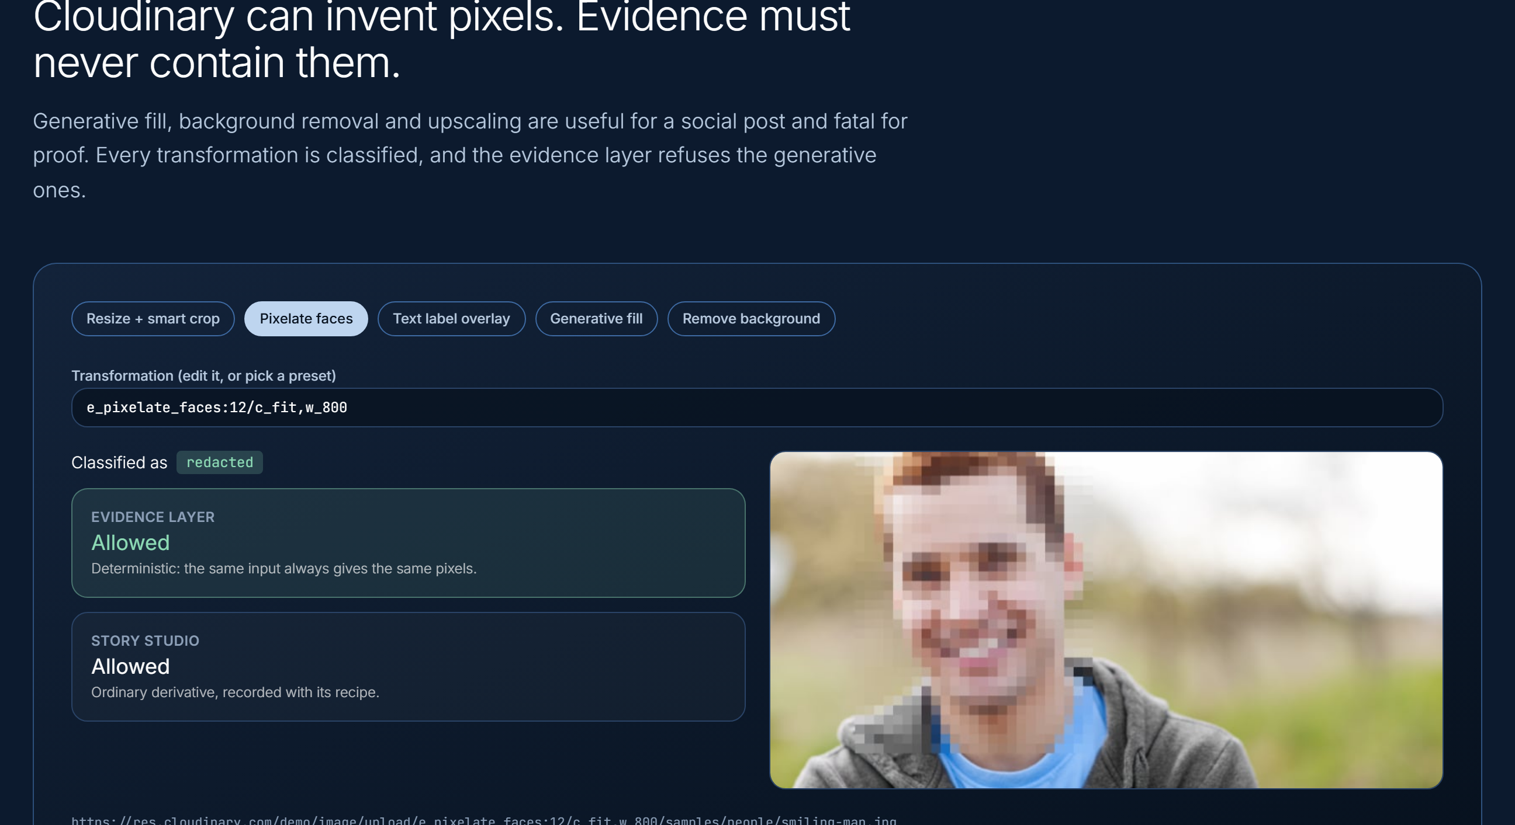
TECHNICAL INNOVATION · INTEGRITY ENGINEERING
Deterministic perception paired with agentic reasoning.
Pramaan enforces strict architectural boundaries so AI models provide high-level reasoning without ever contaminating the underlying evidence layer.
01 / EVIDENCE INTEGRITY
The Generative Firewall (assertGenerativeFirewall)
Transforms classified as transcoded, redacted, edited, or ai_generated. assertGenerativeFirewall throws on e_gen_*, b_gen_fill, background removal, or upscaling. Generative pixels are strictly banned from evidence.
02 / SPATIAL & FORENSIC MATH
PostGIS Containment & 64-bit pHash Matching
check_site_geofence RPC calculates polygon boundary distance; >150 m triggers hard flag cap (Score 40). Bitwise popcount pHash matching in SQL identifies reused media (<=4 bits) even if resized or recompressed.
03 / ORCHESTRATION & GROUNDING
LangGraph 6-Agent Pipeline with HITL
Specialized agents (understand, organize, analyze, identify, compare, synthesize, discover, report). Flagged evidence halts execution at HITL checkpoint. Uncited claims are pruned; search loops capped at 3.

Slide 7
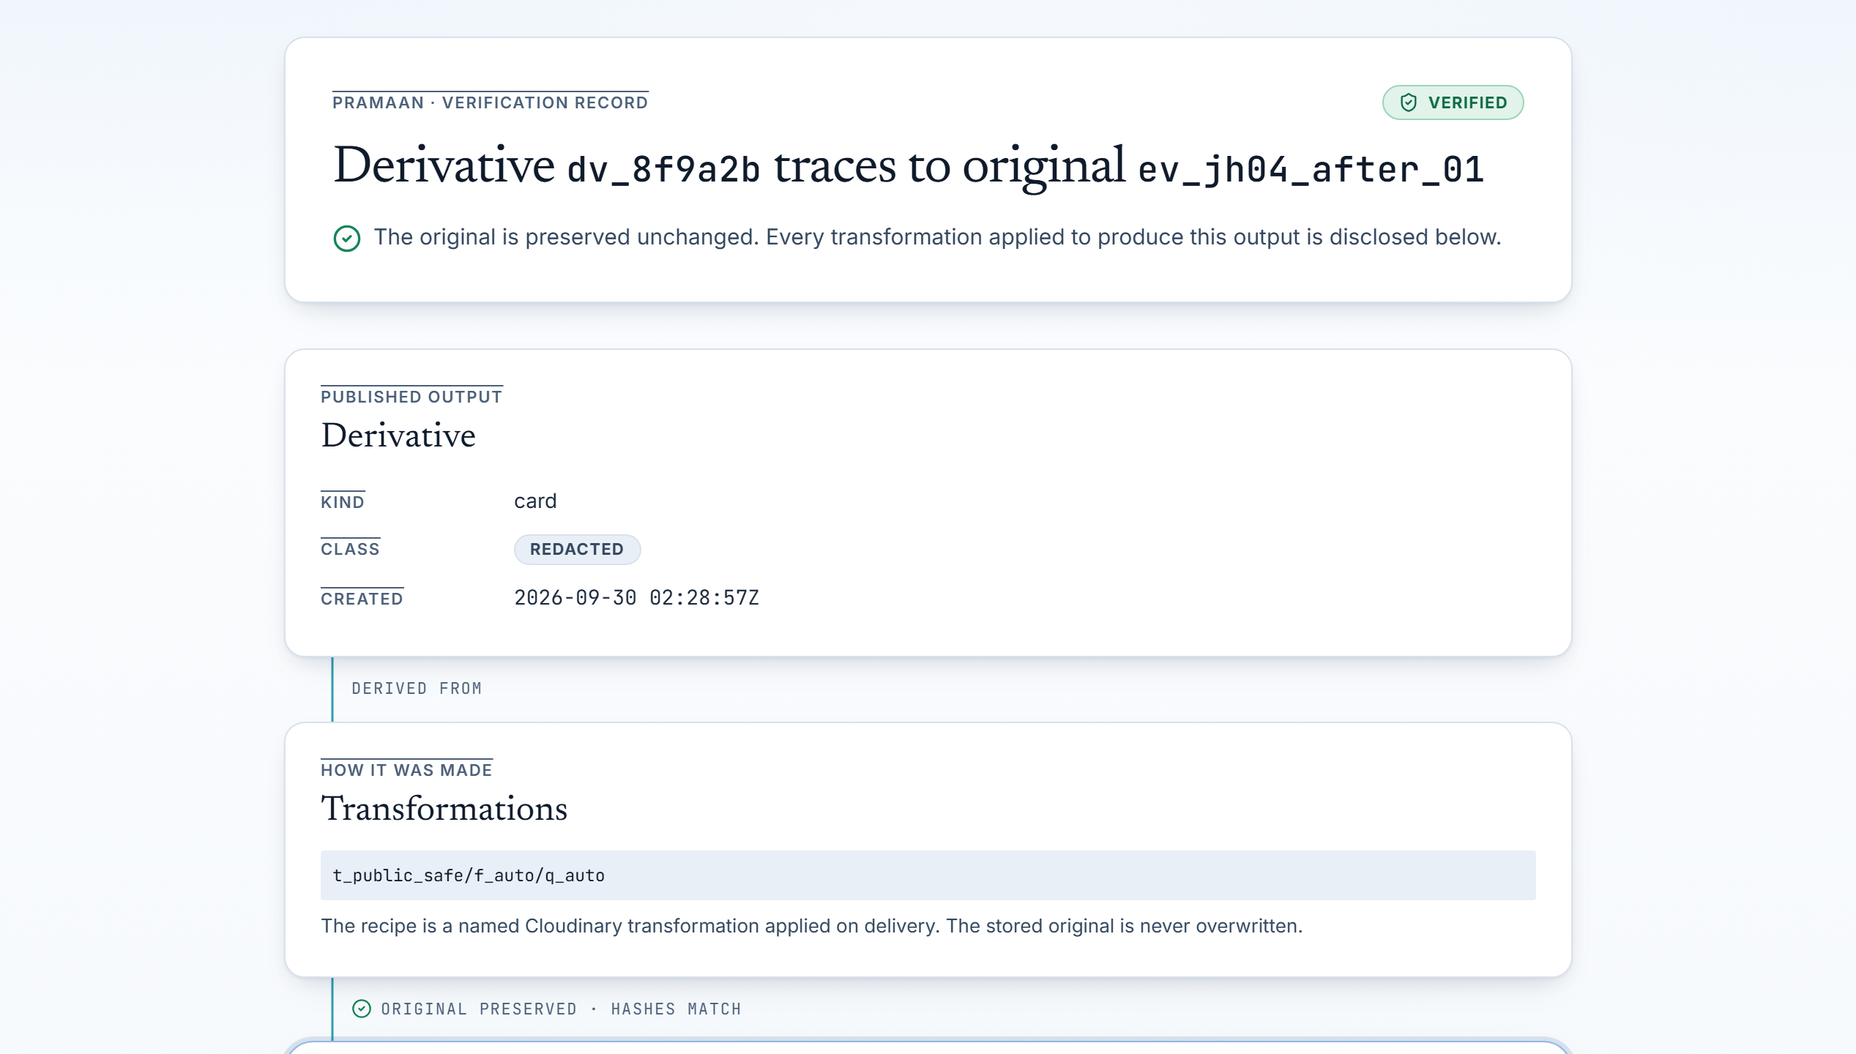
KEY DIFFERENTIATORS · FORENSIC STANDARD
Built for institutional credibility, not casual photo sharing.
Every technical decision in Pramaan is engineered to survive independent auditor scrutiny, corporate ESG audits, and regulatory inspection.
01 / EXPLAINABLE SCORING
Pure Transparent Math vs Black-Box AI
8 weighted signals (P1-P3, I1-I3, R1, Q1) produce a 0-100 score. Hard cap (Score 40) on duplicates or geofence breaches. No-GPS cap (Score 79) prevents unverified claims.
02 / CODE-LEVEL FIREWALL
Zero Synthetic Pixels in Evidence
Generative AI is quarantined to Story Studio and explicitly labelled 'AI-assisted'. Evidence delivery URLs strictly permit only deterministic redaction (e_pixelate_faces).
03 / CRYPTOGRAPHIC AUDIT
SHA-256 Hash-Chained Audit Ledger
Every event (ingest, review, derivative, report) is linked cryptographically: entry_hash = sha256(prevHash + event + subject + payload + time). Tampering breaks the chain visibly.
04 / PUBLIC LINEAGE
Verify QR & Recipe Inspection (/verify/[id])
Auditors scan a QR code on any published impact report to inspect the transformation recipe, SHA-256 hashes, and base parent evidence.

Slide 8
VALIDATION & ROADMAP · REAL-WORLD IMPACT
Validated against actual field fraud patterns.
Benchmarked against real test cases from the JalSetu Foundation Check Dam JH-04 dataset, detecting 100% of synthetic, recycled, and location-spoofed assets.
PROTOTYPE VALIDATION EVIDENCE
Jhabua JH-04 Benchmark Suite
• 20 Seeded Evidence Test Rows: 14 verified, 2 needs review, 3 flagged, 1 rejected.
• Screen Recapture Detection: Caught phone photographing screen displaying check dam (Score 40).
• Perceptual Hash Deduplication: Identified recycled photo with bitwise Hamming distance 0 (Score 40).
• PostGIS Geofence Containment: Flagged farm pond photo 6,327 m outside site boundaries (Score 40).
• Missing Metadata Gating: Capped photo lacking EXIF GPS at 79, routing to review queue.
• 14 Automated Checks Passing: 100% test coverage across dataset math, pHash distance, and agent graphs.
PRODUCTION EVOLUTION
Built Today vs Scaled Tomorrow
CURRENT WORKING PROTOTYPE (BUILT)
• End-to-end evidence pipeline: Capture -> Cloudinary AI -> PostGIS -> Gemini.
• 8-signal explainable Trust Engine with dual hard caps.
• Generative Firewall blocking synthetic media from evidence.
• LangGraph 6-agent workflow with HITL and cited reports.
• Cryptographic SHA-256 audit ledger and public QR lineage.
NEXT SCALE & ENTERPRISE DEPLOYMENT (PLANNED)
• Offline-first PWA sync using IndexedDB for zero-connectivity field sites.
• Hardware-backed C2PA cryptographic signature embedding (fl_c2pa).
• Enterprise multi-organisation tenant isolation with fine-grained RLS.
Proof for every photo. Accountability for every rupee.

