Slide 1
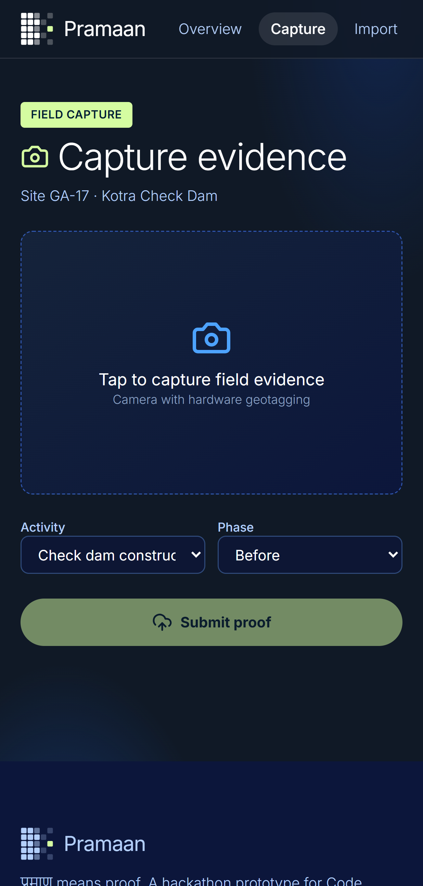
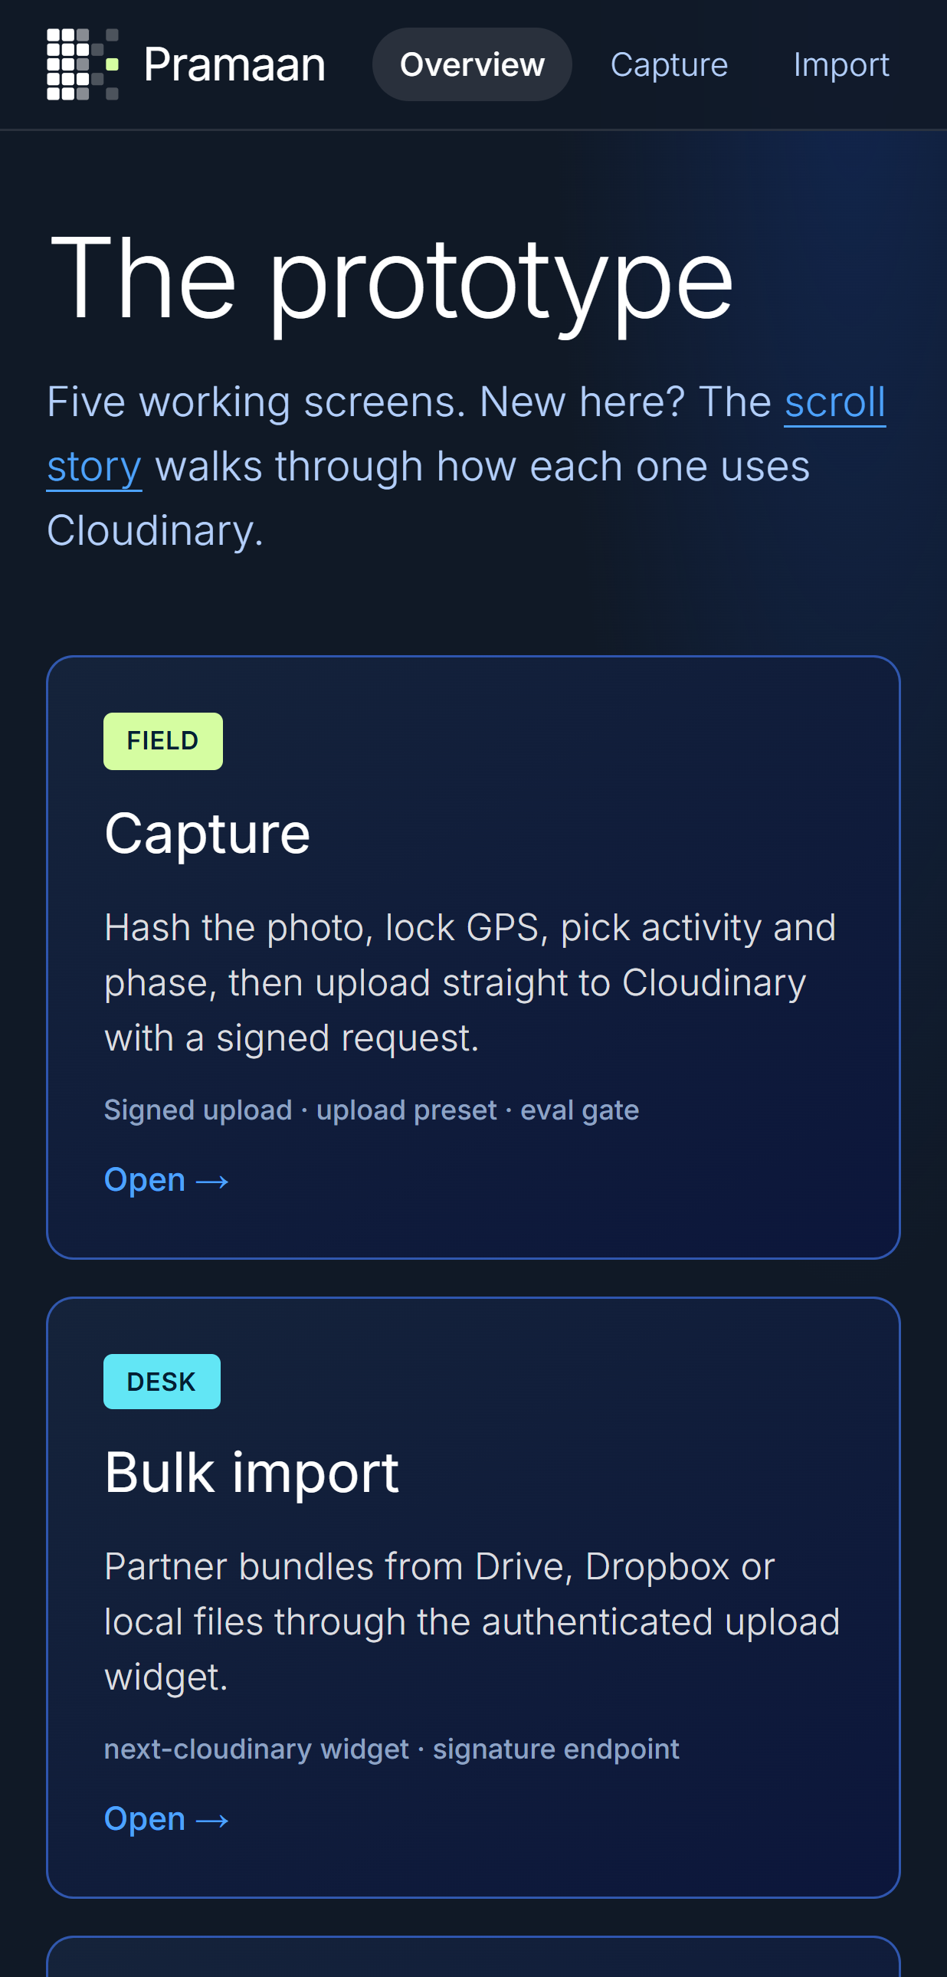
CODE CUBICLE 6.0 · GRAND FINAL
Cloudinary track · PS-02 · Paytm, Noida · 11 October
PRAMAAN
प्रमाण · proof
Proof for every photo. An evidence pipeline for field media, built on Cloudinary.
TEAM
Sanskar Tiwari - Team Leader
Shambhavi Patil - Member
Kanishka Salgude - Member
HoloTrio
TRACK · CLOUDINARY PS-02
WORKING PROTOTYPE
Notes:
Pramaan (प्रमाण = proof). Screens are captured from the running prototype (/capture and /prototype at phone width). Hook first: photos alone aren't proof.

Slide 2




THE PROBLEM
PRAMAAN प्रमाण
Photos alone aren't proof.
Rajasthan made geotagged photos mandatory for MGNREGS attendance and uncovered fake claims. Then the fraud adapted: photos of photos, recycled images, even two dogs submitted as proof that nine people worked.
Recycled images
Same photo reused across sites and years
Photos of screens
Recaptures pass a casual glance
₹2,600 cr
₹34,909 cr
Rule 8(3)
fake wage claims uncovered in Rajasthan, Nov 2024 to Jun 2025
CSR spend in FY 2023-24 across roughly 59,600 projects
larger CSR projects need an independent impact assessment
Context stripped
Messaging apps delete EXIF and GPS
Lost lineage
Edited for a campaign, no link to the original
Nobody can tell a real photo from a recycled one. The chain of evidence is missing.
CODE CUBICLE 6.0 · CLOUDINARY TRACK · PRAMAAN
02
Notes:
Sources on the Pramaan story page: The420.in via research notes (₹2,600 cr); MoRD circular July 2025 (manual checks, 'photographs of photographs'); National CSR Portal via The CSR Journal (₹34,909 cr); Companies (CSR Policy) Rules 2021 amendment.

Slide 3
ROOT CAUSE
PRAMAAN प्रमाण
Field media has no evidence chain.
The problem statement says reporting is slow. The real problem is that nothing links a photo to where, when and by whom it was taken, or to the report it ends up in.
FIELD
WHATSAPP
DESK
REPORT
Photo taken
›
Metadata stripped
›
Renamed, edited, folder-sorted
›
Pretty campaign asset
Context, GPS, time
No provenance
Duplicates undetected
Link to original lost
What this costs
Days rebuilding donor reports that nobody fully trusts. Beneficiary photos, often of children, also need consent under the DPDP Act, so faces must be handled by default, not by exception.
CODE CUBICLE 6.0 · CLOUDINARY TRACK · PRAMAAN
03
Notes:
Root cause: absent evidence chain, not slow reporting. Full analysis: research/03_problem_deep_dive/01_root_cause_analysis.md.

Slide 4







THE SOLUTION
PRAMAAN प्रमाण
One photo. Seven pillars. Full proof.
Capture
Understand
Verify
Discover
SHA-256, GPS, activity and phase are locked into a signed direct upload to Cloudinary.
Cloudinary AI Vision reads the photo in a fixed JSON schema: activity, people, recapture and synthetic cues.
Eight-signal Trust Score, PostGIS geofence and pHash reuse routes each photo to Verified, Review or Flagged.
Gemini plans a query, the server whitelists it, Cloudinary Search runs it.
BUILT
BUILT
BUILT
API BUILT · UI NEXT
Compare
Tell
Trace
From field photo to verified impact.
Every pixel traceable.
Drag a slider across two verified photos, or share one composite URL.
Evidence-cited reports and Cloudinary PDF packs.
Hash-chained ledger and a Verify page behind every QR.
BUILT · AUTO-PAIR NEXT
API BUILT · UI NEXT
BUILT
CODE CUBICLE 6.0 · CLOUDINARY TRACK · PRAMAAN
04
Notes:
Status labels come from the 'Honest status' section of the Pramaan story page. Automatic before/after pairing, vegetation index, video transcripts and C2PA are designed, not built.

Slide 5
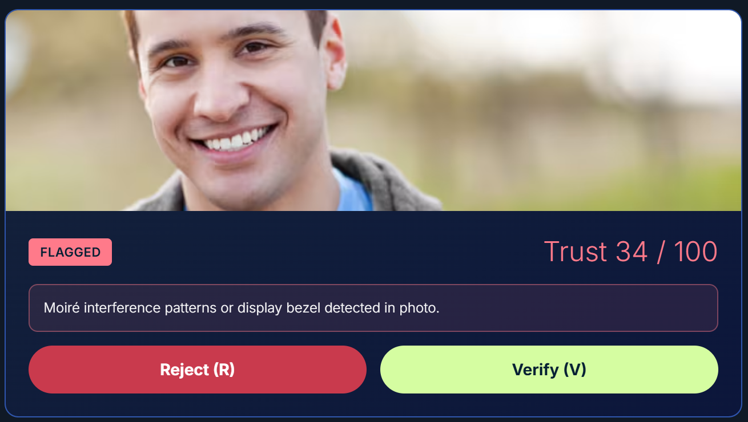
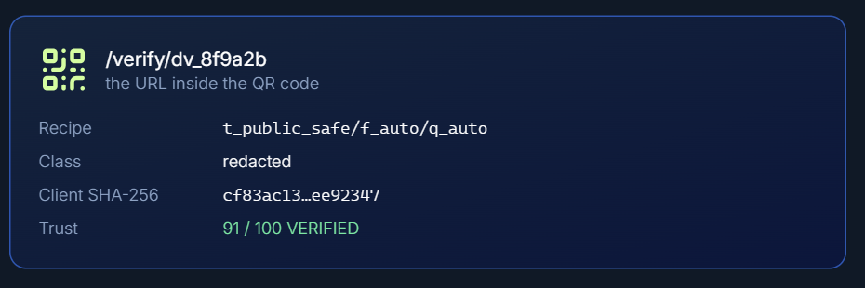
THE APP · LIVE PROTOTYPE
PRAMAAN प्रमाण
Capture, decide, verify.
01
Capture
02
Review queue
03
Verify
Scan the QR on any output. The page shows the recipe, its class, the client hash and the trust score.
Worst first, with the reason on screen. V verifies, R rejects.
Screens are captured from the running app, not mockups.
Every decision is written to the ledger.
Hash, GPS, activity and phase are signed, then the photo goes straight to Cloudinary.
CODE CUBICLE 6.0 · CLOUDINARY TRACK · PRAMAAN
05
Notes:
Live demo runs here. Screens: /capture at phone width, review queue card, verify card. The Review page needs Supabase reachable when demoing live.

Slide 6
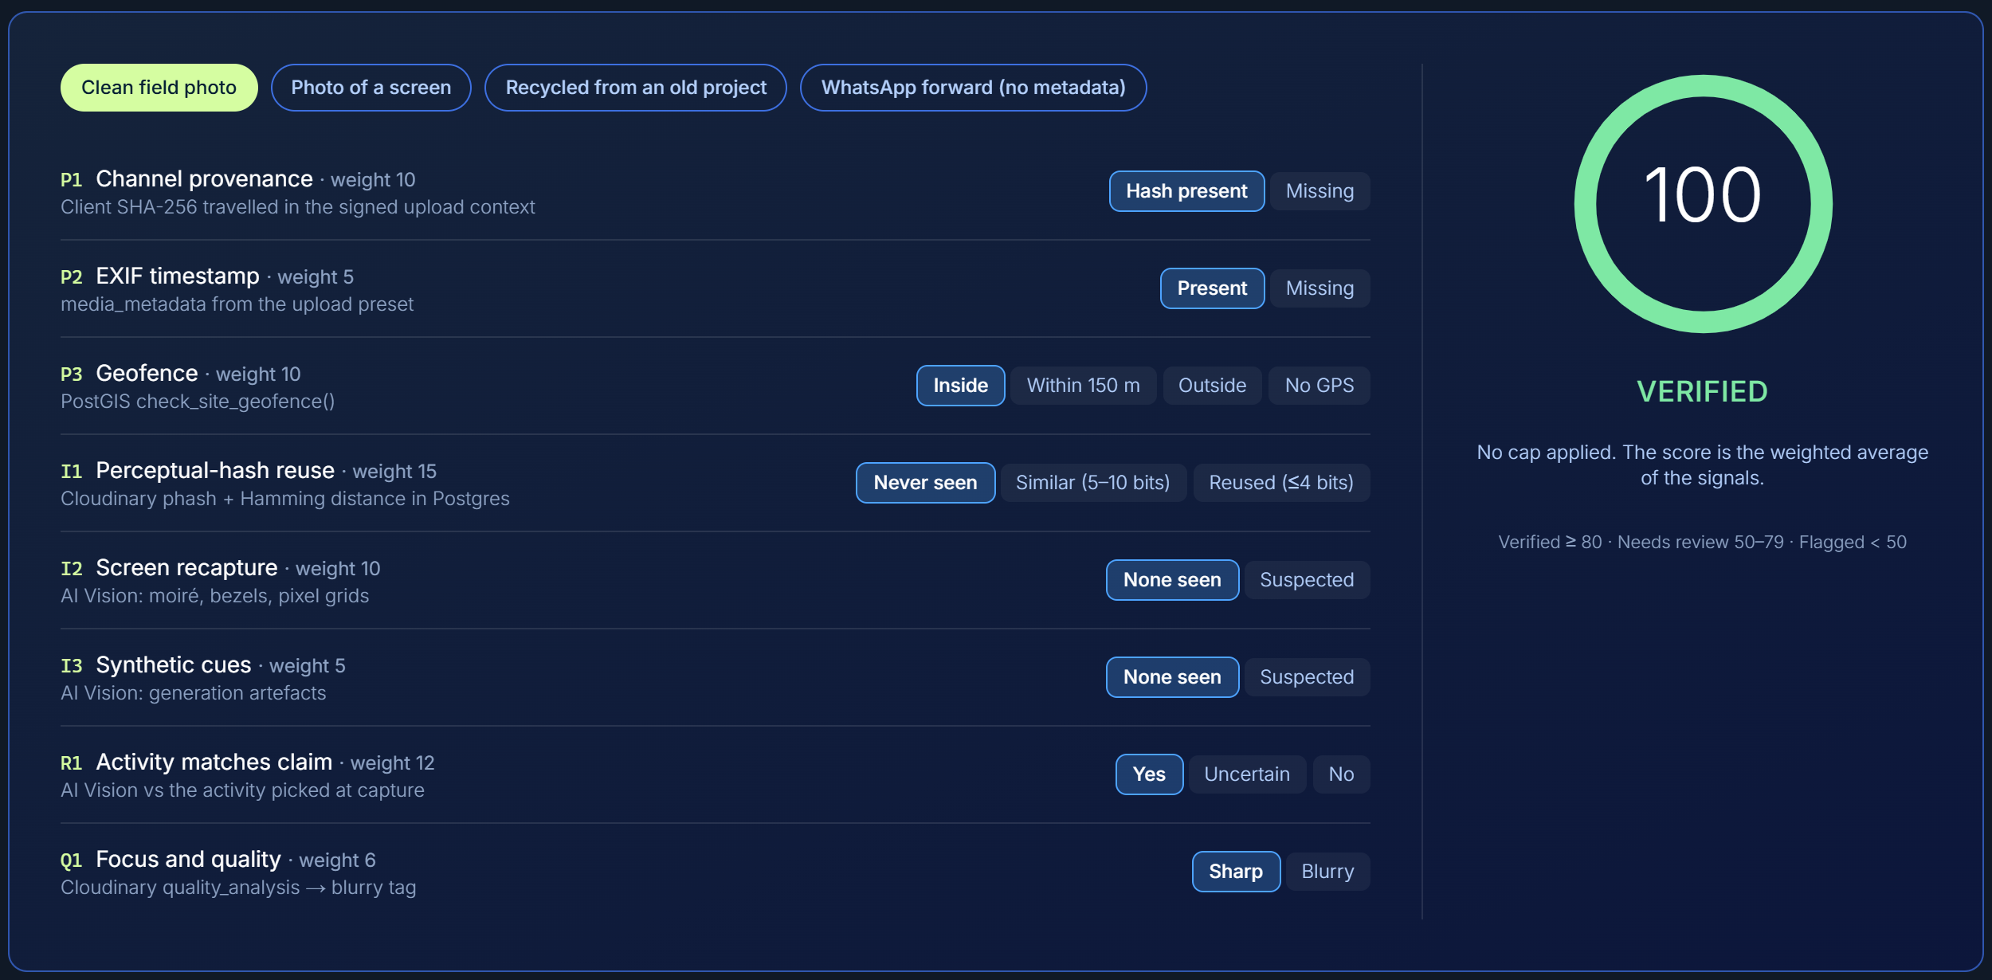
VERIFY
PRAMAAN प्रमाण
A score you can argue with.
Live calculator from the story page. It runs the same scoring module as the server.
Hard flags beat averages
No GPS, no auto-verify
A reused or recaptured photo caps at 40.
Without EXIF GPS the score stops at 79.
CODE CUBICLE 6.0 · CLOUDINARY TRACK · PRAMAAN
06
Notes:
Weights from lib/trust-scoring.ts. Pure math shared between the browser calculator and the server trust engine.

Slide 7
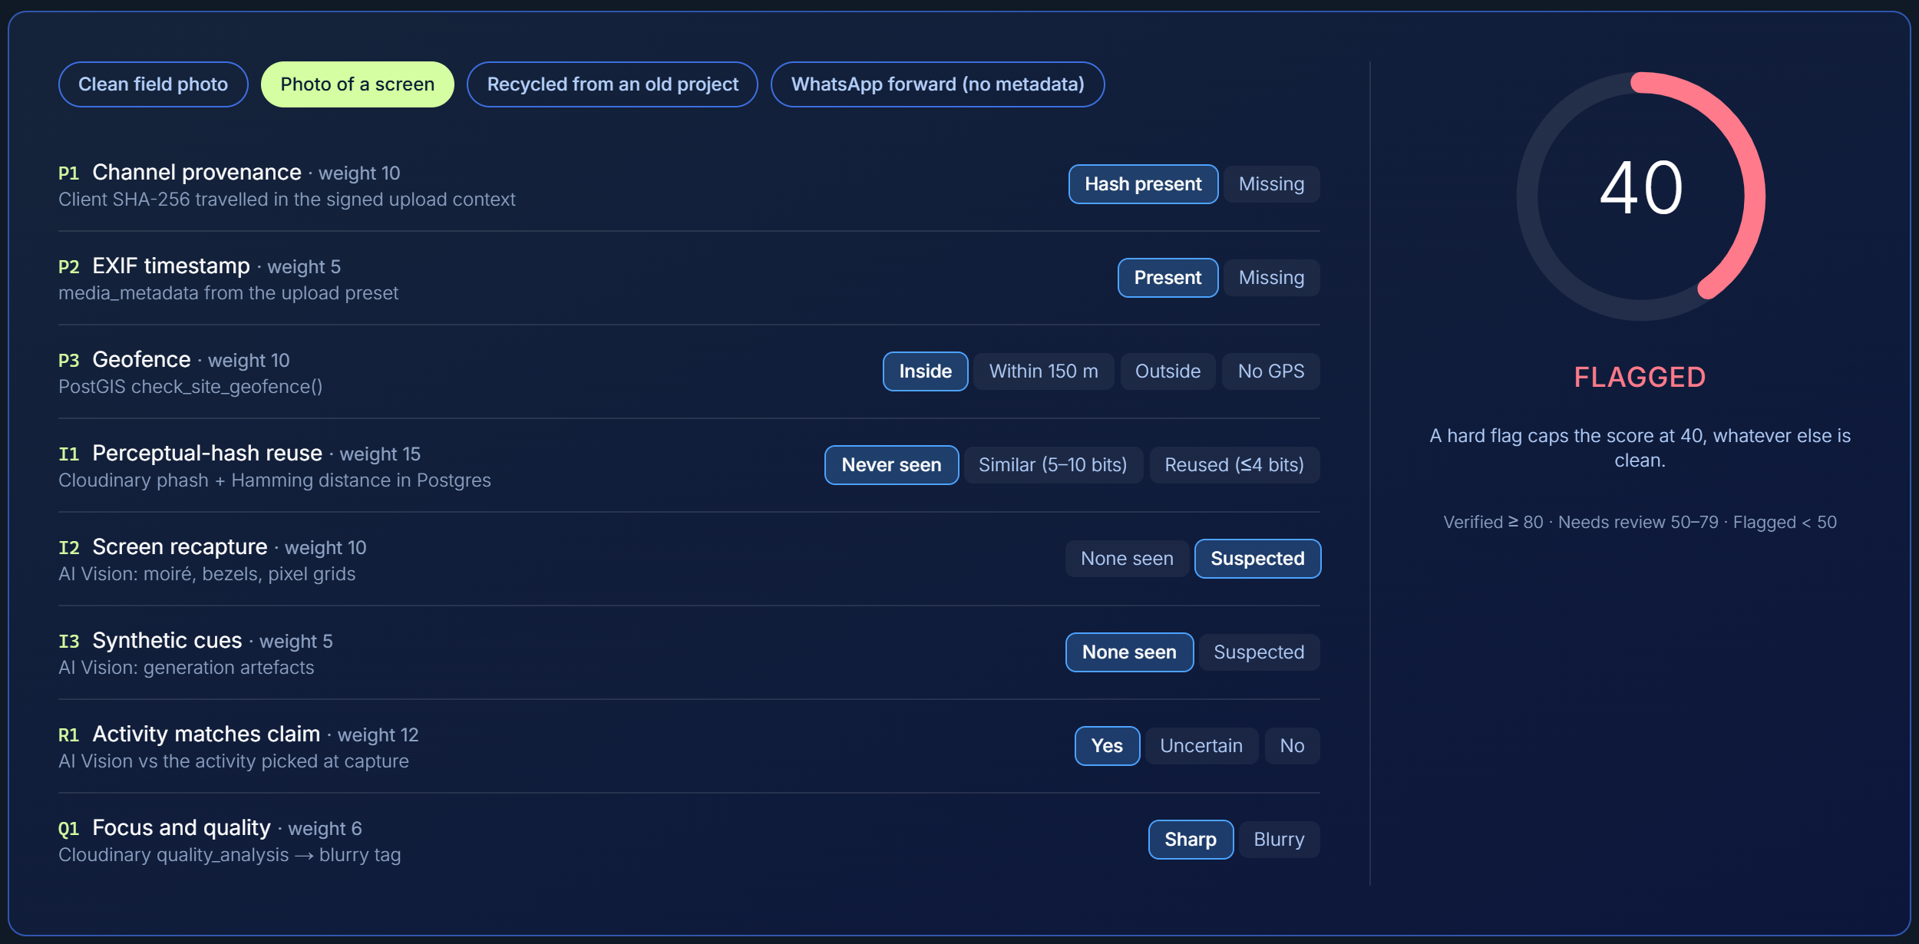
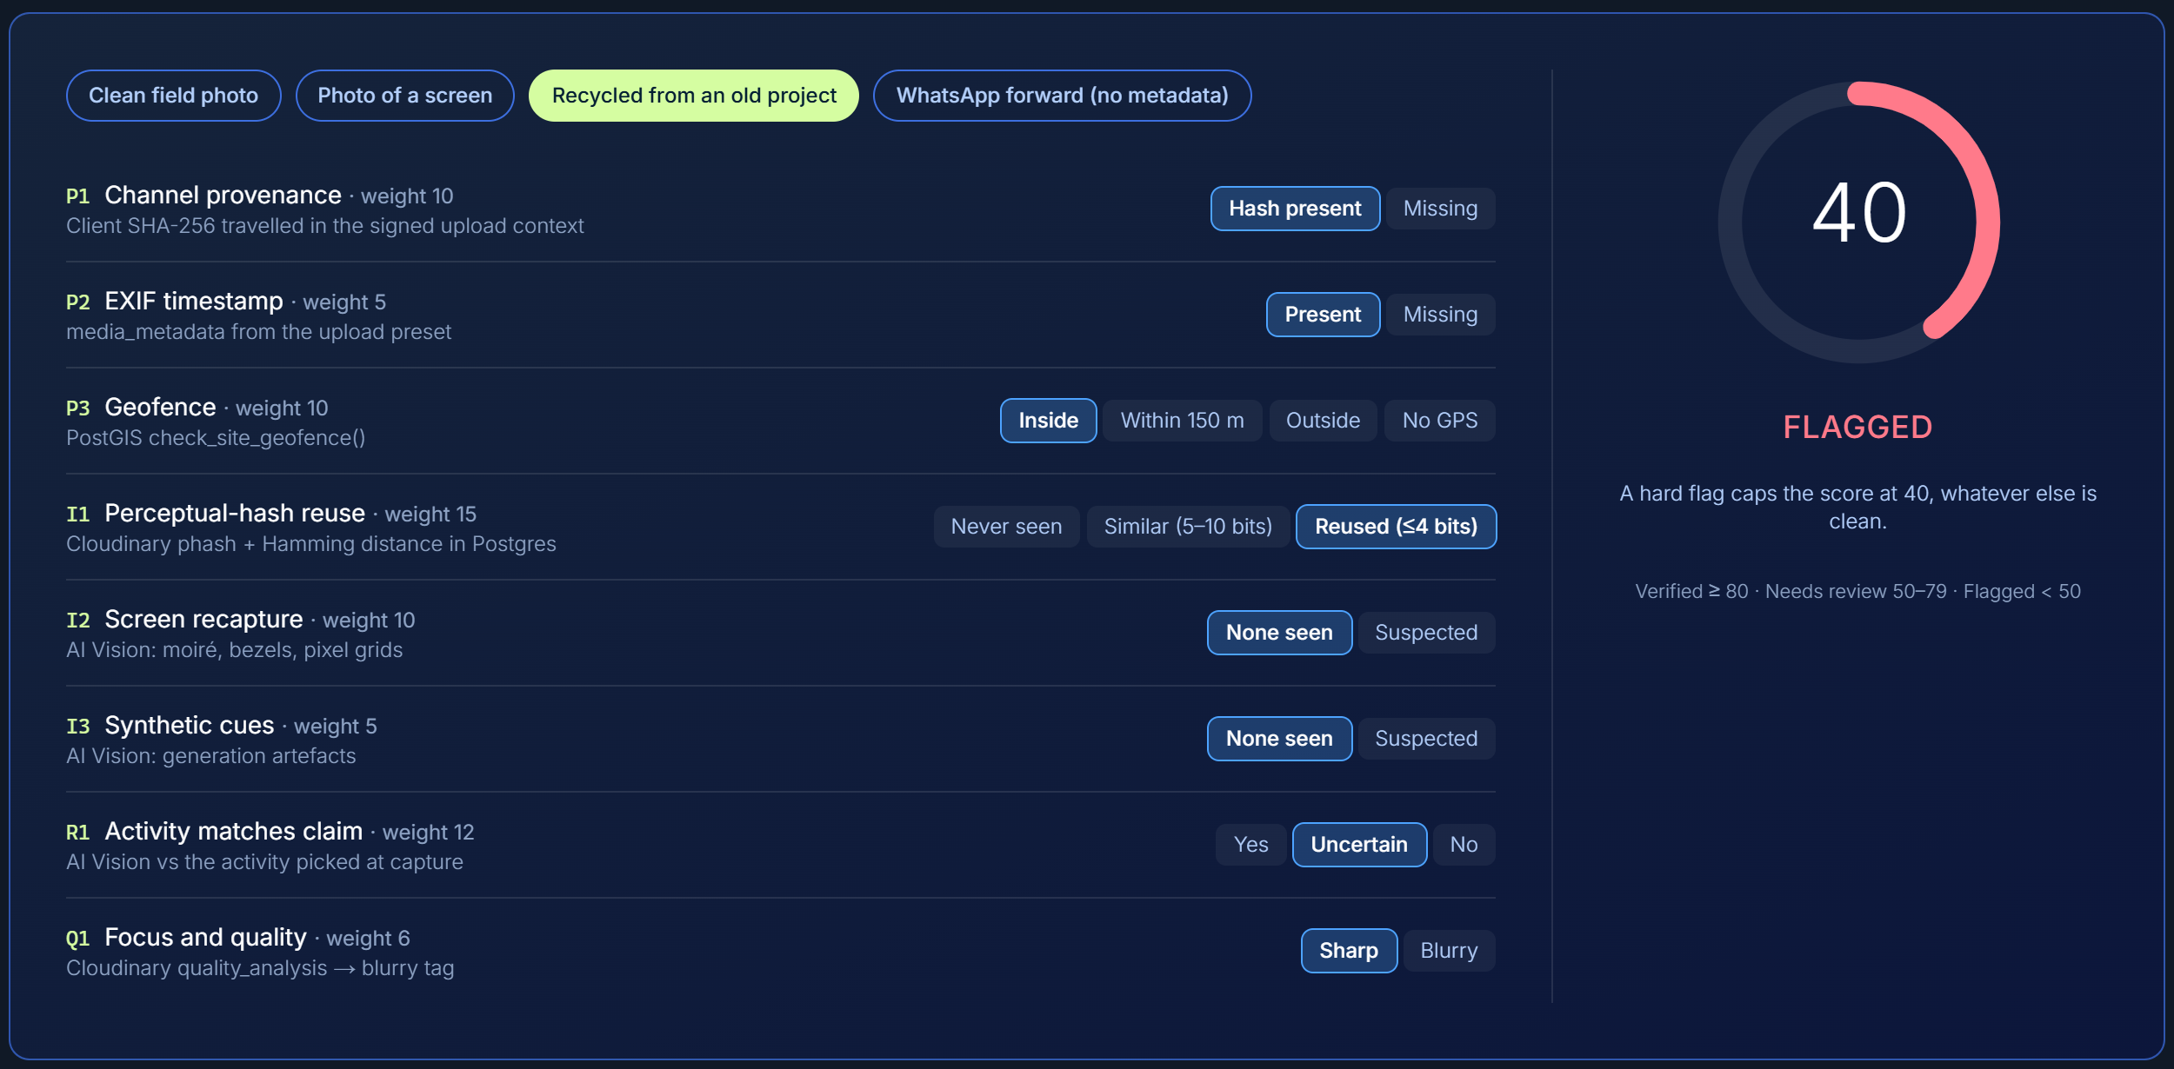
VERIFY · LIVE
PRAMAAN प्रमाण
Fraud, caught by a hard cap.
Photo of a screen
FLAGGED · 40
Recycled from an old project
FLAGGED · 40
Suspected recapture (moiré, bezels) caps the score at 40.
Reused pHash (≤4 bits apart) caps the score at 40.
Language for staff is "needs review", never "fake". The reason is always shown, and one damning signal cannot be diluted by seven clean ones.
CODE CUBICLE 6.0 · CLOUDINARY TRACK · PRAMAAN
07
Notes:
Both screenshots are the trust calculator on the story page with the preset scenarios 'Photo of a screen' and 'Recycled from an old project'.

Slide 8
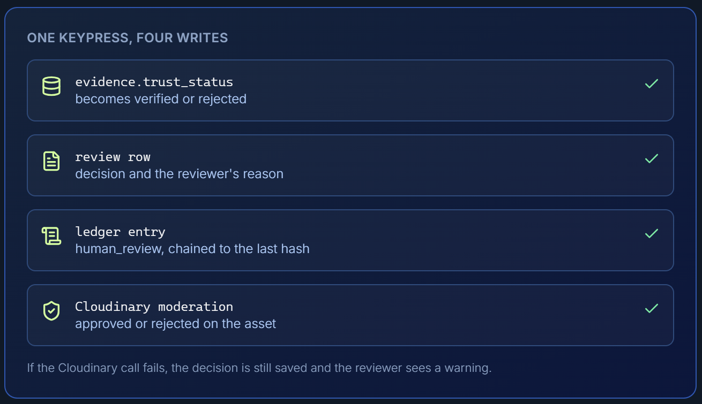
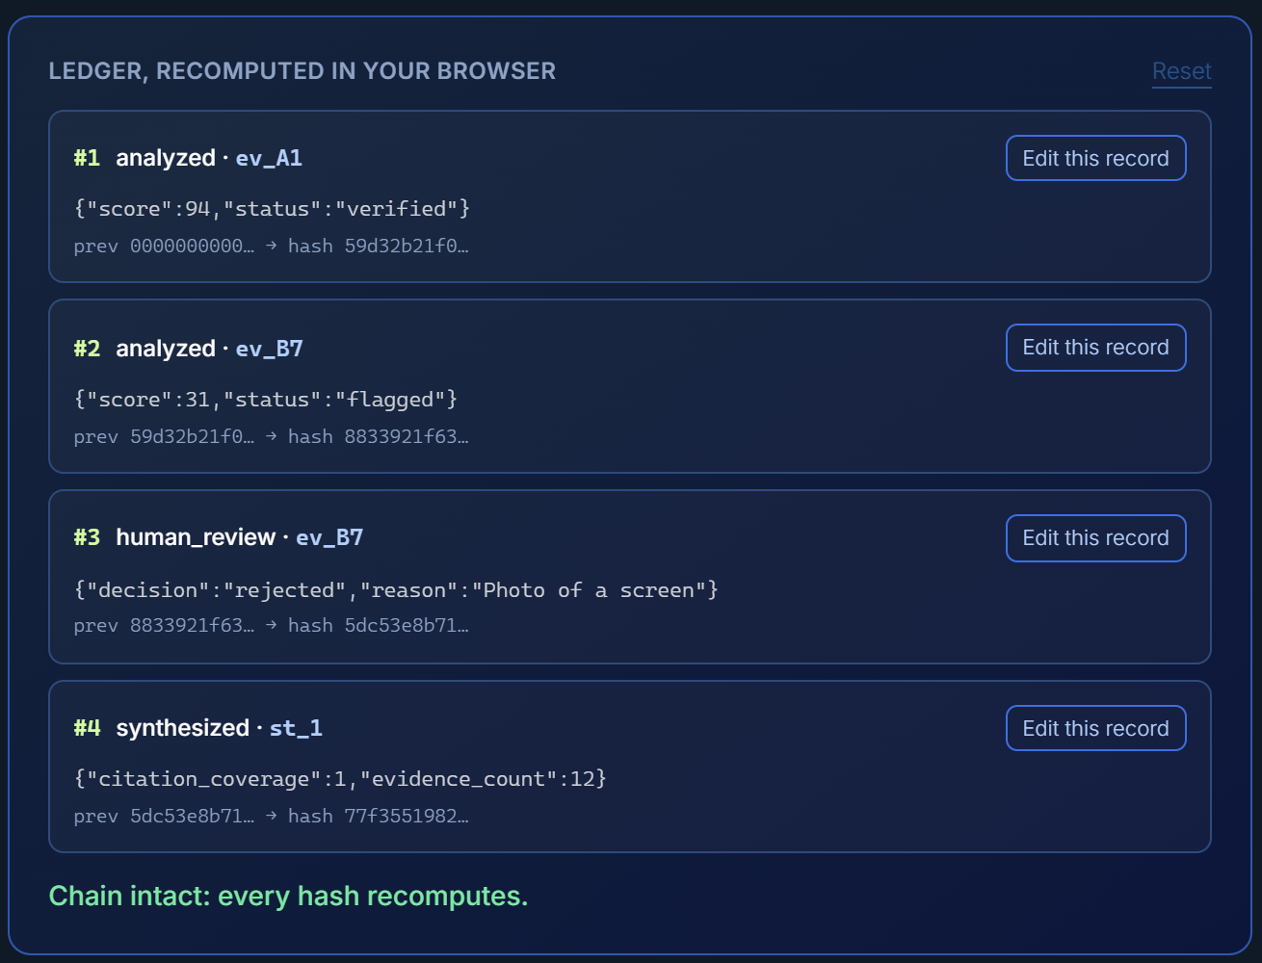
REVIEW AND LEDGER
PRAMAAN प्रमाण
People decide. The record can't be quietly rewritten.
One keypress, four writes
Ledger, recomputed in the browser
Trust status, review row, ledger entry and Cloudinary moderation stay in step. If Cloudinary is unreachable, the decision still stands and the reviewer is warned.
Each entry hashes its payload and the previous entry. Edit any record and the chain breaks visibly.
CODE CUBICLE 6.0 · CLOUDINARY TRACK · PRAMAAN
08
Notes:
Screens from the Review and ledger chapter of the story page. Ledger code: lib/ledger.ts. Review action: app/(dashboard)/review/actions.ts.

Slide 9
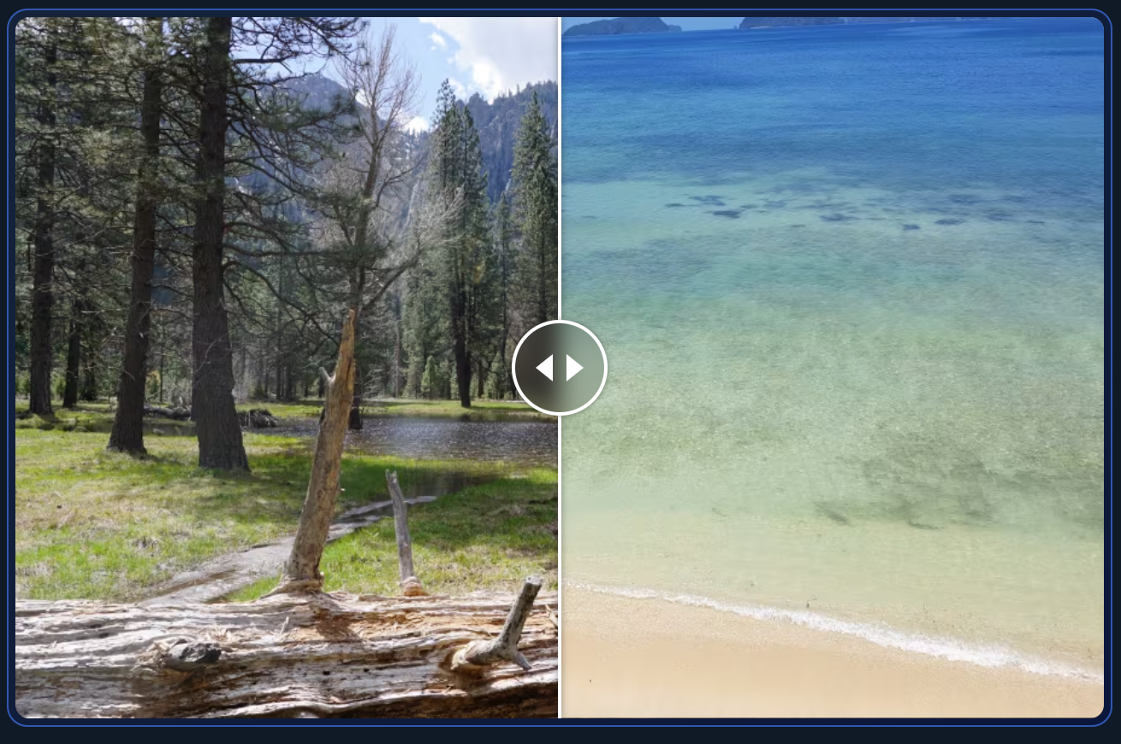
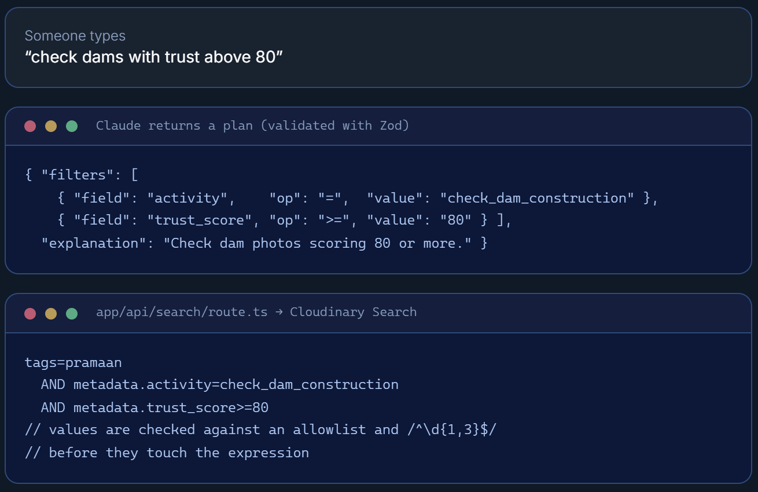
CHANGE OVER TIME · DISCOVER
PRAMAAN प्रमाण
Same place, two dates. Ask in plain words.
Drag across two verified photos
Gemini plans, the server checks, Cloudinary searches
Both photos are checked to be from the same site, cropped around the subject (c_fill, g_auto) and served as f_auto, q_auto. Demo photos come from Cloudinary's sample cloud.
A sentence becomes a Zod-validated plan. The server keeps only allowlisted fields and values before building the Cloudinary Search expression, so the model can suggest a query but cannot inject one.
CODE CUBICLE 6.0 · CLOUDINARY TRACK · PRAMAAN
09
Notes:
Compare screen: /compare/[pairId]. Search API: POST /api/search. Automatic before/after pairing and search/story screens are designed, not yet built.

Slide 10
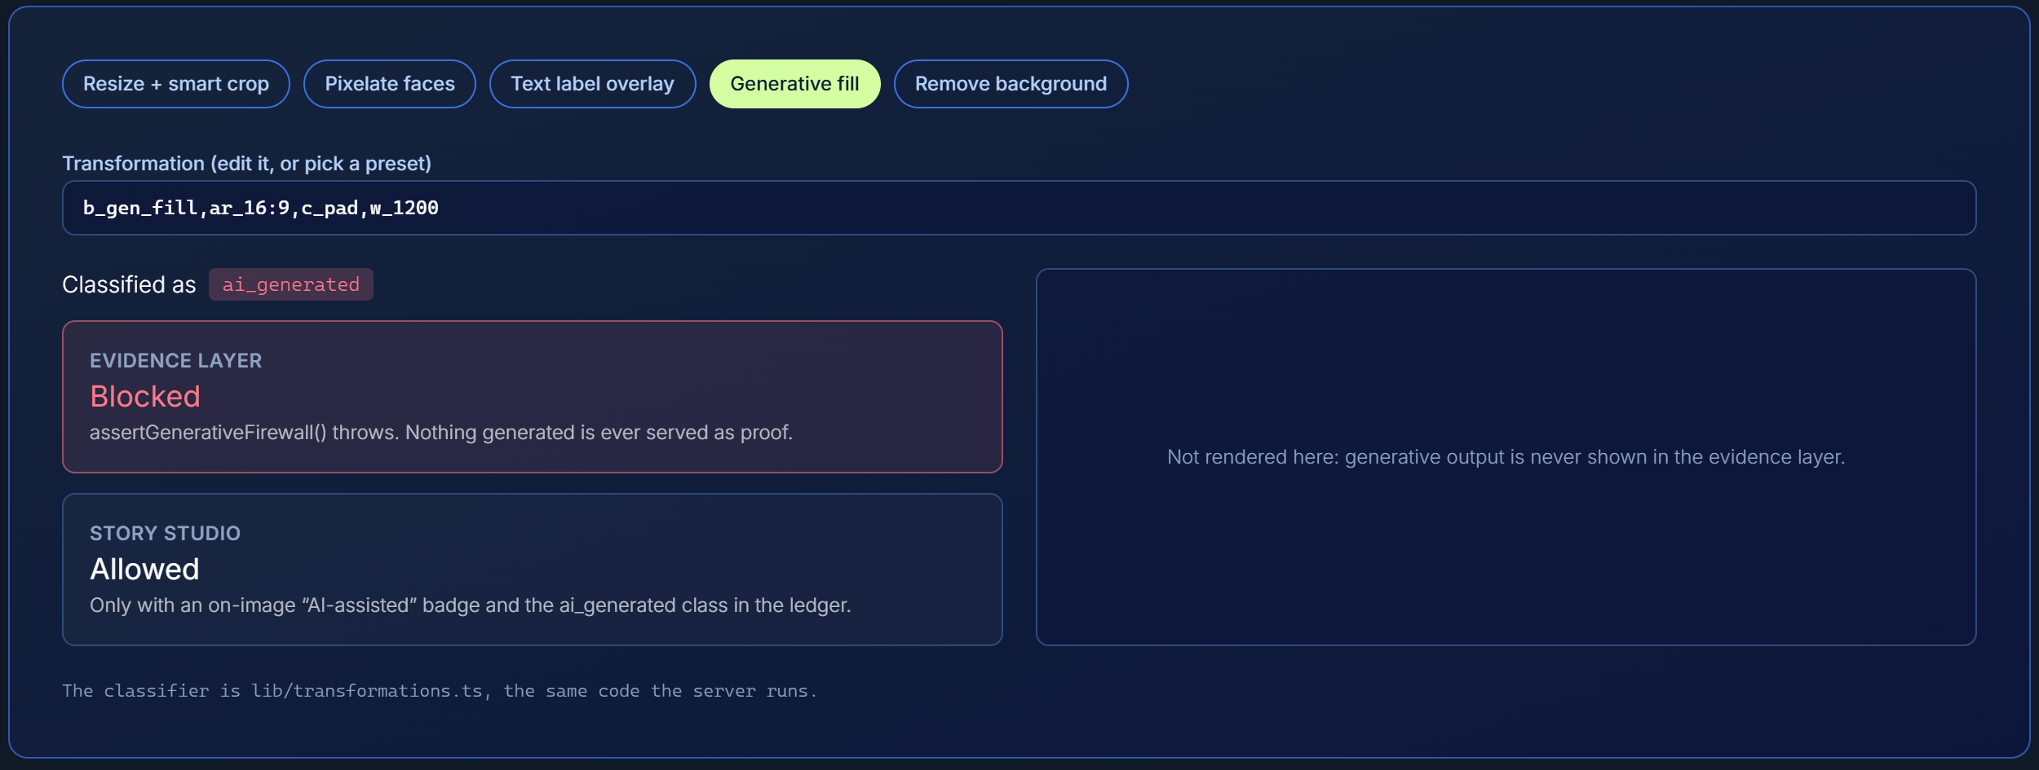
TRACE
PRAMAAN प्रमाण
GenAI can make a campaign prettier.
It can never make evidence.
transcoded
Format, size, quality
redacted
Faces pixelated, consent-aware
edited
Crop, overlay, composite
ai_generated
Story Studio only, labeled
Pick a transformation. The classifier labels it, and the evidence layer refuses generative ones.
CODE CUBICLE 6.0 · CLOUDINARY TRACK · PRAMAAN
10
Notes:
Firewall lab is on the story page. lib/url-builder.ts assertGenerativeFirewall throws for generative steps such as e_gen_*, background removal or upscaling. Verify card: /verify/[derivativeId].

Slide 11
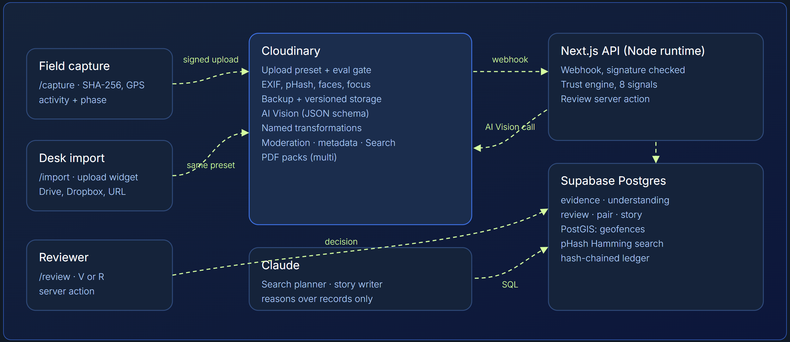
ARCHITECTURE
PRAMAAN प्रमाण
Cloudinary is the evidence engine, not a bucket.
CLOUDINARY
Signed uploads, eval gate, AI Vision, pHash, named transforms, search, moderation, PDF packs
GEMINI
Reads records only: search planner and story writer, both Zod-validated. Never decides trust.
DATABASE
Supabase Postgres: PostGIS geofences, pHash Hamming search, hash-chained ledger
APP
Next.js 15, React 19, TypeScript, Tailwind 4
SETUP AS CODE
npm run setup:cloudinary creates presets, transforms and metadata fields
CODE CUBICLE 6.0 · CLOUDINARY TRACK · PRAMAAN
11
Notes:
Diagram is the pipeline chapter of the story page. Cloudinary does the inspecting; the server turns findings into a score; every decision is written down.

Slide 12









CLOUDINARY DEPTH
PRAMAAN प्रमाण
Every capability has a job.
Signed uploads
Upload preset + eval gate
AI Vision (JSON schema)
pHash, faces, quality
Server signs an allowlist; secret never leaves it
Tags no_gps, blurry, faces, edited_software
Activity, claim match, recapture, synthetic cues
Raw signals the trust score is built from
Named transformations
Consent-aware redaction
Overlay composite
Fill, g_auto, f_auto, q_auto
Seven recipes, a name instead of a string
Faces pixelated unless consent is on file
Before and after in one URL
Cropped and served in the best format
Webhooks
Moderation status
Metadata + Search API
PDF packs with multi()
Signature verified, 500 on failure so it retries
Reviewer decision mirrored into the DAM
activity and trust_score written back
Verified evidence rendered for a funder
All twelve are in the code. Designed next: video transcripts and chapters, and C2PA content credentials.
CODE CUBICLE 6.0 · CLOUDINARY TRACK · PRAMAAN
12
Notes:
Each entry maps to a file listed in the 'Cloudinary, feature by feature' chapter: app/api/sign-upload, scripts/setup-cloudinary.ts, jobs/analyze-image.ts, lib/url-builder.ts, app/api/cloudinary/webhook, app/(dashboard)/review/actions.ts, app/api/search, app/api/stories.

Slide 13
WHAT THE JURY WANTS
PRAMAAN प्रमाण
Built for how Cloudinary judges.
1
Deep media integration
Cloudinary as perception, rendering and lineage: eval gate, AI Vision, pHash, transforms, moderation. Not storage.
2
Functional, real app
Five working screens: capture, import, review, compare, verify. Code, migrations and seed data in the repo.
3
Real-world usefulness
Grounded in Indian data, with a paying buyer: CSR teams under Rule 8(3).
4
Honest engineering
Built vs designed is stated on the page. Generative pixels are blocked from evidence.
5
Documentation and video
README explains each integration and design decision. 2-4 minute demo video.
CODE CUBICLE 6.0 · CLOUDINARY TRACK · PRAMAAN
13
Notes:
Criteria from research/01_hackathon/01_event_brief.md. If the Cloudinary Next.js Starter Kit, Skills Pack, AI Power Start or MCP servers were used in the build, add them to row 1; the repo does not show them.

Slide 14
IMPACT
PRAMAAN प्रमाण
What the prototype proves.
8
7
0
1
weighted trust signals, each with a reason on screen
named Cloudinary transformations, so a recipe is a name
generated pixels allowed in the evidence layer
hash chain behind every decision
The buyer
NGOs use it free. Funders and CSR teams pay for portfolio views and audit packs. Building a quarterly donor report from field photos, about 20 hours today, is the design target to cut to under one hour, to be validated with pilot NGOs.
CODE CUBICLE 6.0 · CLOUDINARY TRACK · PRAMAAN
14
Notes:
The counts come straight from the app: eight signals (lib/trust-scoring.ts), seven named transformations (scripts/setup-cloudinary.ts). Add flag-rate and precision from the labeled test set before presenting.

Slide 15
HONEST STATUS
PRAMAAN प्रमाण
What is done, and what is not.
BUILT
NOT YET PROVEN
DESIGNED, NOT BUILT
Signed capture and desk import
Upload preset with eval gate
Webhook, AI Vision job, eight-signal engine
PostGIS geofence and pHash reuse
Review queue, ledger, moderation sync
Compare, verify, search and story APIs
Generative firewall classifier
Type-checks and builds, but not yet run end to end on live accounts
Cloudinary moderation may need a different call
Review screen has no login yet
Demo images come from Cloudinary's public sample cloud
Automatic before/after pairing
Vegetation index from pixels
Video transcripts and chapters
C2PA credentials
Embedding search
Screens for search and story writing
CODE CUBICLE 6.0 · CLOUDINARY TRACK · PRAMAAN
15
Notes:
Mirrors the 'Honest status' chapter of the story page. Say where the prototype stops before the jury asks.

Slide 16

PRAMAAN · प्रमाण
Thank you
Every photo verified.
Every pixel traceable.
From field photo to verified impact, built on Cloudinary.
REPO
Scan for the code, README and research
TEAM
Sanskar Tiwari - Team Leader
Shambhavi Patil - Member
Kanishka Salgude - Member
HoloTrio
github.com/kanishkasalgude/cloudinary_research
Code Cubicle 6.0 · Cloudinary track · Paytm, Noida · 11 Oct
Notes:
QR points to the GitHub repo. Swap in a live-URL QR once the app is deployed.

