Slide 1
INTRODUCTION
Different time-scales on which environments change: seasonal/annual change; circadian change; regular change on the order of minutes or hours
How can each of these be tracked?
Drawing the distinction between physiological response and cognitive response
Bringing in the definition of tracking
Tracking what? Choices between options
Introducing the concept of time-based environmental change
The concept of patch choice
Quick aside that these are the kinds of patches bats experience normally
Stripping it down to two choices
The Stephens papers and the simple choice you can have
The relevance of this to the bats
Introducing comparison between available choices
Weber’s Law and volume discrimination in bats
We know bats can discriminate between reward dimensions according to Weber’s Law
What is Weber’s Law

Slide 2
INTRODUCTION
Any other previous literature about cognitive strategies in the bats
Reinforcement learning and the sub-category of win-stay, lose-shift
What we know about the way they cope with time-based change
We know this is what they do in the serial reversal learning task
What is known about the bats’ cognitive strategies
Now tying it up together: the rationale for our experiment
Reversal learning was choice-based not time-based
So the question is, what happens when the bats are faced with a time-based environmental change?
This is the basic idea of the experiment
This is the description of the experiment
Our pilot studies showed that…
An exploratory study – this is what we wanted to get out of the experiment
Study description

Slide 3

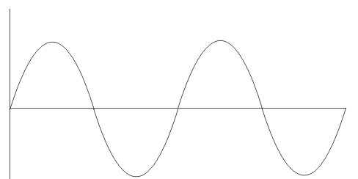
Fixed Option
Fluctuating Option
Volume outputs vary according to a sine wave
y(t) = Asin(2πft+φ) + D
Volume = 7 µL
25 µL
Experiment 2: 13.5 µL
Experiment 1: 7 µL
2 µL
Condition 1: 0.75 hour period
Condition 2: 1.5 hour period
Condition 3: 3 hour period
Condition 4: 6 hour period

Slide 4
RESULTS
Result 1: Most of the bats responded to the reversals
Result 2: Response to the changing environment was influenced by the rate of change of the fluctuating option
Rhythmicity in the data
Period vs volume
Result 3: The expectation of reward at any timepoint is based on recent reinforcement, not projection from the past
Trend and period plots
Expectation at the two fixed options
Result 4: The response to the changing environment was maybe influenced by the contrast between the fixed and fluctuating options
Overall observation

Slide 5
DISCUSSION
Bats respond to time-based change
How fine-grained this response is – rhythmicity result
More visits to fluctuating option when downward trend rather than upward
Verbal summary of the results
Bats are capable of responding to an environment that changes in a time-based way on the order of hours, not just seconds
This change is influenced by volume and recent experience
The role of satiation and why this is cognitive and not purely physiological
Interpreting the results and tying it up with the rational
Connecting what the bats did to what was previously known about their cognitive strategies
Volume discrimination; serial reversal learning; other papers on cognitive strategies in bats
Science paper – modelling was done
A description of what we think is happening: outlining reinforcement learning in the bats
What is known about the bats’ cognitive strategies

Slide 6
DISCUSSION
How do nectar levels in flowers change?
Patch choice and the subjective/objective mean difference
Cannot project, so go by recent memory because of inter-individual competition
Do bats keep a running tally of what was experienced recently in each patch?
Connect with what is known about patch choice strategies and the Stephens model
What this implies for the bats’ foraging ecology and nectar-feeding animals in general
Intermediate time-scales can be tracked with constant environmental input
The state of the environment is in no doubt because it is always accessible in this case
Animals can respond to changes on ecologically-relevant time-scales using cognitive strategies
Time-based environmental change

