Slide 1
Airline Customer Satisfaction Analysis

Slide 2
Overview
This report analyzes a dataset containing customer feedback on an airline's services. Multi-faceted approach to gain insights from this data:
Data Cleaning and Analysis: Leveraged Python libraries (Pandas, NumPy, Matplotlib) to clean, organize, and analyze the data.
Database Management: Utilized the cleaned data to import in Microsoft SQL Server for query execution.
Data Visualization: Employed Power BI to create interactive visualizations and reports to communicate findings .

Slide 3
AGENDA
Problem Statement
Research Objectives
Hypothesis
Data Overview
Analysis & Findings
Dashboard using Power BI
Recommendations

Slide 4
Problem Statement
Following the pandemic, the airline industry suffered a massive setback as a result, in order to revitalize the industry in the face of the current recession, it is absolutely necessary to understand the customer pain points and improve their satisfaction with the services provided. Hence, how can the airline leverage customer feedback data to optimize its services in the post-pandemic era where customer expectations and preferences may have shifted?

Slide 5
Research Objectives
Overall Sentiment Analysis Calculate the average sentiment score and identify the distribution of positive, negative, and neutral feedback.
Correlation Analysis
Examine the relationships between different customer satisfaction ratings and identify factors influencing overall satisfaction.
Impact of Delays
Assess the impact of departure and arrival delays on customer satisfaction.
Age and Satisfaction
Determine if age significantly impacts satisfaction with specific aspects of the flight experience.
Segment-Specific Analysis
Compare satisfaction levels between business and personal travelers.
Flight Distance and Satisfaction
Analyze how flight distance affects customer satisfaction

Slide 6
Hypothesis
There is a significant correlation between specific aspects of the flight experience (e.g., inflight services, seat comfort).
Arrival Delay and Departure delay might have an adverse impact on the customer satisfaction.
Customer satisfaction levels vary across different passenger classes (Economy, Economy Plus, Business).
Customer satisfaction levels vary across different age groups (Children, Young Adults, Adults, Seniors).

Slide 7
About Dataset
The dataset is rich in information, containing 22 columns and 25,977 rows and includes information on customer demographics(e.g. age, gender, class) flight experience(Inflight Wi-Fi service, On-board service) and overall satisfaction.
Dataset Source: Kaggle
By analyzing this dataset, airlines can gain valuable insights into the factors and can tailor their services accordingly to enhance customer experience.

Slide 8
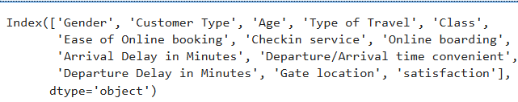
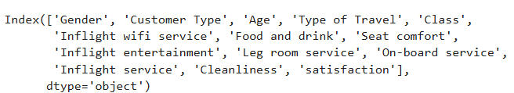
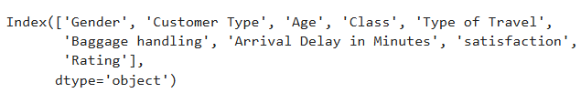
Analysis & Findings
The dataset was categorized into three main aspects of the customer journey:
Pre-flight
In-flight
Post-flight

Slide 9
The overall percentage of positive, negative or neutral ratings.
Satisfied customers: 43.89%
Dissatisfied customers: 56.10%
The loyal customers : 21,111 (81.27%)
The disloyal customers: 4782 (18.41%)
The loyal customers which are dissatisfied: 10,950 (75.14%)
The loyal customers which are satisfied: 10,161 (89.11%)

Slide 10
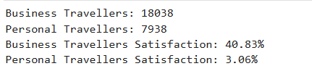
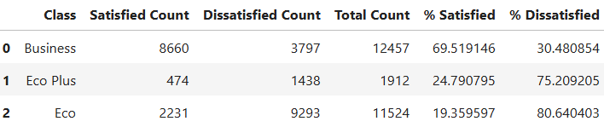
There are more business travellers than personal travellers and business travellers are more satisfied than personal travellers.
Satisfaction based on class:
Economy class passengers are the most dissatisfied.

Slide 11
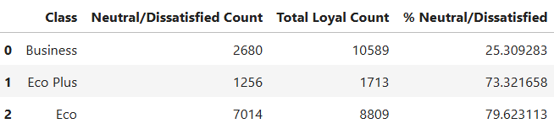
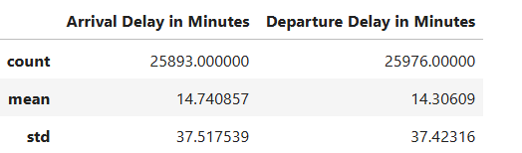
Satisfaction based on loyalty:
Loyal customers who are dissatisfied are: economy >economy plus>business.
Average arrival delay is 15 minutes and average departure delay is 14 minutes.
Passengers are more loyal in Economy Plus and then in business class 85%,89%,76%.

Slide 12
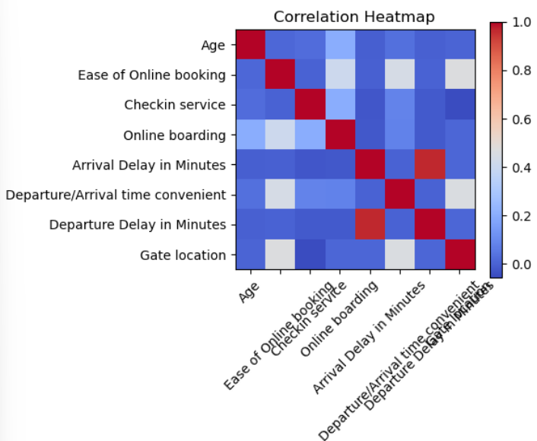
PRE-FLIGHT
People who find online booking easy will also be satisfied with the online boarding process.
Strong Positive Correlation Between Online Booking and Gate Location.
Customers that are Overall satisfied are unhappy with the Departure/Arrival time.
Customers that are Overall Dissatisfied are unhappy with the Online Booking service.

Slide 13
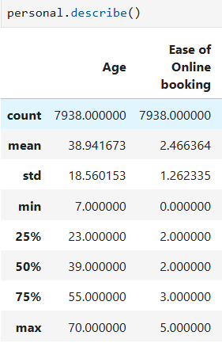
A significant portion of personal travelers express dissatisfaction with the ease of online booking. 75% of respondents rated it a 3,
a neutral sentiment. However, a concerning number of customers, particularly in the 20th and 50th percentiles, rated it a 2.

Slide 14
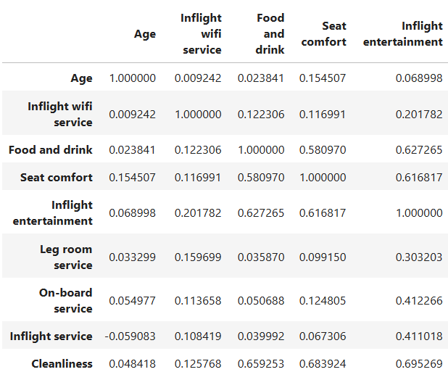
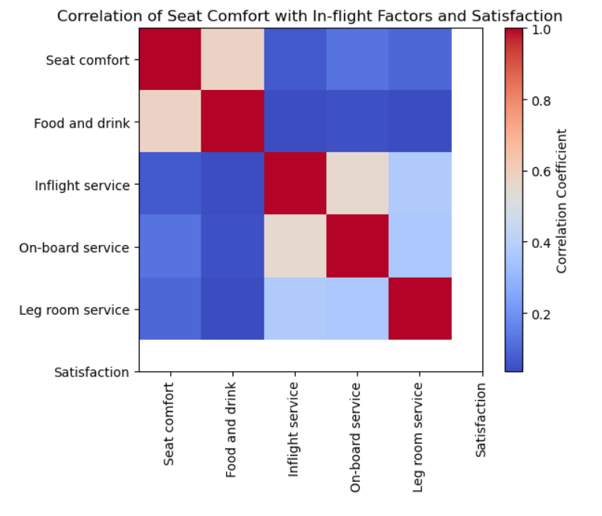
IN-FLIGHT
Inflight Entertainment, Seat Comfort, Food and Drink, and Cleanliness These factors are highly correlated, indicating that passengers who are satisfied with one of these factors are likely to be satisfied with the others as well.
This suggests that focusing on improving these aspects can have a significant impact on overall passenger satisfaction.

Slide 15
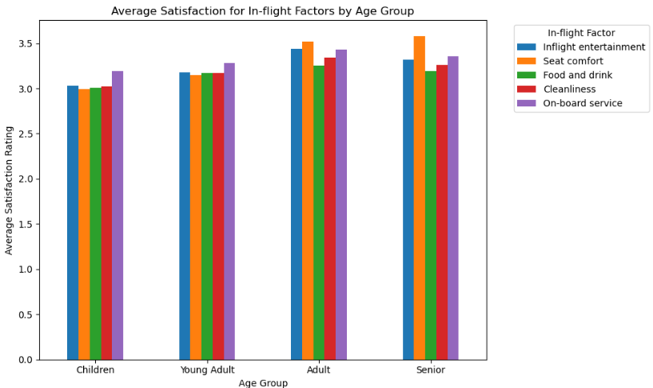
Children(7-17) and
Young Adults(18-24)
Show a higher level of satisfaction with in-flight entertainment compared to Adults and Seniors.
Adults(25-54) and Seniors(55-85)
lean towards more seat comfort and cleanliness.

Slide 16
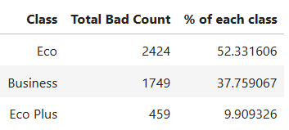
POST-FLIGHT
Customers rated Baggage Handling service as:
Good(4 & above) : 61.86%
Average(3) : 20.03%
Bad(2 and below) : 17.77%
Class type with customers who have rated "Baggage Handling" less than 3
Economy class passengers has the highest
count percentage of low satisfaction score.

Slide 17
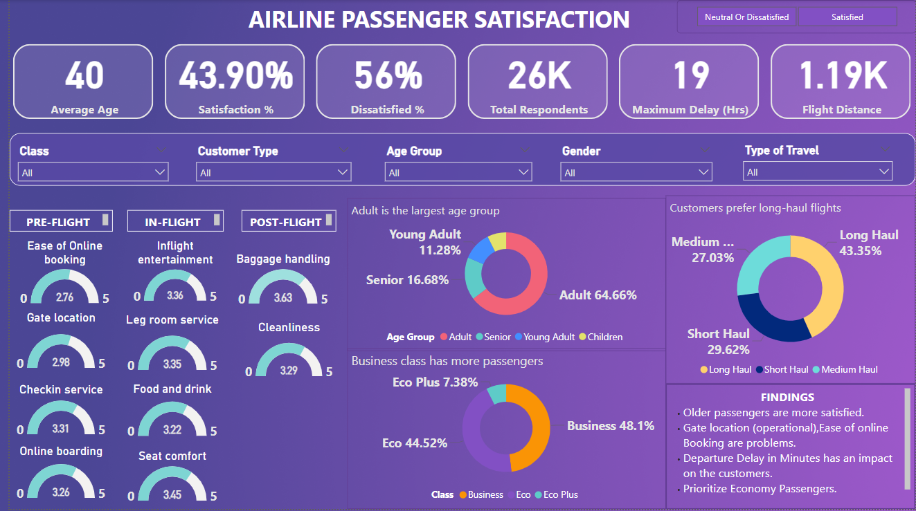
DASHBOARD USING POWER BI

Slide 18
RECOMMENDATIONS
Address the specific needs and pain points of economy class passengers.
Streamline the online booking process to improve user experience and reduce friction.
Focus on improving operational services to increase efficiency to reduce delay during arrival and departure time both.
Invest in in-flight entertainment, seat comfort, food and beverage quality, and cabin cleanliness.
Prioritize Younger Passengers given their lower satisfaction levels in comparison to Adults and seniors.

