Slide 1


Slide 2
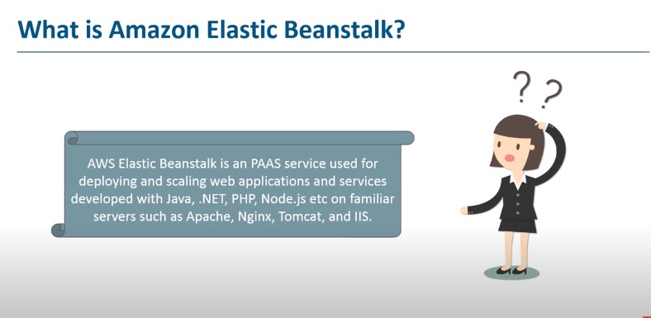

Slide 3
Elastic Beanstalk a PaaS
Key Features: AWS Elastic Beanstalk. The PaaS offering was developed by Amazon and helps developers deploy applications on AWS cloud. Elastic Beanstalk automatically handles every aspect in the cloud upload, including capacity provisioning, load balancing, scaling, and application health monitoring

Slide 4
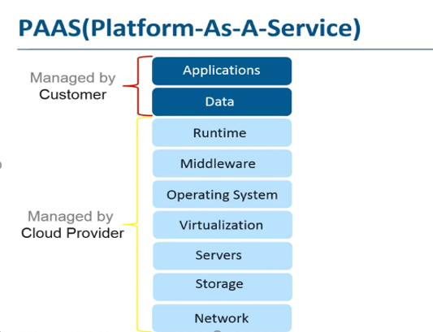

Slide 5


Slide 6


Slide 7
Main Benefit of Elastic Beanstalk:
Elastic Beanstalk will setup an "environment" for you that can contain several EC2 instances, an optional database, as well as a few other AWS components such as an Elastic Load Balancer, Auto-Scaling Group, Security Group.

Slide 8
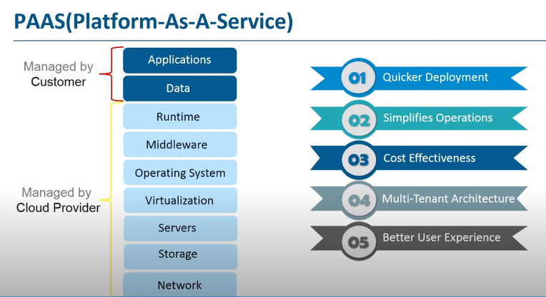

Slide 9
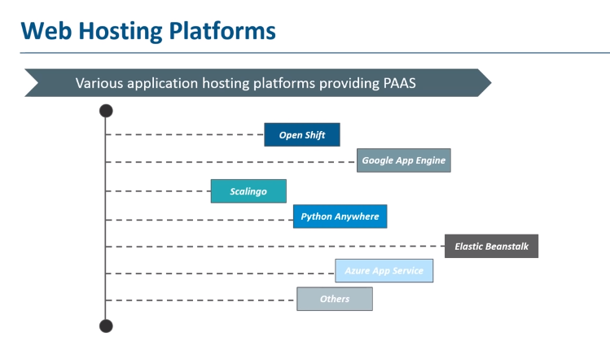

Slide 10


Slide 11
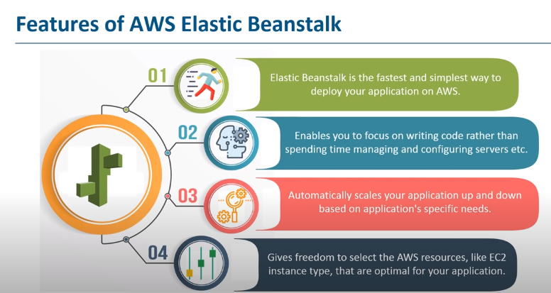

Slide 12


Slide 13
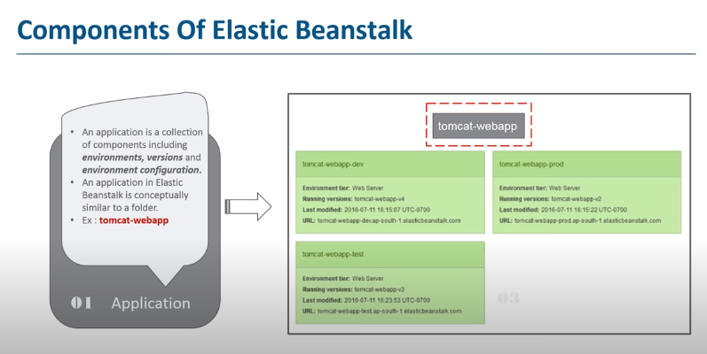

Slide 14
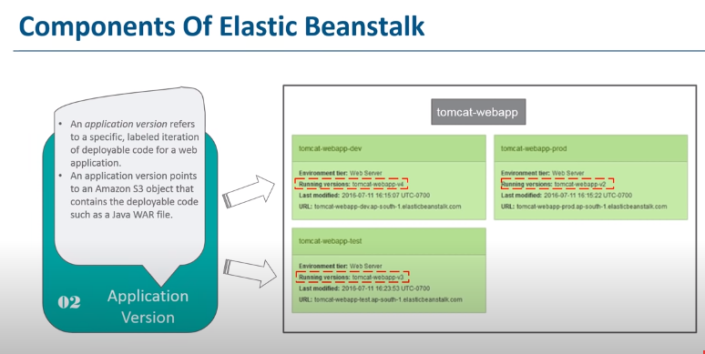

Slide 15
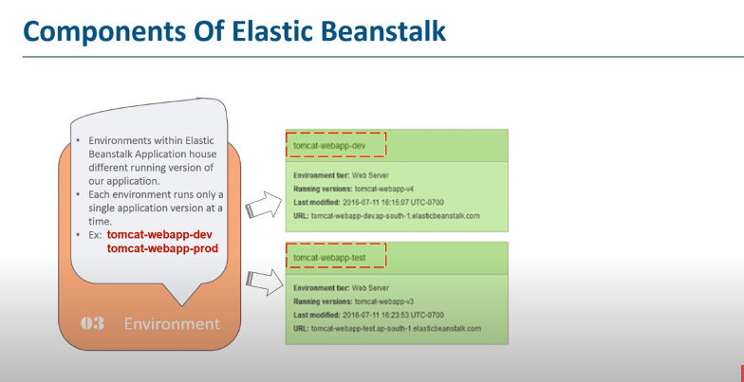

Slide 16
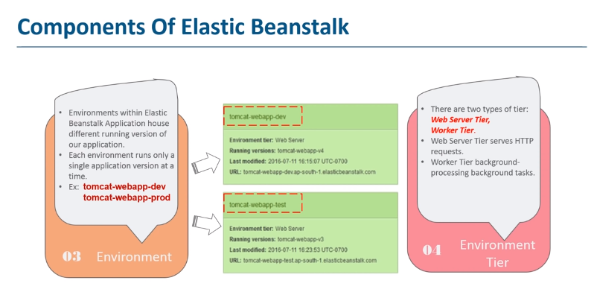

Slide 17
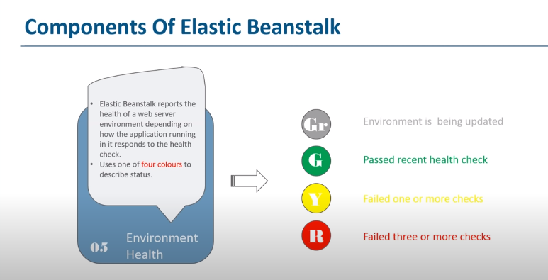

Slide 18


Slide 19
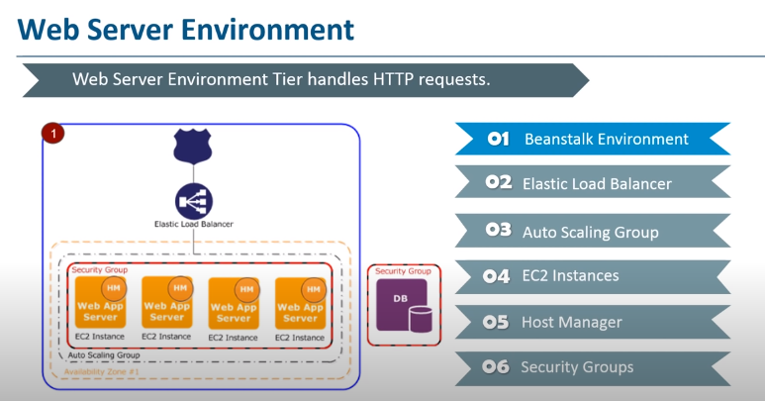

Slide 20
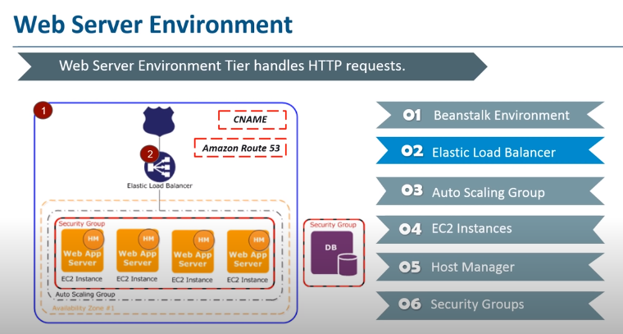

Slide 21
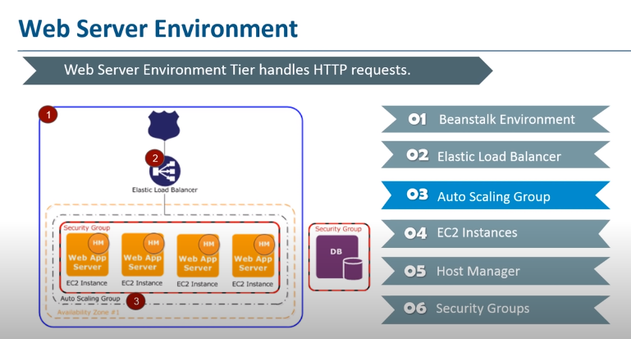

Slide 22
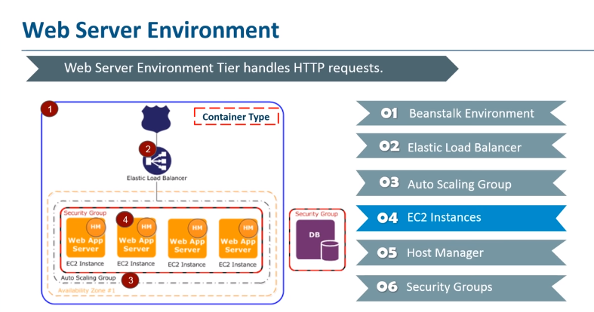

Slide 23
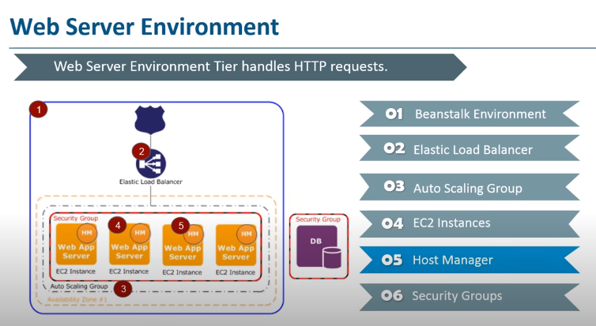

Slide 24
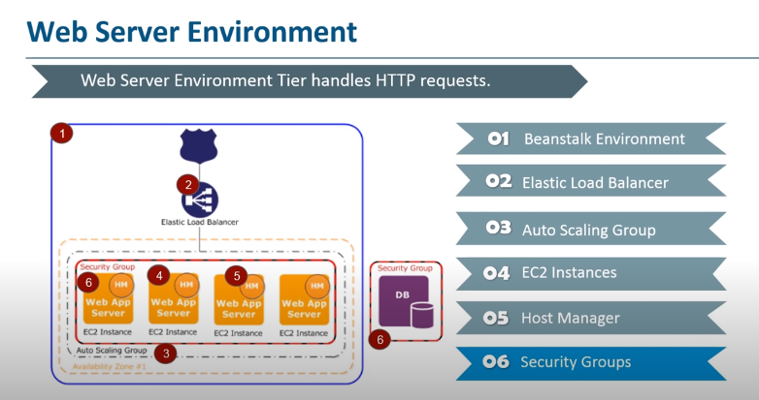

Slide 25


Slide 26
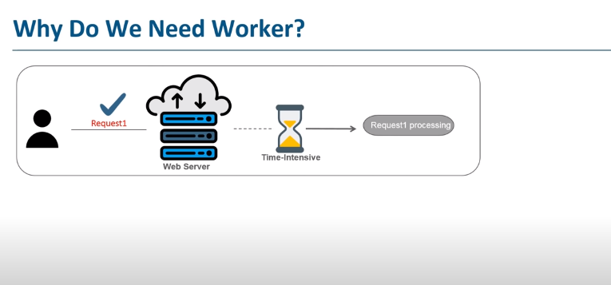

Slide 27
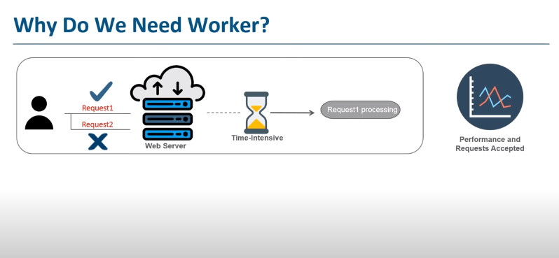

Slide 28
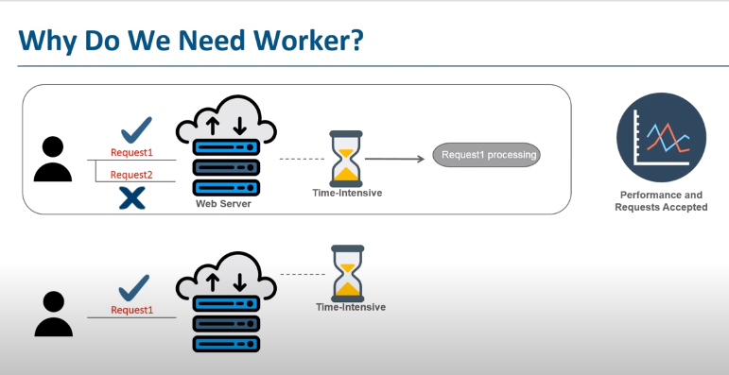

Slide 29
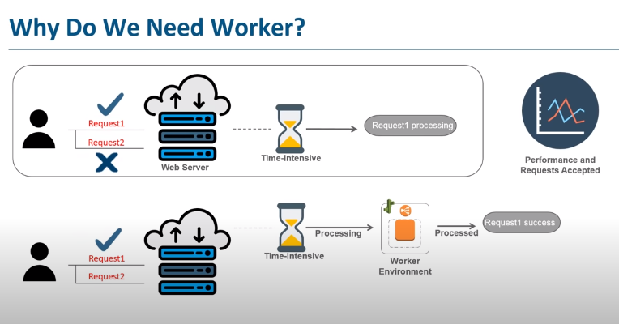

Slide 30
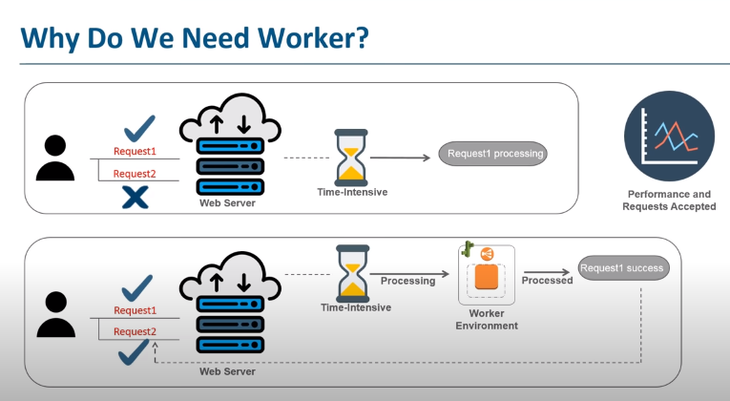

Slide 31
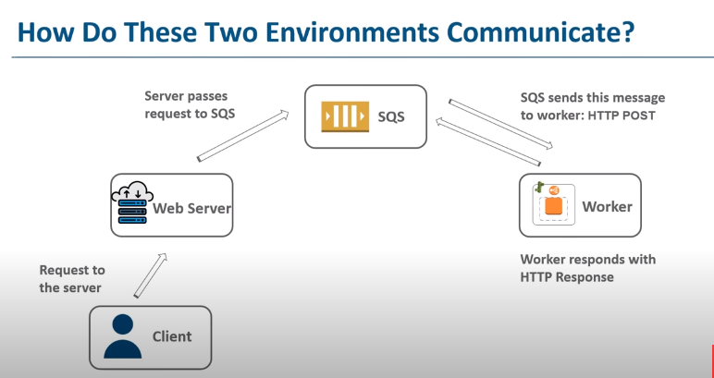

Slide 32


Slide 33
THANK YOU !!

