Slide 1
AWS Identity and Access Management

Slide 2
What is IAM in AWS ?
AWS Identity and Access Management (IAM) enables you to manage access to AWS services and resources securely. Using IAM, you can create and manage AWS users and groups, and use permissions to allow and deny their access to AWS resources. IAM is a feature of your AWS account offered at no additional charge.

Slide 3
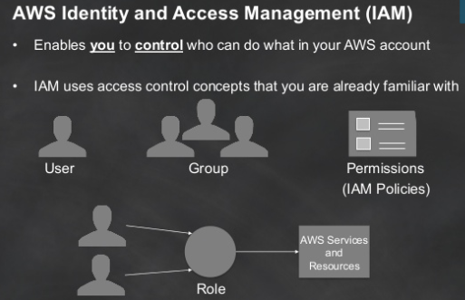
IAM

Slide 4
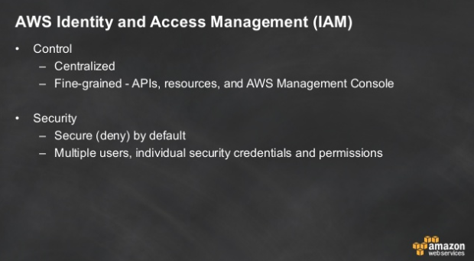

Slide 5
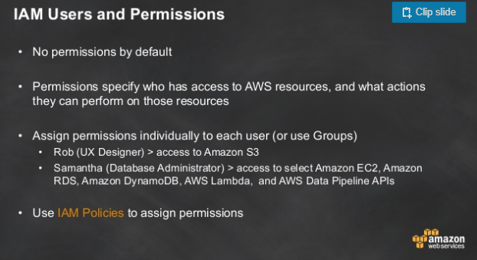

Slide 6
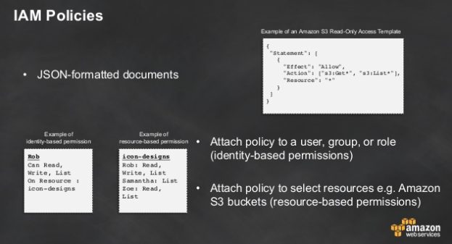

Slide 7

Amazon CloudWatch
Cloud Watch

Slide 8
Outlinee
Interface…
Monitoring…
Management…
Q&A…

Slide 9
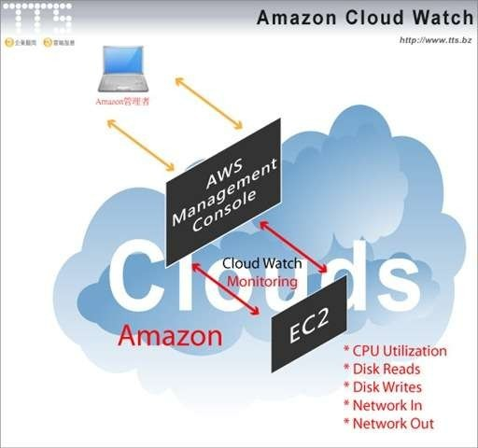

CloudWatch

Slide 10

CloudWatch

Slide 11

It can monitor…
Amazon EBS
Amazon EC2
Amazon RDS
Amazon SNS
Amazon SQS
Auto Scaling
Elastic Load Balancing

Slide 12
It can monitor…
Monitored AWS resources | Frequency | Charge
EC2 instance (basic) | every 5 mins | free
EC2 instance (detail) | every 1 min | additional
EBS volumes | every 5 mins | free
Elastic Load Balancers | every 5 mins | free
RDS DB instance | every 1 min | free
SQS queues | every 5 mins | free
SNS topics | every 5 mins | free

Slide 13

CloudWatch

Slide 14
Default Metrics
EC2 instance
CPUUtilization
DiskReadBytes
DiskReadOps
DiskWriteBytes
DiskWriteOps
NetworkIn
NetworkOut
EBS
CPUUtilization
DiskReadBytes
DiskReadOps
DiskWriteBytes
DiskWriteOps
NetworkIn
NetworkOut

Slide 15
CloudWatch Concepts
Metrics
Namespaces
Dimensions
Timestamps
Units
Statistics
Periods
Regions
Alarms*

Slide 16
Metrics
Defined by
Name
Namespace
Dimensions
time stamp
(optionally) a unit of measure
Note:
Data come from any application or business activity from which you collect data, not just Amazon Web Services products and applications.

Slide 17
Metrics on EC2 instance
Metrics Name | Description | Units
CPUUtilization | The percentage of allocated EC2 compute-units | Percent
DiskReadOps | Completed read operations from all ephemeral disks available to the instance | Count
DiskWriteOps | Completed write operations to all ephemeral disks available to the instance. | Count
DiskReadBytes | Bytes read from all ephemeral disks available to the instance | Bytes
DiskWriteBytes | Bytes written to all ephemeral disks available to the instance. | Bytes
NetworkIn | The number of bytes received on all network interfaces by the instance. | Bytes
NetworkOut | The number of bytes sent out on all network interfaces by the instance. | Bytes

Slide 18
Dimension on EC2 instance
Dimension | Description
AutoScaling GroupName | all instances in a specified capacity group.
ImageId | all instances running this EC2 AMI
InstanceId | the identified instance only
Instance Type | all instances running with this specified instance type

Slide 19
Timestamps
Each metric data point must be marked with a time stamp
Valid Ranges:
up to two weeks in the past
up to one day in the future
By default, cloudwatch creates a time stamp based on the time the data was received
Note:
Better to provide the time stamp under UTC
Statistics from CloudWatch, all times reflect the UTC time zone.
•

Slide 20
Regions
Each Amazon Region
completely isolated from the others
CloudWatch does not aggregate data across Regions
Metrics are completely separate between Regions

Slide 21
Alarms
Watches a single metric over a specified time period
performs one or more actions
based on the value of the metric to a given threshold over a number of time periods
Action:
a notification sent to an SNS topic or Auto Scaling policy
Invoke actions for sustained state changes only
Specify the period over which the comparison is made
Specify how many consecutive periods the threshold must be breached before you are notified

Slide 22
Alarm State
OK
The metric is within the defined threshold
ALARM
The metric is outside of the defined threshold
INSUFFICIENT_DATA
the metric is not available, alarm started
not enough data is available for the metric to determine the alarm state

Slide 23
Features in Alarms
Create
up to 400 alarms per AWS account
List
any or all of the currently configured alarms
list any alarms in a particular state
filter the list by time range
Disable/enable
Test an alarm by setting it to any state
This temporary state change lasts only until the next alarm comparison occurs
View an alarm's history
Cloudwatch preserves alarm history for two weeks
Each state transition is marked with a unique time stamp
The time stamp helps to confirm unique state changes

Slide 24
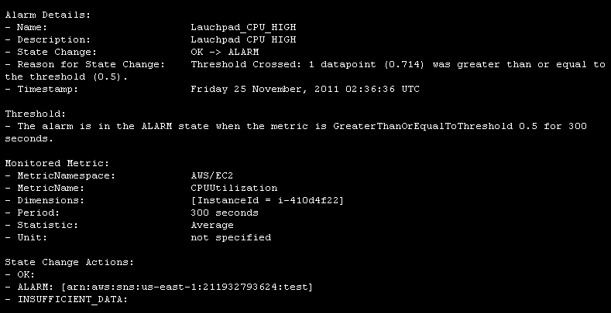
Email Alarm

Slide 25
Pricing
Detailed Monitoring for EC2 instances
at one-minute frequency
7 pre-defined metrics per instance
$3.50 per instance per month (=$0.50*7)
Custom Metrics
$0.50 per metric per month
Alarms
$0.10 per alarm per month
API Requests
$0.01 per 1,000 Get, List, or Put requests
Free Tiers
•
•
Basic Monitoring metrics (at five-minute frequency). All customers (each month)
– 10 metrics; 10 alarms; 1 million API requests

