Slide 1

AWS Lambda and Serverless

Slide 2
What Is AWS Lambda
AWS Lambda is a compute service that lets you run code without provisioning or managing servers. AWS Lambda executes your code only when needed and scales automatically, from a few requests per day to thousands per second. You pay only for the compute time you consume - there is no charge when your code is not running. With AWS Lambda, you can run code for virtually any type of application or backend service - all with zero administration. AWS Lambda runs your code on a high-availability compute infrastructure and performs all of the administration of the compute resources, including server and operating system maintenance, capacity provisioning and automatic scaling, code monitoring and logging

Slide 3


AWS Compute offerings
Amazon EC2
Virtual servers in the Cloud
Amazon ECS Container management service for running Docker containers
on EC2
Amazon Lambda
Serverless compute platform for stateless code execution in response to events

Slide 4
Let’s talk about Lambda!
Serverless compute platform for stateless code execution in response to events

Slide 5

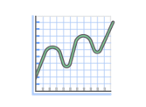
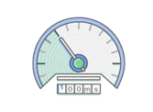
Benefits of AWS Lambda
No servers to manage
Continuous scaling
No idle/cold servers

Slide 6
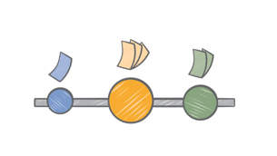
Pay per request
Buy compute time in 100ms increments
Low request charge
No hourly, daily or monthly minimums
No per-device fees
Never pay for idle
Free tier: 1 million requests, and 400,000 GBs of compute every month, for every customer.

Slide 7


Working with Lambda
Bring your own code
Node.js, Java, Python, C#
Bring your own libraries (even native ones)
Simple resource model
Select power rating from 128MB to 3GB
CPU and network allocated proportionately
Metrics show usage

Slide 8


Working with Lambda
Flexible use
Call or send events
Integrated with other AWS services
Build serverless ecosystems
Flexible authorization
Securely grant access to resources, including VPCs
Fine-grained control over what can call your functions

Slide 9


Working with Lambda
Programming model
Built-in AWS SDK
Front end is Lambda
Use processes, threads, /tmp and sockets normally
Authoring functions
Author directly with WYSIWYG editor in console
Package code as .zip and upload to Lambda or S3
Plugins for Eclipse and Visual Studio
Command line tools

Slide 10


Working with Lambda
Stateless
Persist data using Amazon S3, RDS, Elasticache or non-relational database
No affinity to infrastructure (can’t login to host)
Monitoring and logging
Built in metrics for requests, latency, errors and throttles
Built in logging with CloudWatch

Slide 11




Common use cases
Data triggers
Trigger functions on data updates in S3, SNS, etc.
Big data
Real time processing of streaming data updates using Kinesis.
Control systems
Customize responses and workflows to state changes within AWS.
Serverless backends
Execute server-side backend logic

Slide 12
Other use cases

Slide 13
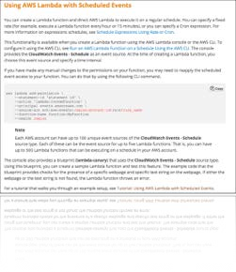
Scheduled events (cron)
Start or stop an environment at a specific time
Log cleanup
Batch data jobs
Alarm clock
Infrastructure automation
Scheduled backups

Slide 14
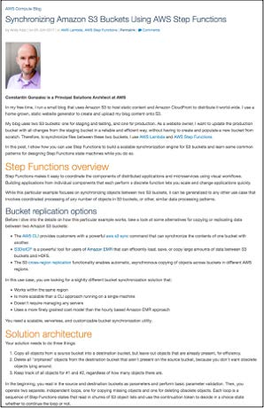
Backup and disaster recovery
Cross-region replication
Off-site backups
But! Validation of backups can be hard.
Set rules on Lambda to define what needs to be checked and backed up
Alert on validation failure

Slide 15
Practical:
Create IAM Role
Before we write any code, we need to create an IAM role that has permissions to do the following:
Retrieve information about volumes and snapshots from EC2
Take new snapshots using the CreateSnapshot API call
Delete snapshots using the DeleteSnapshot API call
Write logs to CloudWatch for debugging
In the AWS management console, we'll go to IAM > Roles > Create New Role.

Slide 16
Policy:
Paste the JSON below for the policy:
{ "Version": "2012-10-17", "Statement": [ { "Effect": "Allow", "Action": [ "logs:*" ], "Resource": "arn:aws:logs:*:*:*" }, { "Effect": "Allow", "Action": "ec2:Describe*", "Resource": "*" }, { "Effect": "Allow", "Action": [ "ec2:CreateSnapshot", "ec2:DeleteSnapshot", "ec2:CreateTags", "ec2:ModifySnapshotAttribute", "ec2:ResetSnapshotAttribute" ], "Resource": [ "*" ] } ] }

Slide 17

Thank You..

