Slide 1
Elastic Load Balancing

Slide 2
Elastic Load Balancing automatically distributes incoming application traffic across multiple Amazon EC2 instances.

Slide 3
A load balancer distributes incoming application traffic across multiple EC2 instances in multiple Availability Zones. ... Elastic Load Balancing detects unhealthy instances and routes traffic only to healthy instances. Your load balancer serves as a single point of contact for clients.

Slide 4





Load Balancer used to route incoming requests to multiple EC2 instances.
EC2
Instance
EC2
Instance
ELB
EC2
Instance

Slide 5


Architecture
ELB VPC
Customer VPC
us-west-1a
EC2
Instance
ELB
Amazon Route 53
us-west-1b
ELB
EC2
Instance

Slide 6




Elastic
Secure
Integrated
Cost Effective

Slide 7

Health checks allow for traffic to be shifted away from failed instances

Slide 8

Health Checks
EC2
Instance
Health checks ensure that request traffic is shifted away from a failed instance.
ELB
EC2
Instance
EC2
Instance

Slide 9

Health Checks
Support for TCP and HTTP health checks.
Customize the frequency and failure thresholds.
Must return a 2xx response.
Consider the depth and accuracy of your health checks.

Slide 10
Idle timeouts allow for connections to be closed by the load balancer when no longer in use.

Slide 11

Idle Timeouts
Length of time that an idle connection should be kept open.
For both client and back-end connections.
Defaults to 60 seconds but can be set between 1 and 3,600 seconds.
Timeouts should decrease as you go up the stack.

Slide 12
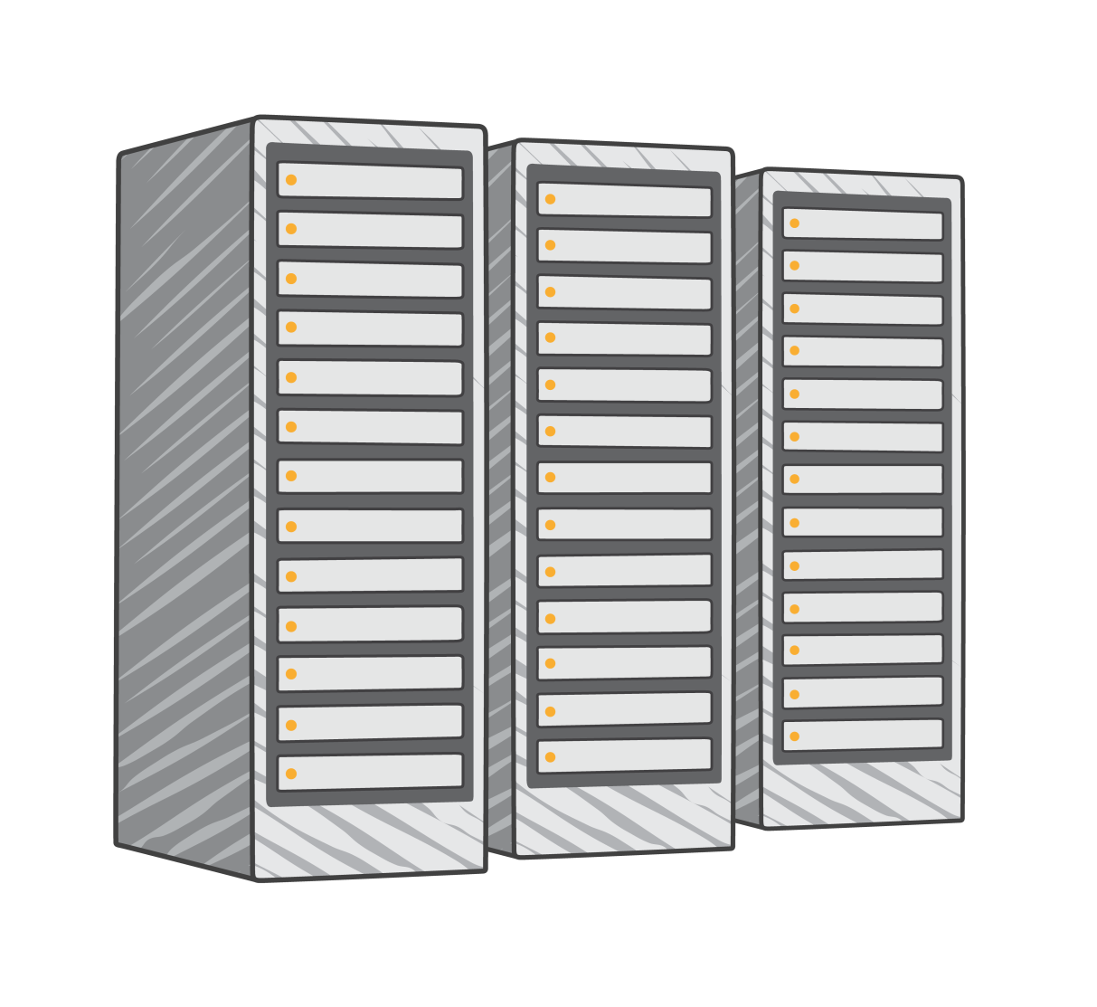
Using multiple Availability Zones

Slide 13
Types of Load Balancer
Classic Load Balancer -> Previous Generation (V1)
Application Load Balancer -> New Generation (V2)
3. Network Load Balancer -> New Generation (V2)

Slide 14
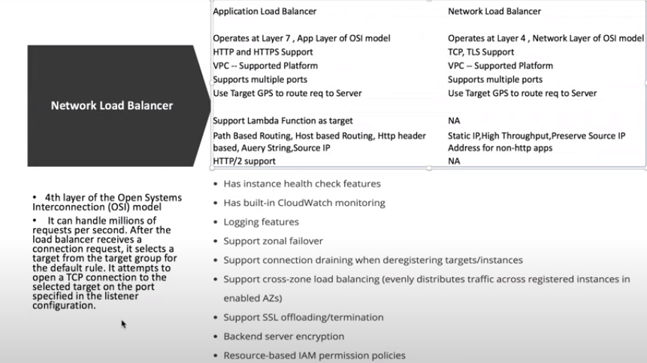

Slide 15


Multiple Availability Zones
Amazon Route 53
ELB VPC
Customer VPC
us-west-1a
EC2
Instance
ELB
us-west-1b
ELB
EC2
Instance

Slide 16
Multiple Availability Zones
Amazon Route 53
ELB VPC
Customer VPC
us-west-1a
EC2
Instance
ELB
us-west-1b
ELB

Slide 17

Always associate two or more subnets in different zones with the load balancer

Slide 18
Using multiple Availability Zones does bring a few challenges.

Slide 19
Traffic Imbalances
Request Count
Time

Slide 20

Imbalanced Instance Capacity
Amazon
ELB VPC Customer VPC
Route 53
us-west-1a
EC2
Instance
ELB
us-west-1b
EC2
Instances
ELB

Slide 21


Cross-Zone Load Balancing
Amazon
ELB VPC Customer VPC
Route 53
us-west-1a
EC2
Instance
ELB
us-west-1b
EC2
Instances
ELB

Slide 22



Traffic Imbalances
Cross-Zone Enabled
Request Count
Time

Slide 23

Cross-Zone Load Balancing
Load balancer absorbs impact of DNS caching.
Eliminates imbalances in back-end instance utilization.
Requests distributed evenly across multiple Availability Zones.
Check connection limits before enabling.
No additional bandwidth charge for cross-zone traffic.

Slide 24

Understanding DNS
Each load balancer domain may contains multiple records.
Round robin used to balance traffic between Availability Zones.
DNS records will to change over time; never target IP addresses directly.
After being removed from DNS, IP addresses are drained and quarantined for up to 7 days.

Slide 25

SSL Offloading
Support for both SSL and HTTPs is provided.
Support for latest ciphers and protocols including Elliptical Curve Ciphers and Perfect Forward Secrecy.
Ability to fully customize ciphers and protocols to be used by each load balancer.
SSL Negotiation Suites provided to remove complexity of selecting ciphers and protocols.

Slide 26
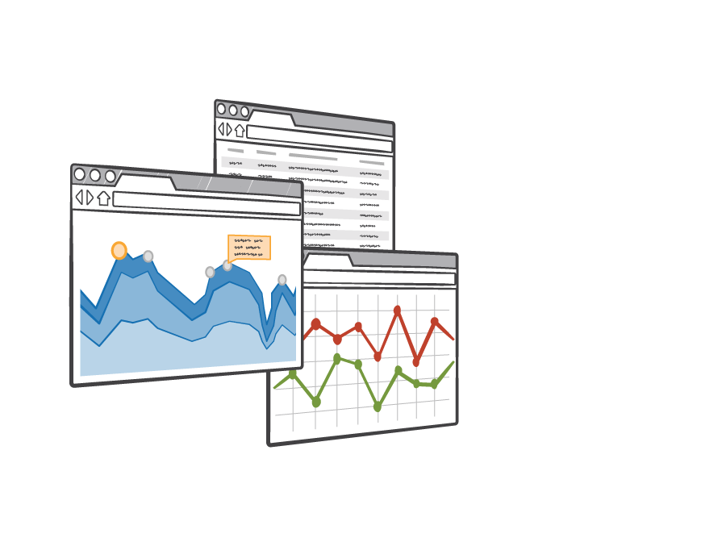
Amazon CloudWatch Metrics
13 CloudWatch metrics provided for each load balancer.
Provide detailed insight into the health of the load
balancer and application stack.
CloudWatch alarms can be configured to notify or take action should any metric go outside of the acceptable range.
All metrics provided at the 1-minute granularity.

Slide 27

AWS Auto Scaling
AWS Auto Scaling lets you build scaling plans that automate how groups of different resources respond to changes in demand. You can optimize availability, costs, or a balance of both. AWS Auto Scaling automatically creates all the scaling policies and sets targets for you based on your preference.
AWS Auto Scaling monitors your application and automatically adds or removes capacity from your resource groups in real-time as demands change.

Slide 28
AWS Auto Scaling
Auto Scaling is the process of automatically increasing or decreasing the computational resources delivered to a cloud workload based on need. The demand for computational resources is usually determined by: The number of incoming requests (front-end traffic).

Slide 29
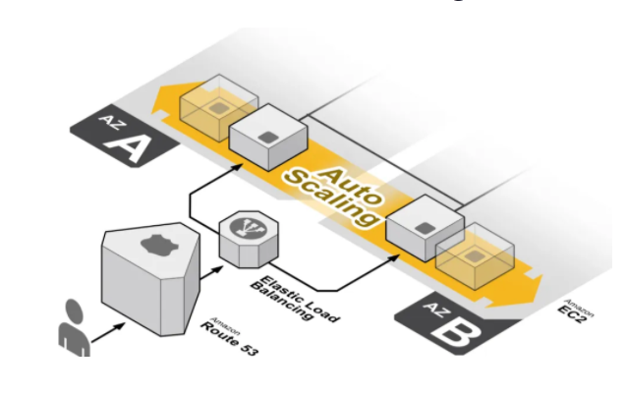
AWS Auto Scaling

Slide 30
Benefits of Auto Scaling
Better fault tolerance.
Amazon EC2 Auto Scaling can detect when an instance is unhealthy, terminate it, and launch an instance to replace it.
Better availability.
Better cost management.

Slide 31
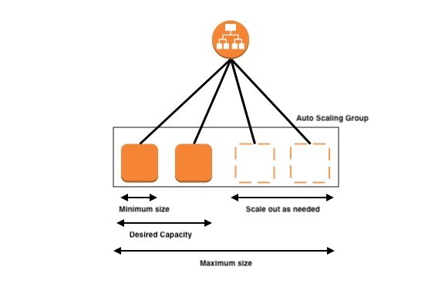
Amazon EC2: Auto Scaling

Slide 32
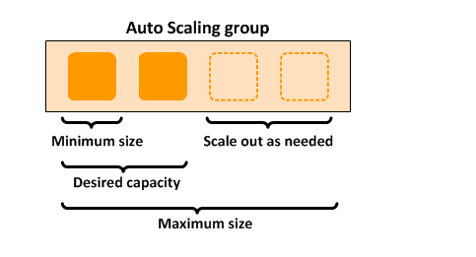
For example, the following Auto Scaling group has a minimum size of one instance, a desired capacity of two instances, and a maximum size of four instances. The scaling policies that you define adjust the number of instances, within your minimum and maximum number of instances, based on the criteria that you specify.

Slide 33
Launch Configurations and Auto Scaling Groups. 1. Launch Configurations hold the instructions for the creation of new instances. 2. Auto Scaling Groups, on the other hand, manage the scaling rules and logic, which are defined in policies.
Auto Scaling has two components:

Slide 34
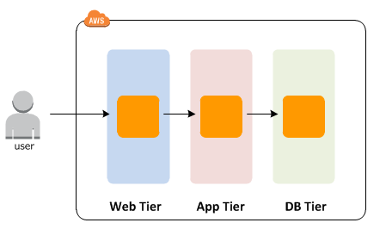
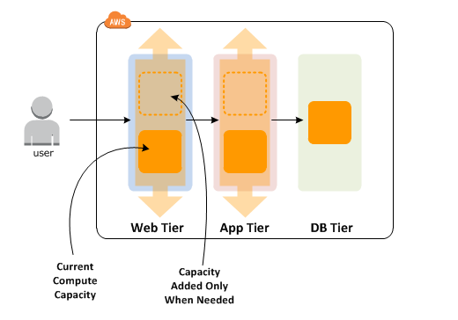
Example: Web App Architecture
In a common web app scenario, you run multiple copies of your app simultaneously to cover the volume of your customer traffic. These multiple copies of your application are hosted on identical EC2 instances (cloud servers), each handling customer requests.

Slide 35
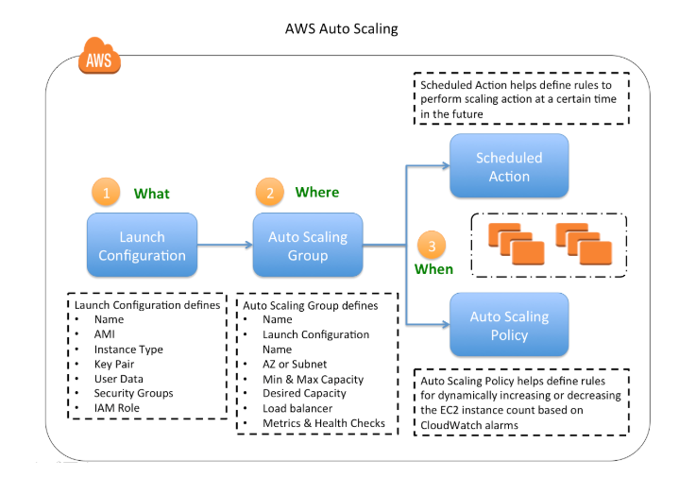
Auto Scaling Configuration

Slide 36
Thank you.!!

