Slide 1
New Wheels
Business Report
~ BY Shaik Shameer

Slide 2

[Q1] What is the distribution of customers across states?

Slide 3
INSIGHTS
1. There are total of 49 states with 994 customers.
2. Out of which we selected five states which have 36.8% of customers respectively with California and Texas have 97, Florida with 86, New York with 69 and District of Columbia with 35.
3.The five states with least customers are Vermont with 1, Wyoming with 1, Maine with 1, Mississippi with 2 and North Dakota with 2.

Slide 4
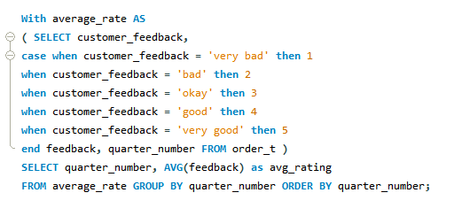
[Q2] What is the average rating in each quarter?

Slide 5
INSIGHTS
1. The average of first quarter is 3.5548, second quarter 3.3550, third quarter 2.9563 and fourth quarter 2.3970.
2. We can observe decline in the average rating; rating is reduced from quarter to quarter.
3. The rating in first quarter to last quarter has a decline trend.
4. Based on the above data and facts we can say that customers are dissatisfied over comparing first to last quarter.

Slide 6
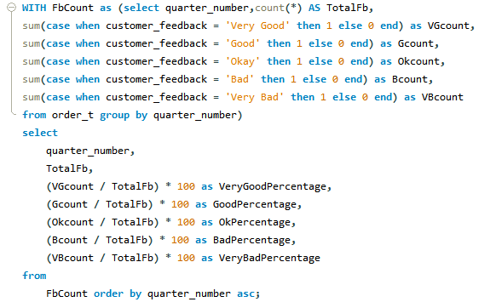
[Q3] Are customers getting more dissatisfied over time?

Slide 7
INSIGHTS
1. Data from the column very good percentage we can see the quarter percentage is around 30 and quarter 4 percentage is around 10. There is higher declination from quarter 1 to quarter 4. We can see same scenario in good percentage column too
2. The column very bad percentage we can see the quarter percentage is around 10 and quarter 4 percentage is around 30. There is higher inclination from quarter 1 to quarter 4. We can see same scenario in bad percentage too
3. In the first quarter 58.7% of customers are satisfied and gave good and very good feedback but in the last quarter only 20% of the customers are satisfied and gave good and very good feedback.
4. By the data we can say customers are dissatisfied over time.

Slide 8
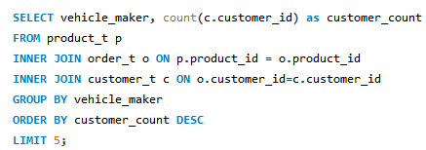
[Q4] Which are the top 5 vehicle makers preferred by the customer.

Slide 9
INSIGHTS
1. Chevrolet is the top among the customers.
2. There are 54 vehicle makers in the data
3. The top 5 vehicle makers are Chevrolet with 83 customers, ford with 63 customers, Toyota with 52 customers, Pontiac with 50 customers and Dodge with 50 customers.
4. Top five vehicle makers have 30% of the customers

Slide 10
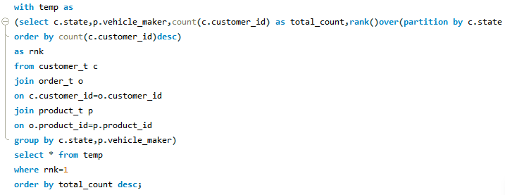
[Q5] What is the most preferred vehicle make in each state?

Slide 11
INSIGHTS
1. Chevrolet is the most preferred vehicle maker. Many states are using the vehicle manufactured by Chevrolet.
2. Chevrolet, Dodge is the next vehicle maker preferred

Slide 12

[Q6] What is the trend of number of orders by quarters?

Slide 13
INSIGHTS
1. For all quarters orders are decreasing
2. First quarter comprises of 31% of orders
3. Last quarter comprises of 20% of orders

Slide 14
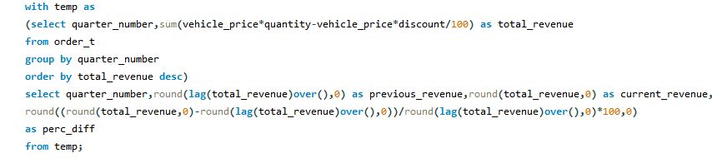
[Q7] What is the quarter over quarter % change in revenue?

Slide 15
INSIGHTS
1. Revenue current in the first quarter is 39493447 , second quarter is 32783621 , third quarter is 29297793 and in fourth quarter is 23398373
2. Revenue change in the second quarter is -17 which means there is 17% fall in the revenue compared to the first quarter.

Slide 16
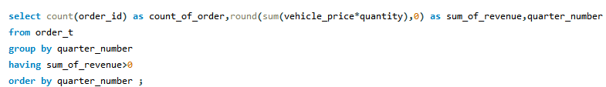
[Q8] What is the trend of revenue and orders by quarters?

Slide 17
INSIGHTS
1. Revenue and total orders for the quarters are displayed in the table above
2. We can see that first quarter had good revenue and good number of orders compared to last quarter
3. We can also see that total no of orders are decreased as quarter increases which effecting the revenue and also decreasing.
4. For every quarter orders are getting decreased

Slide 18
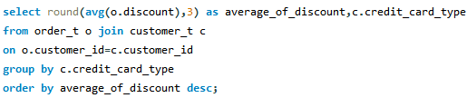
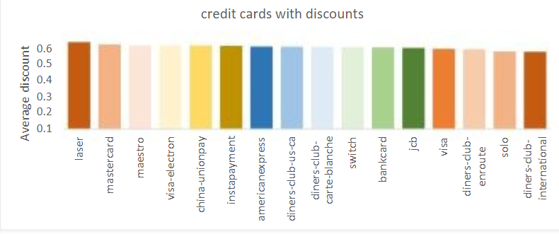
[Q9] What is the average discount offered for different types of credit cards?

Slide 19
INSIGHTS
1.There are 16 types of credit cards.
2.Out of which laser card gives more discount than any other type of cards and diner club international card gives least discount.
3.Credit card average discount ranges from 0.643 to 0.584.

Slide 20

[Q10] What is the average time taken to ship the placed orders for each quarters?

Slide 21
INSIGHTS
1. Average time taken for shipping the order to customers in the first quarter is 57.16 days.
2. Average time taken for shipping the order to customers in the second quarter is 71.11 days.
3. Average time taken for shipping the order to customers in the third quarter is 117.75 days.
4. Average time taken for shipping the order to customers in the fourth quarter is 174.09 days

Slide 22
THANK YOU

