Slide 1
Predicting Term Deposit subscription
Group 1
Shaik Shameer (TL)
S P Gajapathii
Bhushan Choudhary
Shreya Bhatkande
Purva vaishnav
Sam Wilkerson
Mentor:
Ms. Anjana Agrawal

Slide 2
Problem Definition
Problem Statement: Predict whether a customer will subscribe to a term deposit based on their attributes and past campaign outcomes.
Importance: Enhances the effectiveness of marketing campaigns and optimizes resources by targeting customers likely to subscribe.
Value Additions: Improves customer segmentation, tailors marketing strategies, and boosts subscription rates.

Slide 3
Importance of Problem
Business Impact: Increase bank revenue by identifying potential subscribers, thus enabling focused marketing efforts. Strategize the campaigns according to the highlights from the model.
Technology Impact: Utilizing machine learning to analyse historical data and make data-driven decisions.

Slide 4
Suggested Solution
Solution Overview: Develop a predictive model using machine learning to forecast customer subscription possibility.
Objective: Maximize the precision of predicting customer subscriptions and enhance marketing efficiency.

Slide 5
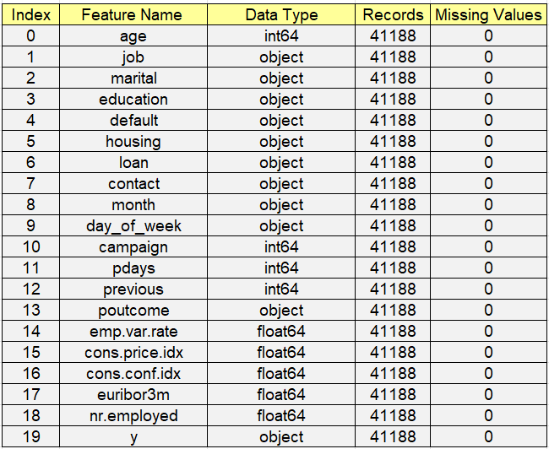
Dataset Considered
Description of the dataset
The dataset contains information on bank marketing campaigns and customer responses.
Source: UCI Machine Learning Repository
Key features:
Age, job, marital status, education, default, housing loan, personal loan, contact method, campaign details, previous outcomes, economic indicators, target variable (term deposit subscription).
Data Size: Approximately 41,000 rows and 20 columns

Slide 6
Exploratory Data Analysis (EDA)
(EDA) Initial Findings: Identified key features influencing customer subscriptions, such as age, job, and previous campaign outcomes etc.
Visualizations: distribution of customer attributes, correlations between features, and subscription rates.
Challenges:
Missing values: We had a total of approx 28% of missing values from columns Job, Marital Status, Education, Default, housing, loan.
Unknown Values: Our categorical columns comprised of “unknown values” which we converted into null values and then we imputed these null values with the mode of every categorical columns, respectively.
Normalizing data for better model performance.

Slide 7
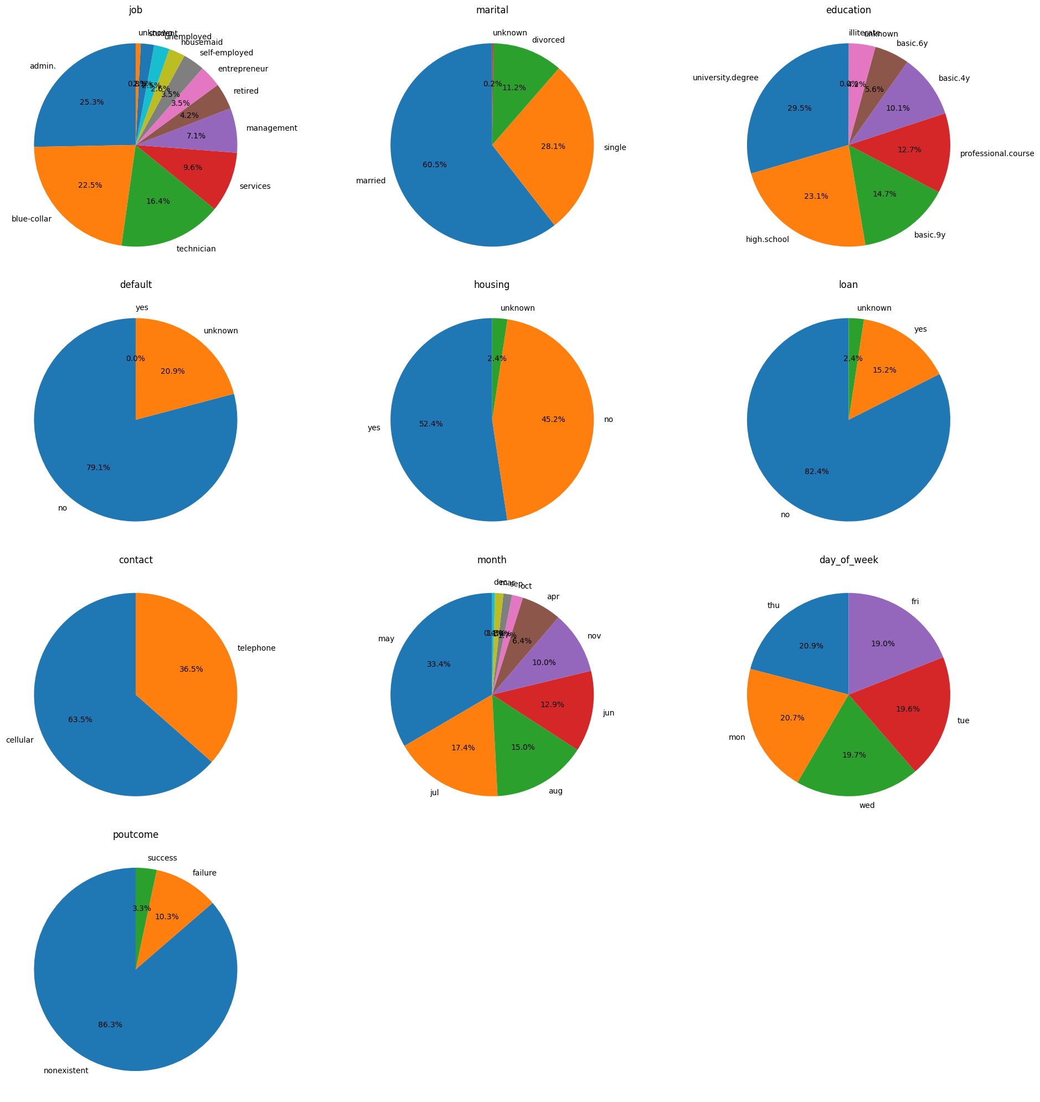
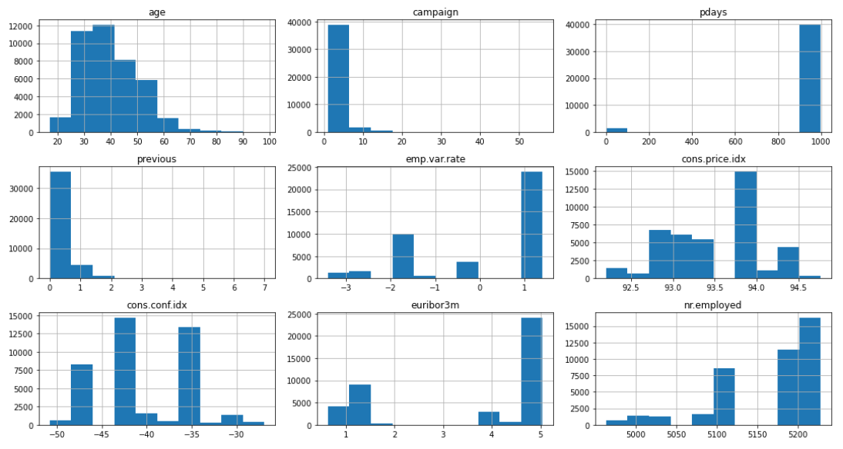
Exploratory Data Analysis (EDA)
Univariate (Numeric)
Univariate (Categorical)

Slide 8
Exploratory Data Analysis (EDA)
Univariate Numerical Analysis
Univariate Categorical Analysis
Age: Right-skewed customer base. Focus marketing on the majority younger
Campaign Contacts: Enhancing initial contacts is crucial as most clients were contacted only a few times.
Pdays: Focus on initial engagement to convert the majority of new customers with no prior contact.
Previous Contacts: Increase follow-up contacts to improve conversion rates, as most clients had few previous contacts.
Job Types: Tailor campaigns to 'blue-collar' and 'management' clients to boost engagement and response rates.
Marital Status: Design campaigns for married clients to enhance effectiveness and appeal
Preferred Contact Method: Prioritize 'cellular' contact to enhance engagement and conversion rates.
Education Levels: Tailor content to resonate with clients holding 'university.degree' or 'high.school' education
Peak Contact Month: Focus marketing efforts in May to capitalize on high customer responsiveness.

Slide 9
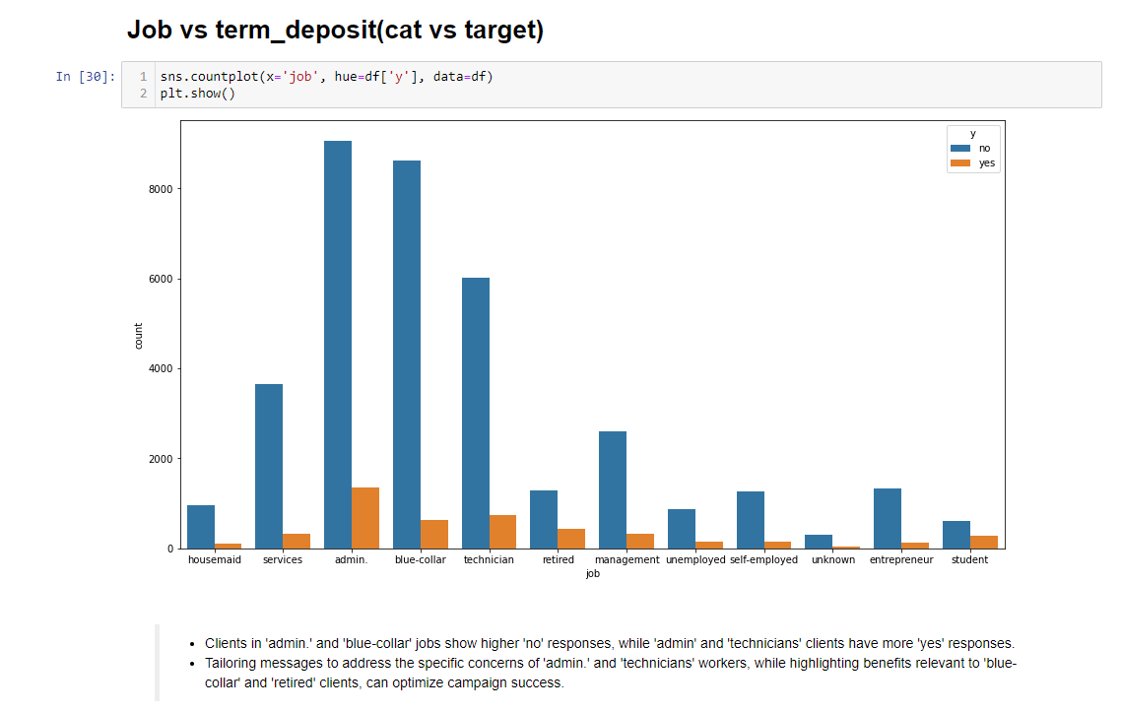
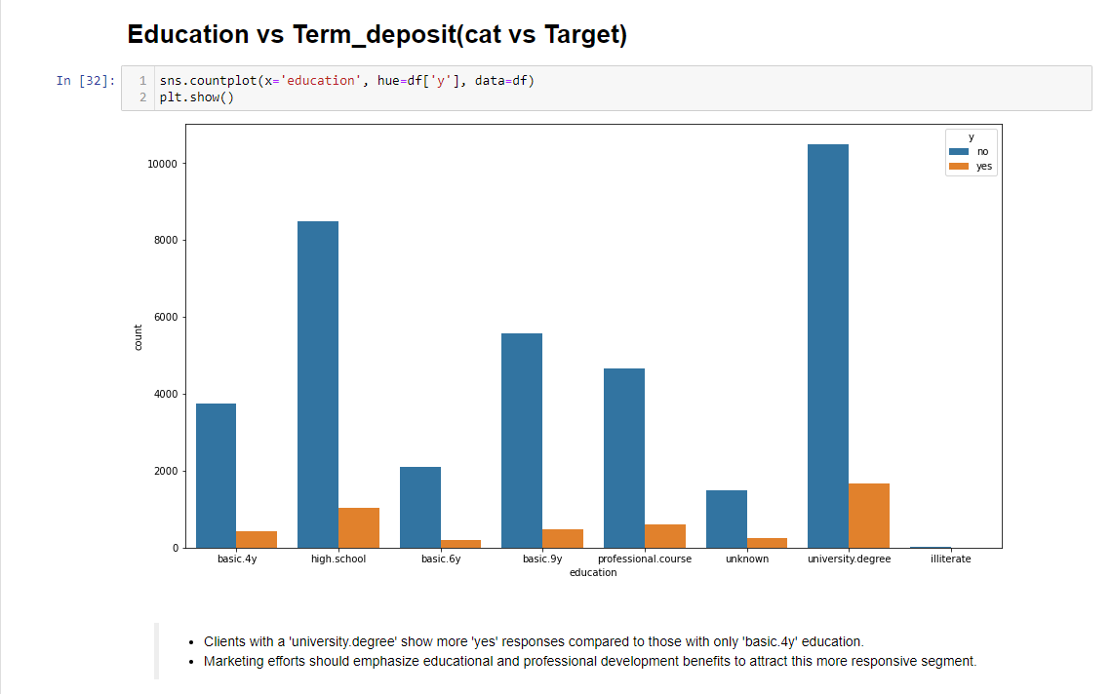
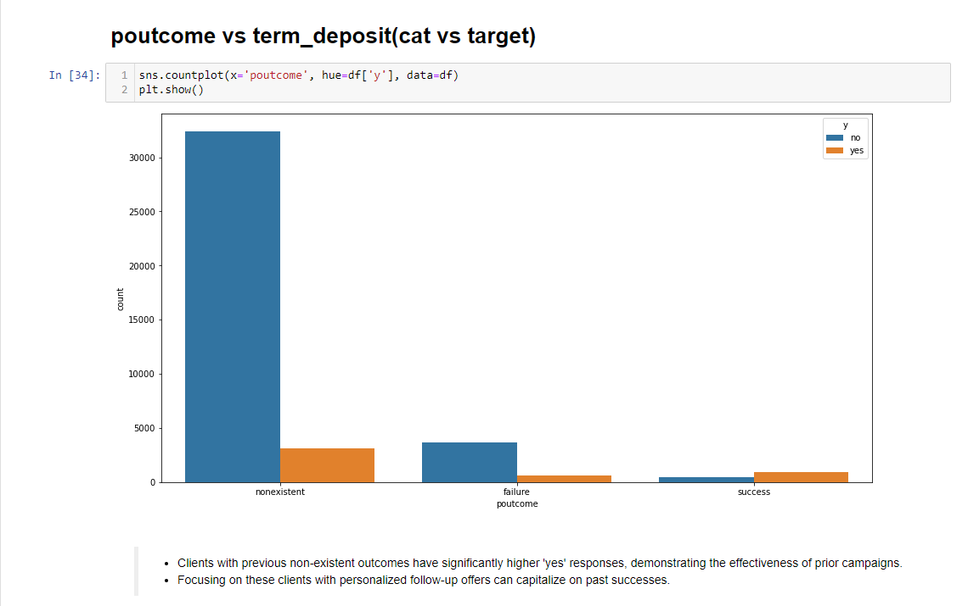
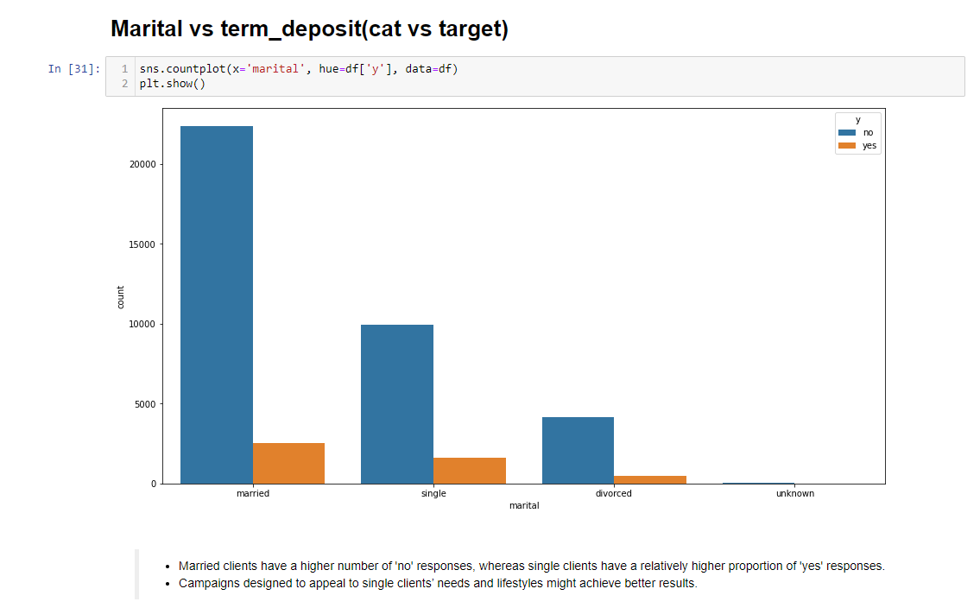
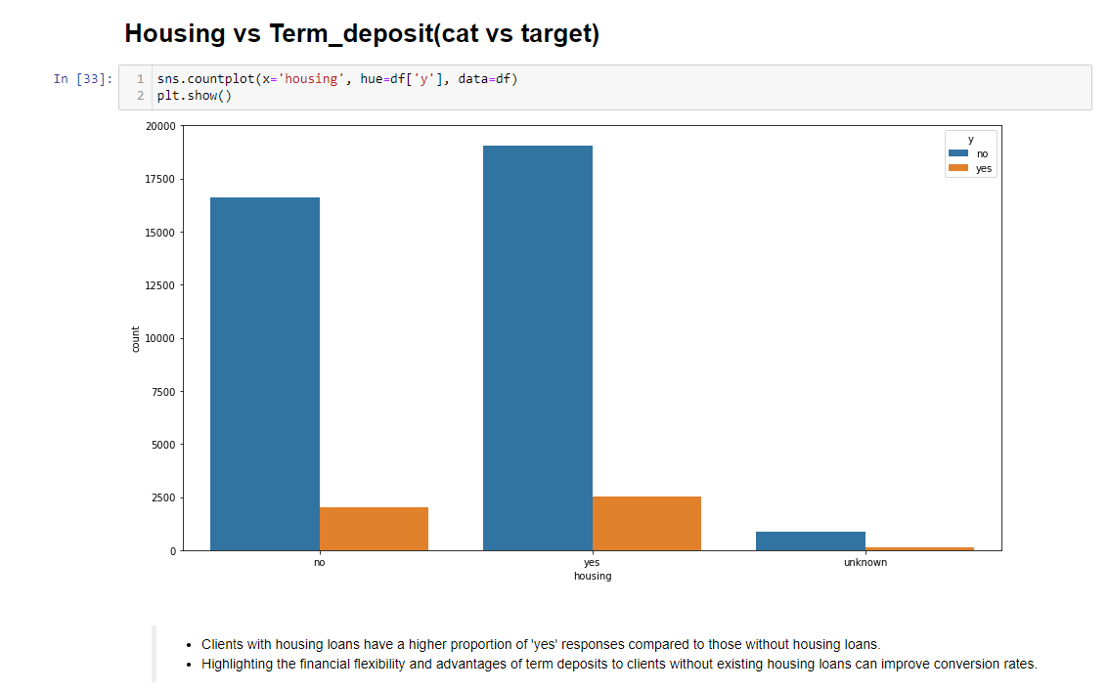
Exploratory Data Analysis (EDA)
Target vs Categorical Variables

Slide 10
Exploratory Data Analysis (EDA)
Target vs Categorical Variables
Key findings: (Target vs Cat)
Job vs Target: Tailoring messages to address the specific concerns of 'admin.' and 'technicians' workers, while highlighting benefits relevant to 'blue-collar' and 'retired' clients, can optimize campaign success.
Education vs Target: Clients with a 'university degree' show more 'yes' responses compared to those with only 'basic.4y' education.
Poutcomes vs Target: Clients with previous non-existent outcomes have significantly higher 'yes' responses, demonstrating the effectiveness of prior campaigns
Marital status vs Target: Single clients respond more positively compared to married ones. Campaigns designed to appeal to single clients’ needs and lifestyles might achieve better results
Housing vs Target: Clients with housing loans tend to have higher positive responses, suggesting a link between financial stability and interest in term deposits. Highlighting the financial flexibility and advantages of term deposits to clients without existing housing loans can improve conversion rates.

Slide 11
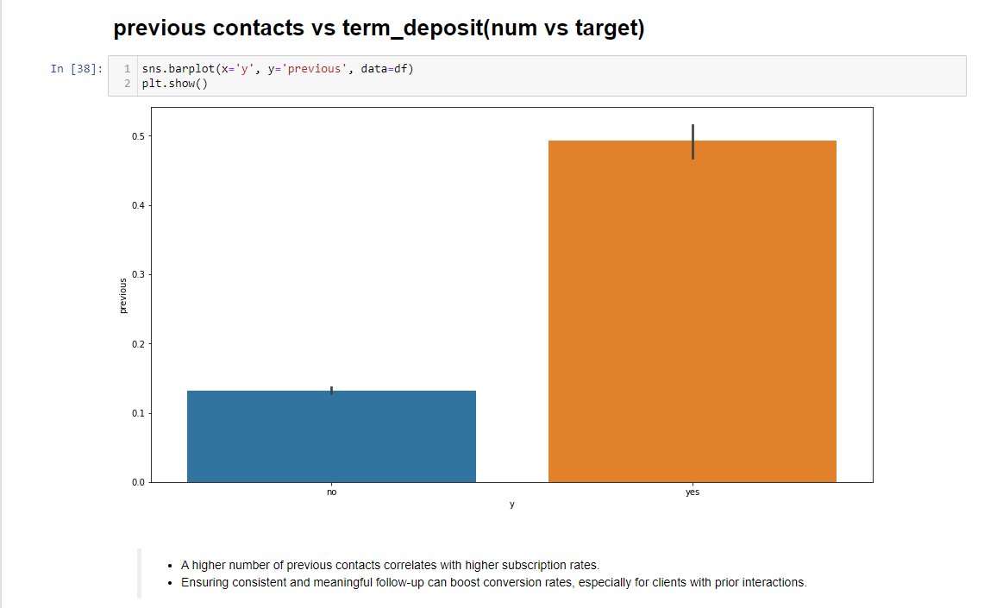
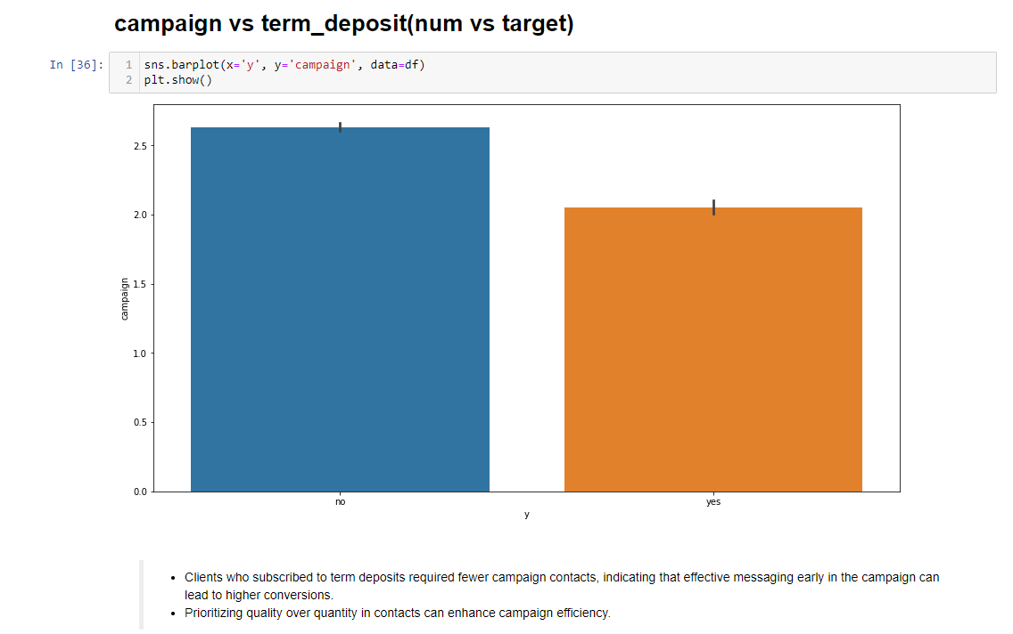
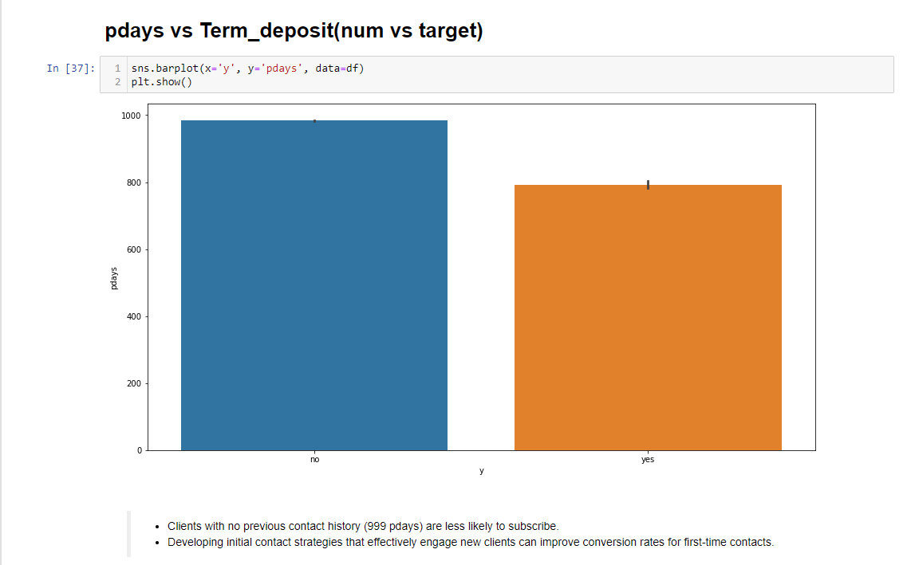
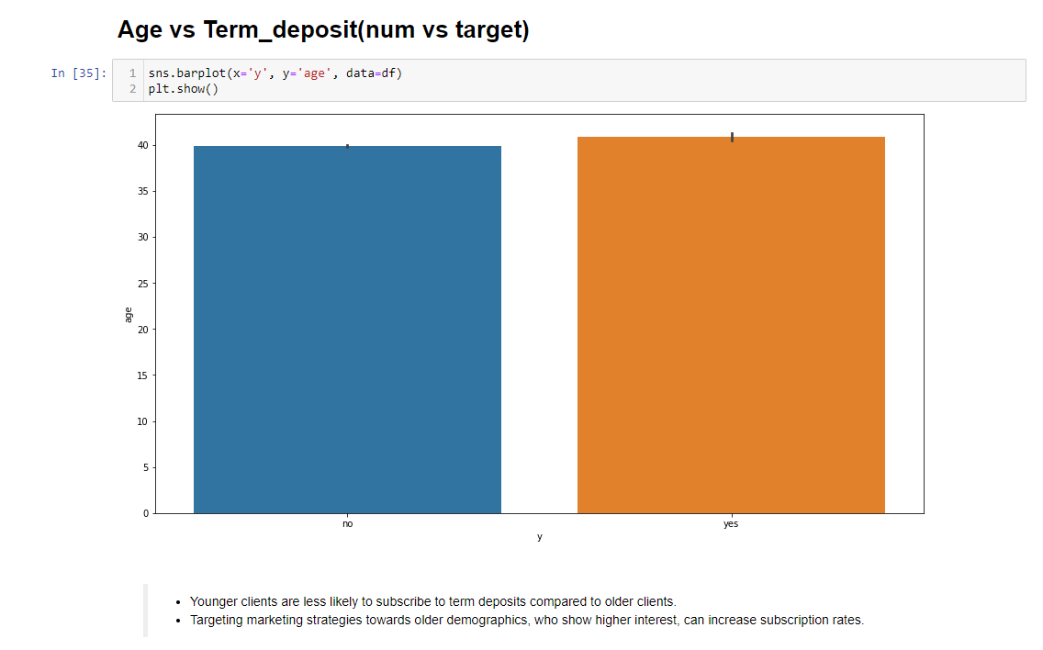
Exploratory Data Analysis (EDA)
Target vs Numeric Variables

Slide 12
Exploratory Data Analysis (EDA)
Target vs Numeric Variables
Key findings: (Target vs Num)
Previous contact vs Target: Ensuring consistent and meaningful follow-up can boost conversion rates, especially for clients with prior interactions.
Campaign vs Target: Developing initial contact strategies that effectively engage new clients can improve conversion rates for first-time contacts.
Pdays vs Target: Clients who subscribed to term deposits required fewer campaign contacts, indicating that effective messaging early in the campaign can lead to higher conversions.
Age vs Target: Targeting marketing strategies towards older demographics, who show higher interest, can increase subscription rates

Slide 13
Statistical Test and Feature Selection
Objective: To identify significant features in the dataset using statistical tests.
Importance: This helps in effective feature selection, enhancing model performance by focusing on the most relevant features.
Significant Features: Age, Campaign, Previous, Emp.var.rate, Cons.price.idx, Cons.conf.idx, Euribor3m, Nr.employed, Job, Marital, Education, Housing, Contact, Month, Day_of_week, Pdays, Poutcome.
Non-Significant Features: Default, Loan.
Next Steps: Focus on significant features for model training and validation. Consider interactions between significant features for potential improvement in model performance.

Slide 14
Algorithm Considered
List of Algorithms: Logistic Regression, Decision Trees, Random Forests, Bagging Classifier, Ada-Boost, Gradient Boost, XG Boost.
Pros and Cons:
Logistic Regression: Simple, interpretable but may underfit.
Decision Trees: Easy to visualize but prone to overfitting.
Random Forests: Robust and accurate but computationally intensive.
Bagging Classifier: Reduces overfitting but increases computation and lowers interpretability.
Ada-Boost: Improves performance but is sensitive to noise and needs careful tuning.
Gradient Boost: High accuracy and flexible but resource-heavy and prone to overfitting.
XG Boost: Performs well with regularization but is complex to tune and resource-demanding.

Slide 15
Solution Architecture
Technical Architecture:
Data Preprocessing: Cleaned data by addressing missing values, encoding categories, and normalizing features.
Feature Selection: Selected key features like age, job, and previous campaign results to enhance model accuracy.
Model Training IDE: Jupyter Notebook
Validation: Evaluated model performance using cross-validation to ensure robustness.
Functional Architecture:
Input Raw Data: Collected data from bank marketing campaigns, including client profiles and campaign outcomes.
Preprocess: Cleaned and transformed the data, including handling missing values and encoding features.
Model Training: Trained models, including Logistic Regression and Random Forest, on the prepared dataset.
Apply Predictive Model: Applied the trained model to predict term deposit subscriptions.
Output Subscription Predictions: Delivered predictions to the marketing team for targeted client engagement.

Slide 16
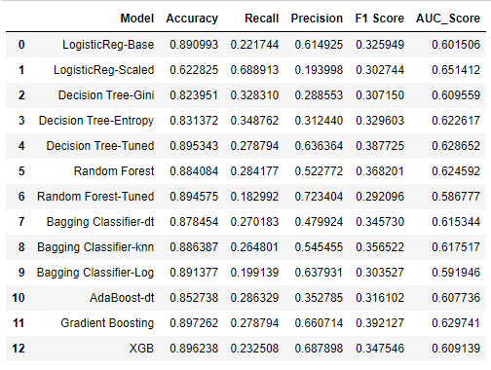
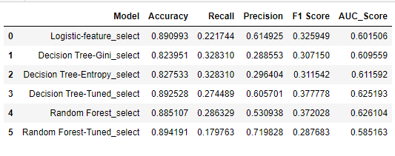
Results
Performance Metrics:
Before removing Loan and default
After removing Loan and default

Slide 17
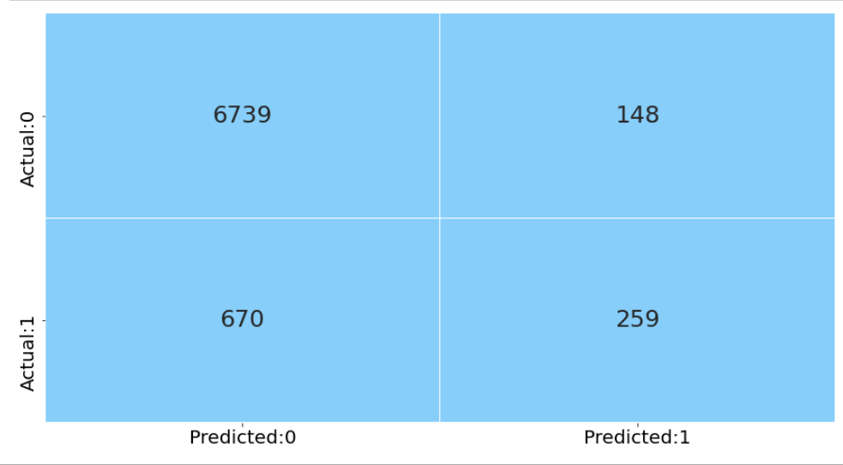
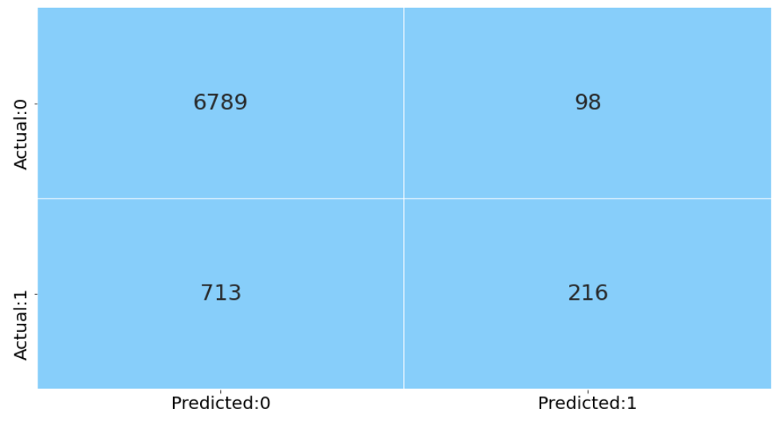
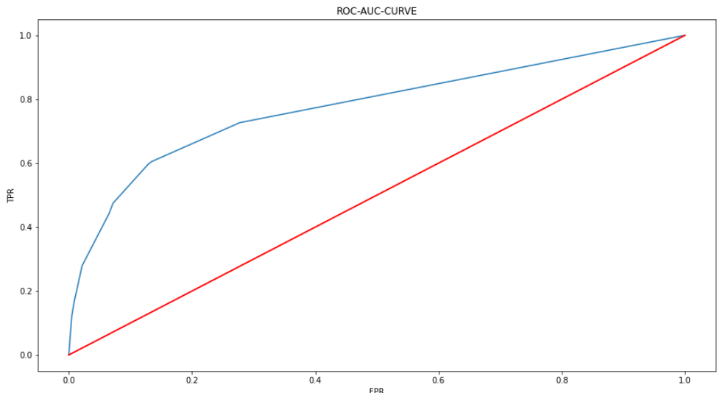
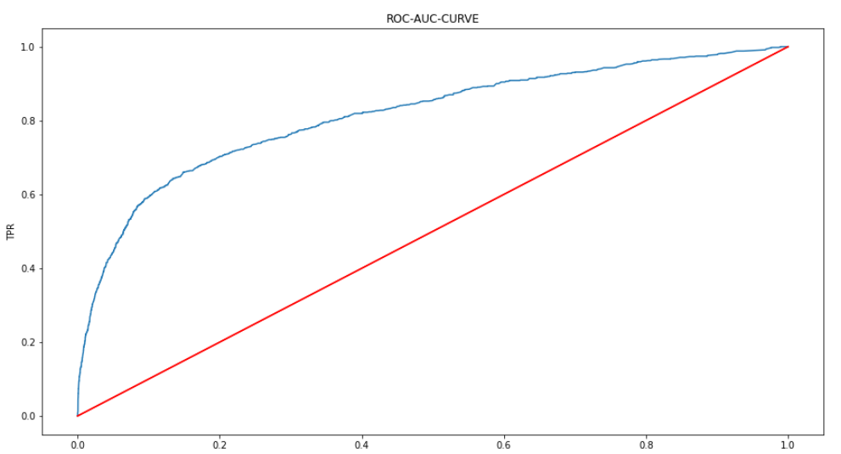
Final Model
Decision Tree - Tuned
XG Boost

Slide 18
Conclusion
Summary: Higher management can identify potential clients who are more likely to subscribe to a term deposit, allowing them to focus their efforts on these promising prospects.
Companies can leverage these insights to forecast and implement targeted strategies in advance. Smarter marketing campaigns, tailored offers, and personalized incentives can be crafted to enhance client engagement and conversion rates.
It’s a win-win situation all round, as the bank can optimize its marketing efforts while clients receive more relevant and appealing offers
Future Work: Further refine the model, explore additional features, and apply segmentation analysis for better-targeted campaigns.

Slide 19
Thank
You!

