Slide 1
Lending Club Case Study
Mr. Shameer Sheik
17-Oct-2023

Slide 2
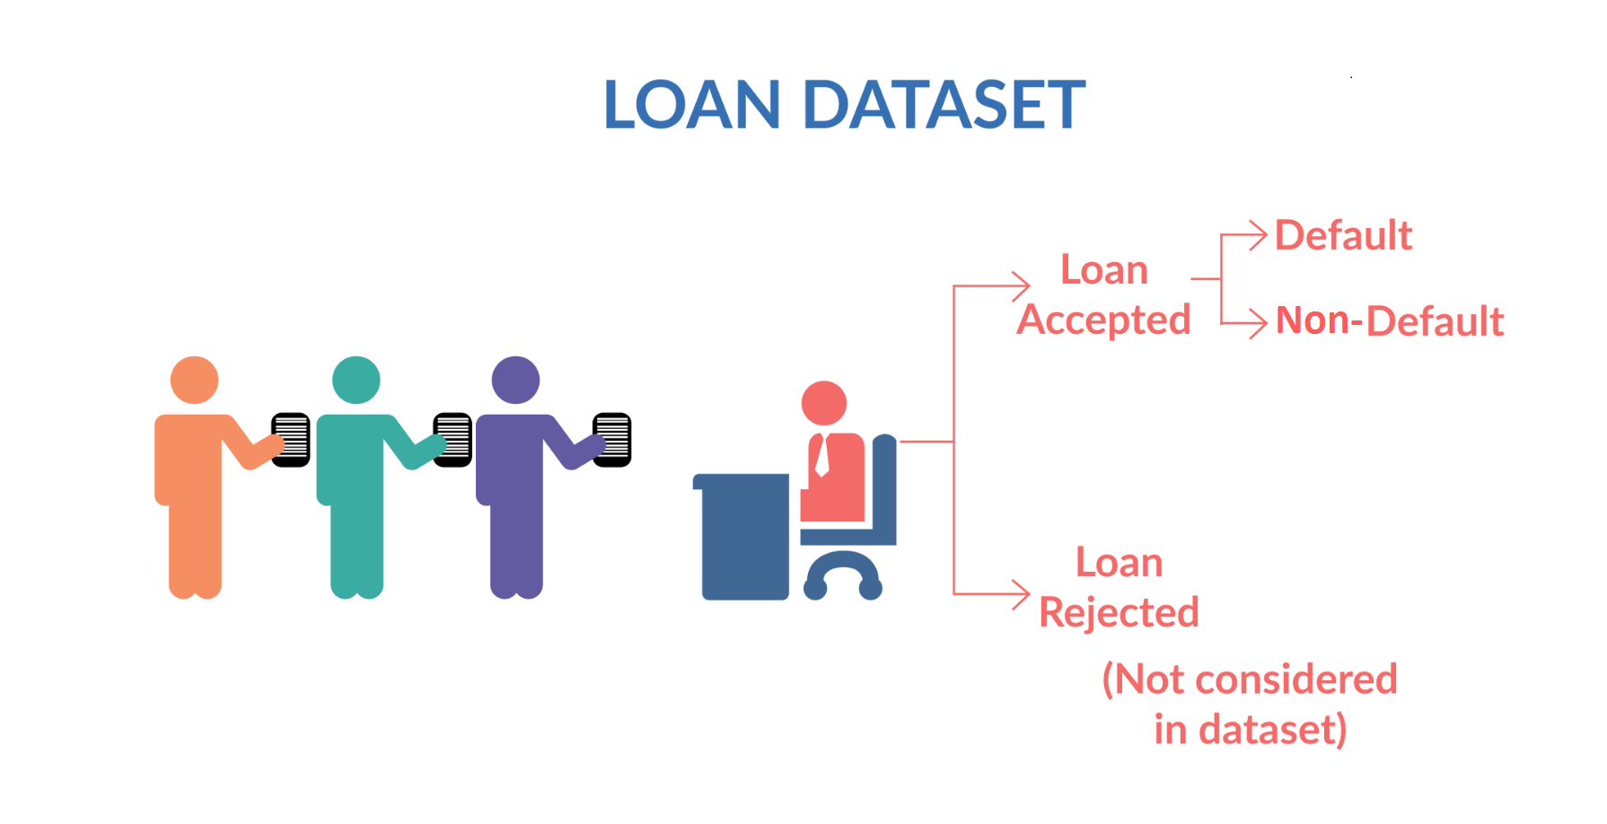

Slide 3
Objective
The Objective of this case study is to implement EDA technique on a real-world problem and understand the insights and present in a business first manner via presentation.
Benefits of the case study:
Gives an idea about how EDA is used in real life business problems.
It also develops a basic understanding of risk analytics in banking and financial services.
How the data is used to minimize loss of money while lending it to clients.
It improves our understating of visualization and what charts to use for real life data.

Slide 4
Business Understanding
We are working for Lending club a finance company which specializes in lending various types of loans to urban customers. When the company receives a loan application, the company has to make a decision for loan approval based on the applicant’s profile. Two types of risks are associated with the bank’s decision:
If the applicant is likely to repay the loan, then not approving the loan results in a loss of business to the company.
If the applicant is not likely to repay the loan, i.e., he/she is likely to default, then approving the loan may lead to a financial loss for the company.
Dataset Details:
The data given below contains information about past loan applicants and whether they ‘defaulted’ or not. Data has details regarding approved loan not the rejected ones. It has 3 status of loan which is Fully Paid, Current and Charged-Off.

Slide 5
Data Clean-up and Preparation Process
Import the Data
Remove Large null value columns
Remove Duplicate data
Remove irrelevant columns
Removing/Fixing null values
Correcting data types and deriving new columns
Filter data for requirement
Removing Outliers

Slide 6
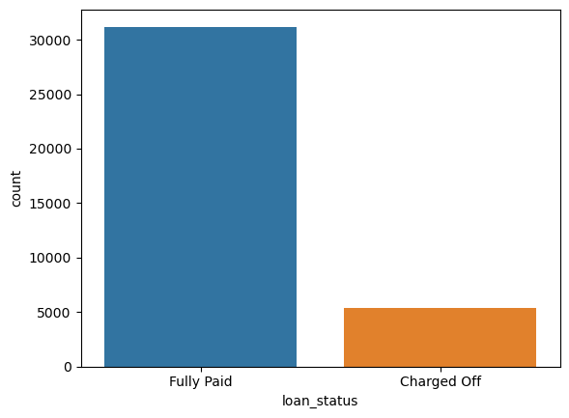
Loan Status and Amount
Loan Status: The number of charged off loan is much smaller(14.5%) compared to total count. Focus part of the analysis is the category of Charged Off.

Slide 7
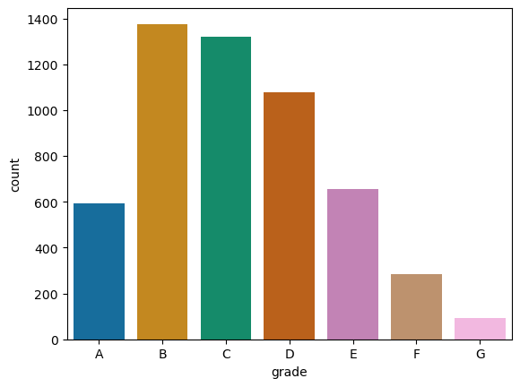
Loan status: Charged Off vs Grade
Loan Status: Employee Grade B, C, D are higher in number and Grade F, G are negligible when compared with other grades.

Slide 8
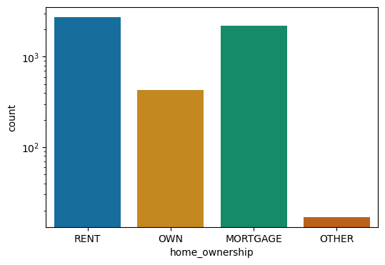
Home Ownership vs Charged Off
Loan Status: Majority “Charged Off” applicants fall under home ownership category as either RENT or MORTGAGE

Slide 9
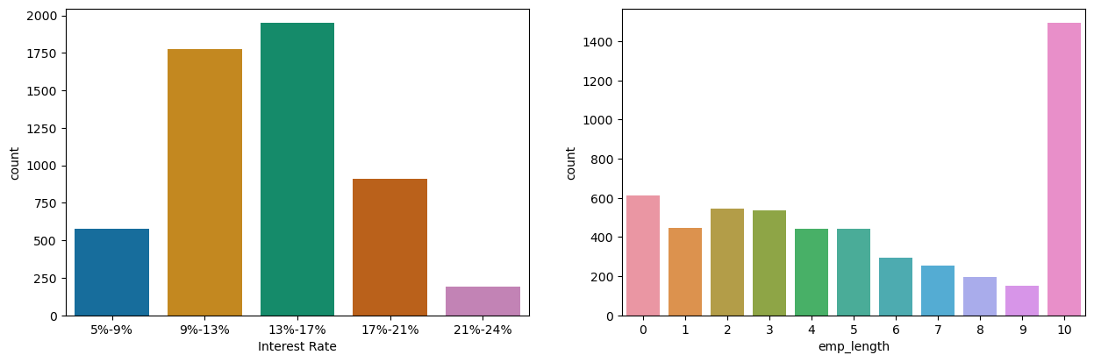
Employment Length & Interest rate
Interest rate: Majority of applicants of interest in range of 9% to 17% are in Charged Off category
Employment Length: Majority of clients have 10+ years of experience and has highest number of defaulted loan.

Slide 10
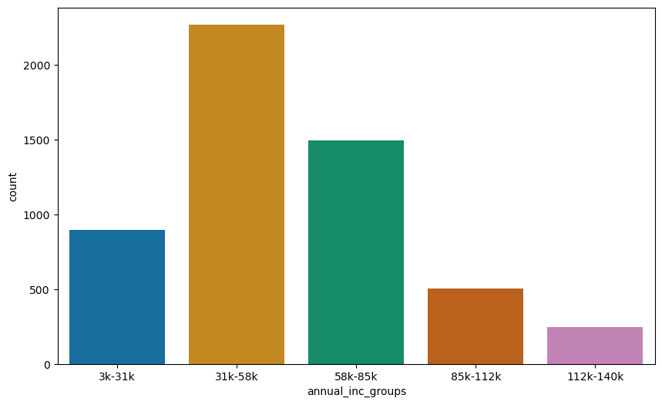
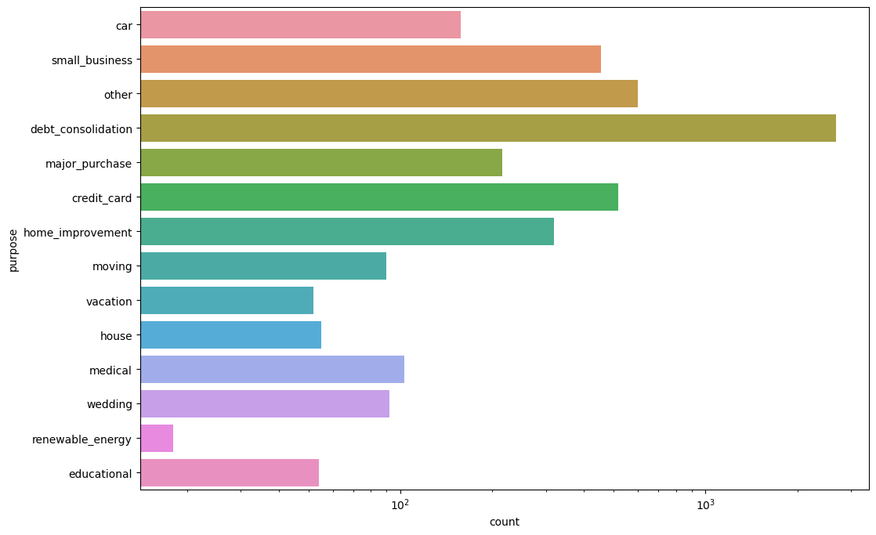
Annual Income & Purpose
Purpose: Loans are taken mostly for debt consolidation followed by credit card payment. Whereas the debt consolidation has highest fully paid loan but also has highest defaulted loans as well.
Annual Income : Majority of clients/applicants with income in between 31k to 58k has higher chance of defaulting.

Slide 11
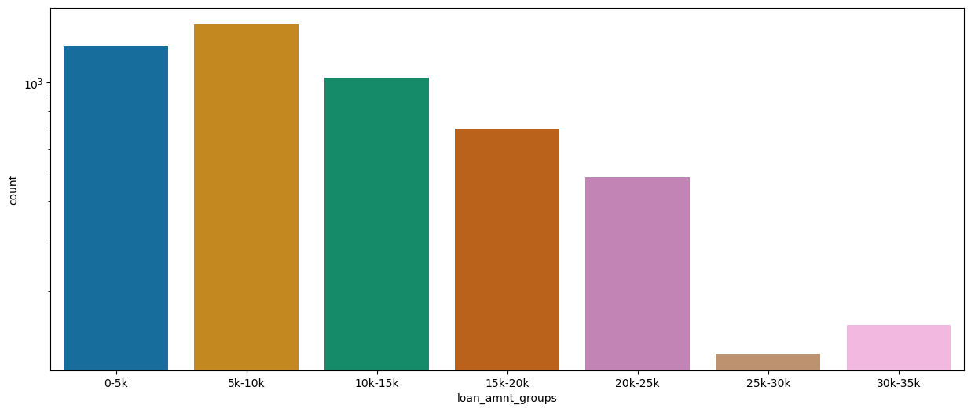
Loan Amount & Charged Off
Loan Amount : Majority of clients/applicants with loan amount of less than 15k has higher chance of defaulting.

Slide 12
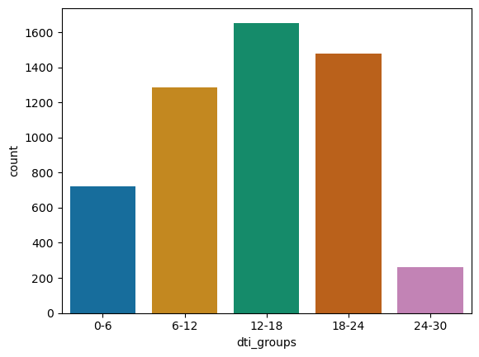
DTI ratio
DTI: The large percentage of Clients/applicants have a large Debt to Income ratio, especially in the range of 12 to 18, which shows that lending to such clients can be very risky.

Slide 13
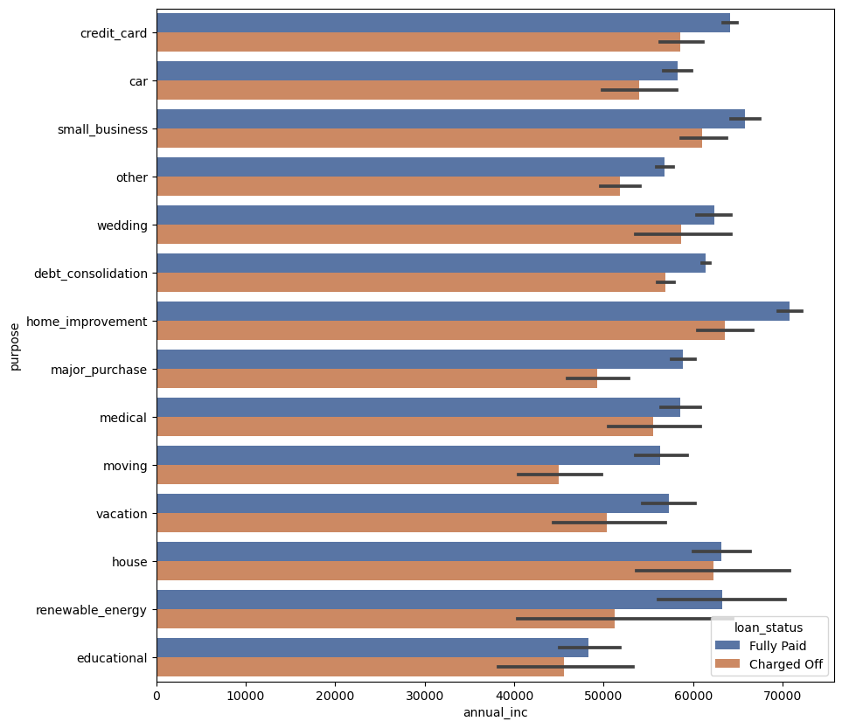
Annual income vs Purpose vs Loan Status
Applicants with Annual income of 60k or more with a purpose of house or home improvement have higher chances of becoming risky.

Slide 14
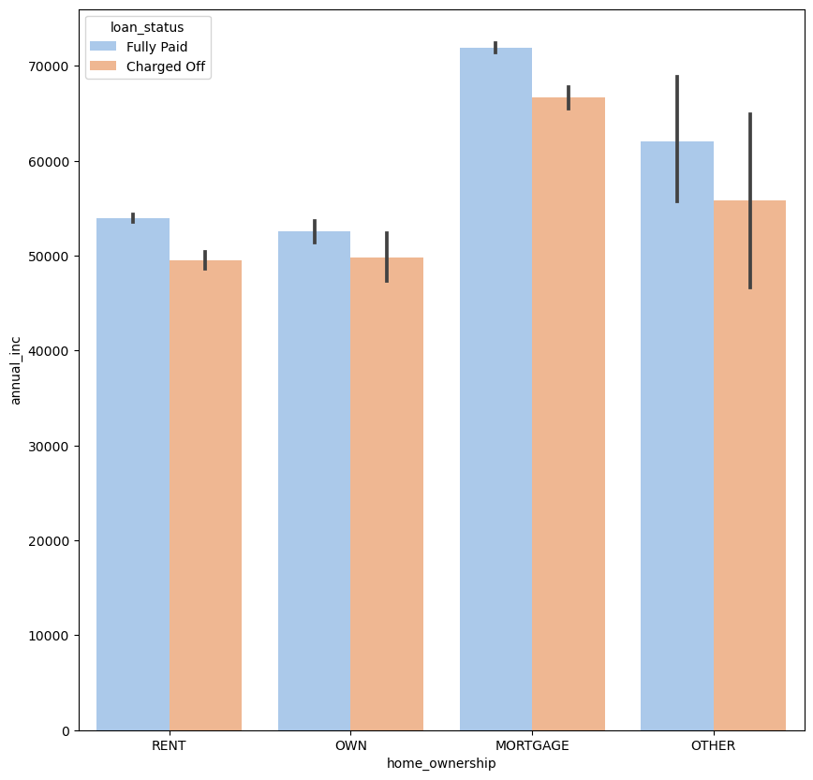
Annual income vs Home ownership vs Loan Status
Applicants with Annual income of 60k or more with a home ownership of MORTGAGE have higher chances of becoming risky or defaulters.

Slide 15
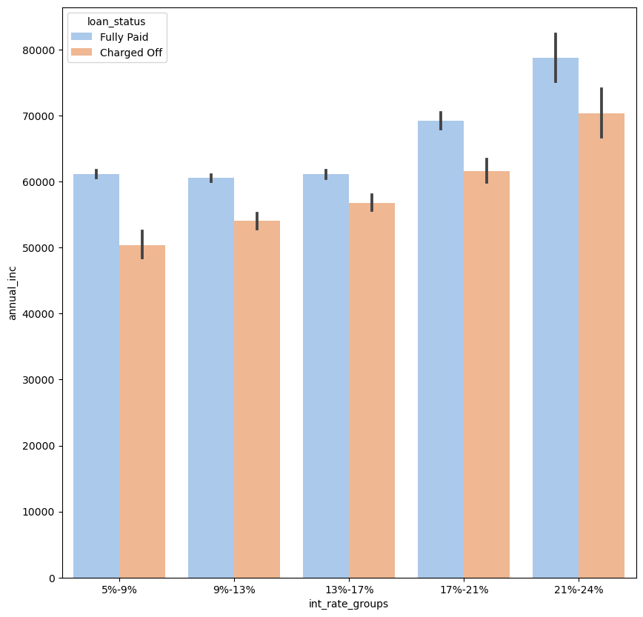
Annual income vs Interest rate vs Loan Status
Applicants with Annual income of 60k or more with a higher interest rates of 21% to 24% have higher chances of becoming risky or defaulters.

Slide 16
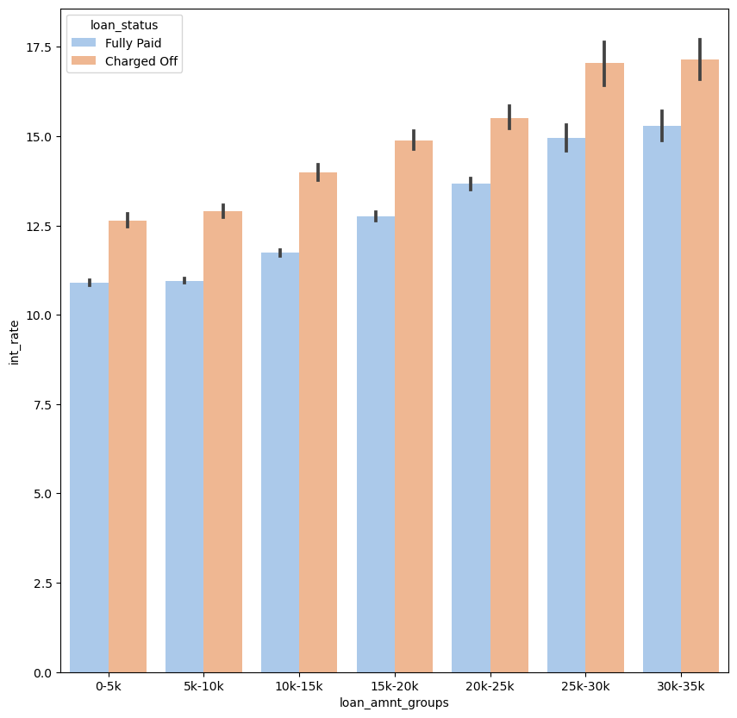
Loan amount vs Interest rate vs Loan Status
Applicants with Loan amount of 30k to 35k with a higher interest rates of greater than or equal to 15% have higher chances of becoming risky or defaulters.

Slide 17
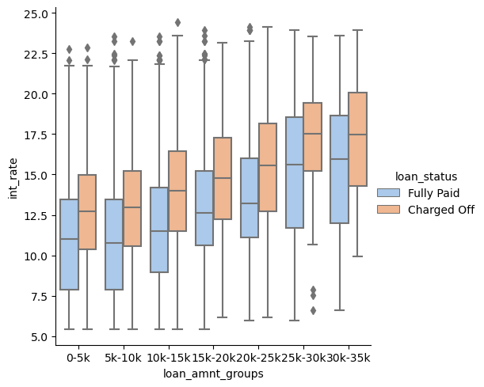
Interest rate vs Loan Amount range vs Loan Status
The interest rate for charged off category loans are higher than that of fully paid loans in all the loan amount groups.
This can be a pretty strong driving factor for loan defaulting.

Slide 18
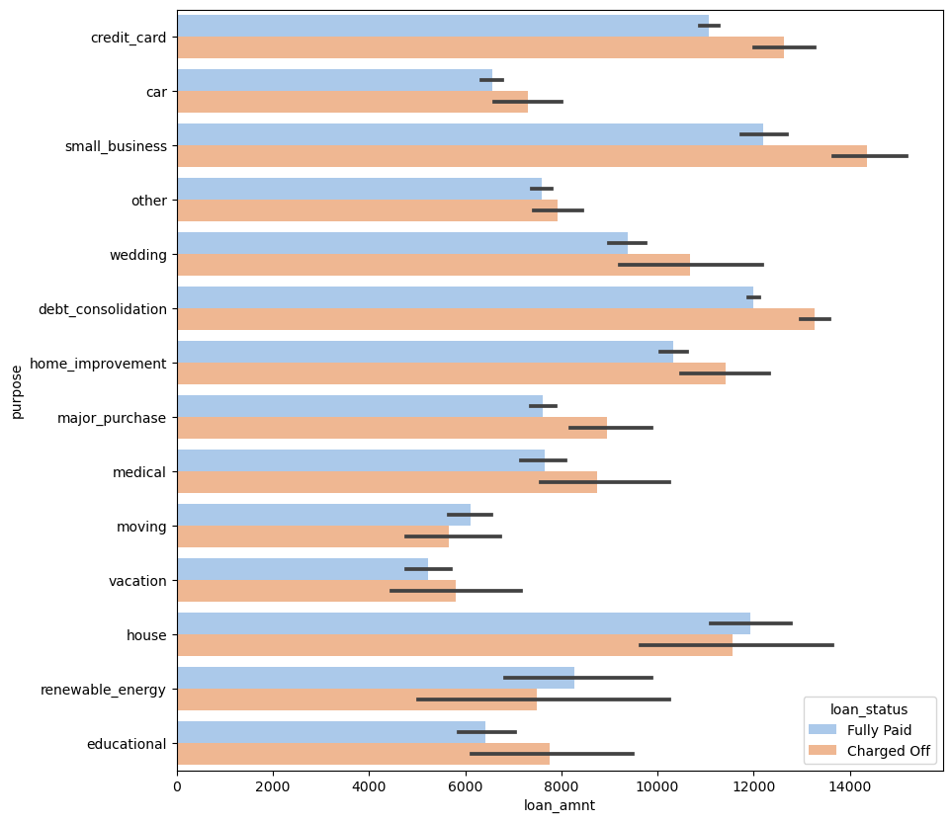
Loan Amount vs Purpose vs Loan Status
Purpose like credit card, small business, debt consolidation and home improvement with a loan amount of 12k or more have more risk applicants.

Slide 19
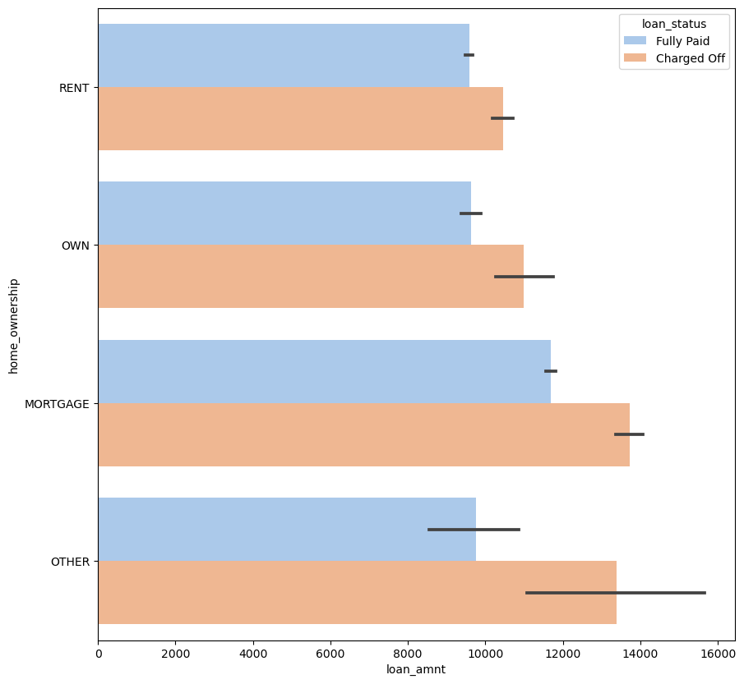
Loan Amount vs House Ownership vs Loan Status
Applicants whose home ownership is 'MORTGAGE and have loan of 14-16k, have higher chances of becoming defaulters.

Slide 20
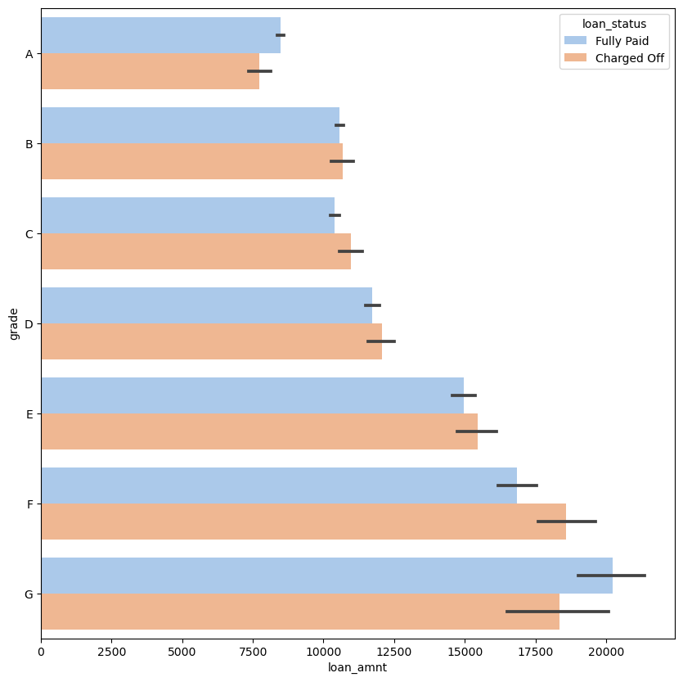
Loan Amount vs Grade
Applicants with loan amount of greater than 15k with F grade have higher chances of becoming defaulters or risky.

Slide 21
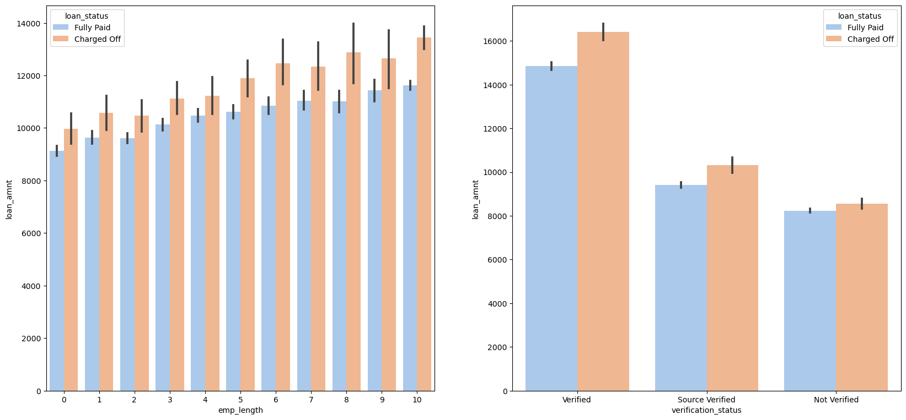
Loan Amount vs Loan Status vs Emp Length vs Verification Status

Slide 22
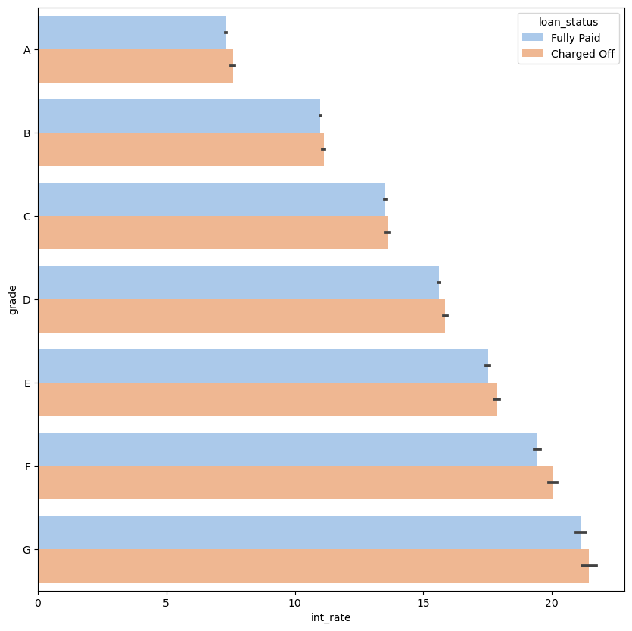
Grade vs Interest rate vs Loan status
Applicants of grade G and interest rate above 20% more likely to be defaulters or risky.

Slide 23
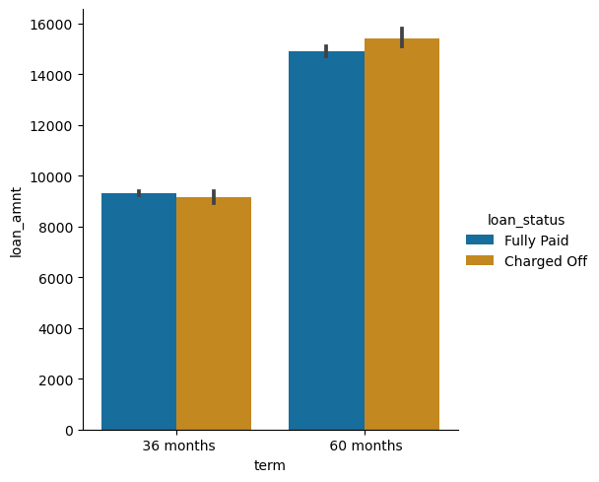
Loan Amount vs Loan Status vs Term
Applicants who applied and defaulted have no significant difference in loan amounts, which means that applicants applying for long term has applied for more loan.

Slide 24
Observations
The above analysis with respect to the Charged Off loans. There is a more probability of defaulting when as per the following:
Applicants taking loan for 'home improvement' and have income of 60k -70k.
Applicants whose home ownership is 'MORTGAGE’ and have income of 60-70k.
Applicants who receive interest at the rate of 21-24% and have an income of 70k-80k
Applicants who have taken a loan in the range 30k - 35k and are charged interest rate of 15-17.5 %
Applicants who have taken a loan for small business and the loan amount is greater than 14k
Applicants whose home ownership is 'MORTGAGE’ and have loan of 14-16k
When Grade is F and loan amount is between 15k-20k
When Employment length is 10+ years and loan amount is 12k-14k
When the Loan is verified, and loan amount is above 16k
For grade G and interest rate above 20%

