Slide 1

K. . Shamela Mini-Project -1 Project Title : Phonepe Transaction Insights Course : Data science Batch : DS-C-WD-E-B144

Slide 2
agenda
Project Overview
Tools & Technologies
Case studies
Charts
Insights & Recommendations

Slide 3

To analyze digital payment dynamics, user engagement, and insurance trends in India using the PhonePe Pulse dataset

Slide 4
Objectives of the Project:
To analyze transaction trends over time.
To identify top performing states and districts.
To study user engagement patterns.
To analyze device brand dominance among users.
To understand insurance adoption trends across regions.
To identify growth opportunities for PhonePe.

Slide 5
Tools and Technologies
Python for Data analysis
Pandas for Data cleaning and processing
MySQL for Querying the Phonepe data
Matplotlib for data visualization
Seaborn for statistical visualization
Plotly for interactive charts
Streamlit for Dashboard creation.

Slide 6
Case studies
1. Decoding Transaction Dynamics on PhonePe
2. Device Dominance and User Engagement Analysis
3. Insurance Penetration and Growth Potential Analysis
4. Transaction Analysis for Market Expansion
5. User Engagement and Growth Strategy

Slide 7
1.Decoding Transaction Dynamics on PhonePe
Objective: Understand transaction behaviour across years, states, and transaction types.
Total Transactions Over Years
Total Transaction Amount Over Years
Top 10 States by Transaction Amount
Transaction Type Distribution
Top States Transaction Trend

Slide 8
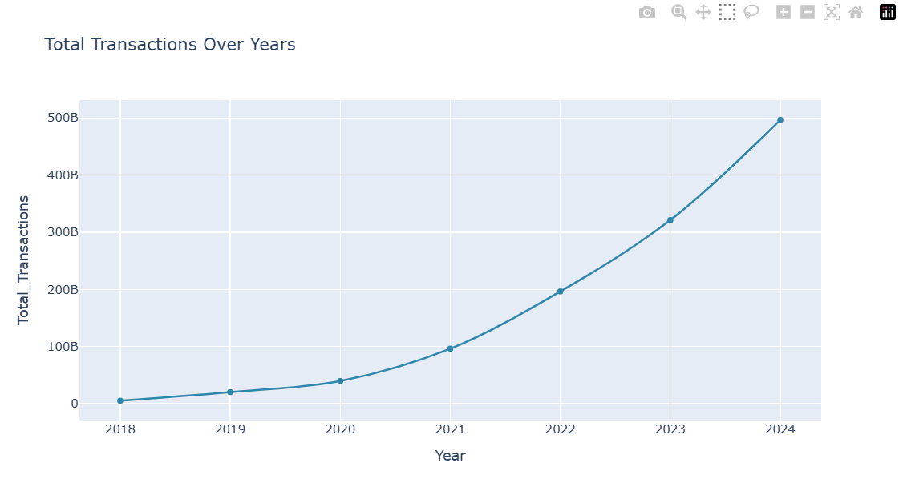
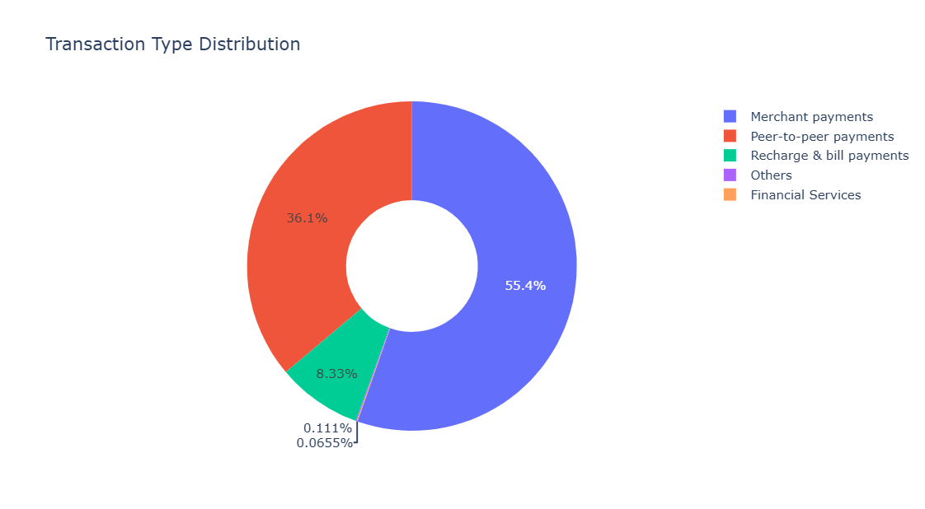
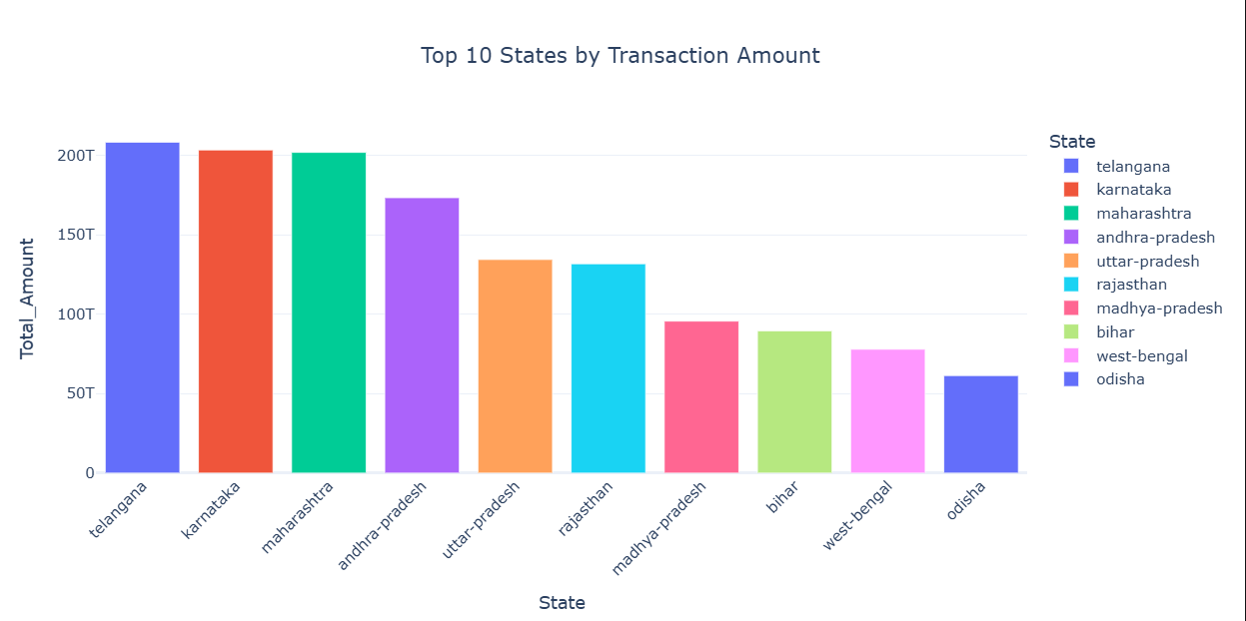
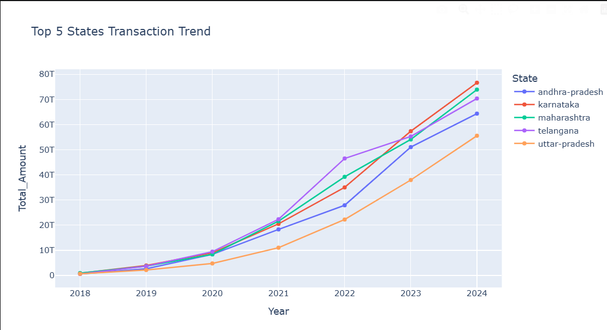
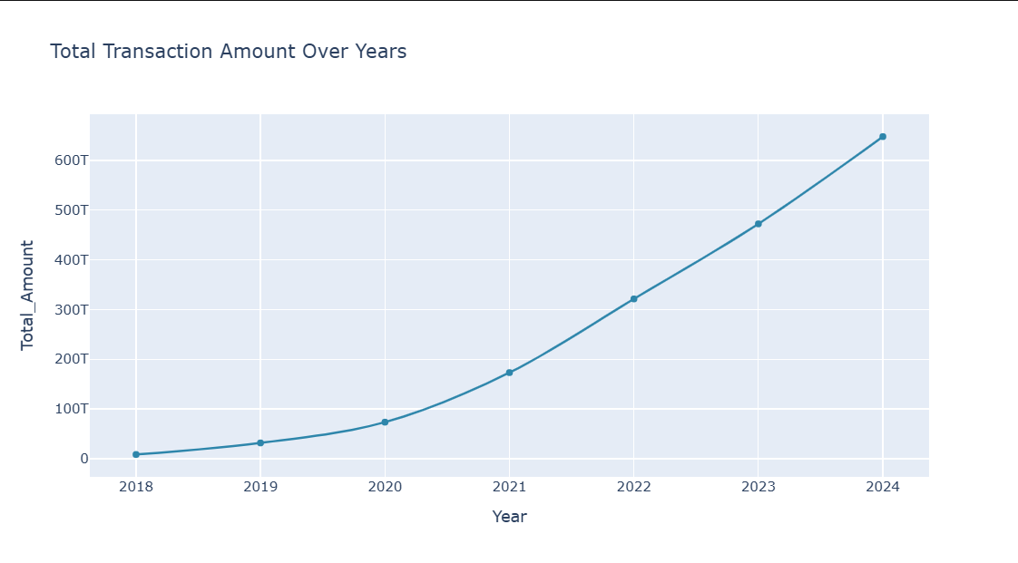

Slide 9
Insights & Recommendations
Transactions have grown steadily, indicating increasing adoption of digital payments.
Transaction value increased significantly each year.
PhonePe is a preferred platform for daily payments and money transfers.
Transaction growth varies across states, highlighting regional differences in adoption.
Enhance user experience in top transaction categories.
Prioritize marketing and partnerships in top-performing states.
Explore premium services for frequent high-value users.

Slide 10
2.Device Dominance and User Engagement Analysis
Objective: Identify device brands used by PhonePe users.
Top Device Brands by Registered Users
Device Brands by User Percentage
Device Brand Usage Growth Over Year
Top Device Brand in Each State
.Top 10 Device Brands Comparison

Slide 11
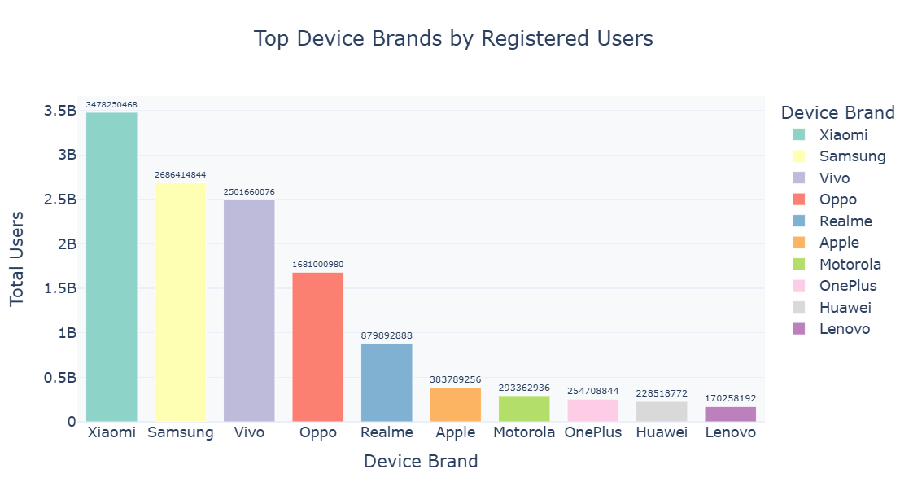
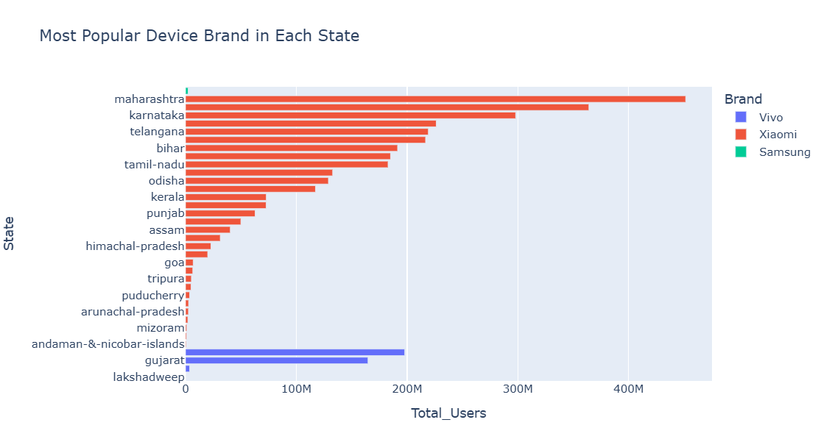
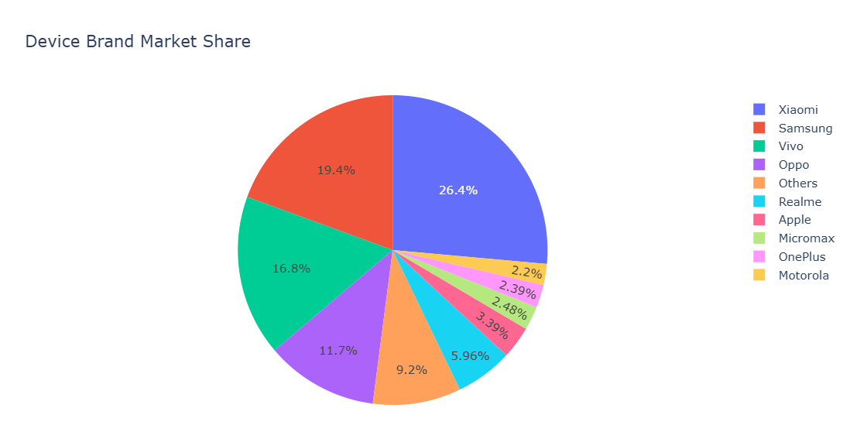
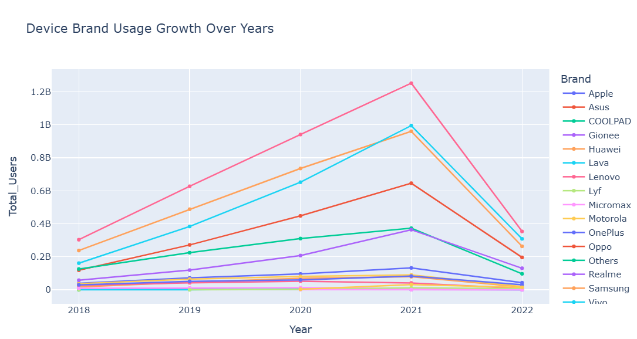
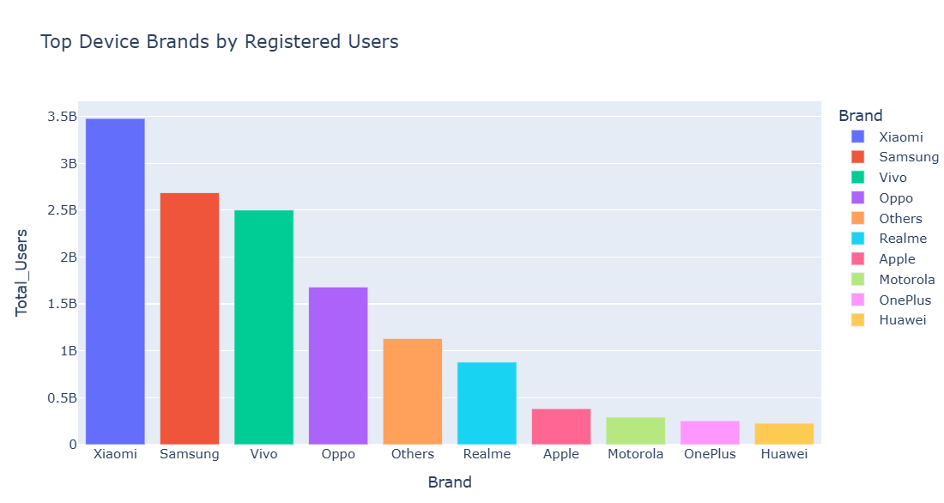

Slide 12
Insights & Recommendations
Brands like Xiaomi, Samsung, and Vivo have the highest registered users.
Shows growth of smartphone usage and mobile payment adoption.
Different states show preference for different smartphone brands.
Focus testing, updates, and UI optimization on these major brands for better performance.
Collaborate with major brands for promotions and pre-installed app integrations.

Slide 13
3. Insurance Penetration and Growth Potential Analysis
Objective: Analyze growth of insurance transactions.
Insurance Growth Over Years
Top States by Insurance Policies
Lowest insurance adoption states
Top States by Insurance Value
Insurance Adoption Trend by Quarter

Slide 14
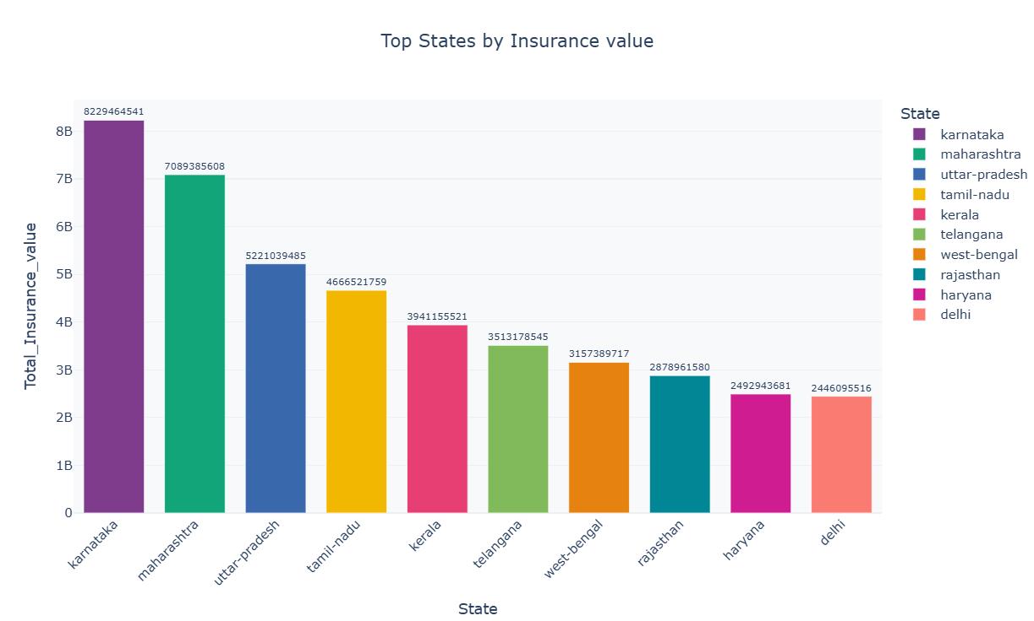
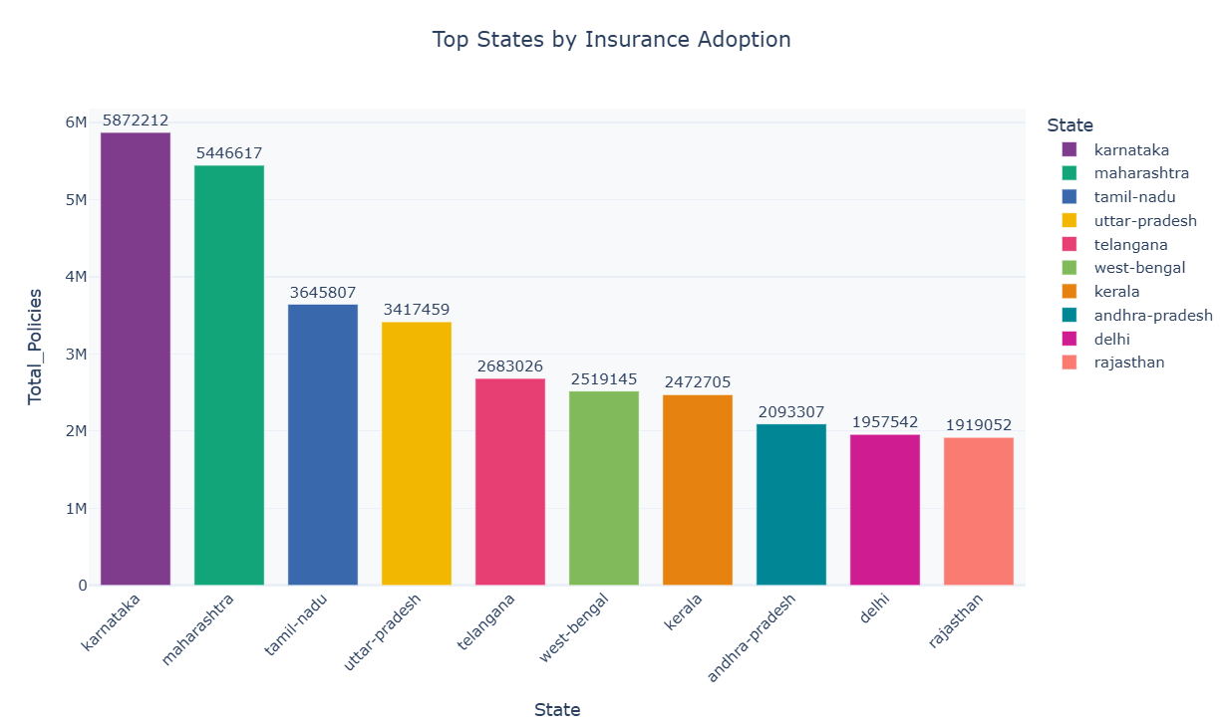
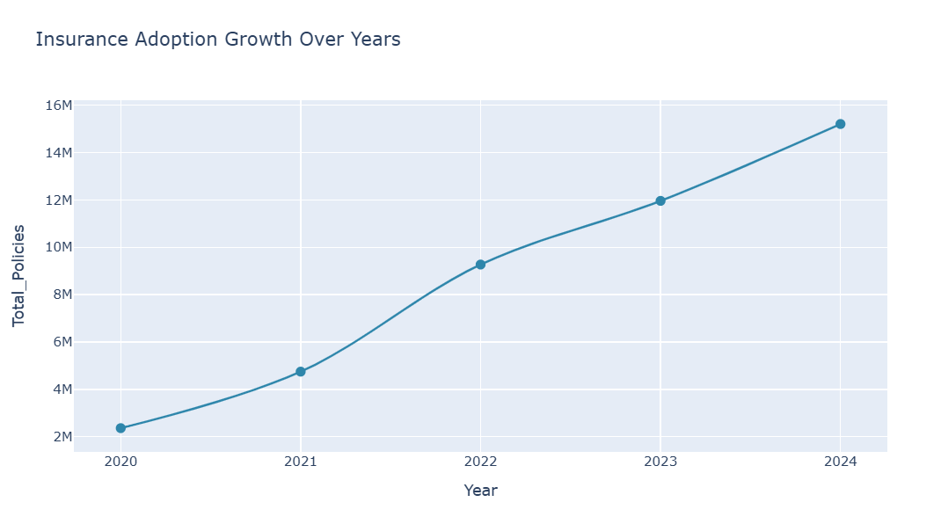
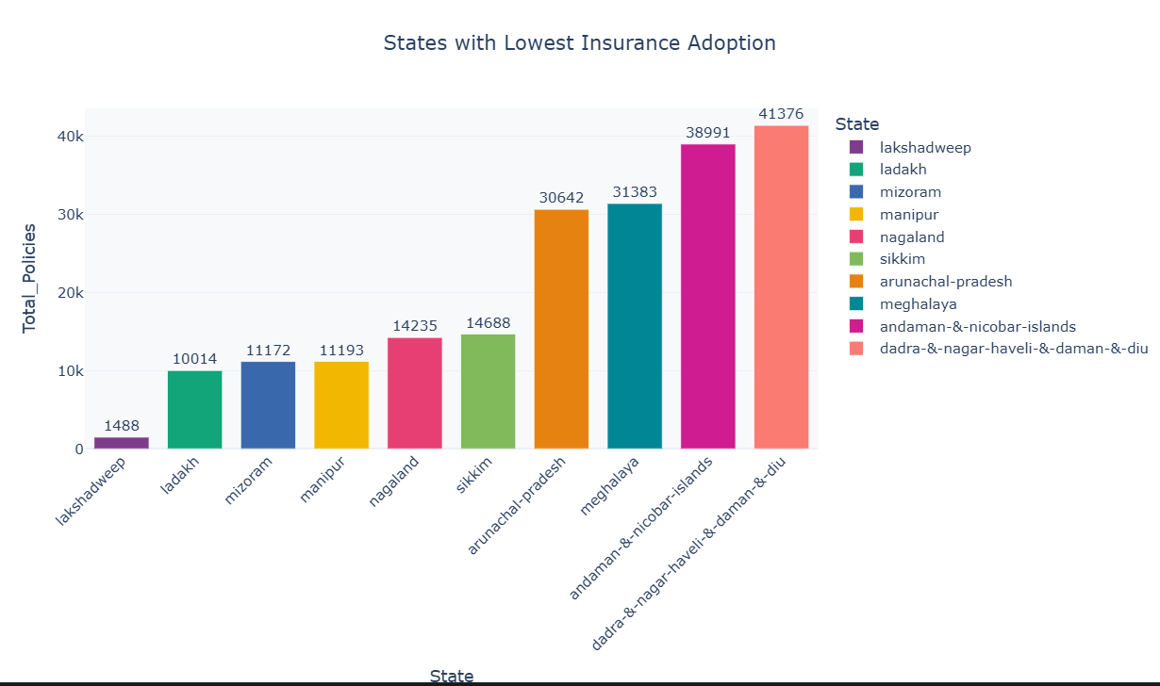
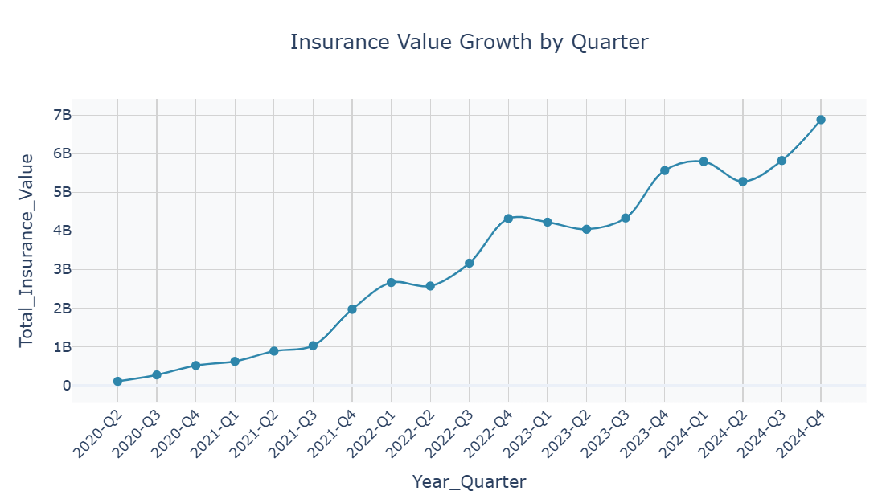

Slide 15
Insights & Recommendations
Insurance transactions have increased gradually.
Certain states show strong insurance adoption.
Some states show very low adoption, indicating untapped markets.
Some states contribute higher insurance value, indicating premium policy purchases.
Increase awareness through campaigns and simplify the onboarding process.
Strengthen partnerships with insurers in these high-performing regions
Promote premium insurance products in these regions.
Launch campaigns during peak periods to maximize conversions.

Slide 16
4. Transaction Analysis for Market Expansion
Objective: Identify districts with high and low transaction performance.
Top Districts by Transaction Value
Lowest Performing Districts
Quarterly transaction growth trend
Average Transaction Value per District
High Transaction Count but Lower Value Districts

Slide 17
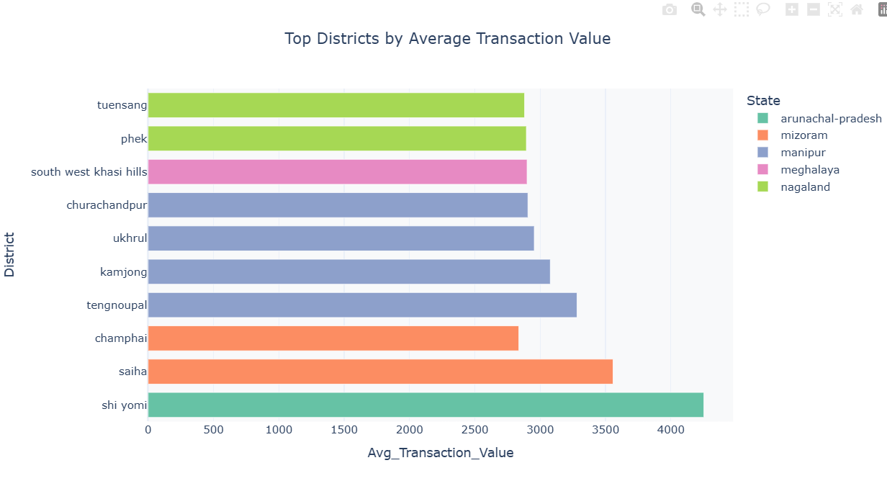
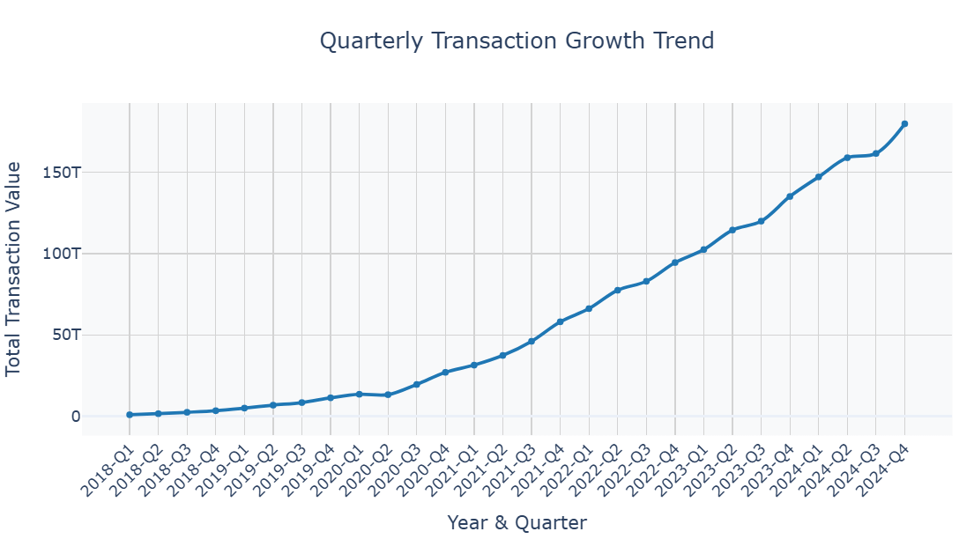
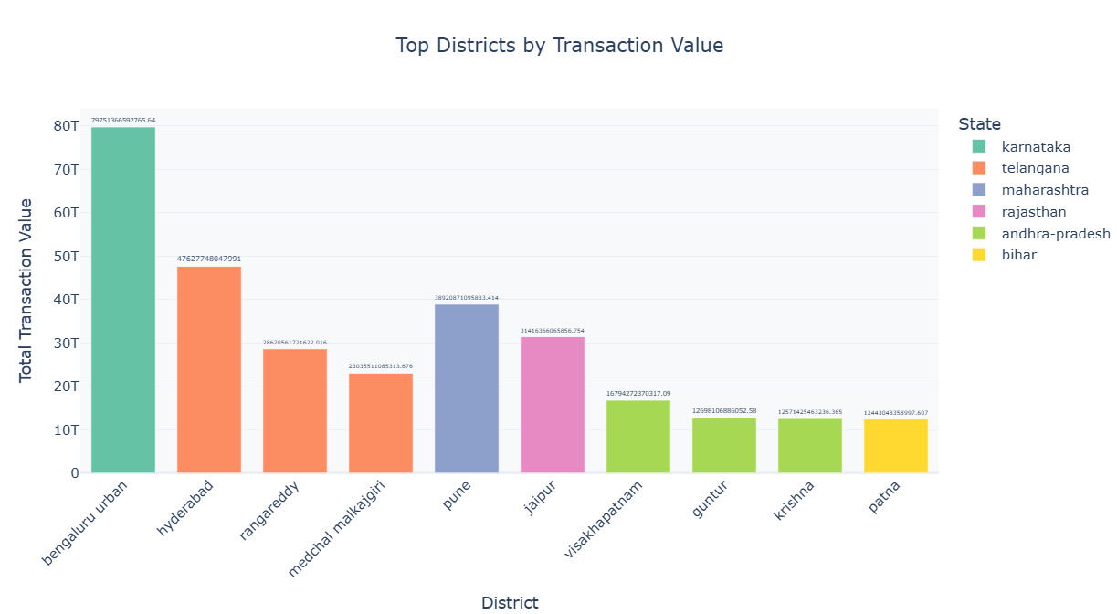
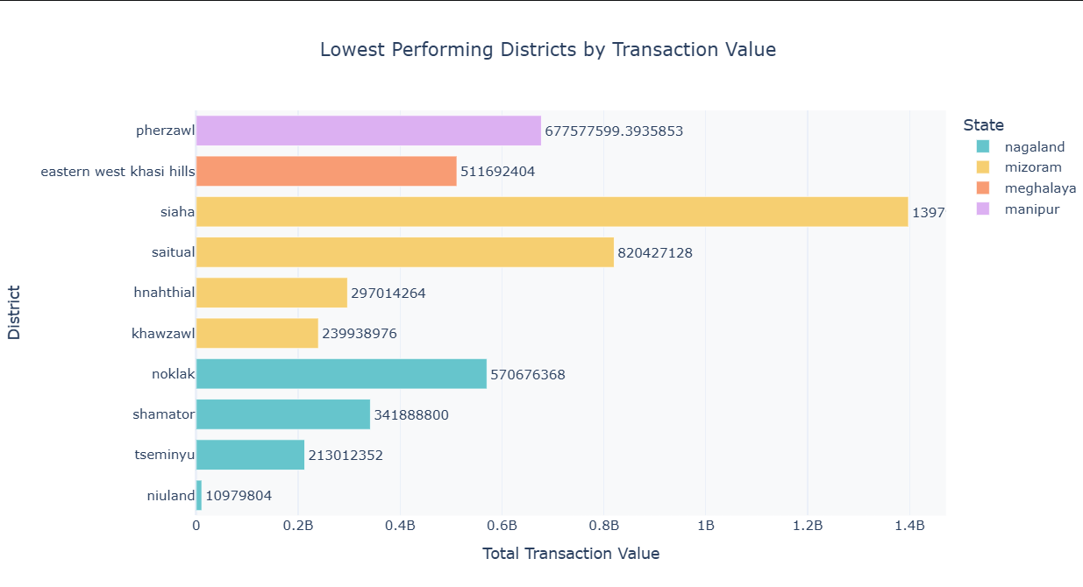
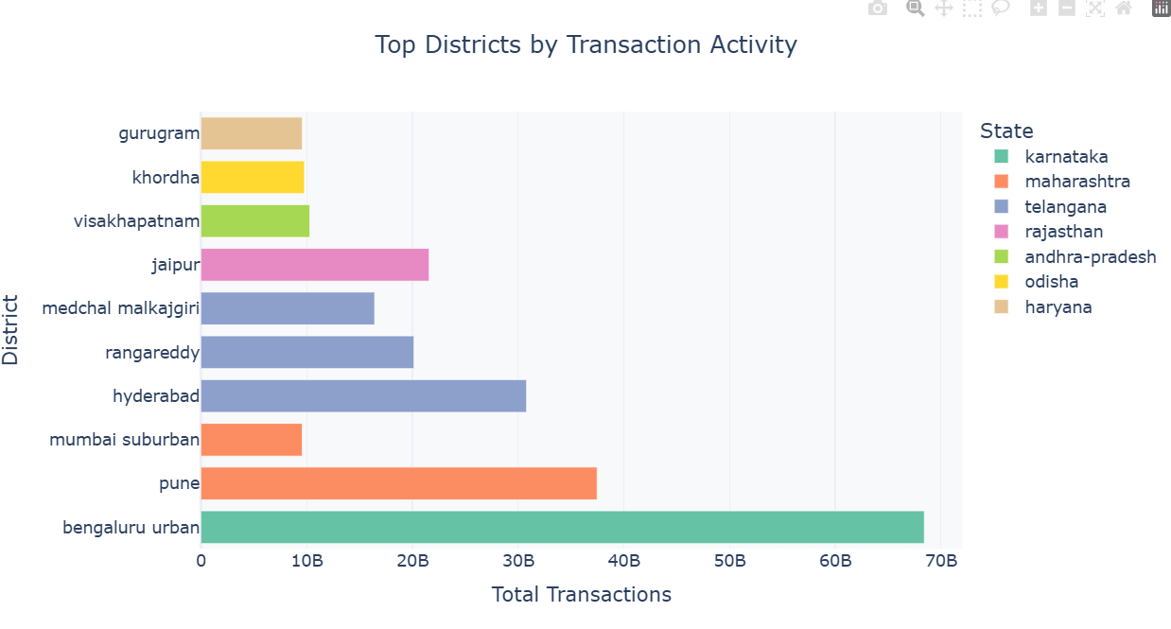

Slide 18
Insights & Recommendations
Few districts contribute significantly to total transactions.
Some districts have low transaction activity due to limited awareness.
Transactions fluctuate across quarters, showing seasonal patterns.
Some districts show higher average values indicating higher spending capacity.
Plan marketing campaigns during high-demand periods.
Improve digital literacy and infrastructure awareness in these regions.
Introduce micro-payment offers and cashback for small transactions.

Slide 19
5. User Engagement and Growth Strategy
Objective: Analyze user engagement based on registrations and app usage
States with Highest User Engagement
Pincode Areas with Highest User Concentration
Districts with Highest User Engagement
User Growth Trend by Year and Quarter
States with Low Engagement

Slide 20
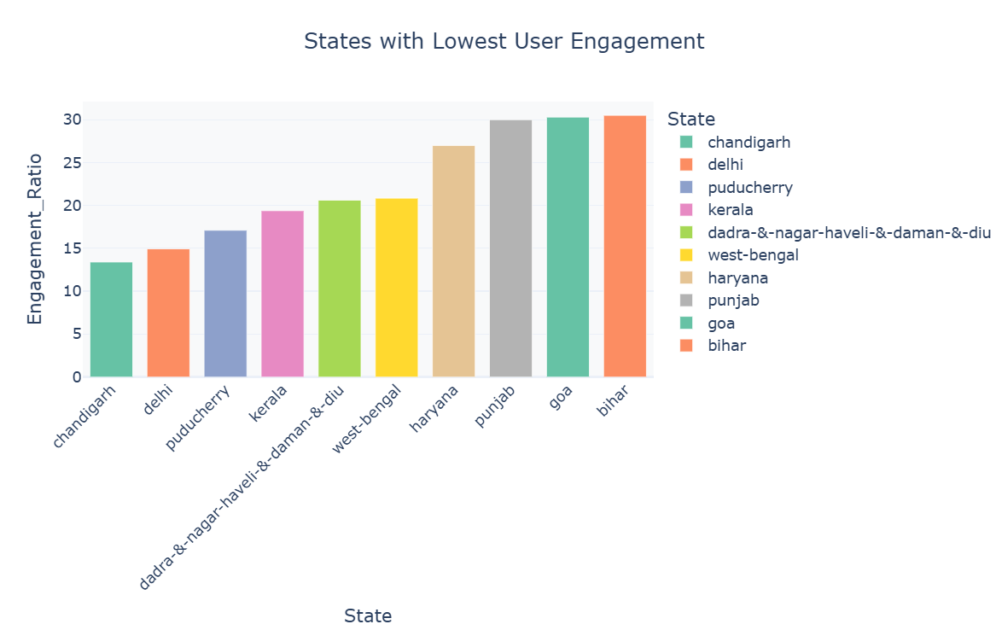
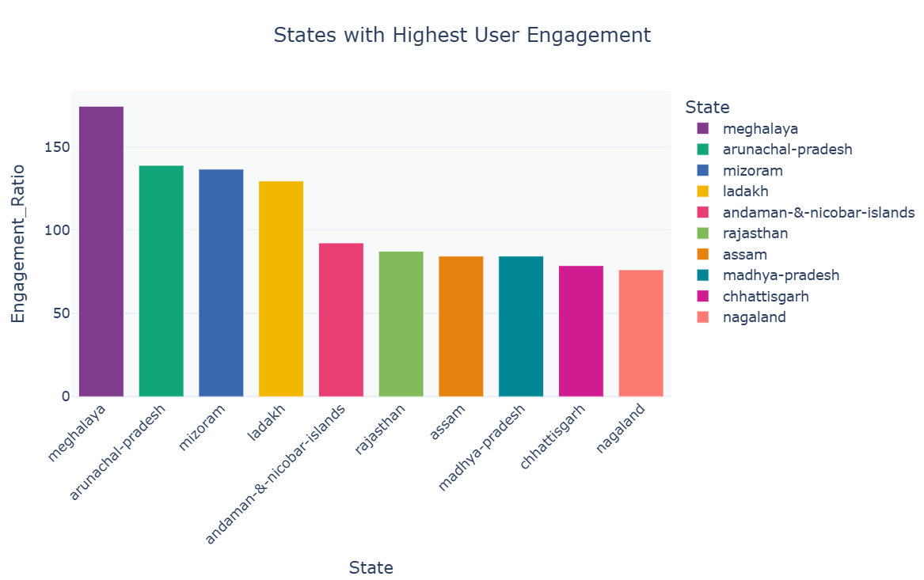
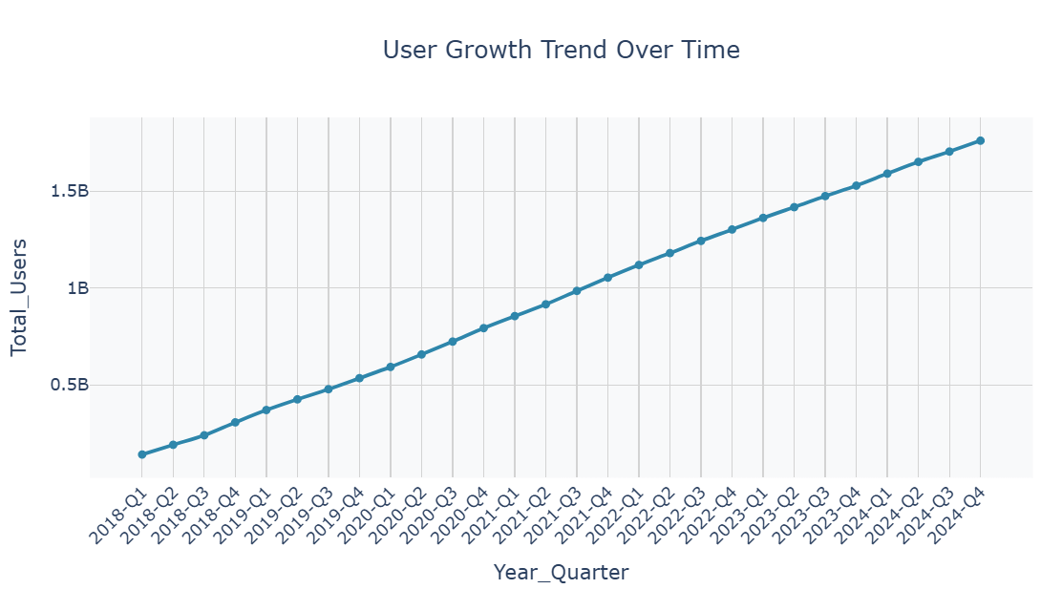
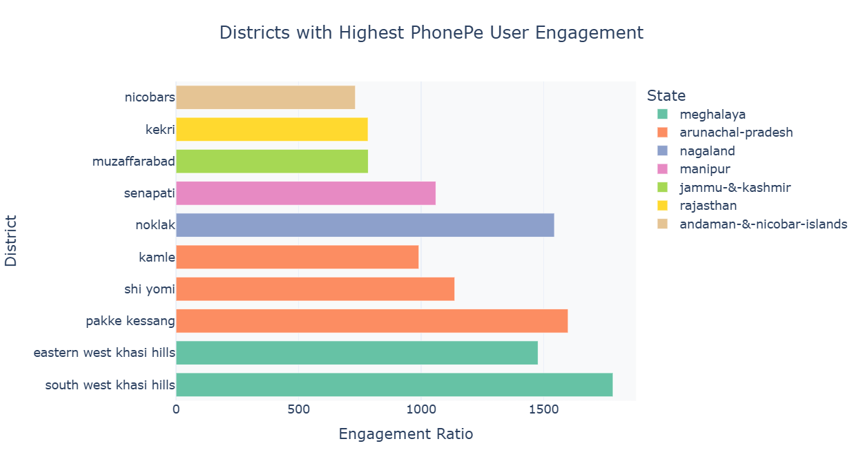
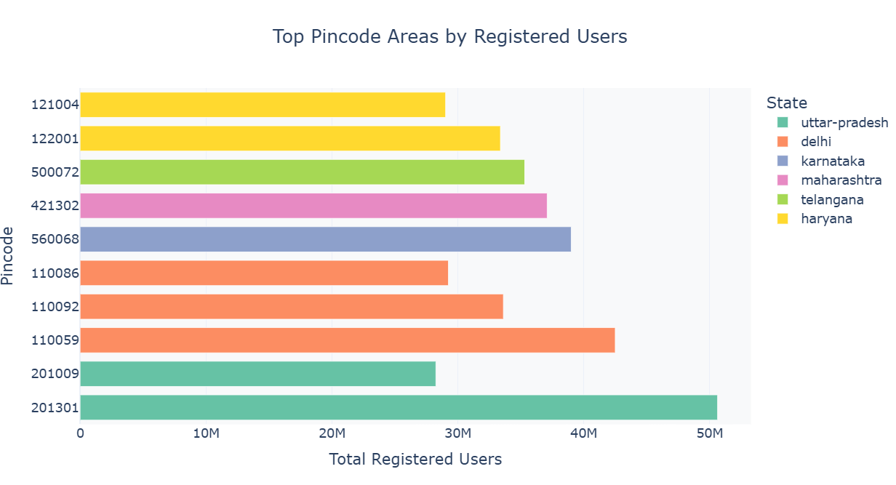

Slide 21
Insights & Recommendations
Some states show high app usage relative to user base.
Certain pincodes have dense user concentration.
User base is steadily increasing over time
Leverage these regions to launch new features and beta testing.
Target these areas for localized promotions and
Improve engagement through offers, notifications, and awareness campaigns. merchant onboarding.

Slide 22
THANK YOU

