Slide 1
CarDekho Used Car Price Prediction
Domain: Automobile

Slide 2
Problem Statement:
The primary objective of is project is to create a data science solution for predicting used car
prices accurately by analyzing a diverse dataset including car model, no. of owners, age, mileage, fuel type, kilometers driven, features and location. The aim is to build a machine learning model that offers users to find current valuations for used cars property owners, tenants, and property management companies. Accurate rent predictions can help landlords set competitive prices, tenants make informed rental decisions, and property management companies optimize their portfolio management.
The goal of this project is to develop a data-driven model that predicts the rental price of residential properties based on relevant features. By analyzing historical rental data and property attributes, the model aims to provide accurate and reliable rent predictions.

Slide 3
Tools Used
PYTHON
MATPLOTLIB
SEABORN
scikit-learncikit-learn
STREAMLIT

Slide 4
Approaches
Data Preprocessing:
Expanding column in dictionary format new_car_detail, new_car_overview, new_car_feature,new_car_specs
REMOVING NULL VALUES
OUTLIER DETECTION
ENCODING
Model Selection:
LINEAR REGRESSION
DECISSION TREE
RANDOAM FOREST
XGBOOST

Slide 5
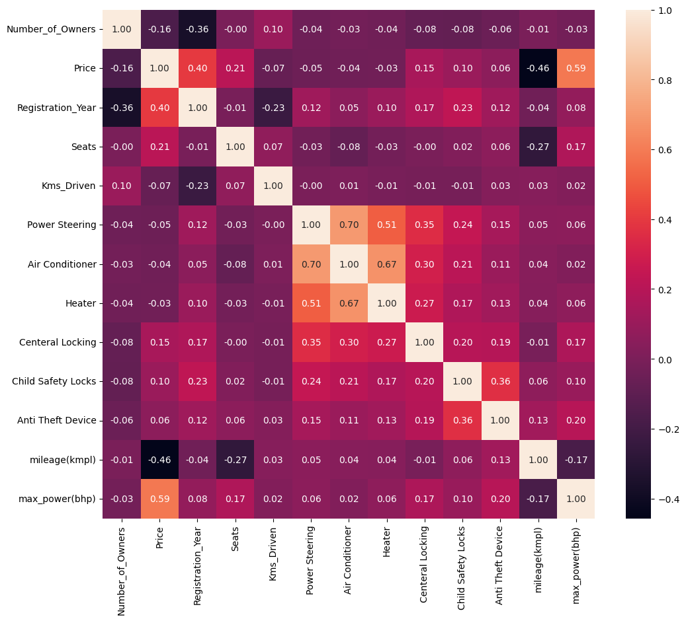
EDA Insights
Correlation Analysis:

Slide 6
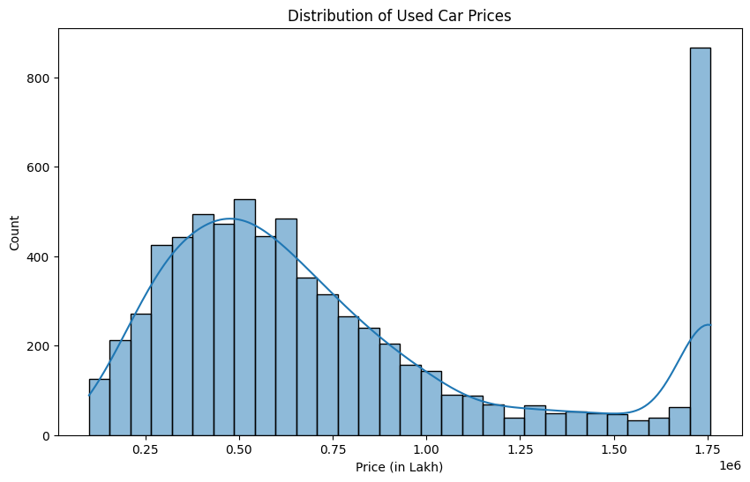
EDA Insights
CAR VS PRICE:

Slide 7
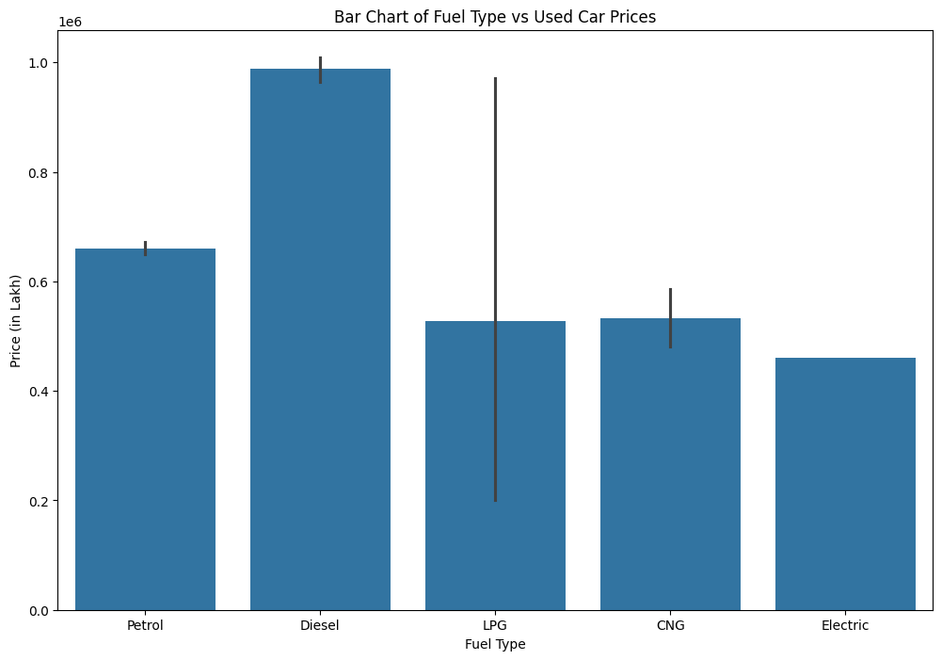
EDA Insights
FUEL TYPE VS CAR PRICE:

Slide 8
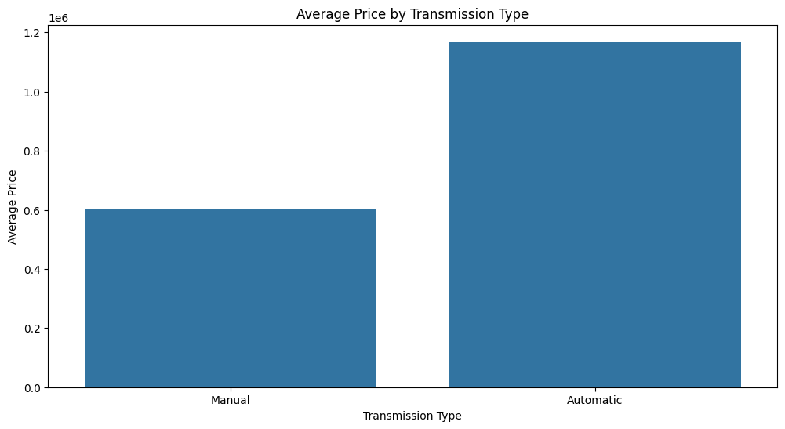
EDA Insights
PRICE VS TRANSMISSION TYPE

Slide 9
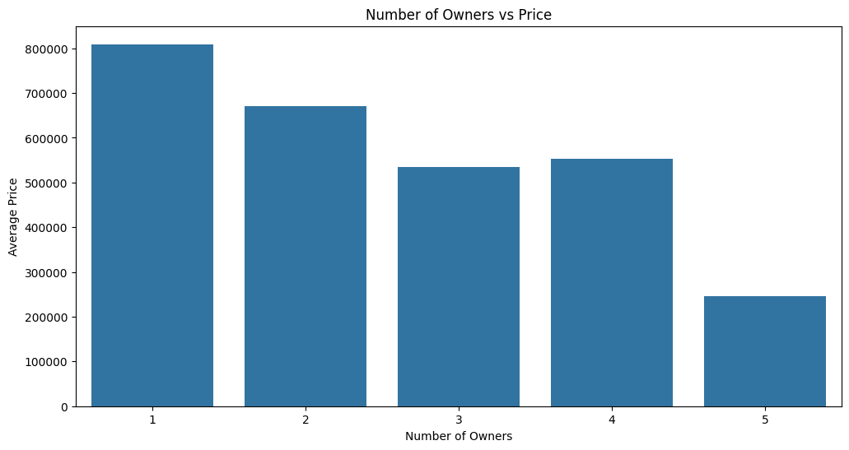
EDA Insights
NO OF OWNERS VS PRICE:

Slide 10
Model Selection
Model Training and Evaluation:
Split the dataset into training and testing sets
Train the selected models
Evaluating metrics:
R2
mean squared error
mean absolute error

Slide 11
Model Performance
Random forest is the best model with R2 - Train: 0.9803 Test: 0.8913.
Deployment:
Created streamlit app for car price prediction

