Slide 1
E-COMMERCE ANALYSIS

Slide 2
CONTENT
Problem Statement
Objective
Tools Used
Approaches
Insights
Conclusion

Slide 3
PROBLEM STATEMENT
In the rapidly evolving landscape of e-commerce, understanding customer behavior and optimizing business strategies are crucial for success. A leading e-commerce platform aims to enhance its market position and increase revenue by leveraging data-driven insights. The company seeks to analyze its existing data to identify trends, patterns, and areas for improvement across various aspects of its operations.

Slide 4
OBJECTIVE
The e-commerce analysis project aims to analyze a dataset from an online retail platform to derive insights that can drive business decisions and optimizations. The primary objective of the analysis is to gain a deeper understanding of the e-commerce platform's performance, customer behavior, and market trends. By leveraging data analytics techniques we aim to uncover actionable insights that can enhance various aspects of the e-commerce business, such as marketing strategies, product recommendations, and operational efficiencies.

Slide 5
TOOLS USED
For an e-commerce analysis project in Python, use a variety of tools and libraries to perform data analysis, visualization, and presentation.
Jupyter Notebooks: Jupyter Notebooks provide an interactive environment for running Python code, analyzing data, and documenting your findings. Use Jupyter Notebooks to perform exploratory data analysis (EDA) and create visualizations.

Slide 6
Pandas: Pandas is a powerful library for data manipulation and analysis in Python. Use Pandas to clean, preprocess, and analyze e-commerce dataset, as well as perform tasks such as data aggregation, filtering, and grouping.
Matplotlib: Matplotlib is a widely-used plotting library in Python for creating static, interactive, and publication-quality visualizations. Use Matplotlib to create various types of plots, including line plots, scatter plots, histograms, and bar charts to visualize e-commerce data.

Slide 7
Seaborn: Seaborn is built on top of Matplotlib and provides a high-level interface for creating attractive and informative statistical graphics. Seaborn includes functions for creating complex visualizations such as pair plots, heatmaps, and Count plots, which can be useful for exploring relationships e-commerce data.
Plotly: Plotly is a versatile visualization library that supports interactive plotting and dashboards. Use Plotly to create interactive charts, maps, and dashboards that can be embedded into Jupyter Notebooks.

Slide 8
APPROACHES
Data Collection and Preparation: Gathering and preprocessing the dataset to ensure data quality and consistency. This involves tasks such as handling missing values, removing duplicates, and transforming data into a suitable format for analysis.
Exploratory Data Analysis (EDA): Conducting exploratory data analysis to understand the distribution of variables, identify patterns, and uncover correlations within the dataset. Visualization techniques such as histograms, scatter plots, and heatmaps will be used to gain insights into customer behavior, product preferences, and sales trends.

Slide 9
Recommendations and Insights: Generating actionable recommendations and insights based on the analysis findings. These insights will inform strategic initiatives aimed at improving customer engagement, increasing sales revenue, and enhancing overall business performance.

Slide 10
INSIGHTS
Popular Product Categories & Brands
1. Clothing & Accessories
2. Footwear
Top Brands
1. ARBO
2. ECKO Unl
3. REEB
4. Pu
5. True Bl

Slide 11
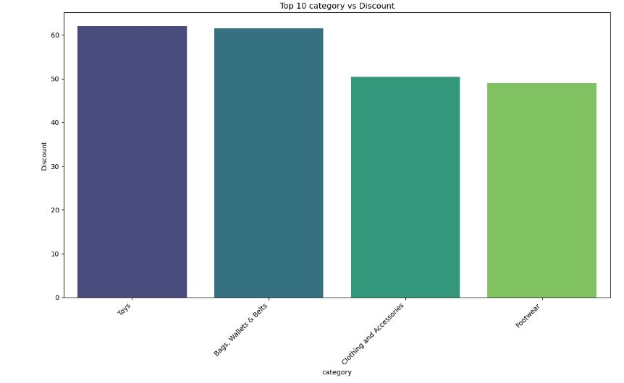
Pricing Strategies

Slide 12
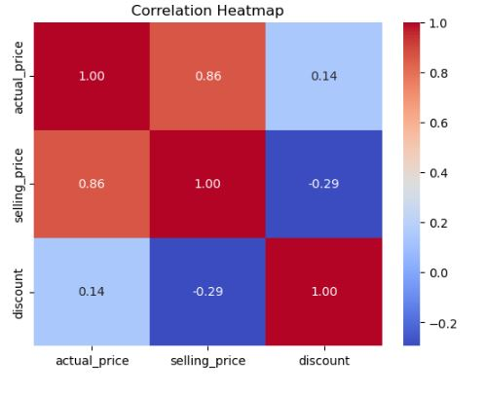

Slide 13
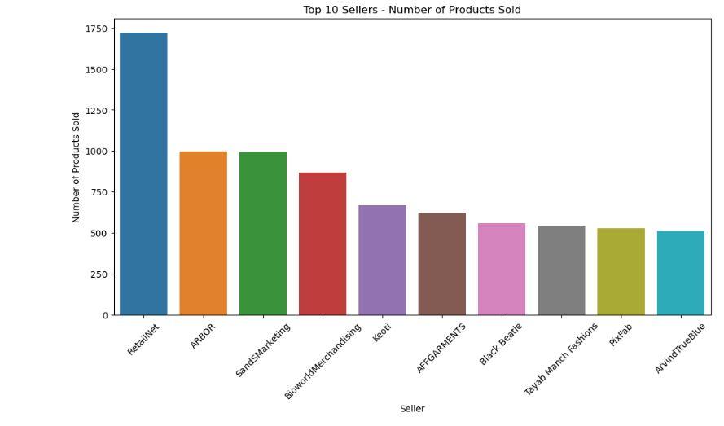
Seller Performance

Slide 14
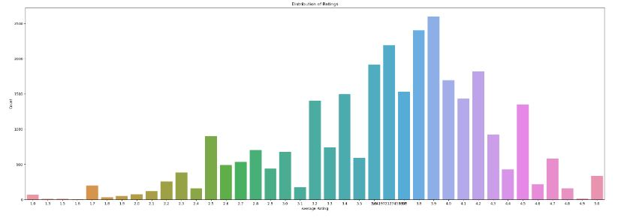
Customer Preferences

Slide 15
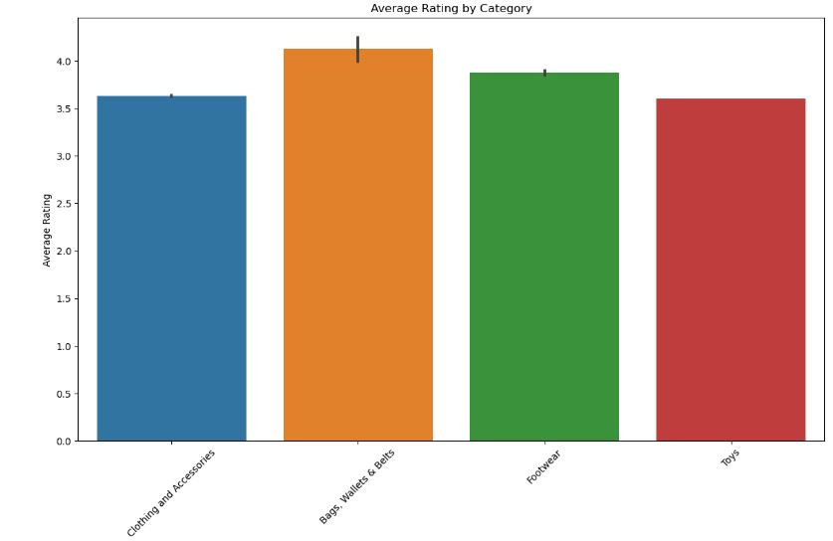

Slide 16
CONCLUSION
People buying more clothing and accessories in ecommerce platform.
People prefer ARBO brand and RetailNet seller in ecommerce platform .
People more interested in buying top wear is ecommerce platform.
In ecommerce platform products actual price distributed mostly in the range of 500-2500.
In ecommerce platform products selling price distributed mostly in the range of 200-2000.
In ecommerce platform products rating distributed mostly in the range of 3-4.5.
In ecommerce platform products discount distributed mostly in the range of 35% to 65% and the overall Average Discount Percentage is 50.70%
In ecommerce platform bags wallets & belts category has high rating around 4.5.
MILD brand has highest rating around 4.9,and MILDIN seller has rating around 4.9.
In ecommerce platform toys category has high discount around 65%.

Slide 17
THANK YOU

