Slide 1

B.Tech. Computer Science and Engineering
BCSE497J – Project-I
An Explainable and Drift-Aware MLOps Pipeline for Credit Card Fraud Detection
Team members:
Shamik Sengupta (23BCE0608)
Yashaswini Kanaujia (23BCE0622)
Faculty guide :
Dr. Sharmila C

Slide 2

Approval Mail From Guide
Get the approval for the following points from your guide through mail before 21-10-2026.(sample attached below)
All the above aspects are addressed and updated by the project team.
Paste your approval mail screenshot here (replace the sample)

Slide 3
Aim
To design and build an end-to-end MLOps pipeline that detects fraudulent credit card transactions, explains every fraud decision to the analyst, and monitors live input data for drift, with the whole system versioned, tested and deployable as containers.
Detect
XGBoost model tuned for heavily imbalanced data (0.17% fraud), served through a REST API.
Explain
Top-5 SHAP feature contributions returned with every fraud prediction.
Monitor
Automatic drift checks on incoming data, with Prometheus alerts and a Grafana dashboard.

Slide 4
Abstract
Credit card fraud is rare but costly. A useful system must not only score transactions, but also explain its decisions and notice when incoming data changes.
We built a complete MLOps pipeline on the ULB credit card dataset: DVC-versioned data, an XGBoost model tuned with Hyperopt (5-fold CV PR-AUC), and MLflow experiment tracking.
The best model is served through FastAPI with input validation; every fraud prediction comes with its top-5 SHAP feature contributions.
Incoming requests are compared with the training data using Evidently; drift is exported to Prometheus, alerted on, and shown in Grafana.
Everything runs with docker compose, and GitHub Actions runs 15 automated tests before building the Docker image.
284,807
0.17%
0.869
82 / 98
transactions
are fraud
test PR-AUC
frauds caught

Slide 5


Literature Review
Paper | Objective | Methodology | Pros / Cons | Findings
Dal Pozzolo et al., 2015 (IEEE SSCI) | Handle class imbalance in fraud data | Undersampling + probability calibration on ULB data | + Simple, fast − Distorts probabilities | Scores must be recalibrated after undersampling
Chen & Guestrin, 2016 (ACM KDD) | Scalable tree boosting | XGBoost: regularised gradient boosting | + Accurate, class weights − Many hyperparameters | Strong default for tabular data
Bergstra et al., 2013 (ICML) | Automate hyperparameter search | Hyperopt with TPE algorithm | + Fewer trials than grid search − Results vary with seed | Efficient model tuning
Saito & Rehmsmeier, 2015 (PLoS ONE) | Evaluate classifiers on imbalanced data | Compare ROC and PR plots | + Clear guidance − Binary tasks only | PR curve is more informative than ROC
Lundberg & Lee, 2017; Lundberg et al., 2020 | Explain individual predictions | SHAP values; exact TreeSHAP for trees | + Exact, per prediction − Hard to read on PCA features | Consistent local explanations
Gama et al., 2014 (ACM CSUR) | Handle concept drift | Survey of drift detection methods | + Broad taxonomy − No deployment details | Deployed models must be monitored
Kreuzberger et al., 2023 (IEEE Access) | Define MLOps | Literature review + expert interviews | + Clear components − No implementation | Needs versioning, CI/CD, serving, monitoring

Slide 6
Research Gap
Evaluation stops at the notebook
Most fraud studies report test-set accuracy only. With 0.17% fraud, predicting "legitimate" for everything already gives 99.83% accuracy.
1
Explainability and drift are studied separately
SHAP and drift detection are rarely shown together inside a running prediction service.
2
Practical deployment problems
The baseline template had one fragile test, no monitoring, and dead AWS links. Evidently and FastAPI also clash on the "multipart" package, so they cannot share one process.
3
Our approach:
PR-AUC based evaluation + SHAP + isolated drift worker, all in one tested, containerised service

Slide 7


Objectives
Train a fraud model without data leakage: stratified split, 5-fold CV and PR-AUC
Tune XGBoost with Hyperopt and track every run in MLflow
Serve the best model through a validated REST API (single and batch)
Return a SHAP explanation with every fraud prediction
Detect input drift automatically and raise Prometheus alerts
Package with Docker and run tests automatically in CI
Identified: SDGs 8, 9 and 16 | TRL 4 (validated in lab) | Outcome: Conference paper

Slide 8
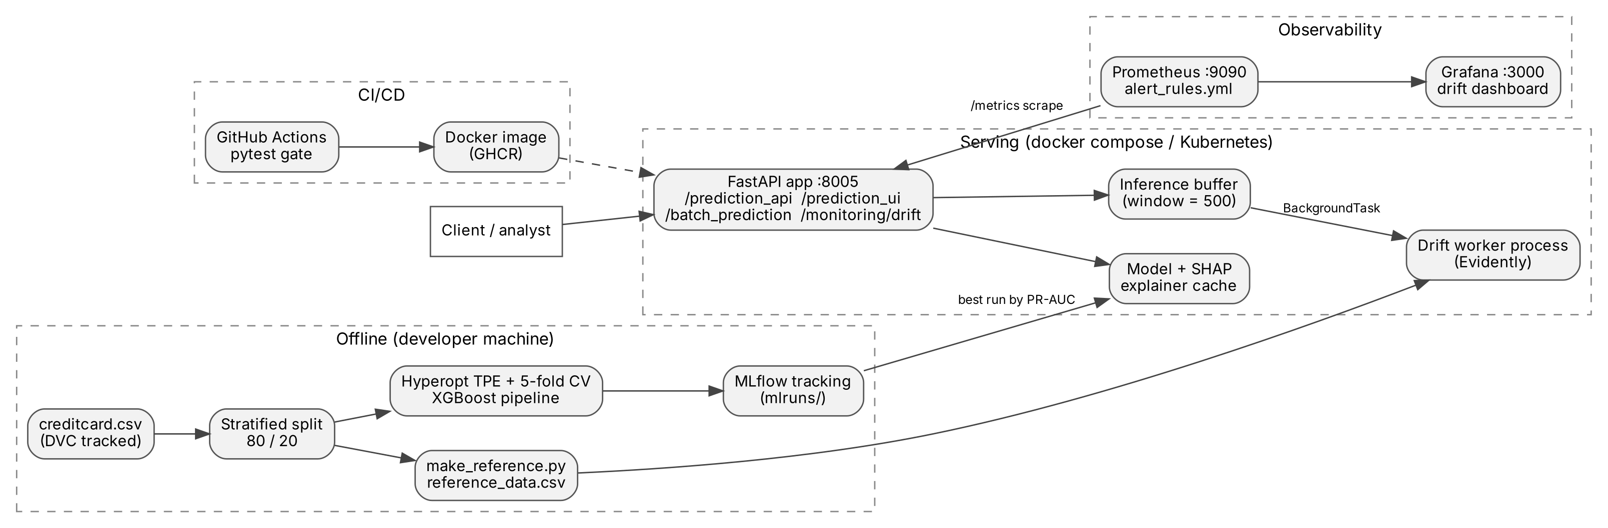
Framework / Architecture
Offline training → MLflow | CI/CD builds the image | FastAPI serves the best run | Prometheus + Grafana watch drift

Slide 9
Functional Requirements
Functional
Non-functional
Predict Fraud / Legitimate with fraud probability from a JSON transaction
Return top-5 SHAP features for every fraud prediction
Reject missing or non-numeric fields (HTTP 422)
Batch prediction on an uploaded CSV file
Track all runs in MLflow; always serve the best one
Drift check every 500 requests or on demand; show in Prometheus and Grafana
Prediction well under 100 ms
Drift failures never break predictions
Reproducible: seed 42, DVC data, pinned versions
Same container locally, compose and Kubernetes
Tests run without dataset or MLflow (CI-friendly)

Slide 10
Modules
1. Data & Versioning
DVC-tracked dataset; stratified 80/20 split keeps the 0.17% fraud rate
2. Training & Tuning
RobustScaler + XGBoost (class weight ≈ 577); Hyperopt, 20 trials × 5-fold CV
3. Prediction API
FastAPI with pydantic validation; best MLflow run cached in memory
4. Explainability
SHAP TreeExplainer; top-5 features for fraud predictions only
5. Drift Monitoring
Evidently worker every 500 requests; Prometheus gauges and alerts
6. Deployment & CI/CD
Docker, docker compose, Kubernetes; GitHub Actions test → build → push

Slide 11
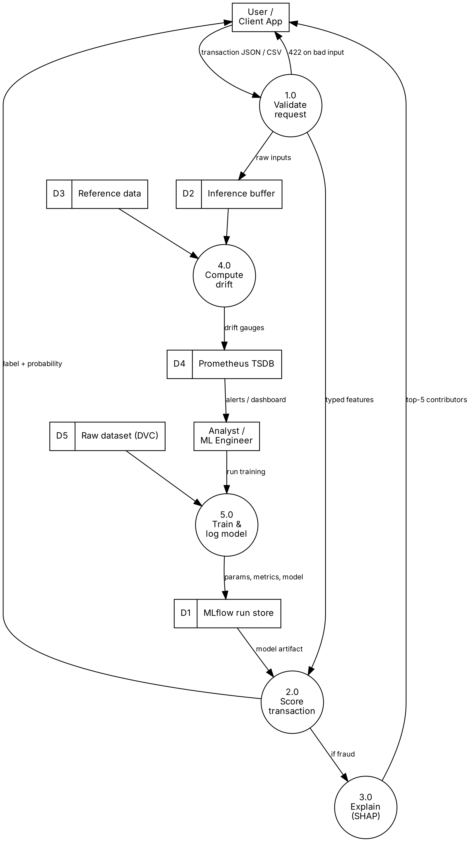
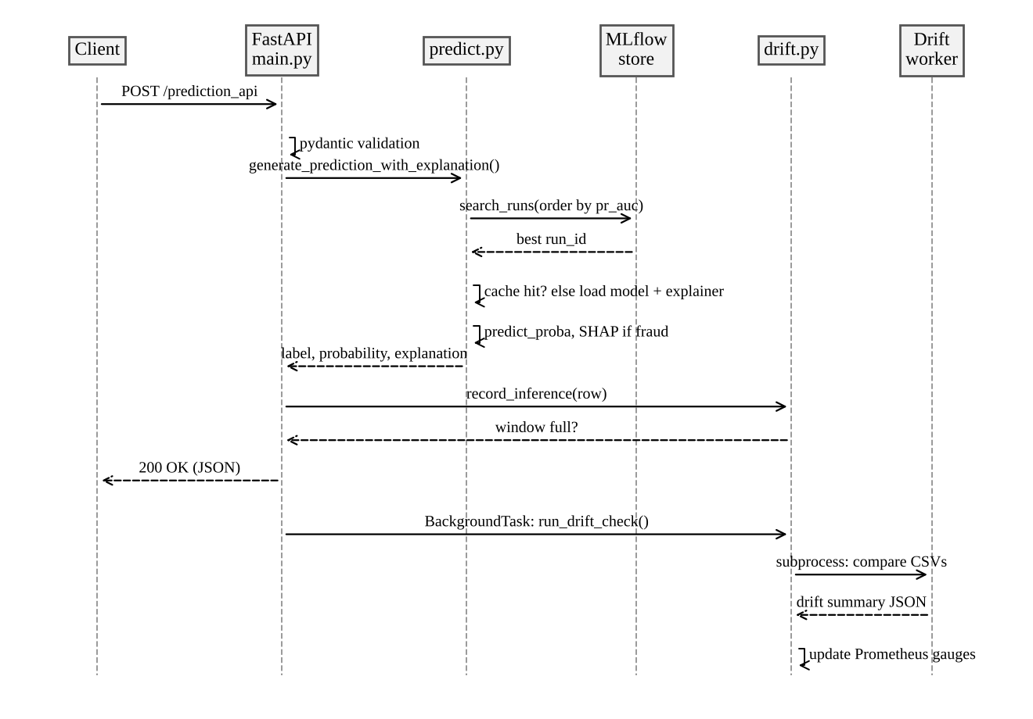
Modules – Data Flow and Sequence
Level-1 Data Flow Diagram
Sequence of a prediction request

Slide 12
Modules – Training and Prediction
creditcard.csv (DVC)
Stratified split 80/20
RobustScaler (Time, Amount)
XGBoost w = 577
Hyperopt 20 × 5-fold CV
MLflow best by PR-AUC
Training
Prediction API
Train: 227,845 rows (394 frauds); Test: 56,962 rows (98 frauds)
Class weight instead of resampling handles imbalance
Each trial scored by mean PR-AUC over 5 folds
Best settings: depth 5, 300 trees, learning rate 0.093
Training run takes about 6.4 minutes on a laptop
Endpoint | Purpose
POST /prediction_api | Label, probability, SHAP
POST /prediction_ui | Label only
POST /batch_prediction | CSV in, CSV with predictions out
POST, GET /monitoring/drift | Run / read drift check
GET /metrics | Prometheus metrics

Slide 13
Modules – Explainability and Drift Monitoring
Explainability (SHAP)
Drift Monitoring
TreeExplainer gives exact contributions for XGBoost and is fast (~12 ms)
Returned only for fraud predictions, so normal traffic is not slowed down
Each feature: value, SHAP score and direction (increases / decreases fraud risk)
Example: V14, V10 and V12 were the top reasons for a real fraud transaction
Every request is stored in a buffer of 500
A separate worker process runs Evidently against 20,000 training rows
29 features checked (Time excluded: it always increases)
Feature drifts if score > 0.1; dataset drifts if ≥ 30% of features drift
Prometheus alerts fire if drift lasts 10 minutes

Slide 14
Experiments and Results – Setup
Item | Details
Dataset | ULB credit card fraud: 284,807 transactions, 492 frauds (0.17%); features Time, V1–V28 (PCA), Amount
Split | Stratified 80 / 20, random seed 42; test set used only once at the end
Model | XGBoost with scale_pos_weight ≈ 577, preprocessing inside a scikit-learn Pipeline
Tuning | Hyperopt TPE, 20 trials, each scored by mean 5-fold CV PR-AUC (range 0.773 – 0.854)
Metrics | PR-AUC (main), ROC-AUC, precision, recall, F1 on the fraud class
Drift test | 300 normal test transactions vs 300 shifted (Amount × 3, 12 PCA features + 1.5)
Tools | Python, scikit-learn, XGBoost, MLflow, SHAP, FastAPI, Evidently, Prometheus, Grafana, Docker

Slide 15
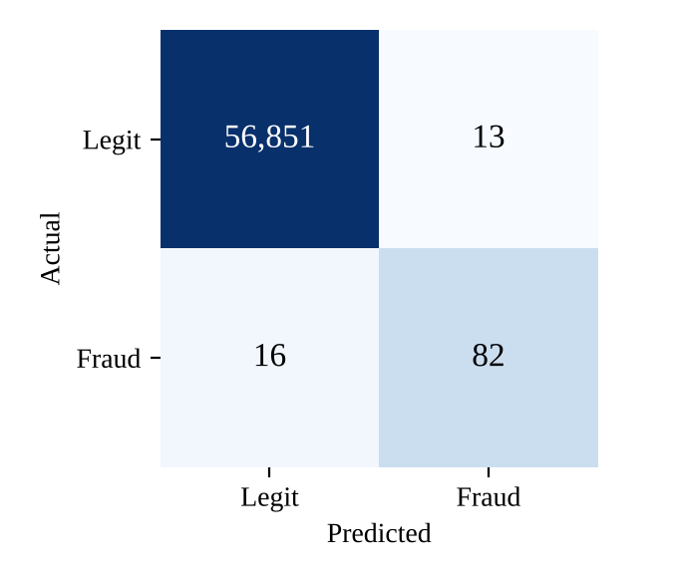
Experiments and Results – Model Performance
0.869
0.981
PR-AUC
ROC-AUC
0.863
0.837
Precision
Recall
Caught 82 of 98 frauds in the test set
Only 13 false alarms out of 56,864 legitimate transactions
Accuracy (99.95%) is not used: predicting all legitimate already gives 99.83%
Confusion matrix (test set, threshold 0.5)

Slide 16
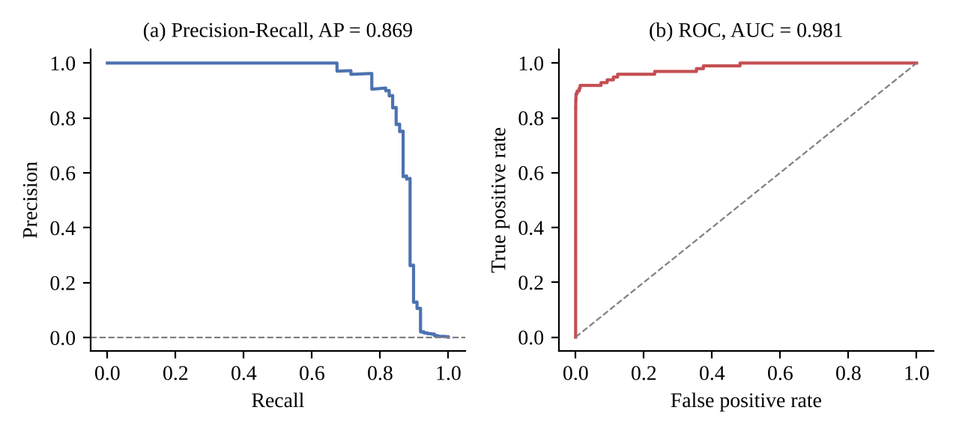
Experiments and Results – Curves and Explanation
SHAP explanation of a real fraud (p = 0.99997)
Feature | Value | SHAP | Effect
V14 | −6.17 | +3.12 | ↑ fraud
V10 | −4.88 | +1.75 | ↑ fraud
V12 | −4.69 | +1.23 | ↑ fraud
V8 | 1.17 | −0.92 | ↓ fraud
V2 | 2.46 | −0.69 | ↓ fraud
Precision-recall and ROC curves on the test set
The ROC curve looks almost perfect, but the PR curve is more honest: precision stays high up to ~80% recall, then drops.
Very low V14, V10 and V12 values pushed the transaction towards fraud.

Slide 17
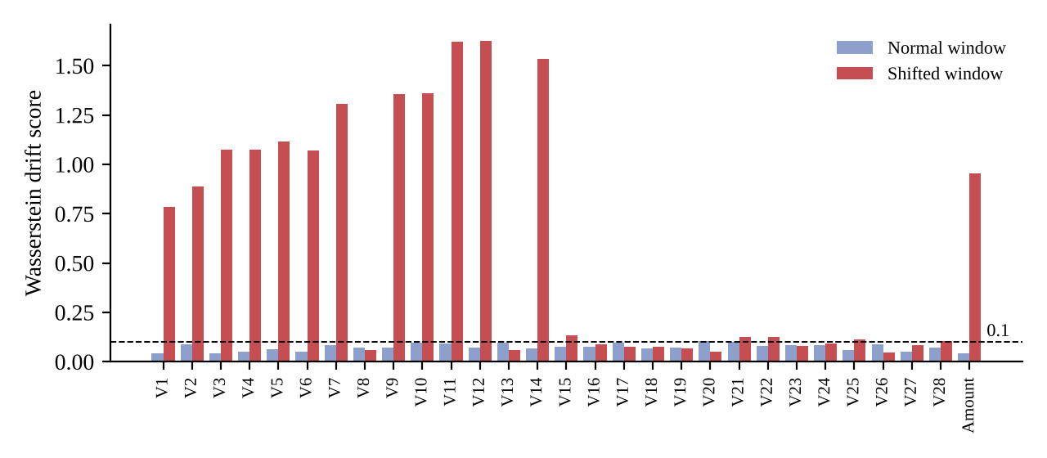
Experiments and Results – Drift Detection
Traffic | Drifted | Share | Alert
Normal | 2 / 29 | 0.07 | No
Shifted | 18 / 29 | 0.62 | Yes
Normal traffic stayed below the 0.3 alert level
All 13 changed features scored 0.78 – 1.63
Both Prometheus alert rules became active
Drift score per feature (threshold 0.1)
Shifted traffic: Amount tripled and 12 PCA features moved by +1.5 to imitate a change in customer behaviour.

Slide 18
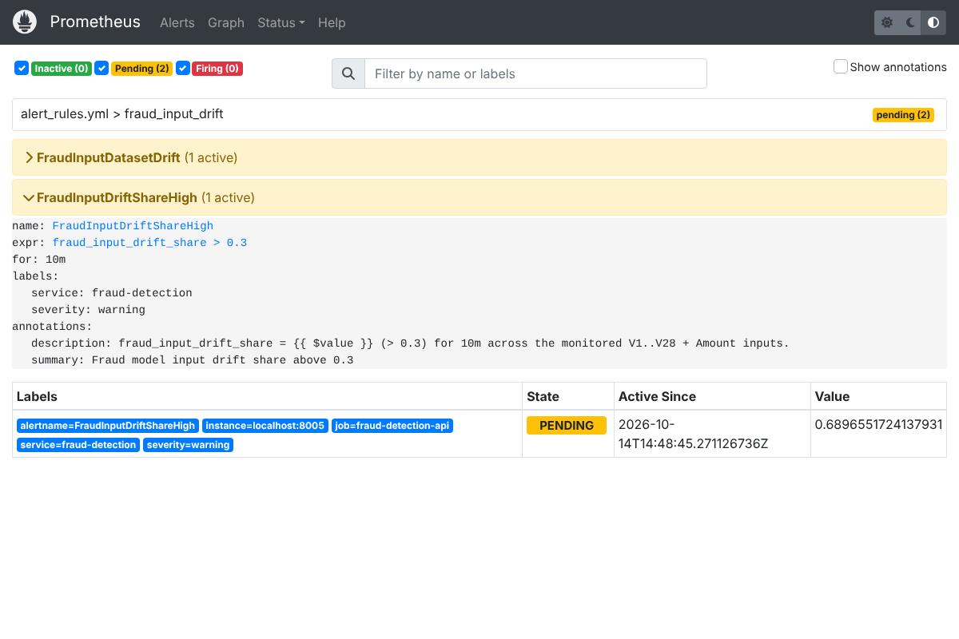
Experiments and Results – Demonstration
Paste screenshot: Grafana "Fraud Model – Input Drift" dashboard
Paste screenshot: FastAPI /docs or a /prediction_api response
Prometheus: drift alerts active during shifted traffic
Run: docker compose up --build → API :8005 | Prometheus :9090 | Grafana :3000

Slide 19
Experiments and Results – Testing and CI/CD
Area | Tests | What is checked
Input validation | 3 | Valid input accepted; missing / wrong type rejected
Feature contract + data split | 3 | 30 features; fraud ratio kept; split repeatable
SHAP explanation | 2 | Top-N features, sorted by importance
Drift buffer + summary | 5 | Fires every window; Evidently output parsed
Prometheus + end-to-end drift | 2 | Gauges updated; real worker detects shift
15 / 15
tests passing (~15 s, no dataset needed)
The old template had one test that broke every time a new model was trained. A failing test now blocks the image from being built.
git push
pytest (15 tests)
docker build (tests again)
Push image to GHCR
docker compose / Kubernetes

Slide 20
Conclusion and Future Work
Conclusion
Future Work
Complete MLOps pipeline from versioned data to monitored containers
PR-AUC 0.869: 82 of 98 frauds caught with only 13 false alarms
Every fraud prediction is explained with SHAP
Drift detector clearly separated normal (2/29) and shifted (18/29) traffic
15 automated tests, one-command deployment, CI-built images
Automatic retraining when drift is detected
MLflow Model Registry for versioned deployments
Send alerts to email / Slack via Alertmanager
Test on data with real, named features over a longer period

Slide 21
Outcome Achieved
Patent – Filed/ Published/ Granted – Screen shot
(or)
International Conference Proceedings – Accepted/ Published/ Scopus Indexed ← Our outcome: conference paper (status: ____ )
(or)
Journal Publication – Accepted/ Published/ Scopus Indexed
(or)
Start-up information (if any)
Others
Outcome Achieved Proof to be uploaded on or before 27 Oct 2026 in the given link https://forms.gle/B9B71VPy5b9bZ9dJ8

Slide 22
References
[1] A. Dal Pozzolo, O. Caelen, R. A. Johnson and G. Bontempi, "Calibrating probability with undersampling for unbalanced classification," in Proc. IEEE Symp. Series on Computational Intelligence, 2015, pp. 159-166.
[2] T. Chen and C. Guestrin, "XGBoost: A scalable tree boosting system," in Proc. 22nd ACM SIGKDD Int. Conf. Knowledge Discovery and Data Mining, 2016, pp. 785-794.
[3] S. M. Lundberg and S.-I. Lee, "A unified approach to interpreting model predictions," in Advances in Neural Information Processing Systems, vol. 30, 2017, pp. 4765-4774.
[4] S. M. Lundberg et al., "From local explanations to global understanding with explainable AI for trees," Nature Machine Intelligence, vol. 2, no. 1, pp. 56-67, 2020.
[5] J. Bergstra, D. Yamins and D. Cox, "Making a science of model search: Hyperparameter optimization in hundreds of dimensions for vision architectures," in Proc. ICML, 2013, pp. 115-123.
[6] D. Sculley et al., "Hidden technical debt in machine learning systems," in Advances in Neural Information Processing Systems, vol. 28, 2015, pp. 2503-2511.
[7] D. Kreuzberger, N. Kühl and S. Hirschl, "Machine learning operations (MLOps): Overview, definition, and architecture," IEEE Access, vol. 11, pp. 31866-31879, 2023.
[8] J. Gama, I. Žliobaitė, A. Bifet, M. Pechenizkiy and A. Bouchachia, "A survey on concept drift adaptation," ACM Computing Surveys, vol. 46, no. 4, pp. 1-37, 2014.
[9] T. Saito and M. Rehmsmeier, "The precision-recall plot is more informative than the ROC plot when evaluating binary classifiers on imbalanced datasets," PLoS ONE, vol. 10, no. 3, e0118432, 2015.
[10] M. Zaharia et al., "Accelerating the machine learning lifecycle with MLflow," IEEE Data Engineering Bulletin, vol. 41, no. 4, pp. 39-45, 2018.

