Slide 1

B.Tech. Computer Science and Engineering
BCSE497J – Project-I
Explainable and Drift-Aware Fraud Detection for Digital Payments: A Production-Grade MLOps Pipeline
Team members:
Shamik Sengupta (23BCE0608)
Yashaswini Kanaujia (23BCE0622)
Faculty guide :
Dr. Sharmila C

Slide 2

Approval Mail From Guide
Get the approval for the following points from your guide through mail before 21-10-2026.(sample attached below)
All the above aspects are addressed and updated by the project team.
Paste your approval mail screenshot here (replace the sample)

Slide 3
Aim
To design and build an end-to-end MLOps pipeline that detects fraud in digital payments (credit cards and UPI), explains every fraud decision to the analyst, and monitors live input data for drift, with the whole system versioned, tested and deployable as containers.
Detect
XGBoost model tuned for heavily imbalanced data (0.17% fraud), served through a REST API.
Explain
Top-5 SHAP contributions with every fraud prediction, in plain feature names on UPI.
Monitor
Automatic drift checks on incoming data, with Prometheus alerts and a Grafana dashboard.

Slide 4
Abstract
Fraud in digital payments is rare but costly. A useful system must score each payment, explain its decision and notice when incoming data changes.
We built a complete MLOps pipeline on the ULB credit card dataset: DVC-versioned data, XGBoost tuned with Hyperopt, MLflow tracking, a validated FastAPI service and SHAP explanations.
Drift is checked with Evidently in a separate process, exported to Prometheus, alerted on and shown in Grafana. 22 automated tests run in CI before the Docker image is built.
ULB features are anonymised, so explanations read "V14 = -6.17". We therefore ran the same pipeline on a simulated UPI stream with 14 named features, where explanations and drift reports become readable.
0.869
2 → 18
0.908
0 → 8
card PR-AUC (82 / 98 caught)
of 29 card features drifted
UPI PR-AUC (119 / 135 caught)
of 14 UPI features drifted

Slide 5


Literature Review
Paper | Objective | Methodology | Pros / Cons | Findings
Dal Pozzolo et al., 2015 (IEEE SSCI) | Handle class imbalance in fraud data | Undersampling + probability calibration on ULB data | + Simple, fast − Distorts probabilities | Scores must be recalibrated after undersampling
Chen & Guestrin, 2016 (ACM KDD) | Scalable tree boosting | XGBoost: regularised gradient boosting | + Accurate, class weights − Many hyperparameters | Strong default for tabular data
Bergstra et al., 2013 (ICML) | Automate hyperparameter search | Hyperopt with TPE algorithm | + Fewer trials than grid search − Results vary with seed | Efficient model tuning
Saito & Rehmsmeier, 2015 (PLoS ONE) | Evaluate classifiers on imbalanced data | Compare ROC and PR plots | + Clear guidance − Binary tasks only | PR curve is more informative than ROC
Lundberg & Lee, 2017; Lundberg et al., 2020 | Explain individual predictions | SHAP values; exact TreeSHAP for trees | + Exact, per prediction − Hard to read on PCA features | Consistent local explanations
Gama et al., 2014 (ACM CSUR) | Handle concept drift | Survey of drift detection methods | + Broad taxonomy − No deployment details | Deployed models must be monitored
Kreuzberger et al., 2023 (IEEE Access) | Define MLOps | Literature review + expert interviews | + Clear components − No implementation | Needs versioning, CI/CD, serving, monitoring

Slide 6
Research Gap
Evaluation stops at the notebook
Most fraud studies report test-set accuracy only. With 0.17% fraud, predicting "legitimate" for everything already gives 99.83% accuracy.
1
Explainability and drift are studied separately
SHAP and drift detection are rarely shown together inside a running prediction service.
2
Practical deployment problems, and no UPI data
The baseline template had one fragile test and no monitoring; Evidently and FastAPI clash on the "multipart" package. For UPI, NPCI and banks publish only aggregates, so no public transaction-level fraud data exists.
3
Our approach:
PR-AUC evaluation + SHAP + isolated drift worker in one tested service, on card data and a simulated UPI stream

Slide 7


Objectives
Train a fraud model without data leakage: stratified split, 5-fold CV and PR-AUC
Tune XGBoost with Hyperopt and track every run in MLflow
Serve the best model through a validated REST API (single and batch)
Return a SHAP explanation with every fraud prediction
Detect input drift automatically and raise Prometheus alerts
Package with Docker and run tests automatically in CI
Apply the same pipeline to a simulated UPI stream with named features
Identified: SDGs 8, 9 and 16 | TRL 4 (validated in lab) | Outcome: Conference paper

Slide 8
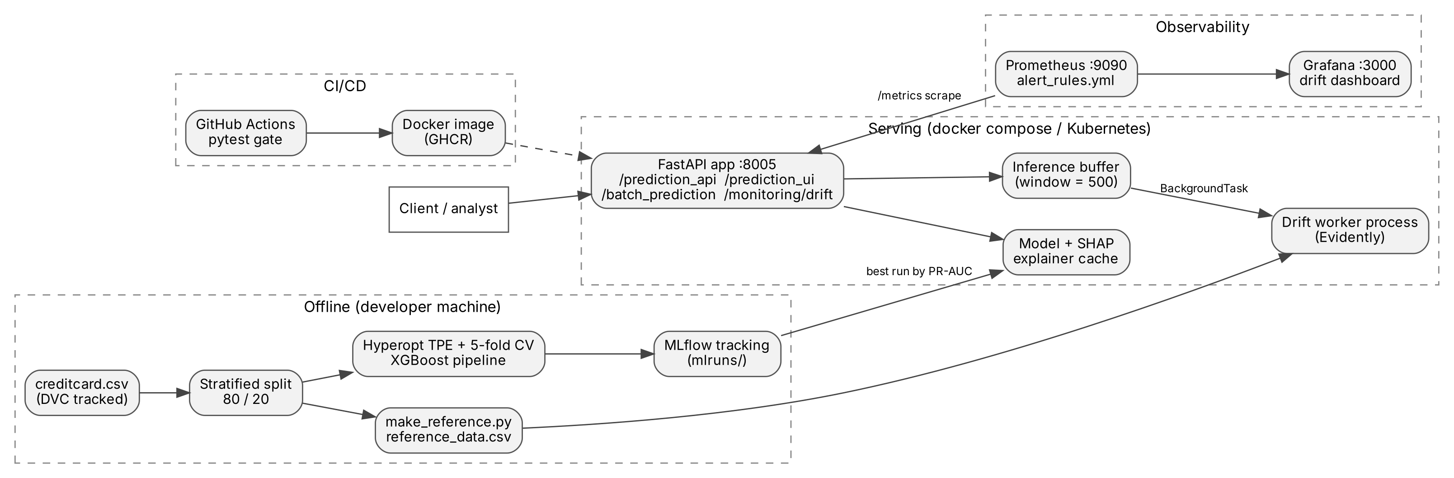
Framework / Architecture
Offline training → MLflow | CI/CD builds the image | FastAPI serves the best run | Prometheus + Grafana watch drift | UPI runs as a 2nd container (:8006)

Slide 9
Functional Requirements
Functional
Non-functional
Predict Fraud / Legitimate with fraud probability from a JSON transaction
Return top-5 SHAP features for every fraud prediction
Reject missing or non-numeric fields (HTTP 422)
Batch prediction on an uploaded CSV file
Track all runs in MLflow; always serve the best one
Drift check every 500 requests or on demand; show in Prometheus and Grafana
Same service runs on UPI data (DATASET=upi); categories validated
Prediction well under 100 ms
Drift failures never break predictions
Reproducible: seed 42, DVC data, pinned versions
Same container locally, compose and Kubernetes
Tests run without dataset or MLflow (CI-friendly)

Slide 10
Modules
1. Data & Versioning
DVC-tracked dataset; stratified 80/20 split keeps the 0.17% fraud rate
2. Training & Tuning
RobustScaler + XGBoost (class weight ≈ 577); Hyperopt, 20 trials × 5-fold CV
3. Prediction API
FastAPI with pydantic validation; best MLflow run cached in memory
4. Explainability
SHAP TreeExplainer; top-5 features for fraud predictions only
5. Drift Monitoring
Evidently worker every 500 requests; Prometheus gauges and alerts
6. Deployment & CI/CD
Docker compose (card + UPI services), Kubernetes; GitHub Actions test → build → push

Slide 11
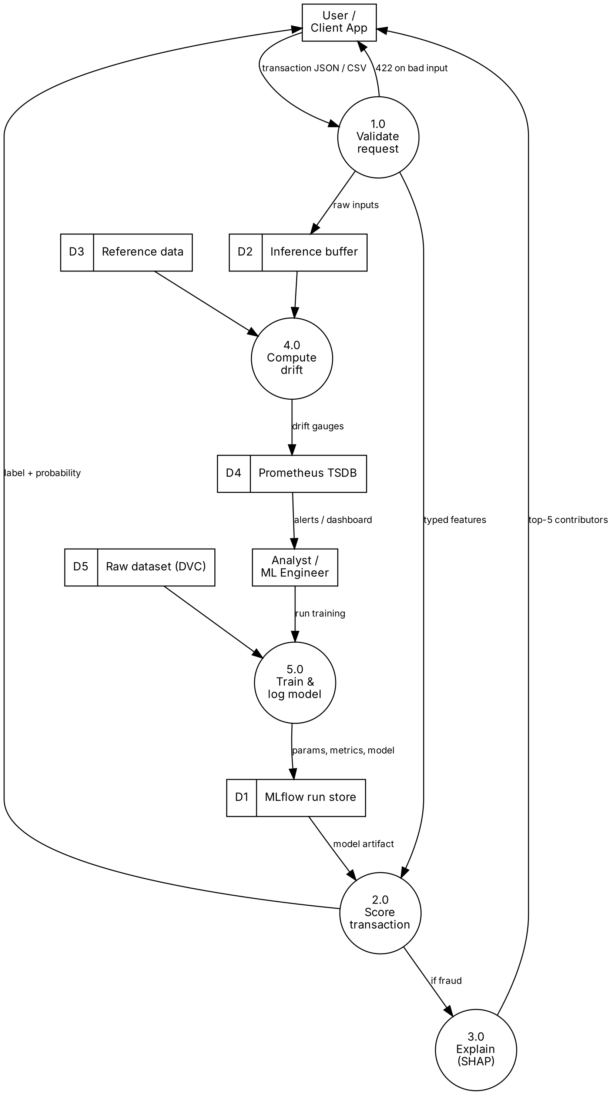
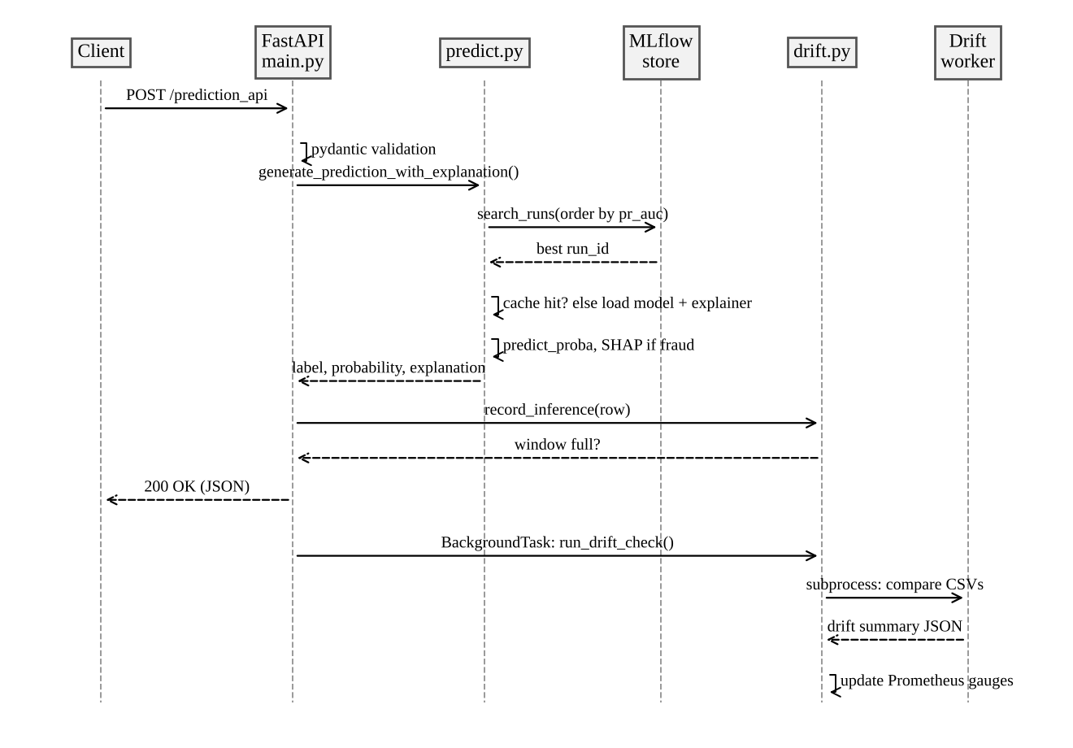
Modules – Data Flow and Sequence
Level-1 Data Flow Diagram
Sequence of a prediction request

Slide 12
Modules – Training and Prediction
creditcard.csv (DVC)
Stratified split 80/20
RobustScaler (Time, Amount)
XGBoost w = 577
Hyperopt 20 × 5-fold CV
MLflow best by PR-AUC
Training
Prediction API
Train: 227,845 rows (394 frauds); Test: 56,962 rows (98 frauds)
Class weight instead of resampling handles imbalance
Each trial scored by mean PR-AUC over 5 folds
Best settings: depth 5, 300 trees, learning rate 0.093
Training run takes about 6.4 minutes on a laptop
Endpoint | Purpose
POST /prediction_api | Label, probability, SHAP
POST /prediction_ui | Label only
POST /batch_prediction | CSV in, CSV with predictions out
POST, GET /monitoring/drift | Run / read drift check
GET /metrics | Prometheus metrics

Slide 13
Modules – Explainability and Drift Monitoring
Explainability (SHAP)
Drift Monitoring
TreeExplainer gives exact contributions for XGBoost and is fast (~12 ms)
Returned only for fraud predictions, so normal traffic is not slowed down
Each feature: value, SHAP score and direction (increases / decreases fraud risk)
Example: V14, V10 and V12 were the top reasons for a real fraud transaction
Every request is stored in a buffer of 500
A separate worker process runs Evidently against 20,000 training rows
29 features checked (Time excluded: it always increases)
Feature drifts if score > 0.1; dataset drifts if ≥ 30% of features drift
Prometheus alerts fire if drift lasts 10 minutes

Slide 14
Modules – UPI Extension (Simulated Data)
Simulated UPI stream
Why it matters: the same fraud, explained
No public UPI fraud data exists, so we wrote a seeded simulator (simulate.py): 330,687 payments, 180 days, 1,200 frauds
14 named features: amount, hour, merchant category, UPI app, new device, new payee, payee VPA age, payments in 24 h, amount vs usual ...
Days 0–89: account takeover (new device, night, large P2P bursts)
From day 90: festive season (bigger baskets, evening shopping, new sellers) and a new scam type
Same pipeline: one-hot encoding + XGBoost, trained on days 0–59, tested on unseen days 60–89 (time split)
Credit card (anonymised)
Flagged because V14 = −6.17, V10 = −4.88, V12 = −4.69. Accurate, but an analyst cannot act on it.
UPI (named features)
is_new_device = 1 (+4.63)
amount_to_user_avg = 12.29 (+3.92)
hour = 4 (+2.09)
txns_last_24h = 8 (+1.50)
txn_type = P2P (+1.09)

Slide 15
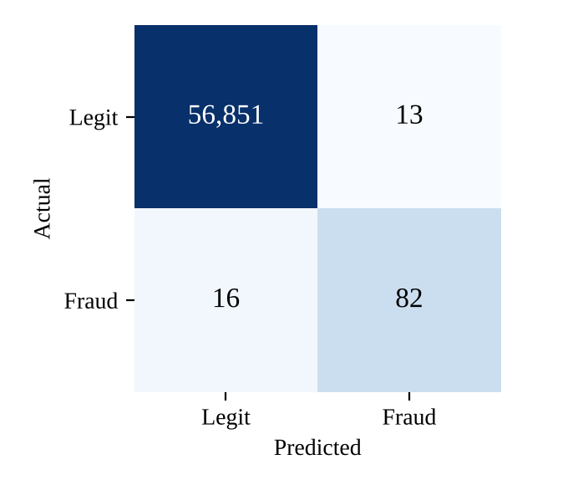
Experiments and Results – Model Performance (Card)
0.869
0.981
0.863
0.837
PR-AUC
ROC-AUC
Precision
Recall
Better than what? Baselines on the same split
Model | PR-AUC | Caught | False alarms
Logistic regression | 0.719 | 90 / 98 | 1,385
Random forest | 0.858 | 73 / 98 | 3
XGBoost (default) | 0.878 | 79 / 98 | 7
XGBoost (default + weight) | 0.880 | 82 / 98 | 11
XGBoost (tuned, ours) | 0.869 | 82 / 98 | 13
XGBoost wins; tuning gave no significant gain over defaults (difference −0.011, 95% CI [−0.028, 0.004]).
Confusion matrix (test set, threshold 0.5)

Slide 16
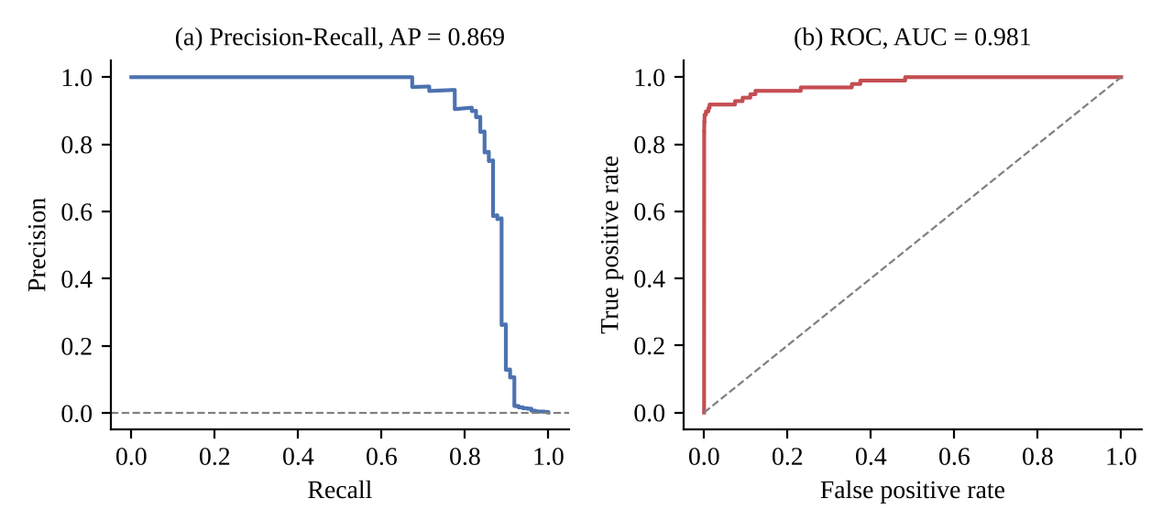
Experiments and Results – Curves and Explanation
SHAP explanation of a real fraud (p = 0.99997)
Feature | Value | SHAP | Effect
V14 | −6.17 | +3.12 | ↑ fraud
V10 | −4.88 | +1.75 | ↑ fraud
V12 | −4.69 | +1.23 | ↑ fraud
V8 | 1.17 | −0.92 | ↓ fraud
V2 | 2.46 | −0.69 | ↓ fraud
Precision-recall and ROC curves on the test set
The ROC curve looks almost perfect, but the PR curve is more honest: precision stays high up to ~80% recall, then drops.
Very low V14, V10 and V12 values pushed the transaction towards fraud.

Slide 17
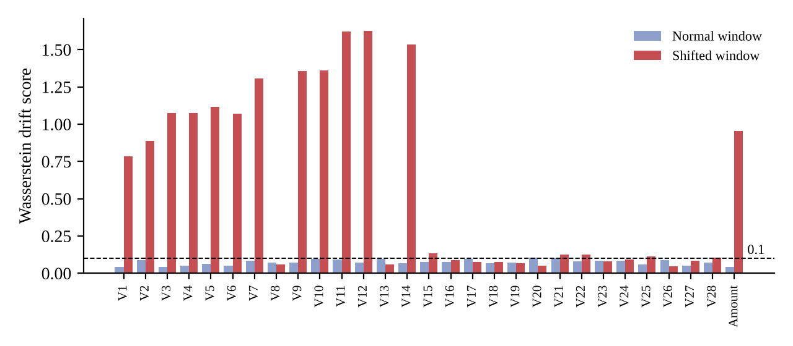
Experiments and Results – Drift Detection
Traffic | Drifted | Share | Alert
Normal | 2 / 29 | 0.07 | No
Shifted | 18 / 29 | 0.62 | Yes
Normal traffic stayed below the 0.3 alert level
All 13 changed features scored 0.78 – 1.63
Both Prometheus alert rules became active
Drift score per feature (threshold 0.1)
Shifted traffic: Amount tripled and 12 PCA features moved by +1.5 to imitate a change in customer behaviour.

Slide 18
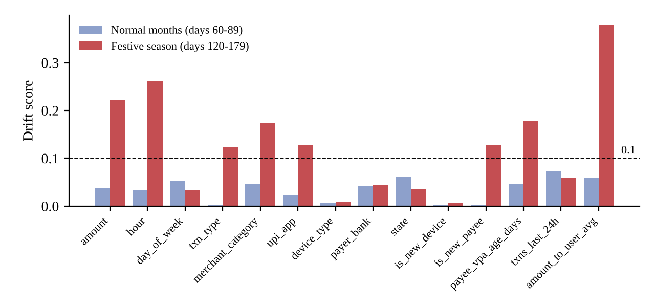
Experiments and Results – UPI Extension
0.908
0.881
PR-AUC
Recall
0.826
119 / 135
Precision
frauds caught
Tested on unseen days 60–89 (25 false alarms)
Normal months: 0 of 14 features drifted
Festive season: 8 of 14 drifted (57%), alert raised
A festive-season scam is missed: the model never saw that pattern, so drift monitoring is the warning
UPI drift score per feature: normal months vs festive season (threshold 0.1)
Top drift: amount vs usual, hour, amount, payee VPA age, merchant category (simulated data)

Slide 19
Experiments and Results – Testing and CI/CD
Area | Tests | What is checked
Input validation | 3 | Valid input accepted; missing / wrong type rejected
Feature contract + data split | 3 | 30 features; fraud ratio kept; split repeatable
SHAP explanation | 2 | Top-N features, sorted by importance
Drift buffer + summary | 5 | Fires every window; Evidently output parsed
Prometheus + end-to-end drift | 2 | Gauges updated; real worker detects shift
Model cache | 1 | Best run cached, refreshed in background
UPI extension | 6 | Simulator, categories, one-hot, SHAP sums, time split
22 / 22
tests passing (no dataset needed)
The old template had one test that broke every time a new model was trained. A failing test now blocks the image from being built.
git push
pytest (22 tests)
docker build (tests again)
Push image to GHCR
docker compose / Kubernetes

Slide 20
Conclusion and Future Work
Conclusion
Future Work
Complete MLOps pipeline from versioned data to monitored containers
PR-AUC 0.869: 82 of 98 frauds caught with only 13 false alarms
Every fraud prediction is explained with SHAP
Drift detector separated normal (2/29) and shifted (18/29) traffic
On simulated UPI data: PR-AUC 0.908, readable explanations, festive drift 8/14
22 automated tests, one-command deployment, CI-built images
MLflow Model Registry for versioned deployments
Send alerts to email / Slack via Alertmanager
Retrain once new fraud labels arrive (champion vs challenger)
Replace simulated UPI data with real labelled data

Slide 21
Outcome Achieved
Patent – Filed/ Published/ Granted – Screen shot
(or)
International Conference Proceedings – Accepted/ Published/ Scopus Indexed ← Our outcome: conference paper (status: ____ )
(or)
Journal Publication – Accepted/ Published/ Scopus Indexed
(or)
Start-up information (if any)
Others
Outcome Achieved Proof to be uploaded on or before 27 Oct 2026 in the given link https://forms.gle/B9B71VPy5b9bZ9dJ8

Slide 22
References
[1] A. Dal Pozzolo, O. Caelen, R. A. Johnson and G. Bontempi, "Calibrating probability with undersampling for unbalanced classification," in Proc. IEEE Symp. Series on Computational Intelligence, 2015, pp. 159-166.
[2] T. Chen and C. Guestrin, "XGBoost: A scalable tree boosting system," in Proc. 22nd ACM SIGKDD Int. Conf. Knowledge Discovery and Data Mining, 2016, pp. 785-794.
[3] S. M. Lundberg and S.-I. Lee, "A unified approach to interpreting model predictions," in Advances in Neural Information Processing Systems, vol. 30, 2017, pp. 4765-4774.
[4] S. M. Lundberg et al., "From local explanations to global understanding with explainable AI for trees," Nature Machine Intelligence, vol. 2, no. 1, pp. 56-67, 2020.
[5] J. Bergstra, D. Yamins and D. Cox, "Making a science of model search: Hyperparameter optimization in hundreds of dimensions for vision architectures," in Proc. ICML, 2013, pp. 115-123.
[6] D. Sculley et al., "Hidden technical debt in machine learning systems," in Advances in Neural Information Processing Systems, vol. 28, 2015, pp. 2503-2511.
[7] D. Kreuzberger, N. Kühl and S. Hirschl, "Machine learning operations (MLOps): Overview, definition, and architecture," IEEE Access, vol. 11, pp. 31866-31879, 2023.
[8] J. Gama, I. Žliobaitė, A. Bifet, M. Pechenizkiy and A. Bouchachia, "A survey on concept drift adaptation," ACM Computing Surveys, vol. 46, no. 4, pp. 1-37, 2014.
[9] T. Saito and M. Rehmsmeier, "The precision-recall plot is more informative than the ROC plot when evaluating binary classifiers on imbalanced datasets," PLoS ONE, vol. 10, no. 3, e0118432, 2015.
[10] M. Zaharia et al., "Accelerating the machine learning lifecycle with MLflow," IEEE Data Engineering Bulletin, vol. 41, no. 4, pp. 39-45, 2018.

