Slide 1
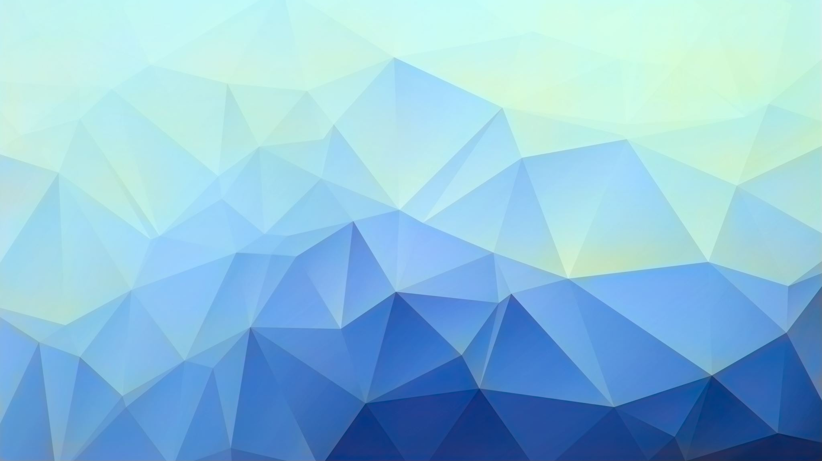
Gesture Recognition Using an ANN
Shamika Dhuri
Cognative Robotics
dhurishamika@gmail.com

Slide 2
What it Does
Gesture recognition of single hands
Simple action in response to gestures
Demo: https://www.youtube.com/shorts/oQvSuy0yqSQ

Slide 3
My Approach
MediaPipe Hands: hand and finger tracking by Google
Creates 3D maps of hands when given an input of a 3D image and gives their normalized 3D coordinates in space
Get training data by taking a video of hand moving through gestures and take each frame as a piece of data to put through MediaPipe
Use MediaPipe to get coordinates of joints
Can be used as features to train an ANN to classify gestures
ANN chosen because we don’t have moving patterns (CNN) or sequential information (RNN)
Classification by ANN can be used to direct Cozmo to a certain action
Simple cozmo code to do actions and reset lift and head position whenever it detects a hand

Slide 4
ANN explained
Sequential fully connected neural network with 2 hidden layers using pytorch
Input a 1d array of 21 neurons
x and y coordinates of every joint on the hand after normalization
Coordinates obtained through MediaPipe
Labels obtained by os walking also input for training
2 hidden linear layers with 28 neuron
2/3 of input size convention
Hidden layers help to improve accuracy as linear separability is difficult with only one layer
ReLU activation layers
Helps mitigate vanishing gradient issue that is caused by SGD
Stochastic Gradient Decent needed for backpropagation for learning
Derivative of ReLU is always more than or equal to 0
Learning rate: 0.1 Epochs: 2500 BatchMode
BatchMode: The batch size is the entire traning dataset.
Used this because I have too little data for each gesture to effectively train if I split it up
Gives longer iteration time but because I'm only training once, I don't care
Learning rate and Epochs chosen to fit with model convergence
Outputs a number (1-10) that indicates what hand position it predicted

Slide 5
Issues I Ran Into
Cozmo’s camera quality
Testing is not always accurate
Hard to detect and differentiate hands from background
Lighting and background dependent
Lowered threshold of hand detection
More likely to detect hand
Causes more inaccuracy in prediction as things that are not hands get detected as hands
Difficult to differentiate shadows
Can no longer accurately detect depth of image
Can no longer use 1/3 of the data points that MediaPipe gives
Python Version
Only works on python 3.7 or higher (MediaPipe Requirement)
DORI was updated!

Slide 6
Results and What Worked
94.6% model training accuracy
Able to run program on DORI
Cozmo responds to all 10 of the gestures!
Cozmo ”resets” head position and lift position after each action
Won’t accidentally obscure its own vision with a gesture
Continuous looking for hands
Don’t have to restart the program to give it another “command”

Slide 7
Future Work
Add image filters
Might fix the issue of detection of hands
Potentially, messing with the contrast would help
Add more robust actions done after gesture is recognized
Add more gestures
Add non-static gestures
Difficult because of camera lag

