Slide 1
Sashimi

Slide 2
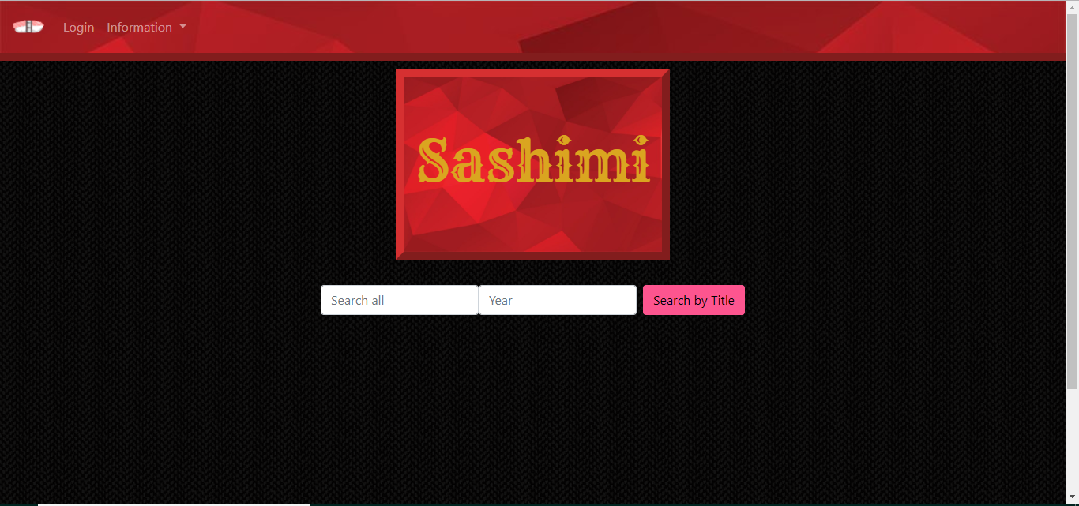
Main Page

Slide 3
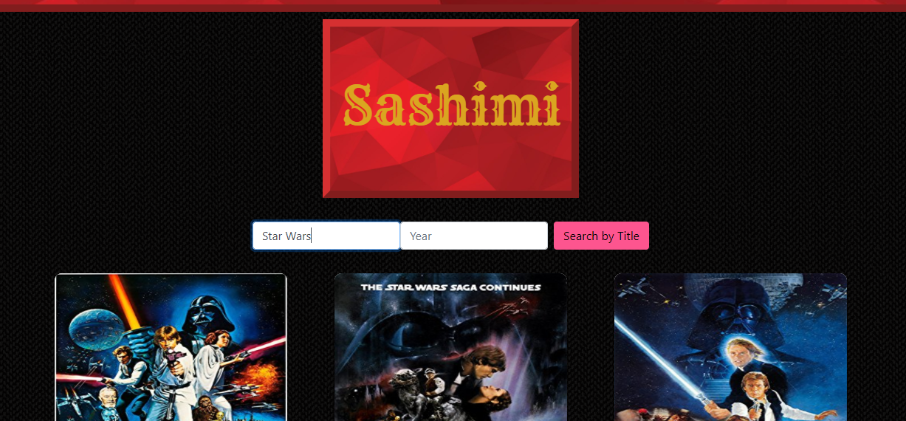
Movie Search

Slide 4
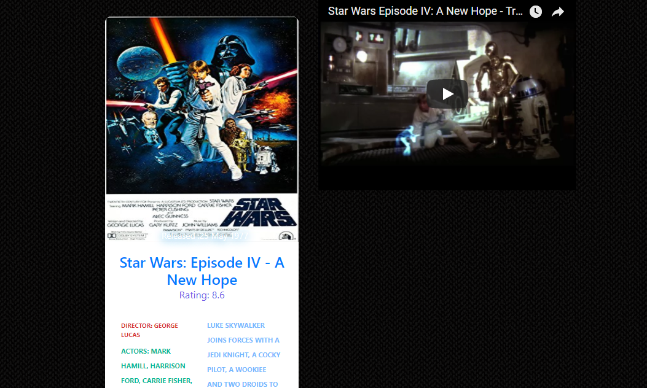
Movie Results

Slide 5
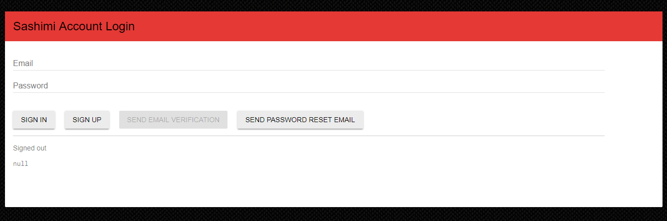
Login Page and Register

Slide 6
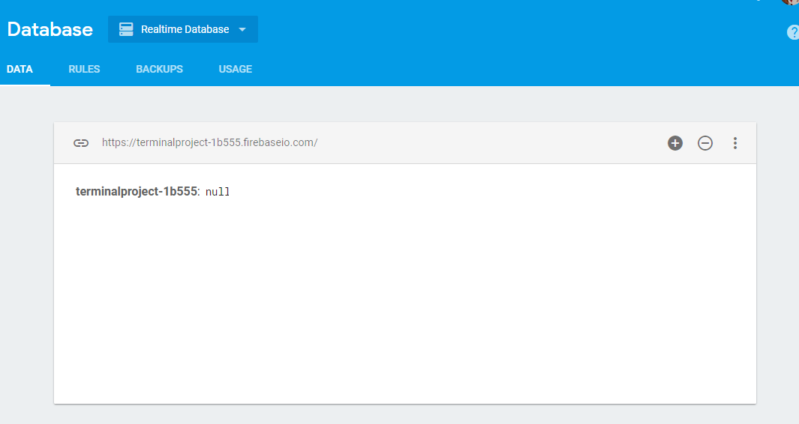
Firebase and User Verification

Slide 7

Top Movies Page

Slide 8
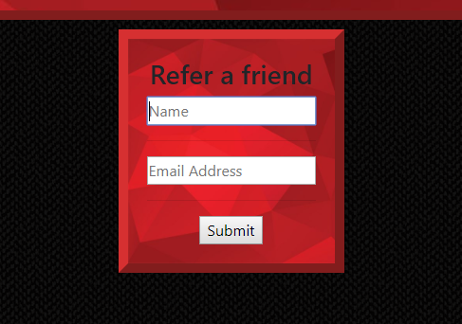
Refer a Friend

Slide 9
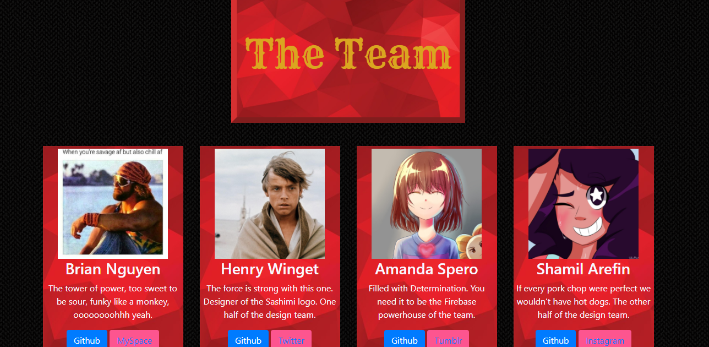
About Us

