Slide 1
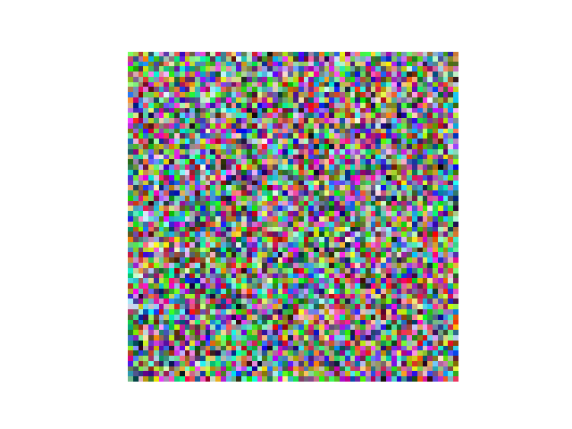
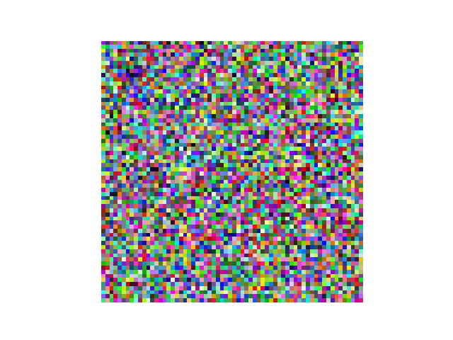
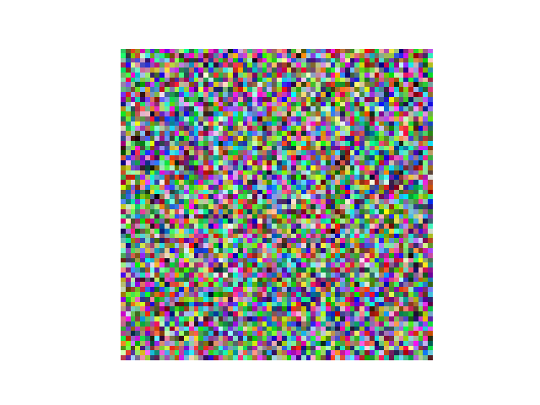
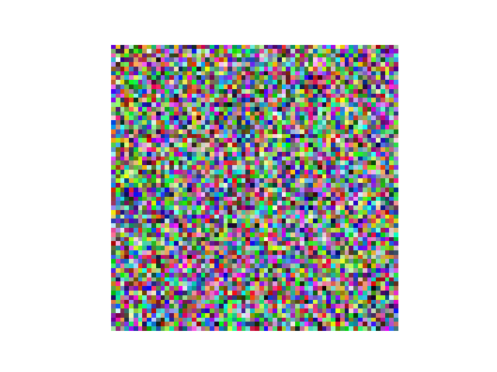
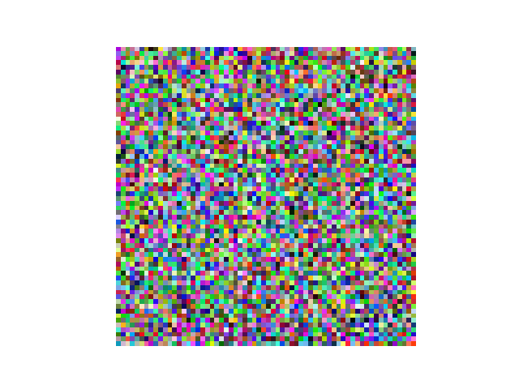
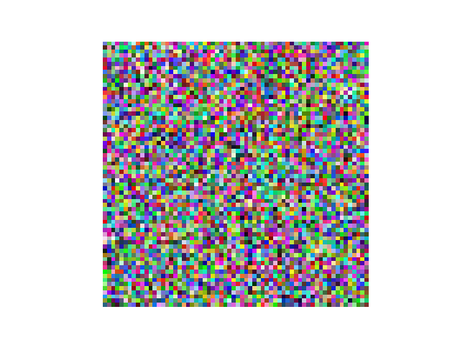
Slide 1: Task Overview
Name: Shamil Tahirov
Student ID: 8
Task: Food Classification (5 types)
Dataset: Fake Food Dataset
Number of classes: 5
Target Accuracy: 85%

Slide 2
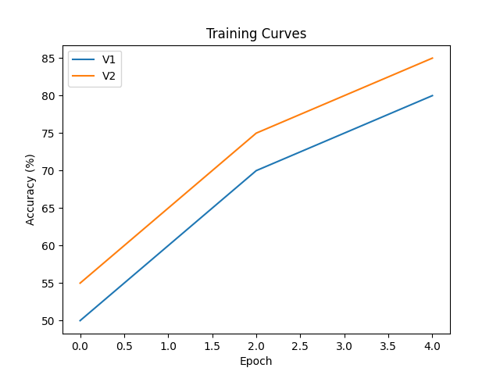
Slide 2: Training & Comparison
Model: Simple CNN
Version 1: lr=0.001, batch=16 -> Accuracy: 80%
Version 2: lr=0.0005, batch=32 -> Accuracy: 85%
Better: Version 2

Slide 3
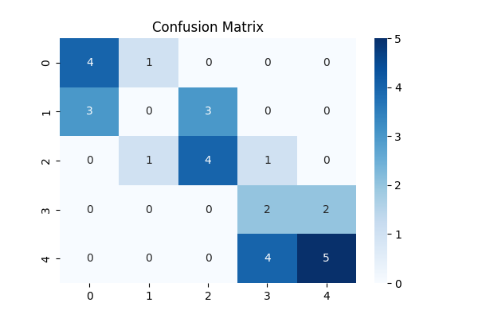
Slide 3: Best Results
Final Test Accuracy: 50.0%

