Slide 1
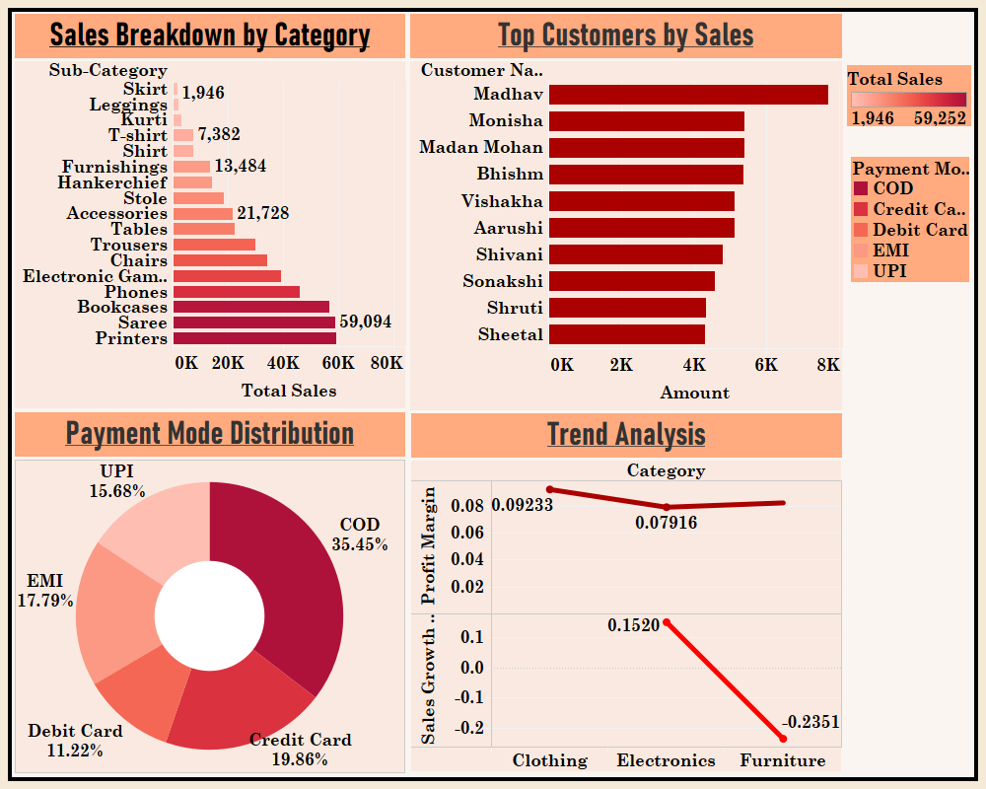
Executive Overview - 1

Slide 2
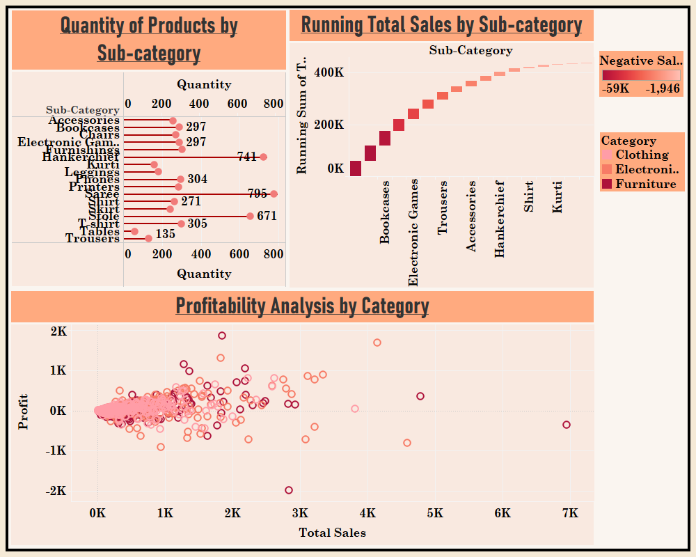
Executive Overview - 2

Slide 3
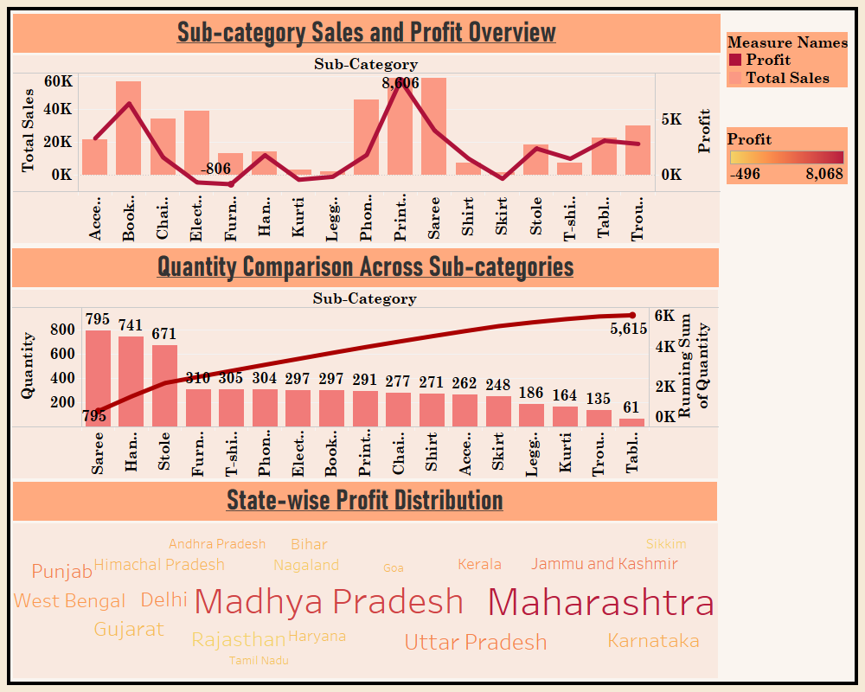
Executive Overview - 3

