Slide 1
LifeQuest
SHAMIM RASHID

Slide 2
Background
Blood and blood products are critical inputs into a wide range of medical procedures.
Over the years the need for blood in hospitals has increased.This is because in the increase of numbers of medical challenges facing Kenyans. ls

Slide 3
LifeQuestHow? Solution
Blood management system for android is developed so that users can view nearest hospitals available and amount of blood available for transfusion.
To sign up, you are required to fill in your personal details.To sign in you are required to use your username and email address.
Donors can register themselves specifying their weight,height,age and blood type.
Users can check the stock of different blood types in the database.

Slide 4
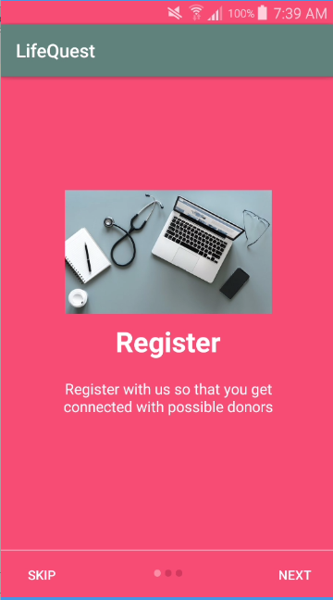
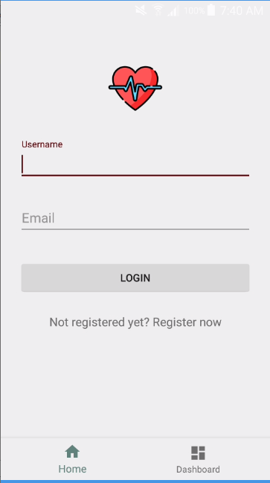
App Flow - Screenshots

Slide 5
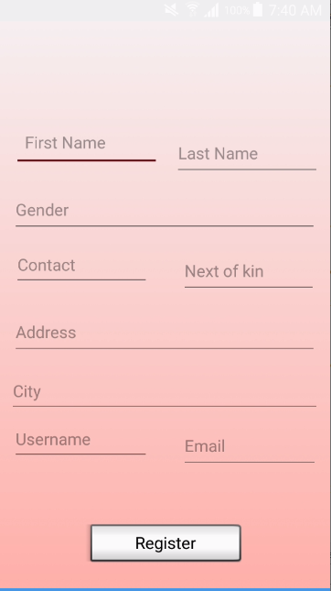
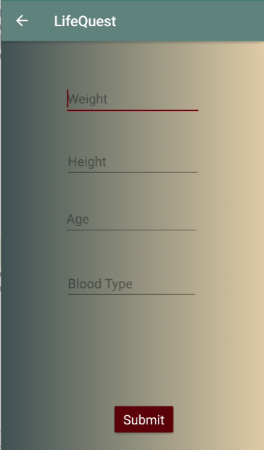
App Flow - Screenshots

Slide 6
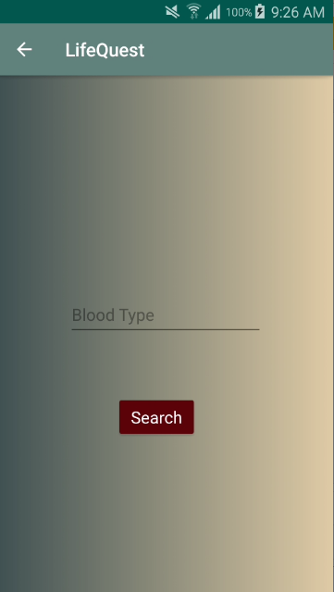
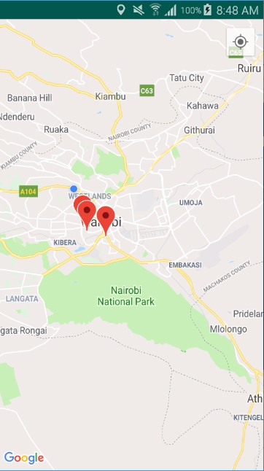
App Flow - Screenshots

Slide 7
Marketing
Social media
Ads
Location-based marketing

Slide 8
Revenue Model
I will make the app free but allow medical related ads by google.

Slide 9
Future Updates
Add an appointment calendar where users can book appointments for blood screening in hospitals of their choice.

