Slide 1


Data Governance @ SneakerPark
Prepared by:
Submitted on:

Slide 2
Background
SneakerPark is an online shoe reseller that allows people to buy and sell used and new shoes. Buyers can bid for shoes or buy them outright, and sellers can set a price or sell to the highest bidder.
Each buyer and seller must have an active account in order to sell, bid, or purchase sneakers using SneakerPark’s website.
SneakerPark authenticates the shoes before shipping them to the buyer, so before listing an item, the seller must ship it to SneakerPark’s warehouse. Upon receipt, SneakerPark assigns an item number to each pair of sneakers and notifies the seller that they are now free to list their item. If the item is not listed within 45 days, SneakerPark returns it to the seller and sends an invoice to the seller for the shipping cost.
If the item is found to be inauthentic or in an unacceptable condition, it is also returned back to the seller in a similar fashion.
When the item sells, the buyer’s account is credited with the purchase price minus the SneakerPark service fee and shipping fees to deliver the item to the buyer.
Currently, SneakerPark only supports sales within the United States.

Slide 3
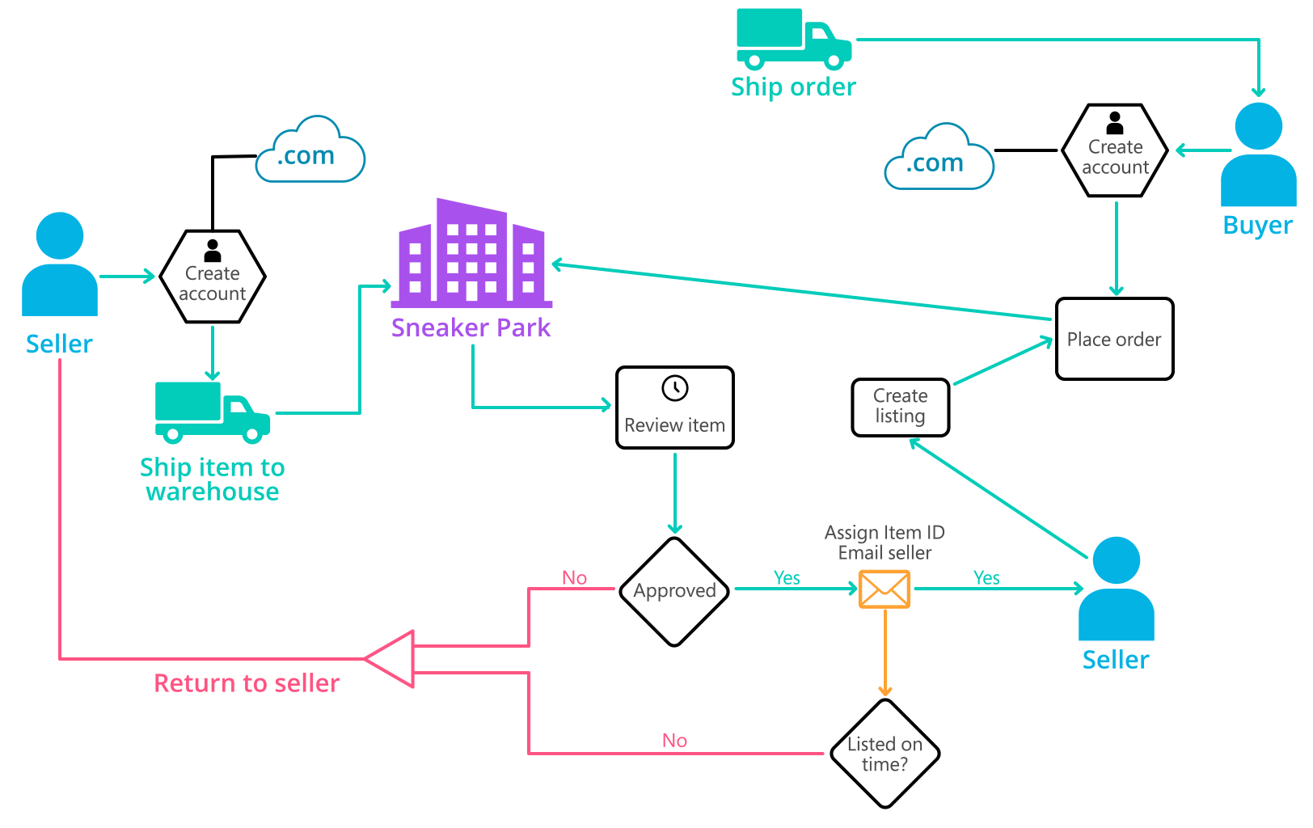
Background (cont’d)
Below you can see a diagram that will hopefully help you visualize some of SneakerPark's business processes. Keep in mind that it does not capture ALL processes and every nuance, but simply serves as another artifact to use in your project.

Slide 4
Step 1
Enterprise Data Catalog Part 1: Enterprise Data Model

Slide 5
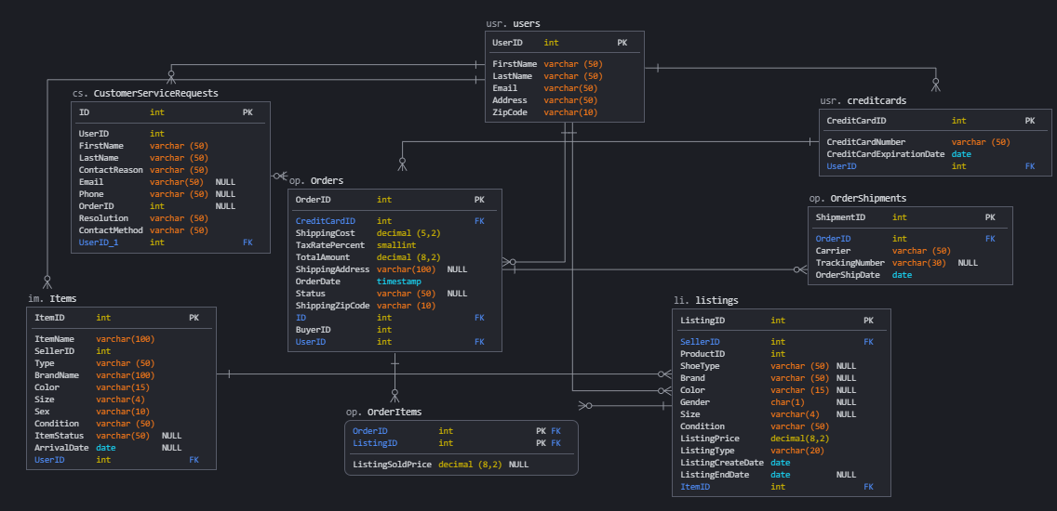
Conceptual Data Model

Slide 6
Step 2
Enterprise Data Catalog Part 2: Metadata

Slide 7
All fields in both tabs. are filled out in sheets template for "Data Dictionary" and the “Enterprise Data Catalog”

Slide 8
Step 3
Data Quality
Part 1: Profiling and Cleansing

Slide 9
Data is profiled with at least 3 data quality issues I have seen in the data. Also provide 1 data quality issue that I haven’t yet seen in the data, but can foresee occurring in the future. Based on the issues I have identified, come up with the data quality rule for each data quality issue, including for the one that you foresee.
Filled out all columns in the "Data Quality Issues" tab with my answers in the provided Sheets template.

Slide 10
Step 4
Data Quality
Part 2: Monitoring

Slide 11
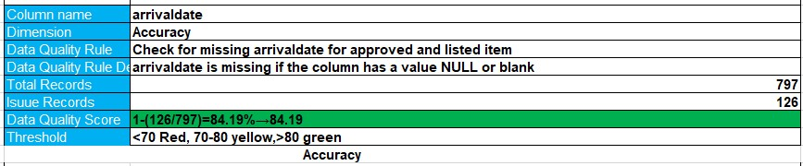
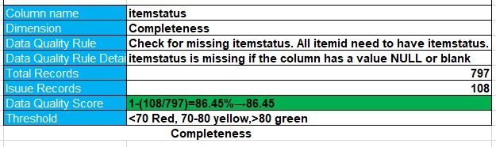
Mock-up of a data quality monitoring dashboard

Slide 12
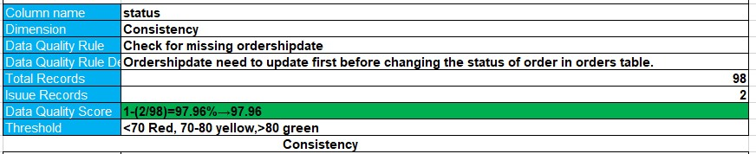
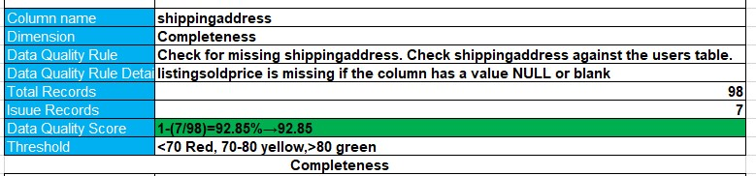
Mock-up of a data quality monitoring dashboard

Slide 13
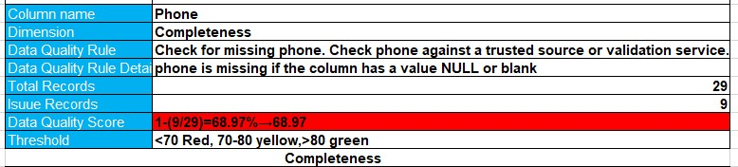
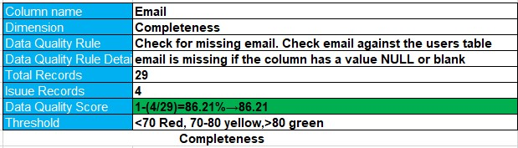
Mock-up of a data quality monitoring dashboard

Slide 14
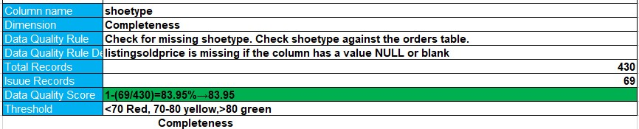
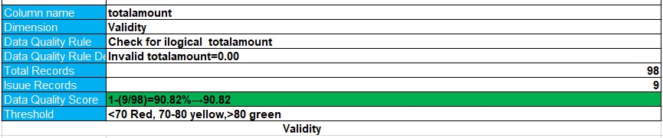
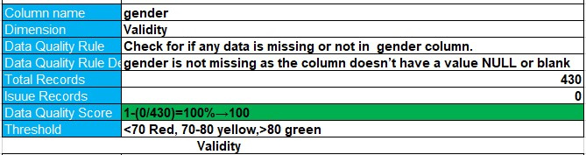
Mock-up of a data quality monitoring dashboard

Slide 15
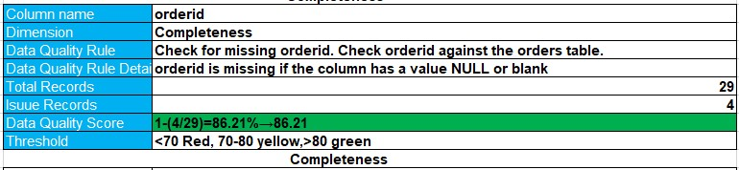
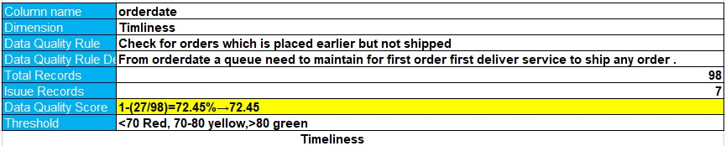
Mock-up of a data quality monitoring dashboard

Slide 16
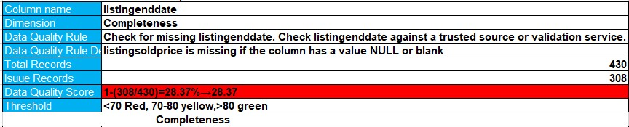
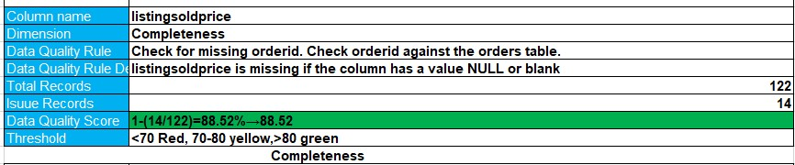
Mock-up of a data quality monitoring dashboard

Slide 17
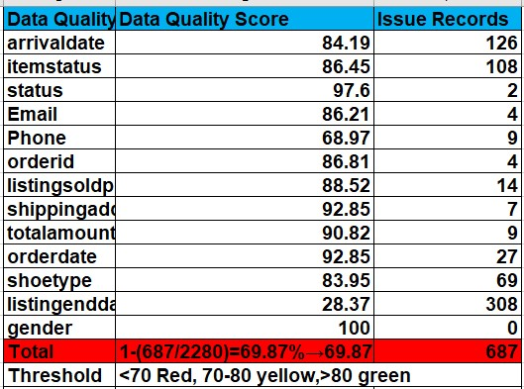
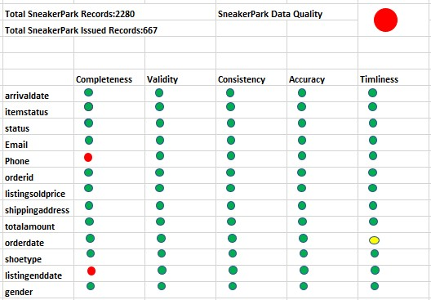
Overall Score
Dashboard

Slide 18
Step 5
Master Data Management
Part 1: MDM Architecture

Slide 19
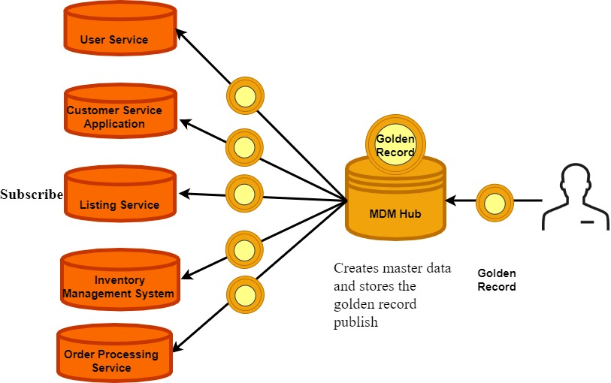
Proposed MDM Implementation Architecture

Slide 20
Explanation:
Problem of SneakerPark’s is for the increased number of sellers, buyers, items, and sales, the company started running into discrepancies between systems which resulted in mischarges, lost revenue, and frustrated customer. As the problem is regarded with mischarge I chose to implement centralized MDM. In centralized MDM master data is created into MDM hub and then the golden record is strapped from MDM hub to source systems for use in applications and transactions. This MDM architecture make available correct and consistent data at all times. The business rules and governance policies are applied and managed consistently in one place resulting in It maintains strong data governance applying and dealing consistently the business rules and governance policies in one place. Correct and consistent data will remove the problem of discrepancies between systems . As golden record is a single, unified version of the data, and it is created by consolidating and correcting inaccurate and duplicated data in different systems so using this record in transactions it will solve the mischarges problem as well as customer frustration. This architecture style increases the system availability. When applied to the sneakerpark system centralized architecture is a non intrusive approach. This non intrusive approach would not affect the availability of the system. There will be minimal disruption of the existing systems and their operations can go on as the data architecture is being build

Slide 21
Step 6
Master Data Management
Part 2: Master Record

Slide 22
4 rules - 2 for Items and 2 for Customers are listed them below.
Items
1.sellerid from im.items table should match with sellerid from li.listings table.
2.type,brandname,color,size,sex,condition from im.item table should match with shoetype,brand,color,gender,size,condition from li.listings table respectively.
Customer
1.userid from cs.customerservicerequests table should match with userid from usr.users table.
2.creditcardid from usr.creditcards table should match with credicardid from op.orders table.

Slide 23
Step 7
Data Governance:
Roles and Responsibilities

Slide 24
Based on SneakerPark's current employees skills below roles are exist and new role need to hire.
Data Quality Manager:
Business is maintaining the data quality. Responsibility of this rule is to estimates requests and problems with data. It describes procedures to form and sustain the data also actions and reports the data quality, documents the data in a data catalog or glossary. This responsibilities can be fulfilled by the business analyst and Data Steward they need to hire new role because Jessica and Jake is maintaining this part partially. They need someone who will work only for data quality issue as data quality manager.
Metadata Manager :
IT support will handle the metadata management as the role of it is to administering database. As jake is already managing the data management so he will be sufficient for managing metadata because new hired role will deal with data quality issue .It will increase Jake’s efficiency as metadata manager.
Master Data Manager :
As Data Stewards and other business subject matter experts play a critical role in MDM implementation so SneakerPark’s need to hire a another Data Stewards along with Jessica for MDM management because SneakerPark is rapidly growing company. It would be beneficial to have multiple Data Stewards . Effectivity of MDM will increase if two or more person will be working side by side to manage MDM.

Slide 25
Standout Suggestions

Slide 26
Create a Business Glossary for SneakerPark and define common terms such as Item, Buyer, etc. Think and discuss how SneakerPark can improve on the consistency of the terms that its systems currently use. (You can use the “Business Glossary” tab of the same Sheets template you’ve been using for the other parts of this project to get you started.)
Document SneakerPark’s current naming conventions. Can you think of any improvements? (You can use the “Standard Naming Conventions” tab of the same Sheets template you’ve been using for the other parts of this project to get you started.) Some examples of Naming Conventions include;
Do not use spaces or special characters.
Use only LOWERCASE.
All identifier fields should end in “_id”.
Avoid acronyms and abbreviations.
Write SQL scripts for the matching rules that you’ve created in Step 6.

