Slide 1
Online Worker Booking
Name: Shiva Sharma
Name: Tauhid Alam
Name:Shamim Ahemad
(Institute Of Engineering And Technology)

Slide 2

INSTITUTE OF ENGINEERING AND TECHNOLOGY DR.RAMANOHAR LOHIA AWADH UNIVERSITY AYODHYA UP

Slide 3
Objective
About
General Zone
UserZone
AdminZone
General Zone Page
SignUp Page
LogIn Page
Dashboard (UserZone)
Conclusion

Slide 4
About
Online Worker Booking acts as bridge between Citizens and Local Service Professionals required for day to day work or home services based on Geo-location in both Urban and Rural areas. It is all-in-one Platform that helps users to hire Service professionals such as Carpenter, Beautician, Cook, Plumber, Driver etc for long and short term needs .
An endeavor of Online Worker Booking which envisions to empower both the citizens as well as Service Professionals purely on local demand and supply basis.

Slide 5
GeneralZone Terms
Home
About Us
Search Workers
Contact Us
SignUp
LogIn

Slide 6
UserZone Terms
Work/Worker Searching
Feedback
My Cart
Complain
My Bills
Setting

Slide 7
AdminZone Terms
Add Work
Manage Worker
Bill mgmt
User mgmt
Review Worker
Order mgmt
Worker Delivery mgmt
Admin Account

Slide 8
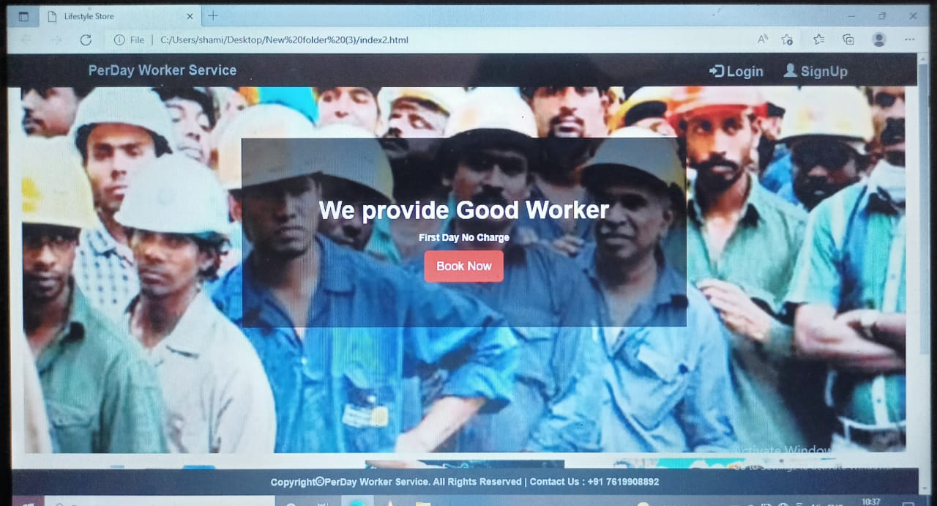
GeneralZone

Slide 9
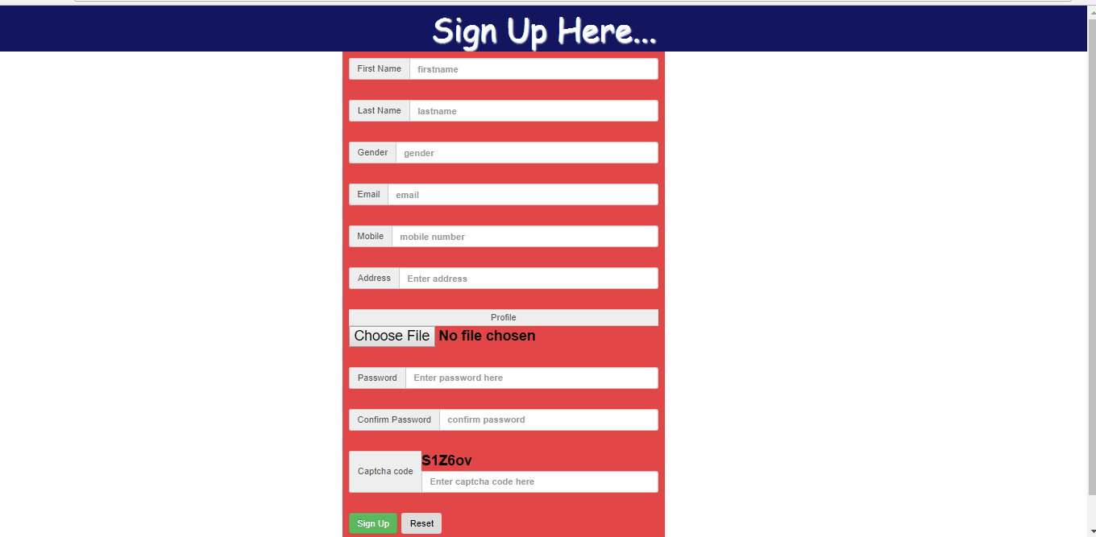
SignUp Page

Slide 10
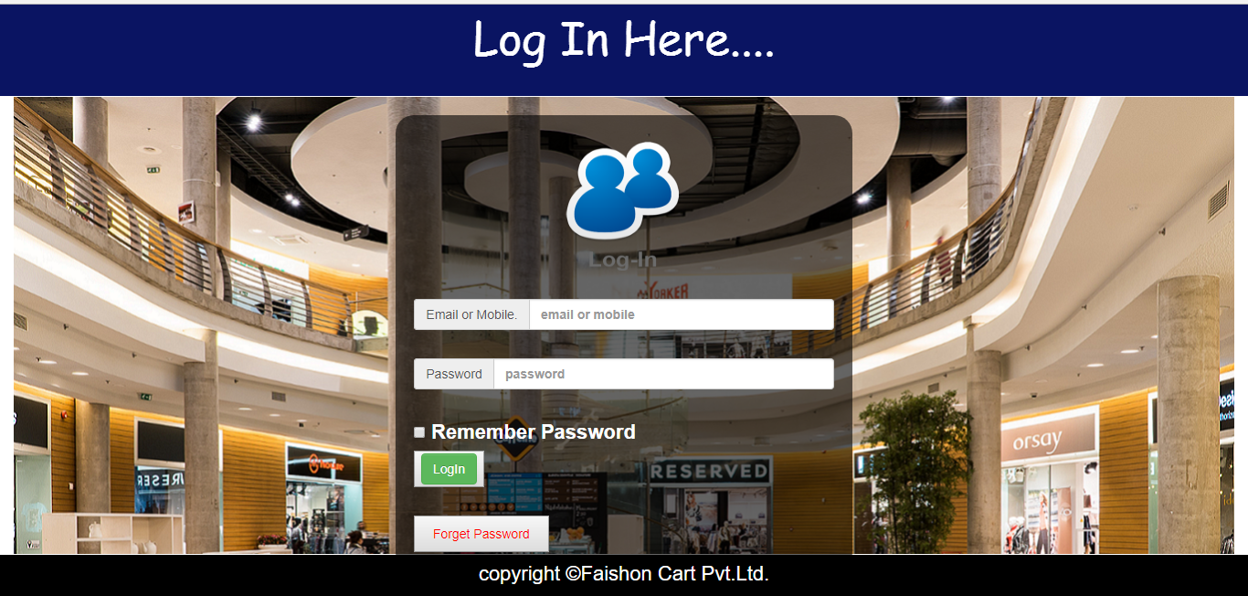
LogIn Page

Slide 11
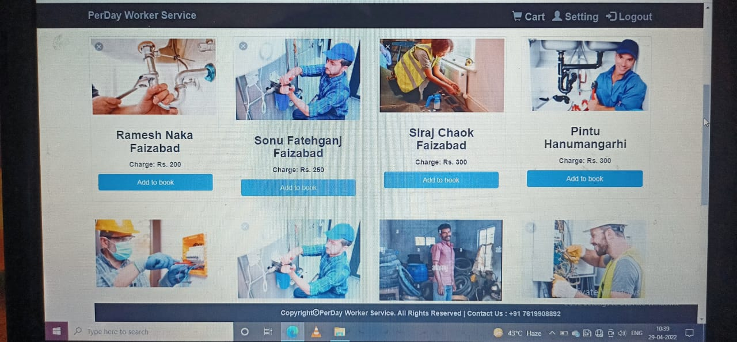
Dashboard (UserZone)

Slide 12
Conclusion
Technology has made significant progress over the years to provide Public a better online Work/Worker experience and will continue to do so for to come.. While this has been the case in some areas, there is still demand for Urban and Rural Citizen in areas where the public feels more comfortable seeing and talk the Worker Hire.
In Worker,Through online booking, you can get information about the worker as well as meet him online and offline by booking at your home.

Slide 13
Thank You…..

