Slide 1
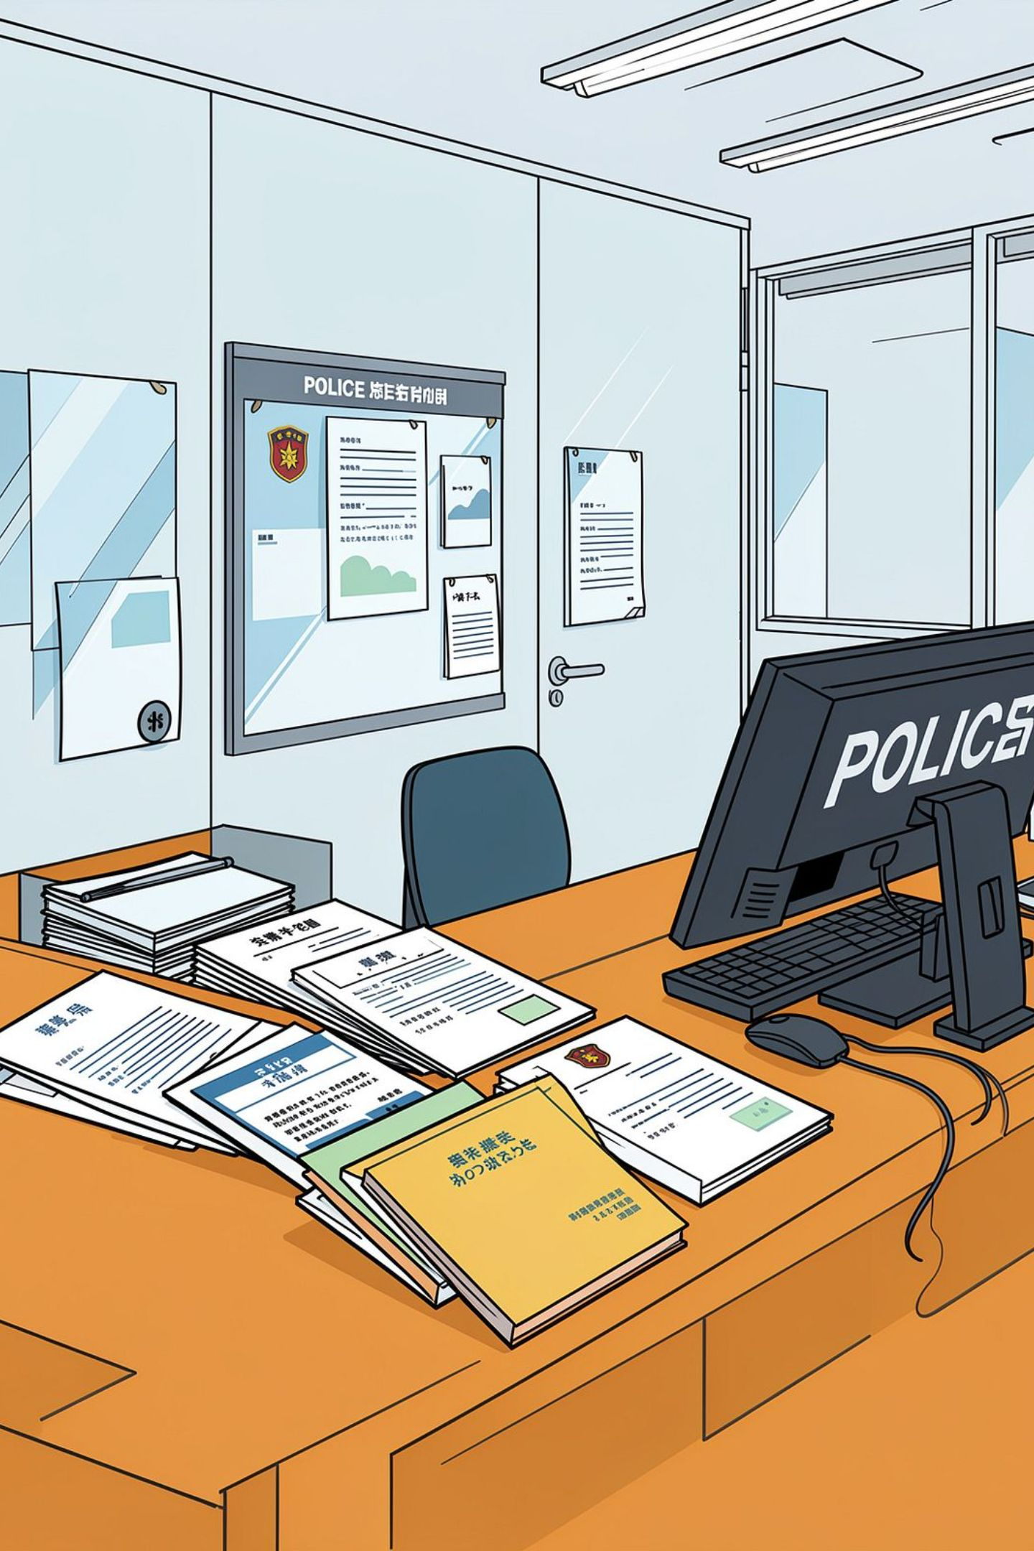
Police Complaint Documentation System
AI-Assisted Complaint Registration & Documentation
Project Review Presentation
Team Members: SHAMINI K - 24MID0263
MAGESH K - 24MID0253
ROHAN KARTHIK - 24MIC0123
RITHIK ROSHAN -24MID0300

Slide 2

Problem Statement & Field Interviews
The Problem
User Research Findings
Manual complaint documentation takes significant time
Complaints given as natural, story-like descriptions
Important information often missing or incomplete
Writers must repeatedly ask clarifying questions
"The system should assist documentation — not change the complainant's facts."
Writer
Inspector
Manual writing requires time; complainants lack structure; missing information requires follow-up
Accuracy and verification are critical; final complaint must reflect complainant's actual statement; unsupported information must not be introduced

Slide 3
Core Problem & Evidence-Preserving Requirement
The Challenge
Evidence-Preserving Principles
Complainants explain incidents naturally as stories. Writers need structured information:
✓ PRESERVE
⬇ EXTRACT
Keep the original complaint statement intact
Extract only information actually present in the statement
❓ ASK
✗ NEVER ASSUME
Suggest questions when information is missing
Do not invent or guess missing information
Incident Type
Object / Property
Date & Time
Location
Person Involved
Description

Slide 4

Proposed Solution & System Workflow
The system converts unstructured voice input into a structured, verified complaint draft while preserving the original statement.
Voice Input
Info Extraction
Complaint Draft
Speech-to-Text
Missing Info

Slide 5
MVP Scope & Features
✓ Included in MVP
→ Future Scope
Complaint details entry
CCTNS Integration
FIR Registration
Police Database Integration
Court Management
Voice input and Speech-to-text conversion
Original complaint preservation
Production-Level Deployment
And more...
Basic information extraction
Missing-information detection & suggested questions
Complaint / CSR draft generation
Writer review and approval

Slide 6
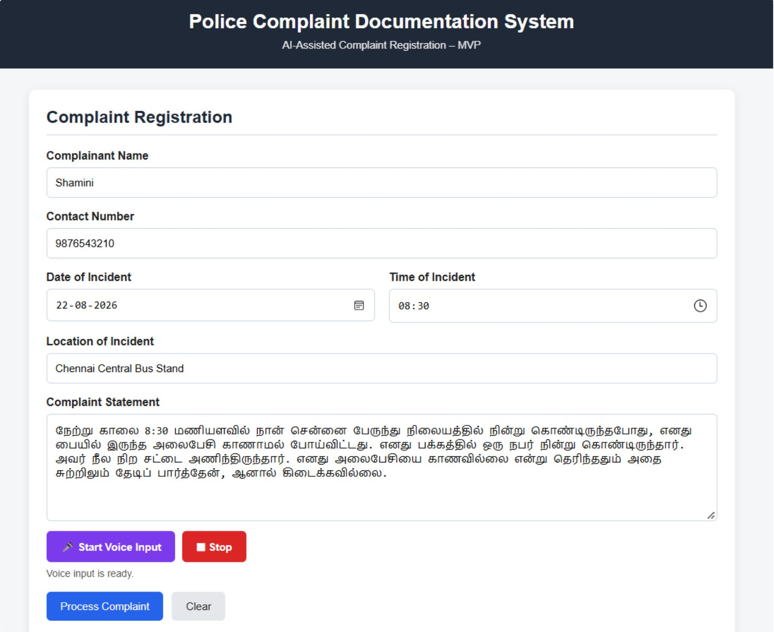
Working MVP Interface
Complaint Registration Interface — Voice Input & Complaint Entry

Slide 7
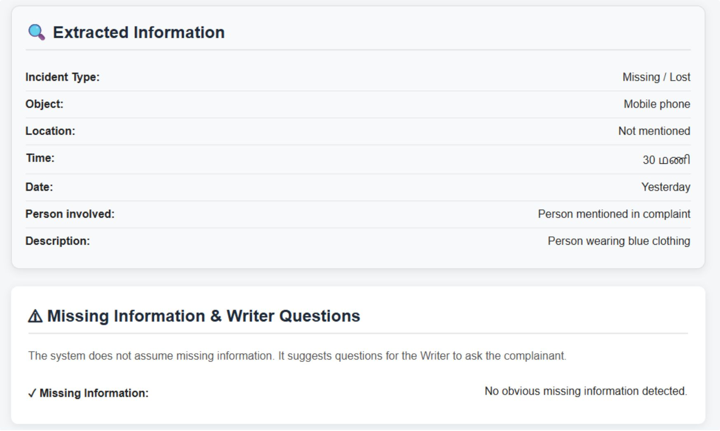
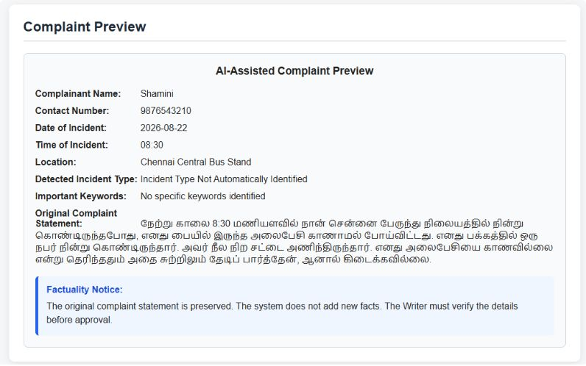
MVP Demonstration: Natural Complaint to Structured Draft
System Processing Workflow: Input → Processing → Extraction → Missing Information Detection
Step 1: Complaint Preview & AI-Assisted Processing
Step 2: Information Extraction & Missing Information Detection

Slide 8

Experiment & Results
Test Cases
Missing / Lost Mobile Phone
Road Accident
Threat
Missing / Lost Bag
Missing / Lost Mobile Phone with Missing Details
Outcome
5 Test Cases → 5 Complaint Drafts Generated → 3 Usable Drafts
60%
70%
Achieved Rate
Threshold
3 of 5 drafts usable
Target not yet met
Status: Threshold NOT achieved — Improvements needed in information extraction accuracy and consistency

Slide 9
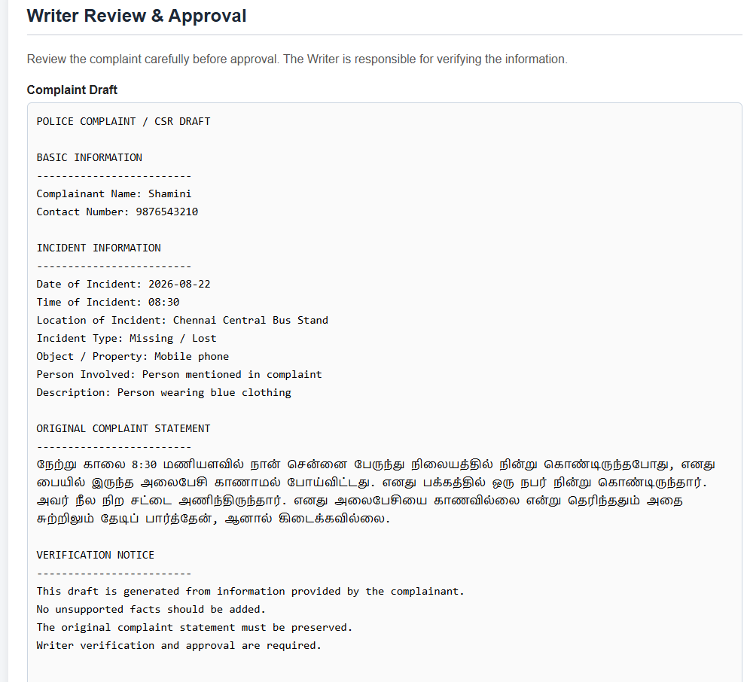
Generated Complaint Draft with Writer Verification

Slide 10
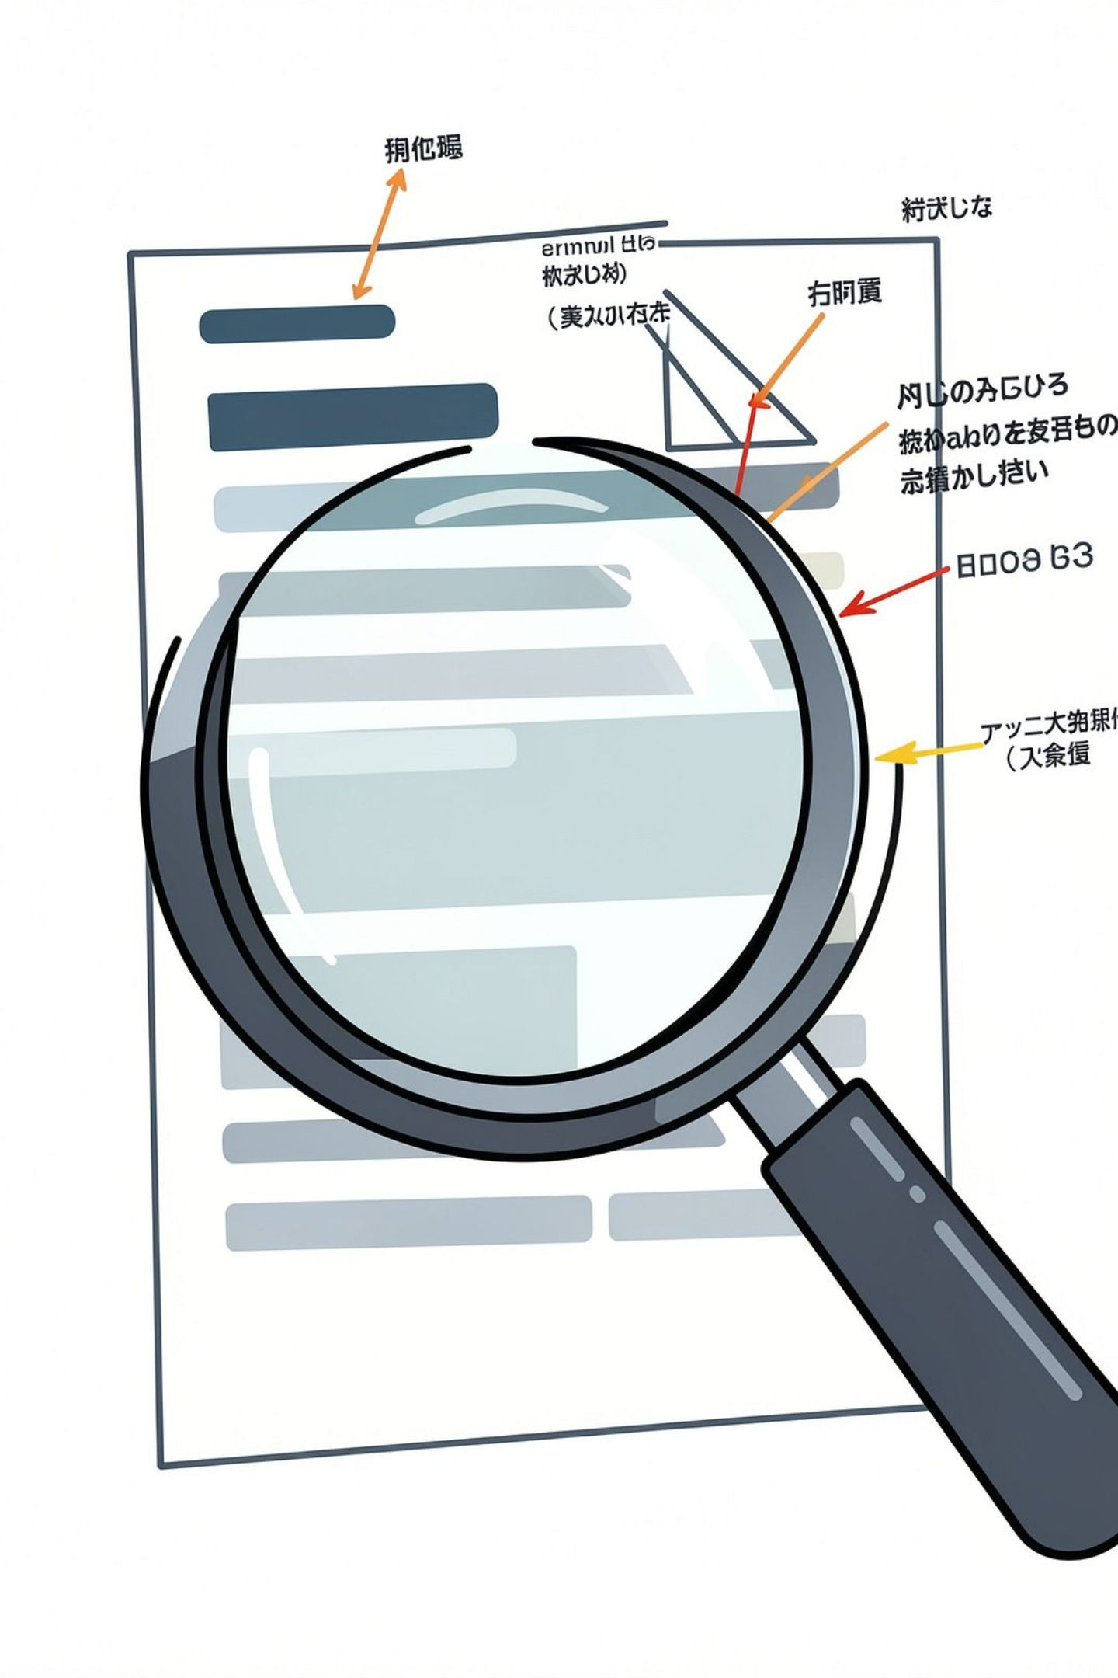
Limitations & Improvements Needed
What Needs Improvement
Next Focus Areas
Improve Tamil complaint understanding and NLP processing
📍 Location Extraction
Inconsistent extraction of location information
Enhance date / time / location extraction accuracy
📝 Description Extraction
Incomplete extraction of detailed descriptions
Strengthen entity and field extraction consistency
Improve evidence-preserving information processing
🔍 Incident Detection
Inconsistent incident type identification
🌐 Tamil Language
Natural Tamil expressions require better extraction rules

Slide 11




Project Progress & Future Direction
✓ COMPLETED
→ CURRENT
Problem Discovery
MVP Development
Initial Experiment
MVP Testing
Limitations Identified
60% Usable Rate
→ NEXT
→ FUTURE
NLP Improvement
Extraction Accuracy
Consistency Enhancement
Database Integration
Police Workflow
Advanced NLP
"The goal is to assist police documentation without changing the complainant's facts."
Thank You
Questions & Discussion

