Slide 1
Agentic Multimodal Medical Assistant
Using MultiCaRe Dataset
CARE CREW
Navya Kasula | Prabhu Kiran Gummadi | Gopikrishna Dengu | Shamitha Reddy Cheedu | Kruthi Reddy Kasarla

Slide 2

PROJECT OBJECTIVES
Analyze multimodal medical data (images + captions + metadata)
Build text and image embeddings
Implement FAISS-based similarity search
Generate LLM-based medical explanations
Demonstrate an agentic AI workflow in a healthcare setting

Slide 3

DATASET OVERVIEW (MultiCaRe)
Multimodal medical dataset including:
Radiology images (CT / MRI / X-ray)
Pathology images
Expert-written captions
Metadata fields (image_type, generic_label, finding, laterality, site)
~135,000 caption records
~11,000 matched images
~5,000 cleaned samples used for analysis and modeling

Slide 4

PROJECT STRUCTURE
Analytical understanding
Cleaning & preprocessing
EDA
Feature engineering
Logistic regression + RFE
Working multimodal model pipeline
Text embeddings using transformers
Image embeddings using ResNet
FAISS retrieval
LLM answer generation
Agentic multimodal workflow demonstration

Slide 5
DATA CLEANING
Standardized missing values
Filled categorical NaN using mode
Converted captions marked as empty to “Unknown”
Matched images to caption entries using ID mapping
Ensured complete multimodal pairs for modeling

Slide 6
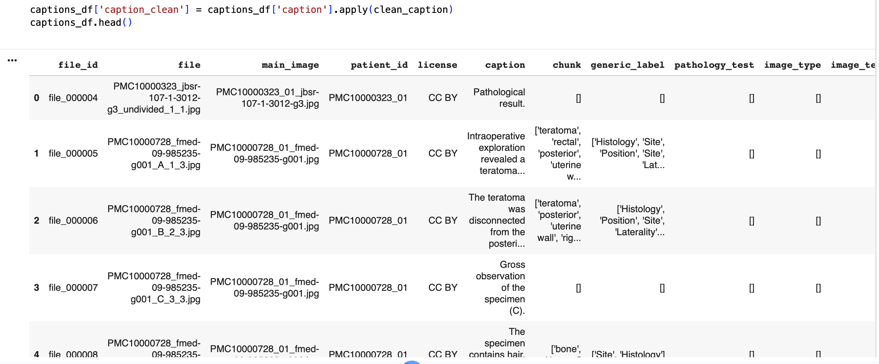
Data Cleaning

Slide 7
EDA SUMMARY
Caption Length Insights
Mean ≈ 137 characters
Long-tailed distribution
Longer captions typically correspond to abnormal findings
Image Type Distribution
CT, MRI, and X-ray most frequent
Pathology images contain most detailed captions

Slide 8
METADATA PATTERNS
Pathology → long, rich captions
X-rays → short, structured captions
Strong relationships observed between:
generic_label and finding
image_type and caption length

Slide 9
FEATURE ENGINEERING
Created:
caption_length (numeric)
has_finding (binary)
generic_label_enc
image_type_enc
Missing values handled → complete dataset

Slide 10
LOGISTIC REGRESSION + RFE RESULTS
Top Predictors of Findings:
caption_length
generic_label_enc
image_type_enc
Metadata + text structure alone provide consistent signals about abnormalities.

Slide 11
MULTIMODAL MODELING OVERVIEW
Text Model
SentenceTransformer (all-MiniLM-L6-v2)
Converts captions → 384-dimensional embeddings
Image Model
ResNet-50 pretrained
Converts images → 2048-dimensional feature vectors
Storage
Two FAISS indexes (text + image) for retrieval

Slide 12
TEXT RETRIEVAL PIPELINE
Query → Embedding → FAISS Retrieval → LLM Explanation
System retrieves semantically similar captions
Example:
“Left lung opacity” → returns clinically relevant captions with similar findings

Slide 13
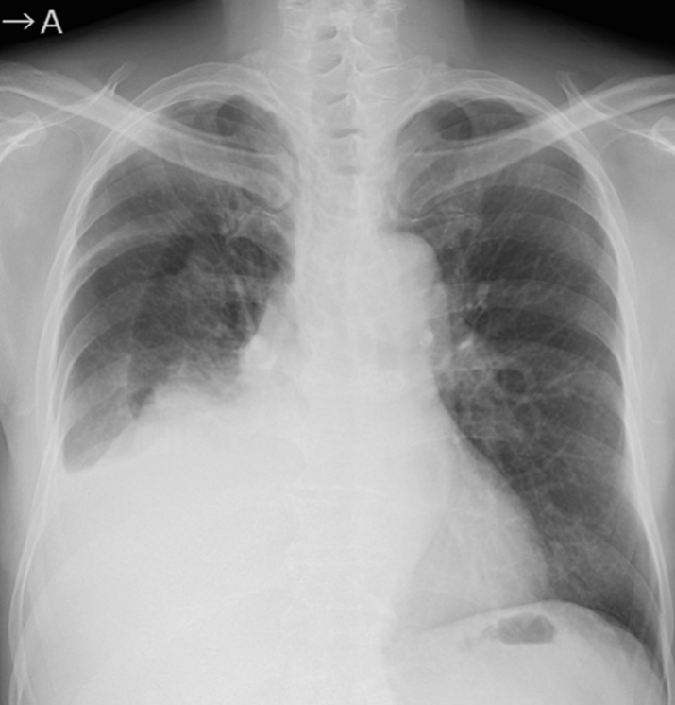
IMAGE RETRIEVAL PIPELINE
Image → ResNet Embedding → Image FAISS Search → Similar Images
Used for visual comparison:
MRI → similar MRI scans
Chest CT → similar CT cases

Slide 14

LLM RESPONSE GENERATION
LLM takes:
Top-k retrieved captions
Optional image context
Outputs:
Clinical explanation
Summary of findings
Possible interpretations
This forms a retrieval-augmented medical assistant.

Slide 15
AGENTIC WORKFLOW
Steps:
User inputs text/image
System retrieves top relevant cases
Constructs contextual prompt
LLM generates medical explanation
(Optional) Reflection/correction
Mimics a real-world medical AI assistant with reasoning capability.

Slide 16
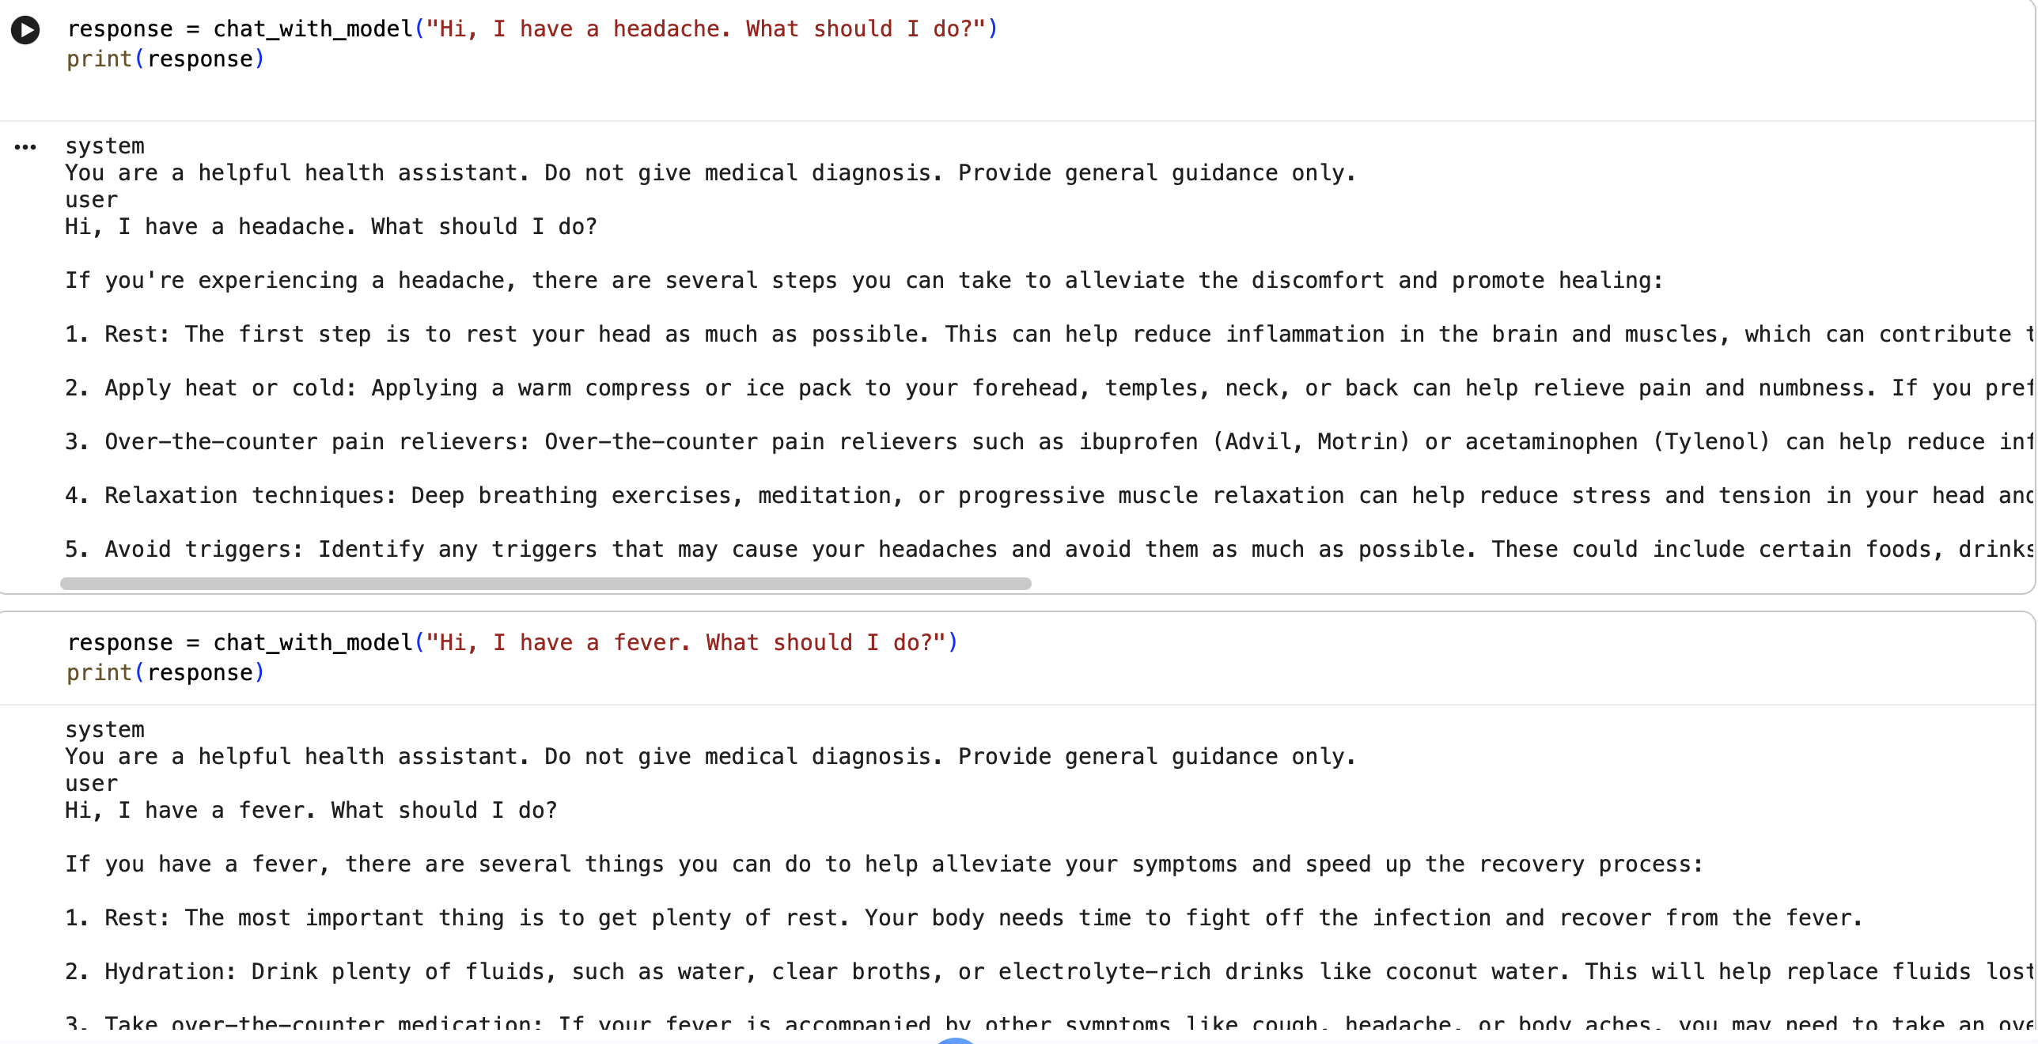
SYSTEM DEMONSTRATION
Text query → similar caption retrieval output

Slide 17
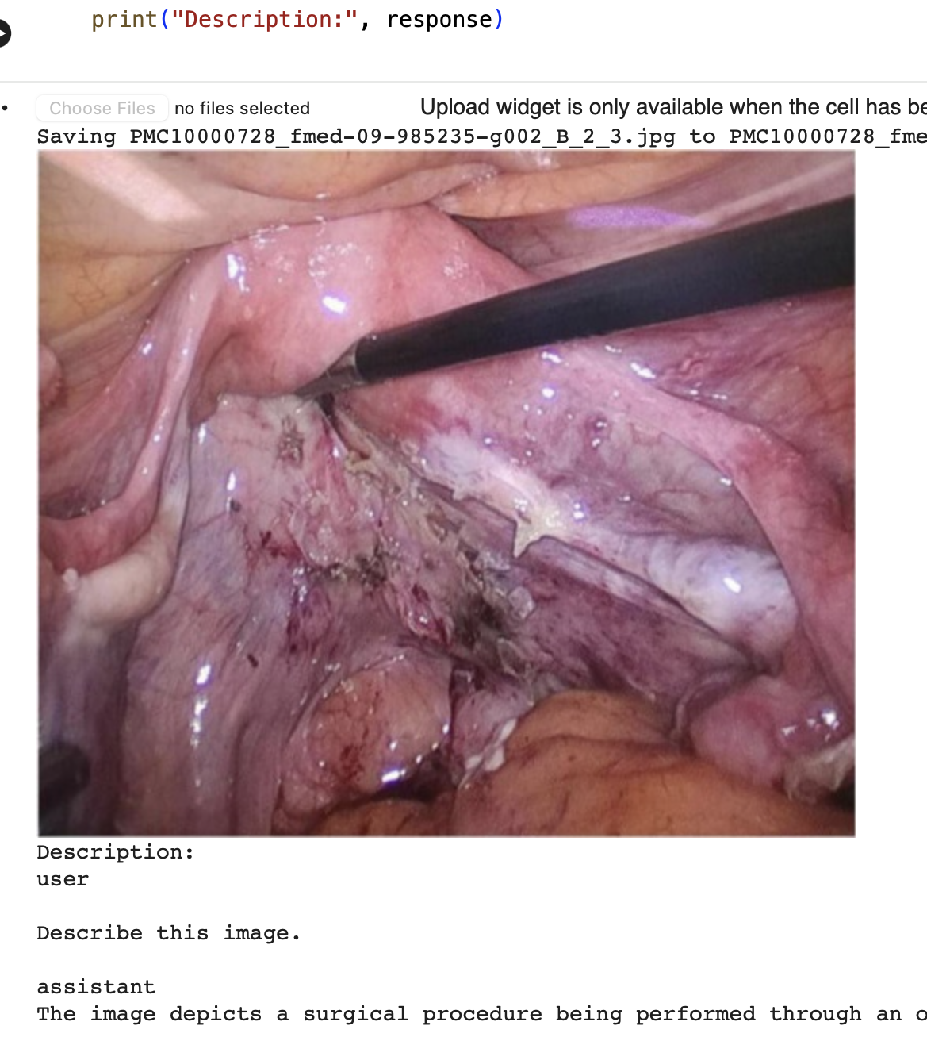
SYSTEM DEMONSTRATION
Image query → similar image clustering
LLM → structured diagnostic explanation

Slide 18
KEY OUTCOMES
Working multimodal prototype
Retrieval-enabled similarity engine
Metadata strongly correlates with findings
LLM explanations contextual and medically coherent
Demonstrates full agentic pipeline from input → retrieval → reasoning → output

Slide 19
LIMITATIONS
No end-to-end multimodal fusion model
No medical-domain fine-tuning (BioCLIP/LLaVA-Med)
Sparse metadata in some fields
Limited compute for large-scale experiments
No clinical validation

Slide 20
FUTURE WORK
Federated Learning
Train across hospitals without sharing raw data
Enhances privacy & increases real-world potential
Fine-tuned CLIP-Style Medical Model
Joint image–text training
Improved alignment & accuracy

Slide 21
CONCLUSION
Successful demonstration of a multimodal agentic assistant
Found significant patterns in medical text + image metadata
Functional retrieval + LLM reasoning pipeline
Strong foundation for future clinical AI systems

Slide 22
THANK YOU

