Slide 1

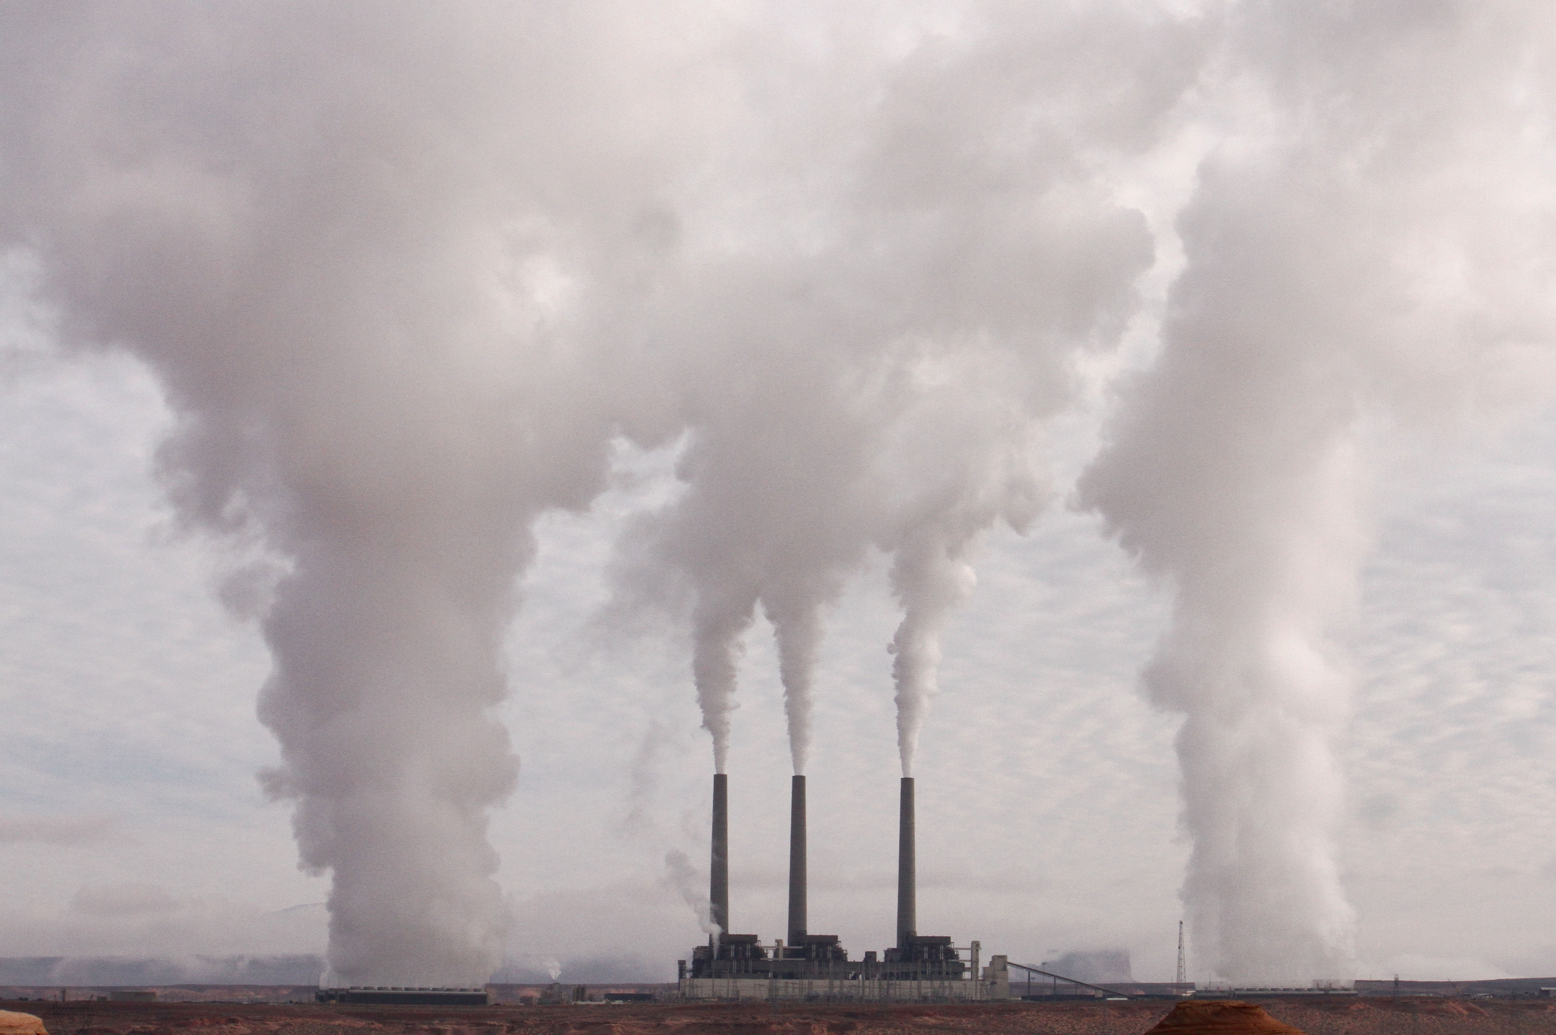

AIR POLLUTION ANALYSIS
(2002- 2024)
Shamitha Joseph
Nashville Software School
March 2026 | Nashville, TN

Slide 2
Why I Chose This Project
Air pollution affects public health and can cause serious health problems.
It impacts climate and damages the environment.
Studying it helps identify causes and possible solutions.
Datasets Used in This Project
Air Pollution Data - U.S. Environmental Protection Agency (EPA)
Renewable Energy Data - U.S. Energy Information Administration (EIA)
Motor Vehicle Registration Data - U.S. Government Open Data Portal

Slide 3








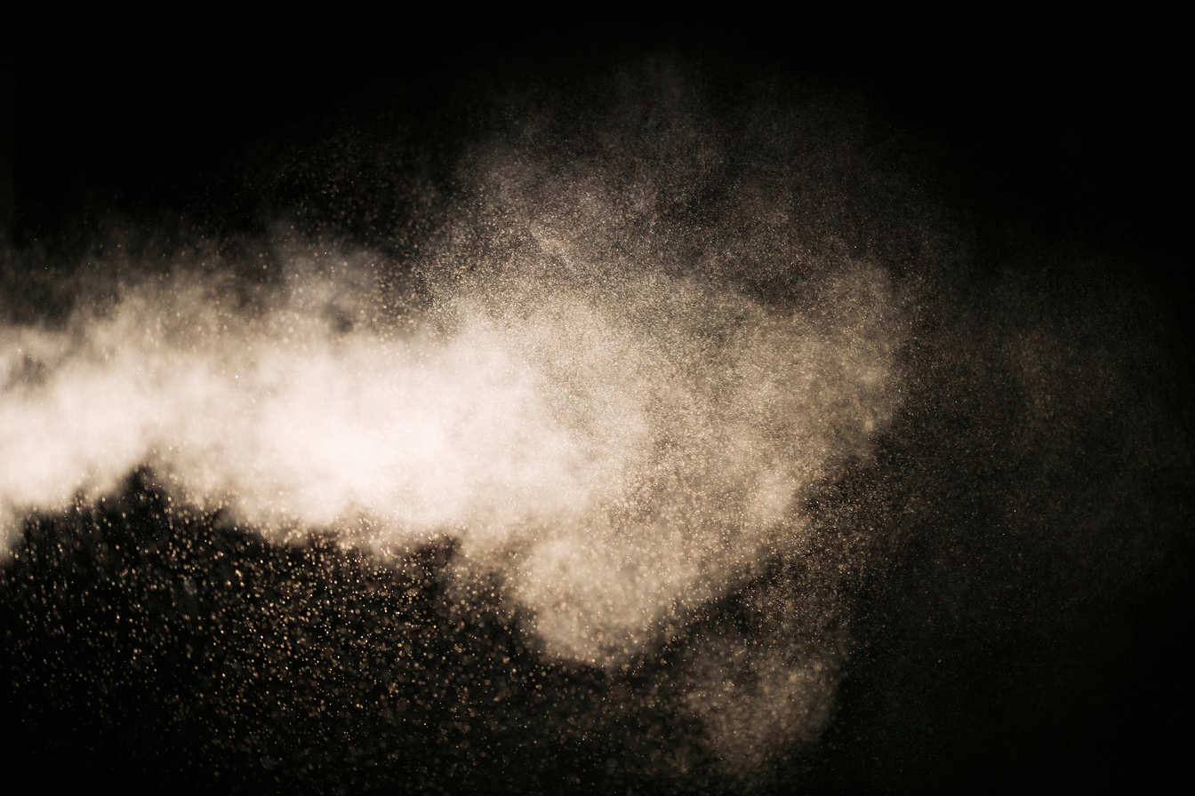
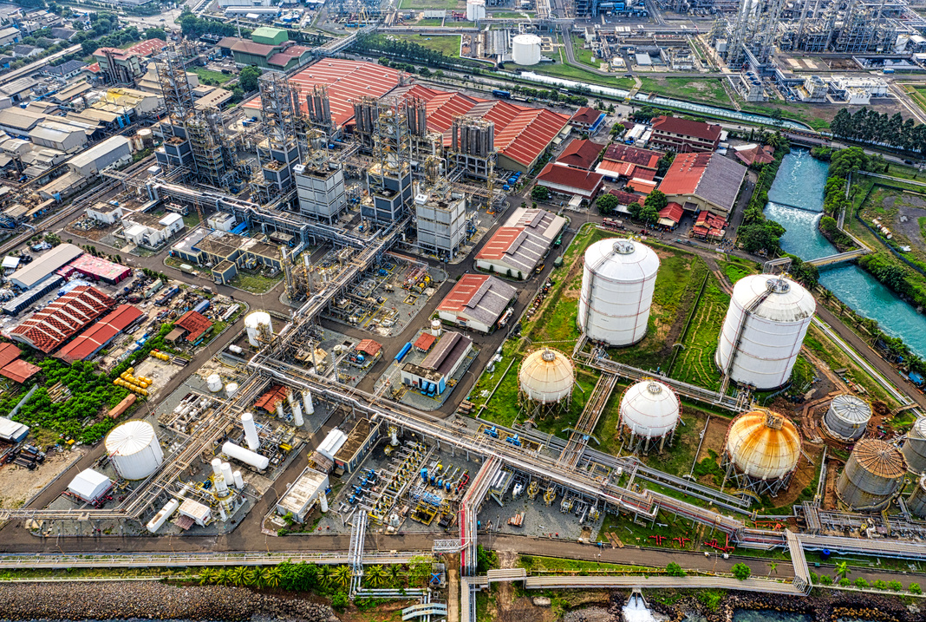
Major Air Pollution Sectors
Transportation Industrial Processes
Fires Solvent
Fuel Combustion Waste Disposal
Agriculture Fuel & Services
Dust Other Non-Industrial

Slide 4
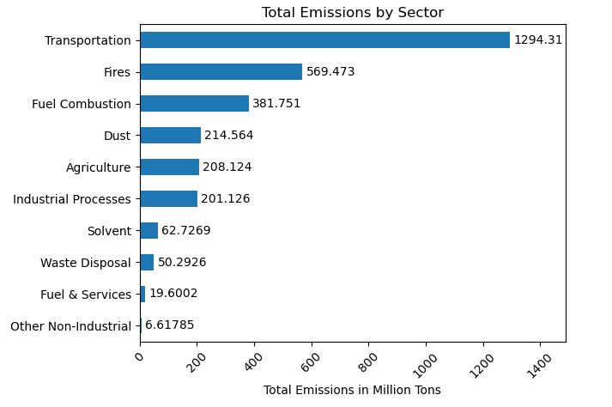
Total Emissions by Sector
Transportation is the largest contributor to emissions.
Fires and Fuel Combustion are the next highest contributors.
Waste Disposal and Other Non-Industrial sources contribute the least.

Slide 5
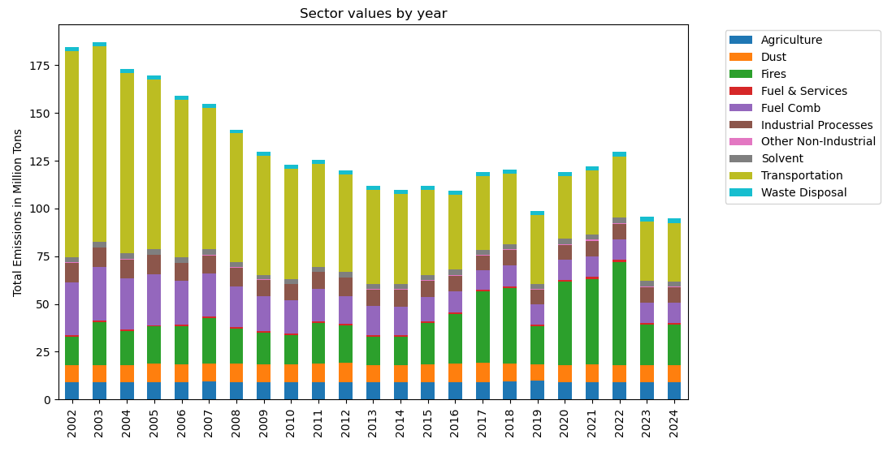
How Sector Emissions Changed Over Time
Total emissions decreased from 2004 to around 2014.
Transportation emissions decreased by 71%
Fuel combustion emissions decreased by 62%
Fire related emissions increased by 41%
Natural Sources

Slide 6
Sectors and Categories
Transportation
Fires
Fuel Combustion
Categories:
On - road vehicles
Off - road vehicles
Aircraft
Rail
Marine
Categories:
Wildfires
Prescribed Fires
Agricultural Burning
Categories:
Electric Generation
Residential
Commercial/Institutional
Industrial Boilers

Slide 7
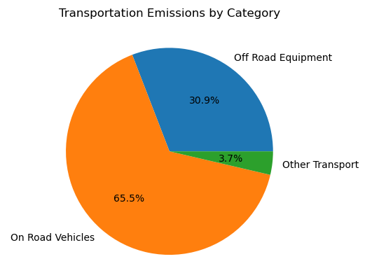
Which Transportation Category Contributes the Most to Emissions
On-road vehicles contribute the highest emission.
Off-road equipment is the second largest contributor.
Marine, aircraft, and rail contribute very little.

Slide 8
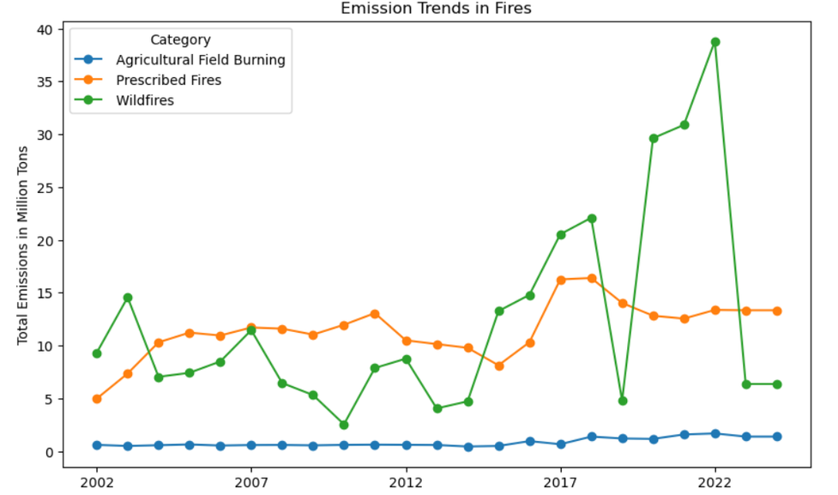
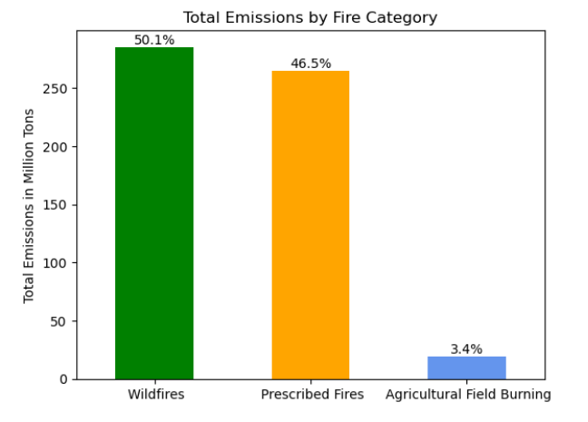
Which Fire Category Contributes Most to Emissions Over Time?
Wildfires cause the major fluctuations in fire emissions and prescribed fires are more stable.
Prescribed fires remain mostly between 10–16 million tons
Agricultural field burning stays very low every year.

Slide 9
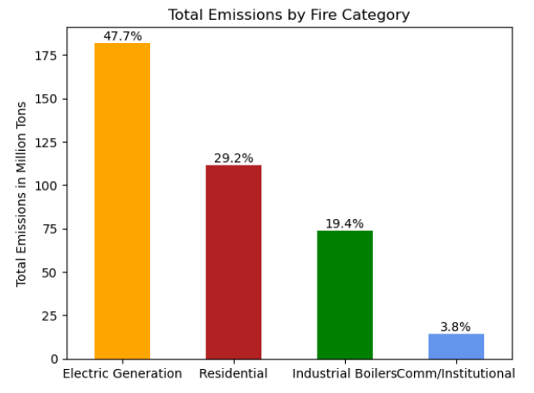
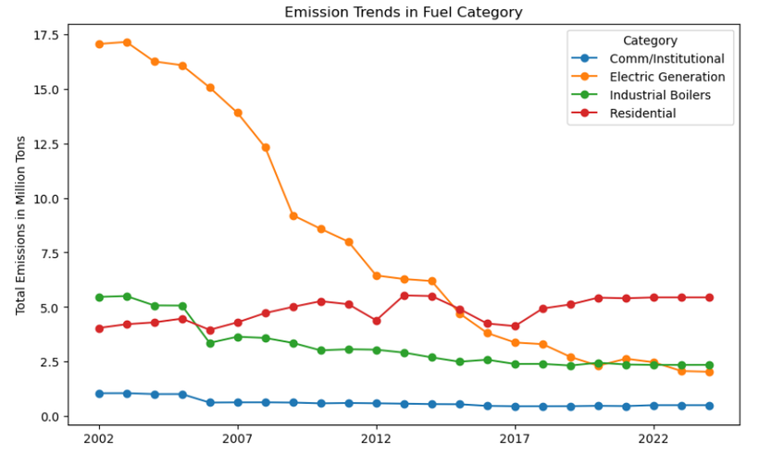
Fuel Combustion Emissions by Category Over Time
Electric generation was the highest emitter in early years
and reduced significantly over time
Residential emissions remained stable or slightly increased
After 2017, residential became the top contributor. This happened because electric generation reduced faster than residential

Slide 10
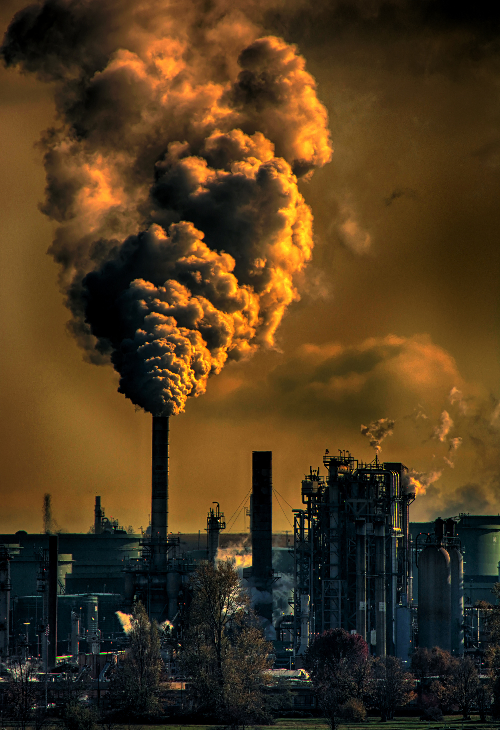
Major Air Pollutants
Particulate Matter
PM2.5 - Very tiny particles
PM10 - Slightly larger particles
Black Carbon - Comes from incomplete burning
Organic Carbon - Comes from smoke and combustion
Gaseous Pollutants
CO - From vehicles and burning fuel
NOx- From vehicles and power plants
SO2 - From coal and industrial fuel
VOCs - From fuel, chemicals and vehicles
NH3 - Mostly from agriculture

Slide 11
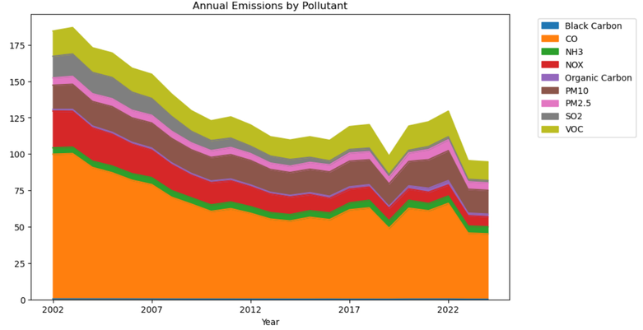
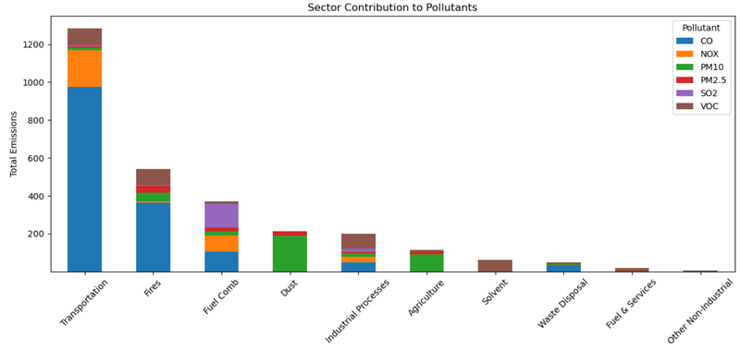
Pollutant Trends and Sector-wise Contributions
CO emissions dropped by about (- 54.8%)
NOX significantly reduced (75.6%)
VOC moderate reduction (-26.3%)
SO2 largest reduction (-88.7%)
PM10 nearly stable (-1.5%)
PM2.5 slight increase (+1.8%)
 | co | NOX | VOC | SO2 | PM10 | OP
Transport | 75.8% | 15.3% | 6.9% | - | - | 2%
Fires | 67.2% | - | 15.8% | - | 8.6% | 8.5%
Fuel Combustion | - | 23.5% | - | 33.7% | - | 14.9%

Slide 12
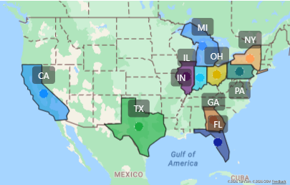
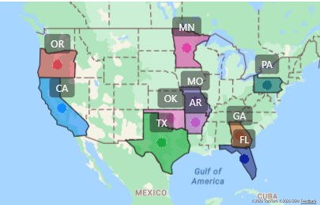
Top 10 Emitting States: 2002 vs 2024
Top 10 Emitting States (2002)
Some states like California, Texas and Florida remain in
the top emitters list.
Several states moved in and out of the top 10.
Emission distribution changed over time.
Policies and cleaner energy influenced trends.
Top 10 Emitting States (2024)

Slide 13
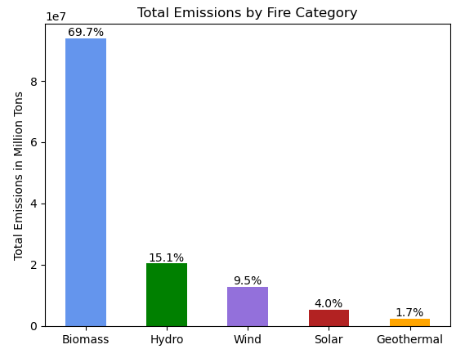
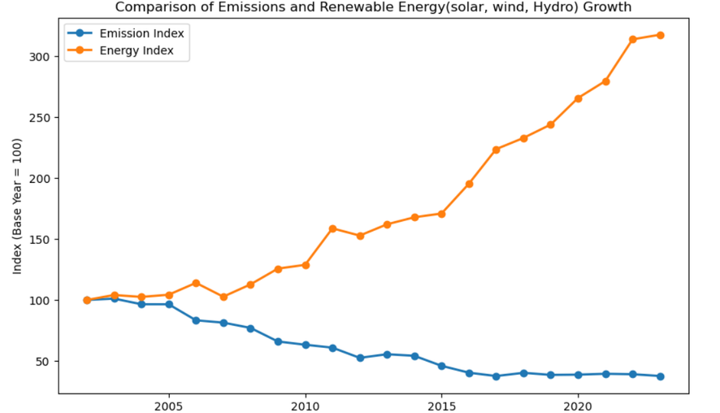
Renewable Energy Growth vs Emission Changes
Biomass has the highest consumption across all years.
Renewable energy increased a lot more than doubled since 2002.
Pollution has reduced by more than half compared to the year 2002.

Slide 14
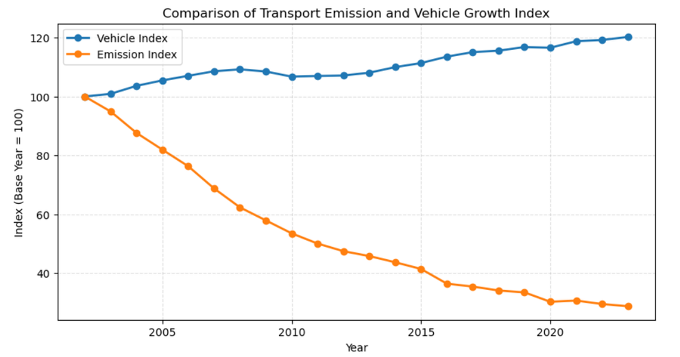
Vehicle Growth vs Transportation Emission Trend (2002–2024)
Vehicle numbers increased steadily from 2002 to 2024.
Transportation emissions decreased significantly during the same period.
That shows the improvement in vehicle technology have helped reduce pollution.

Slide 15

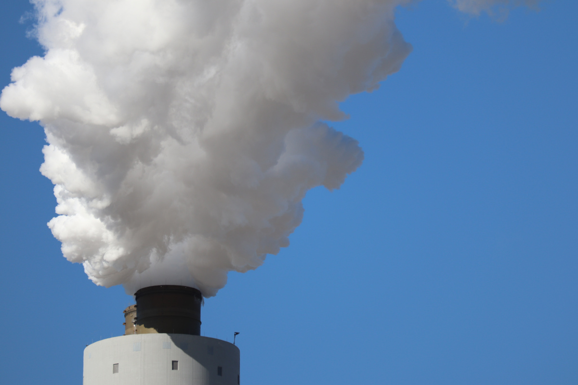
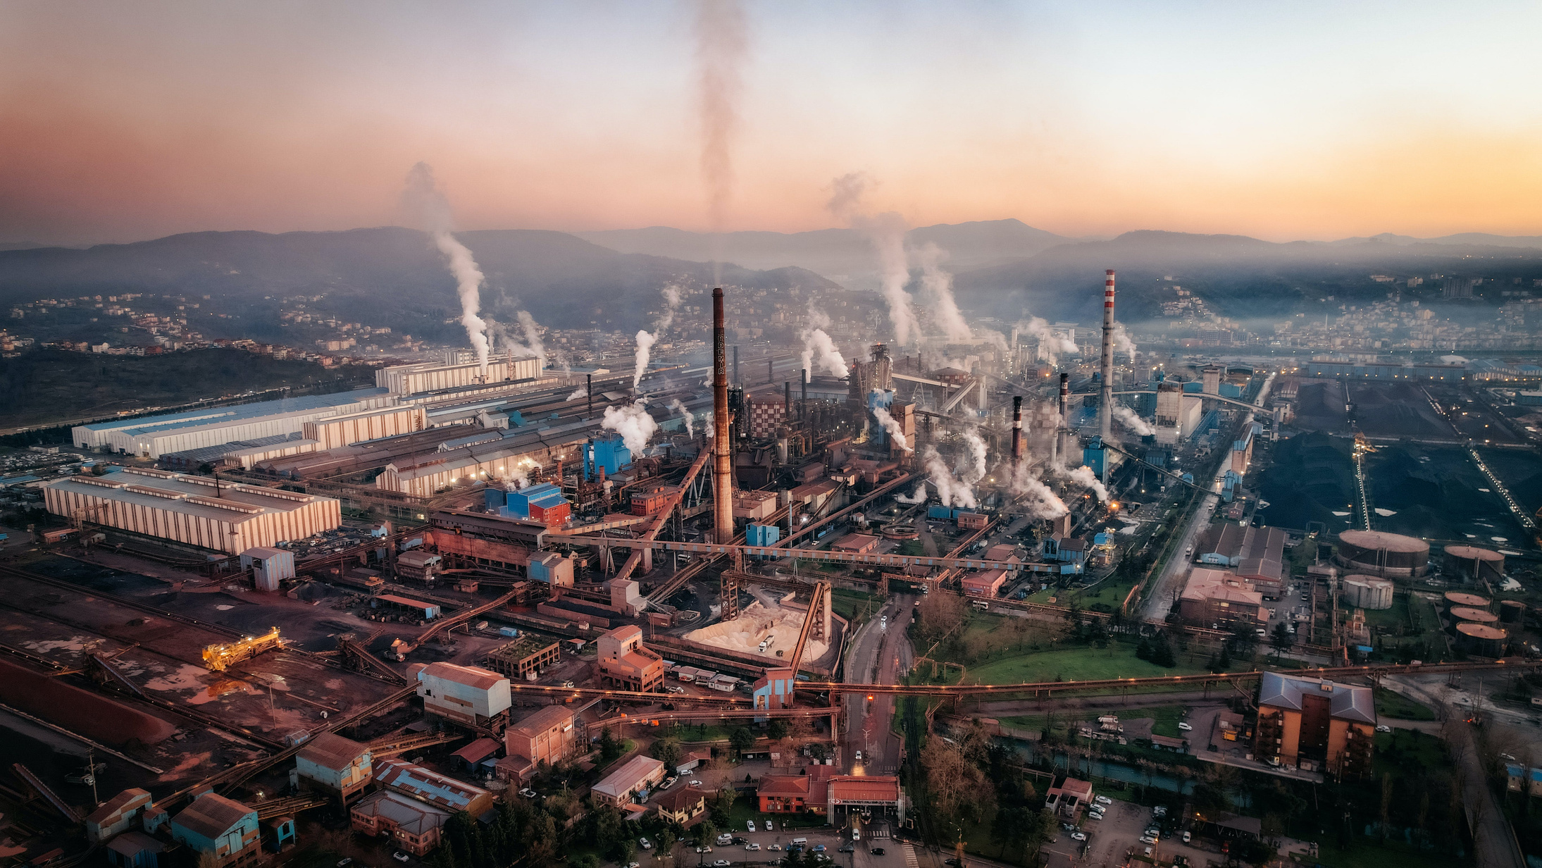
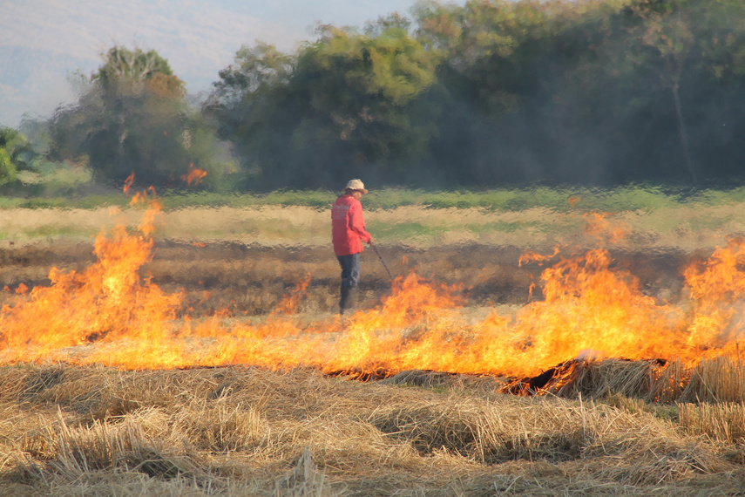
Conclusion
From 2002 to 2024, air pollution has clearly decreased.
The biggest improvements happened in the transportation and fuel combustion sectors.
Harmful pollutants such as CO, SO₂, and NOx have reduced over time.
This reduction happened because vehicles became cleaner and engines became more efficient.
Fuel quality also improved, which helped lower emissions.
Government regulations played an important role in controlling air pollution.
The growth of renewable energy also contributed to reducing air pollution.

Slide 16
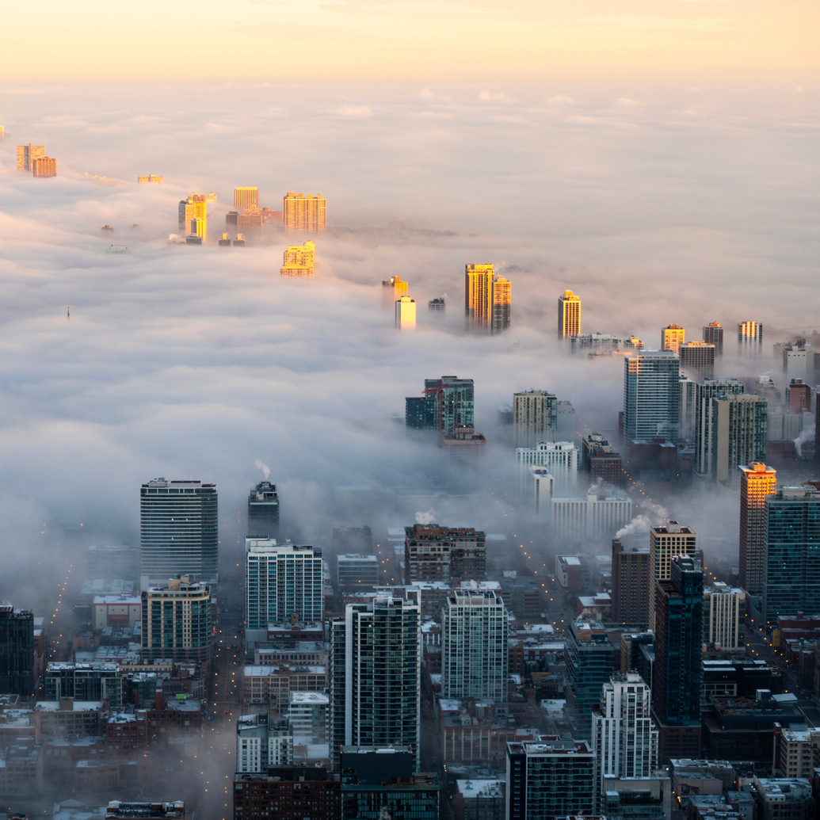
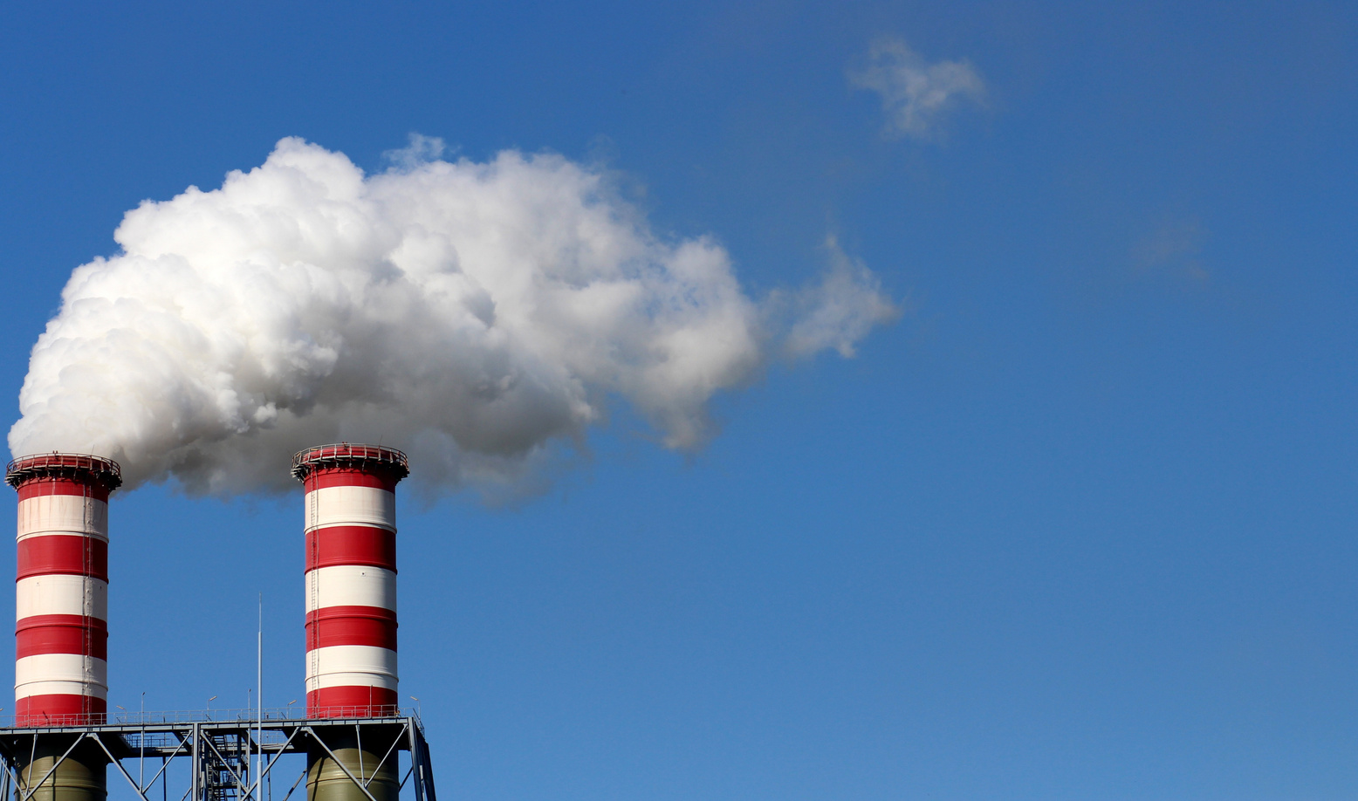
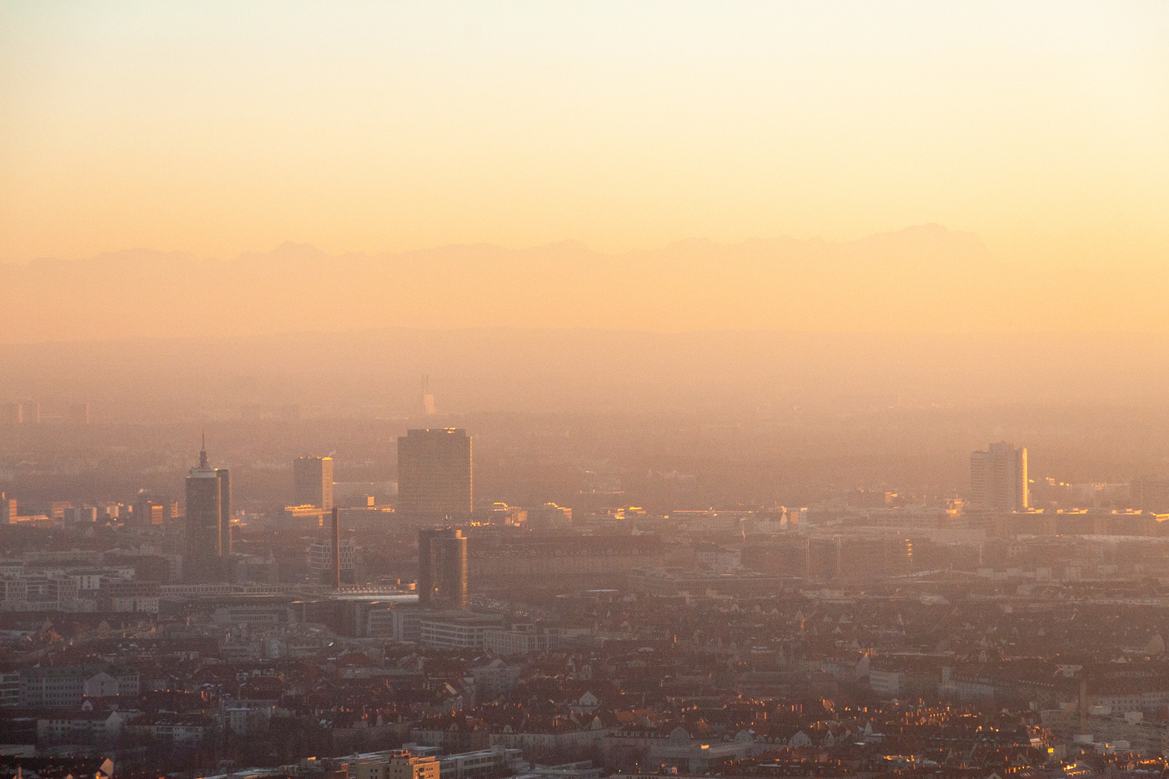
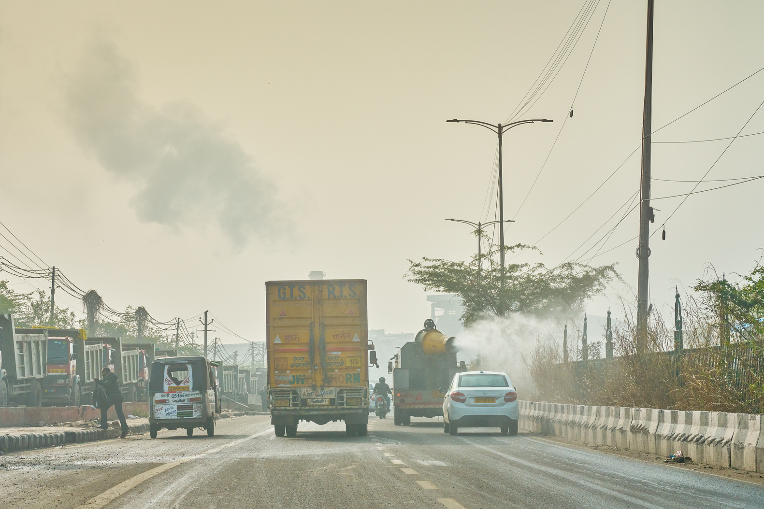


Thank You
Get In Touch
615-275-8778
shamithajino@gmail.com

