Slide 1
Mutual Fund Analytics
Presented by: Shamitha N Shetty

Slide 2
Problem & Objective
Problem
Objectives
• Mutual fund data comes from multiple sources.
• Which contains information about NAV, AUM, SIPs, investor transactions, fund performance and portfolio holdings.
• Analysing these datasets separately makes it difficult to compare funds, understand investor behaviour and identify risk.
• Build an end-to-end mutual fund analytics pipeline.
• Clean and transform raw financial datasets.
• Analyse fund performance and risk.
• Understand investor and SIP behaviour.
• Build an interactive Power BI dashboard.
• Develop advanced analytics and fund recommendations.
2

Slide 3
Data Sources
10 major datasets + MFAPI REST API
10 Major Datasets
Additional Data
• 01_fund_master.csv
• 02_nav_history.csv
• 03_aum_by_fund_house.csv
• 04_monthly_sip_inflows.csv
• 05_category_inflows.csv
• 06_industry_folio_count.csv
• 07_scheme_performance.csv
• 08_investor_transactions.csv
• 09_portfolio_holdings.csv
• 10_benchmark_indices.csv
• MFAPI REST API used for selected scheme NAV data.
• AMFI codes used to identify schemes.
• HDFC Top 100 (125497), SBI Bluechip (119551), ICICI Bluechip (120503), Nippon Large Cap (118632), Axis Bluechip (119092), Kotak Bluechip (120841)
• Analysis period: 2022–2026.
• Processed datasets prepared for analytics and reporting.
3

Slide 4
Project Architecture
Python + SQL Analytics
Power BI Dashboard
Raw CSV Files + MFAPI
Data Cleaning / ETL
Processed CSV Files
→
Data Ingestion
→
→
→
SQLite Database
→
→
Technologies: Python | Pandas | NumPy | Matplotlib | Seaborn | Plotly | SQL | SQLite | Power BI
4

Slide 5
EDA Highlights: Industry & Investor Trends
Investor Insights
Industry Growth
• SIP was the largest transaction type.
• The 26–35 age group represented the largest investor group.
• T30 locations contributed a significant share of investor participation.
• Visuals:
NAV trend analysis
AUM Growth by Fund House
SIP Inflow Trend
Folio Count Growth
Investor Demographics
Geographic distribution
• AUM showed substantial growth during the analysed period.
• SIP inflows followed a strong long-term upward trend.
• SIP inflows reached approximately ₹31,002 Cr in December 2025.
• Folio count increased from 13.26 Cr to 26.12 Cr between January 2022 and December 2025.
5

Slide 6
EDA Highlights: Categories & Portfolio
Category Analysis
Portfolio Analysis
• Monthly category inflows were analysed using a heatmap.
• Different categories showed varying inflow patterns over time.
• Category-level analysis identifies changing investor preferences.
• Correlation analysis was performed for 10 selected funds.
• Sector allocation was analysed across equity fund portfolios.
• Sector concentration varied between portfolios.
• Visuals:
category heatmap
correlation matrix
sector allocation
6

Slide 7
Performance Metrics
Fund Performance Analysis
Top Fund Scorecard
Fund Performance Analysis
The following metrics were calculated:
CAGR — Long-term return
Sharpe Ratio — Return relative to total risk
Sortino Ratio — Return relative to downside risk
Alpha — Excess return compared with benchmark
Beta — Sensitivity to benchmark movements
Maximum Drawdown — Largest peak-to-trough decline
Tracking Error — Difference between fund and benchmark returns
Fund | Score
ICICI Pru Midcap | 84.50
Axis Midcap | 80.75
HDFC Mid-Cap Opportunities | 80.50
Mirae Asset Large Cap | 80.00
Kotak Flexicap | 78.25
7

Slide 8
Advanced Risk Analytics
Risk Analysis
Advanced Analytics
• VaR (95%) estimated downside using the historical fifth percentile of returns.
• Measured the average return during observations worse than the VaR threshold.
• 90-day rolling Sharpe Ratio used to observe changes in risk-adjusted performance.
• Investor cohort analysis
• SIP continuation analysis
• Fund recommendation model
• Sector concentration using HHI
• Risk-adjusted metrics provide a more complete view of fund quality than return alone.
8

Slide 9
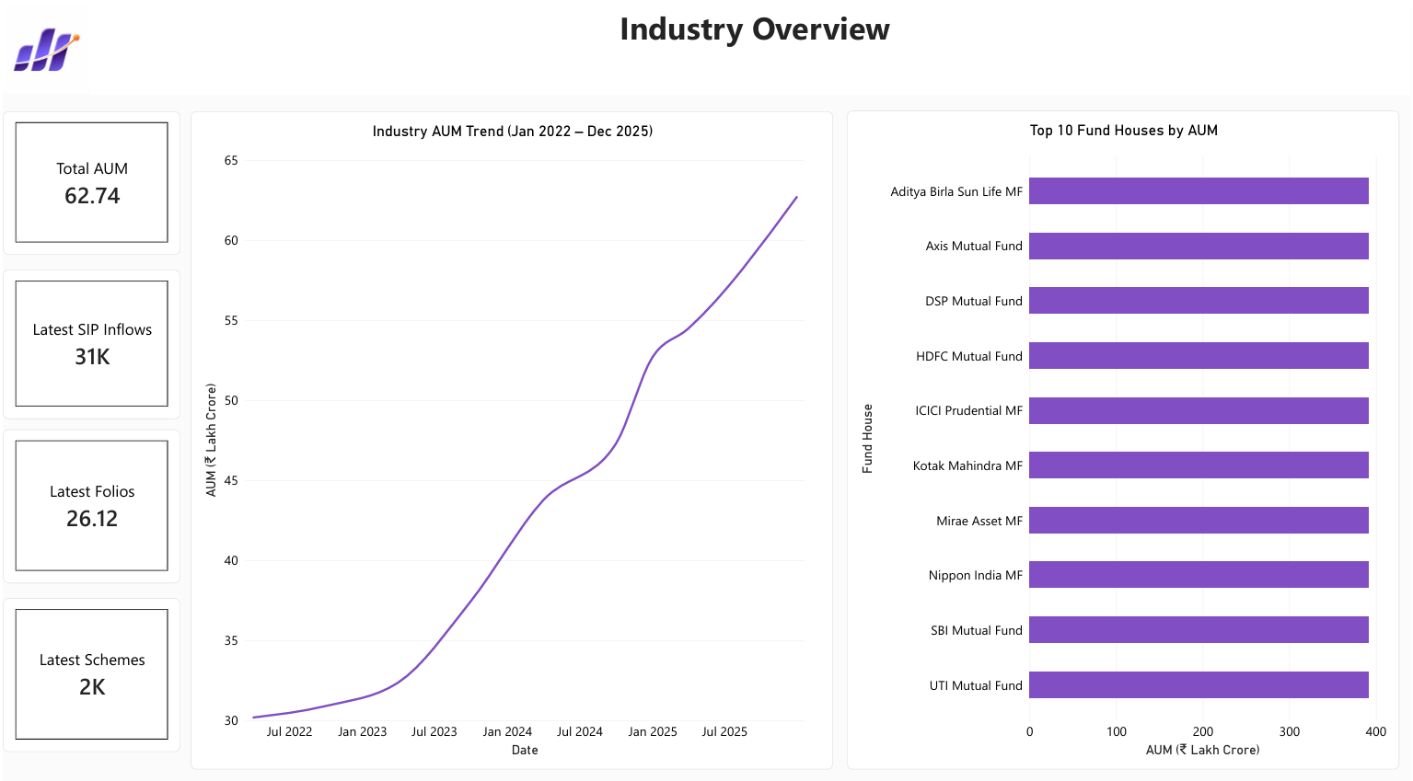
Power BI Dashboard: Industry Overview
9

Slide 10
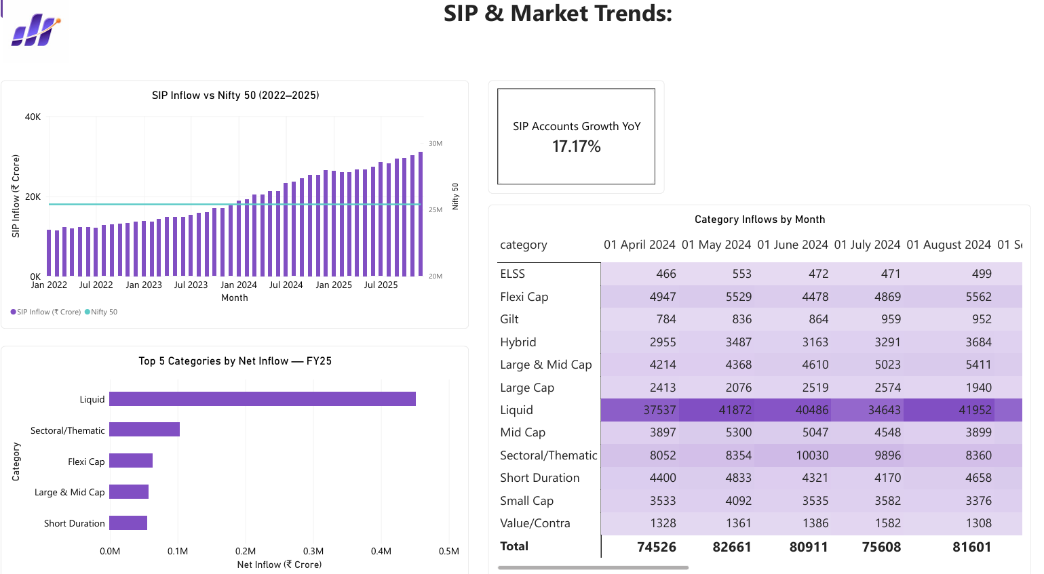
Power BI Dashboard: SIP & Market Trends
10

Slide 11
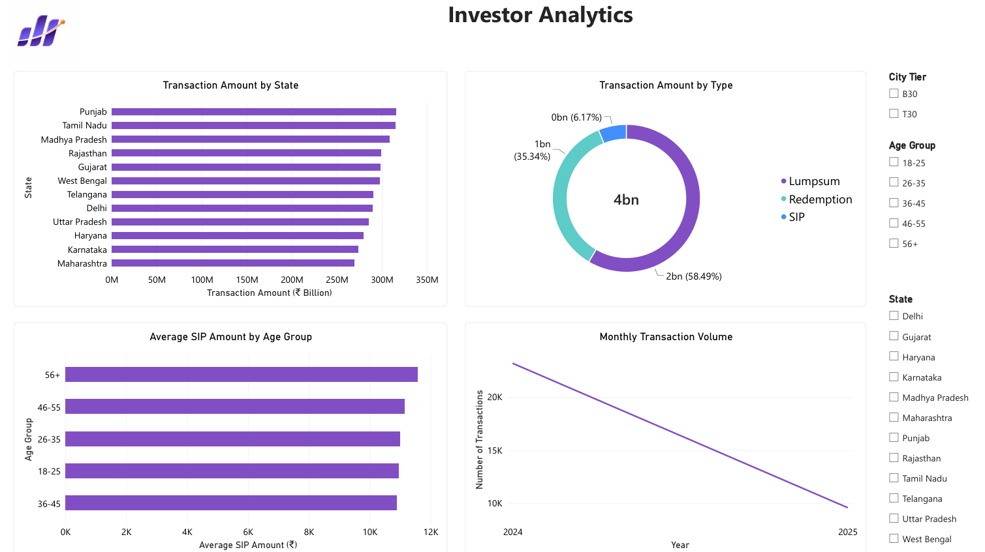
Power BI Dashboard: Investor Analytics
11

Slide 12
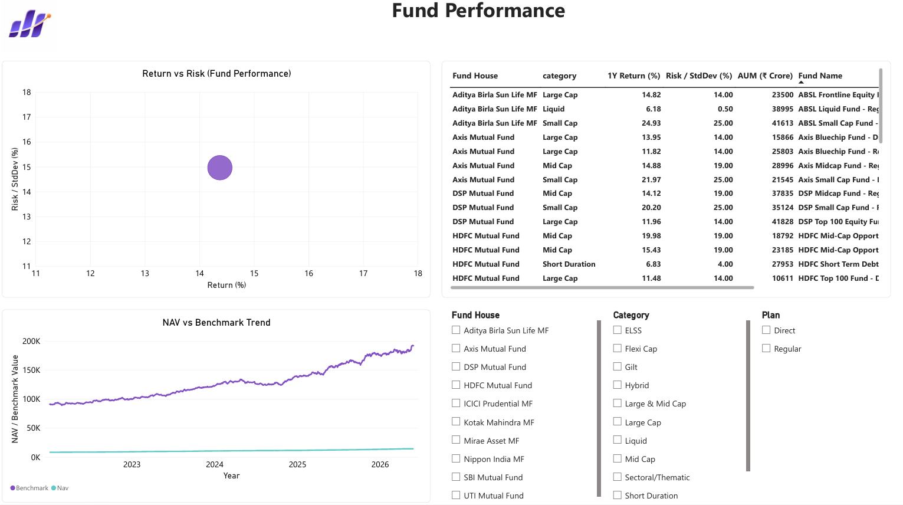
Power BI Dashboard: Fund Performance
12

Slide 13
Key Findings
Mutual fund industry assets showed strong growth.
SIP inflows showed a sustained long-term growth trend.
Folio participation increased significantly.
Fund performance varied considerably across schemes.
Risk-adjusted metrics revealed differences between funds.
Benchmark comparison improved performance evaluation.
VaR and CVaR highlighted differences in downside risk.
Investor behaviour differed across demographic and geographic groups.
Sector concentration varied across portfolios.
The fund scorecard helped identify stronger funds using multiple metrics.
13

Slide 14
Thank You

