Slide 1

Seasonal Agriculture Performance Analysis
Shamitha P H
St. Joseph Engineering College, Mangaluru
AICTE STU ID : STU6935b5fba7f801765127675

Slide 2

PROBLEM STATEMENT
Agricultural activities are influenced by seasonal variations in environmental conditions, farming practices, resource availability and market conditions. As a result, agricultural performance may differ from one season to another. However, raw agricultural data does not clearly explain how agricultural performance changes across seasons or what patterns can be observed in different seasonal conditions. The problem is to analyze the given agricultural dataset and investigate seasonal differences in agricultural performance by identifying meaningful patterns, trends, relationships and variations within the available data.

Slide 3
Project Description
This project analyzes 4,000 farm records across Kharif, Rabi and Zaid seasons.
It compares yield, production, profit, rainfall and water efficiency.
The analysis identifies crop-wise patterns and supports better seasonal planning.

Slide 4

WHO ARE THE END USERS?
Farmers and farm managers
Agricultural planners and extension officers
Agricultural researchers and students
Government and policy decision-makers

Slide 5

Technology Used
  Python
  Google Colab / Jupyter Notebook
  Pandas for data cleaning and analysis
  Matplotlib and Seaborn for visualization
  CSV dataset

Slide 6
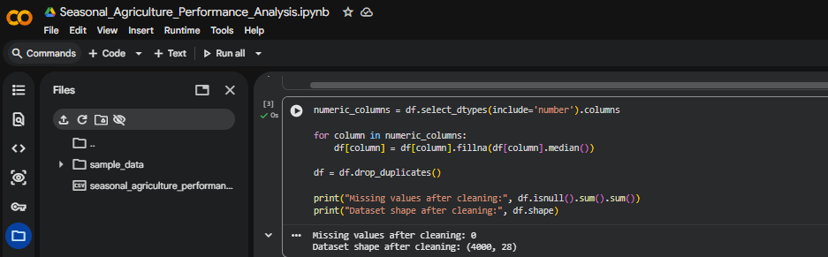
RESULTS

Slide 7
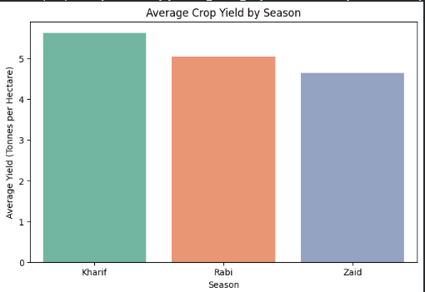
RESULTS

Slide 8
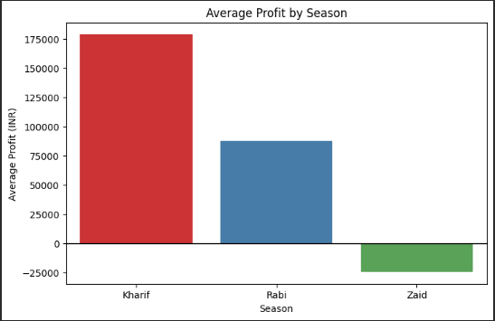
RESULTS

Slide 9
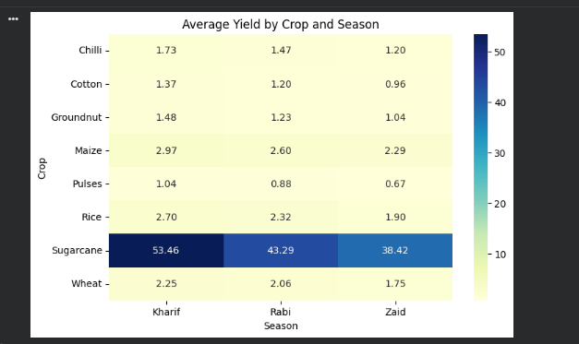
RESULTS

Slide 10
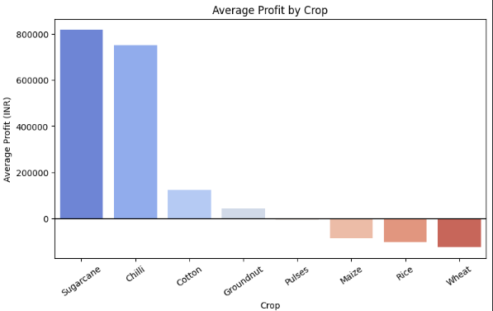
RESULTS

Slide 11
Future scope
• Add machine-learning models to predict crop yield and profit.
• Integrate real-time weather and market-price data.
• Create region-wise dashboards for farmers and planners.
• Provide early alerts for low-profit and low-efficiency farming conditions.

Slide 12
GitHub Link
https://github.com/Shamithaph108/Seasonal-Agriculture-Performance-Analysis.git

Slide 13
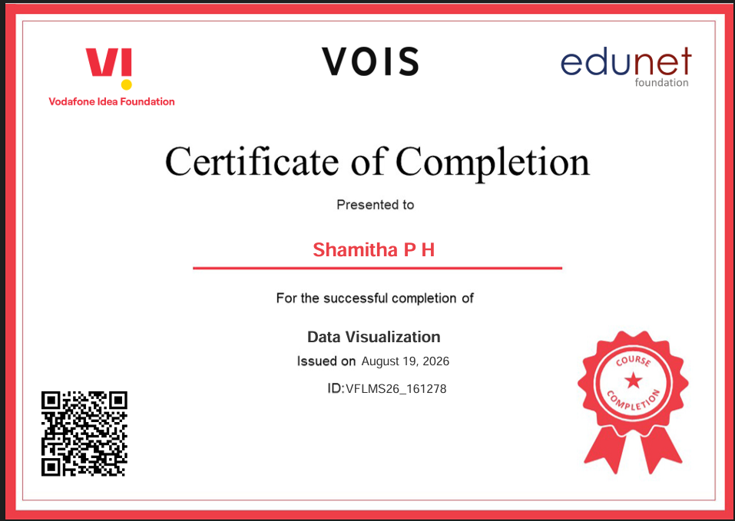
VOIS Course completion certificate -
Course name- Data Visualization

Slide 14
Thank you
.
.

