Slide 1

AGB1211 – DESIGN THINKING
Department of Artificial Intelligence and Data Science
Academic Year: 2024 – 2025 (Odd Semester)
Year :Second Year
Semester :Third Semester
Section :B
Date :06.12.24
PRESENTED BY, GUIDED BY
1.SANTHIYA S(2303811724322096) JOANY FRANKLIN M.E.,
2. SHEKKINAH HEPHZIBAH M(2303811724322104) Assistant Professor,
3. SHAMITHA SRI R(2303811724322102) Department of AI,
4. SOFIYA C(2303811724322106) K.Ramakrishnan College of Technology.

Slide 2
Title of the Project
HEALTH MONITORING DEVICE

Slide 3
Problem Identification
Health monitoring devices aim to address these challenges by offering continuous tracking, early detection of abnormalities, remote monitoring capabilities, and cost-effective solutions, thereby promoting proactive health management and reducing the strain on healthcare systems.
The primary challenge addressed by health monitoring devices is the lack of accessible, real-time, and cost-effective solutions for tracking health parameters.

Slide 4
Objective
The primary objective of a health monitoring device is to provide continuous real-time tracking of vital health parameters, such as heart rate, blood pressure, oxygen levels, glucose levels, and body temperature, ensuring users have up-to-date in sights into their health status.
These devices aim to empower users with better personal health management, promoting awareness and encouraging proactive health decisions.

Slide 5
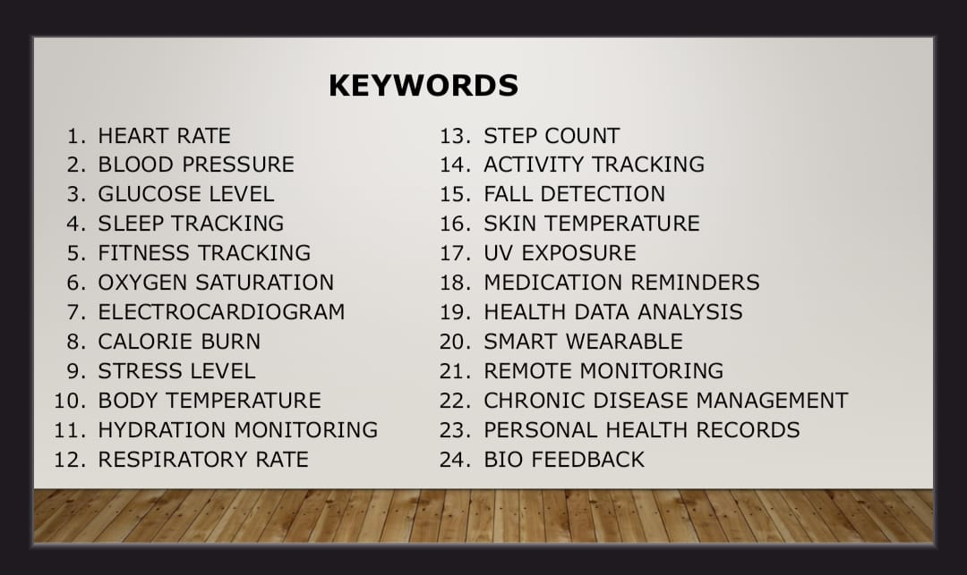
BrainStorming

Slide 6
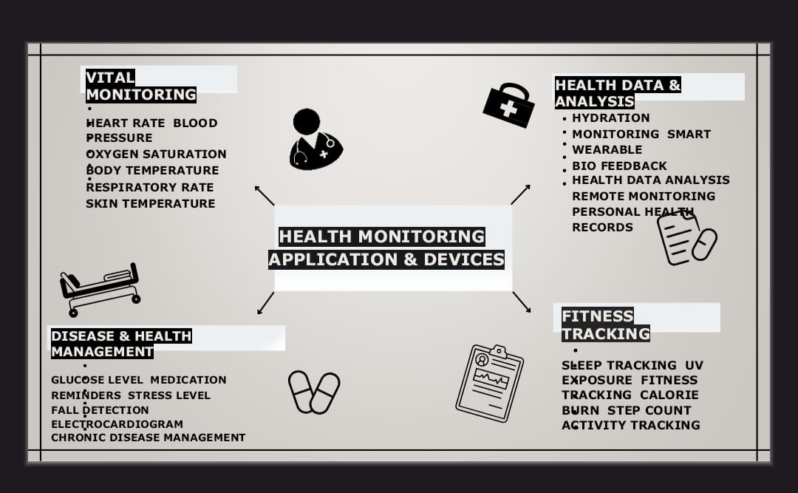
Mind Map

Slide 7
Primary Research
Primary research involves gathering firsthand data directly from sources to understand user needs, preferences, and challenges associated with health monitoring devices. Some examples include:
Surveys and Questionnaires
Focus Groups
Observation Studies

Slide 8
Secondary Research
Secondary research involves analyzing existing data and literature to gain insights into market trends, technological advancements, and consumer behavior.
Market Reports
Government and Healthcare Data
Case Studies

Slide 9
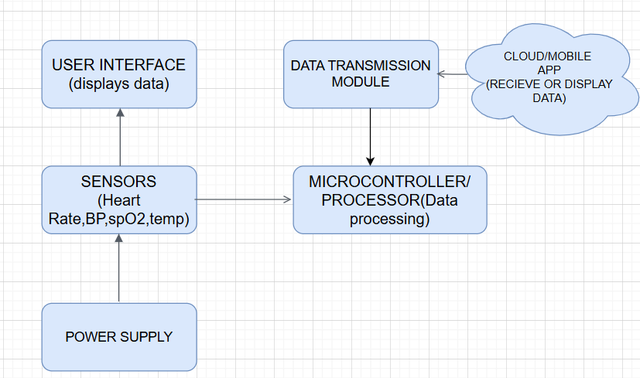
Proposed Work

Slide 10
List of Modules
SENSOR
DATA PROCESSING
COMMUNICATION
POWER MANAGEMENT
DISPLAY AND NOTIFICATION

Slide 11
Module 1 Description
SENSOR
The sensor module is responsible for collecting physiological data. It includes components like heart rate sensors, temperature sensors, and SpO2 sensors to measure vital metrics such as pulse, body temperature, and blood oxygen levels.

Slide 12
Module 2 Description
DATA PROCESSING
The data processing module converts raw data from the sensors into meaningful health insights. It uses a microcontroller or processor, supported by signal conditioning circuits, to filter and process signals for accuracy and reliability. This ensures the data is ready for analysis or display.

Slide 13
Module 3 Description (Cont..)
COMMUNICATION
This module enables the device to transmit data to external systems. It typically includes Bluetooth or Wi-Fi for wireless connectivity, allowing users to sync the device with smartphones or cloud platforms for real-time monitoring and storage.

Slide 14
Module 3 Description (Cont..)
COMMUNICATION
This module enables the device to transmit data to external systems. It typically includes Bluetooth or Wi-Fi for wireless connectivity, allowing users to sync the device with smartphones or cloud platforms for real-time monitoring and storage.

Slide 15
Module 3 Description (Cont..)
POWER MANAGEMENT
The power management module ensures the device operates efficiently. It includes a rechargeable battery to supply energy and, in advanced devices, may feature energy-harvesting components like solar cells to extend battery life.

Slide 16
Module 3 Description (Cont..)
DISPLAY AND NOTIFICATIONS
The display and feedback module provides visual or tactile information to the user. It may include LCD or LED screens to show health metrics, haptic feedback systems to deliver alerts, or audio outputs for notifications. This module ensures the device is user-friendly and accessible.

Slide 17


Results

Slide 18
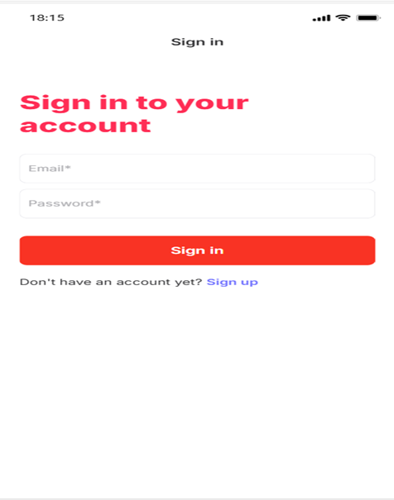

Results

Slide 19
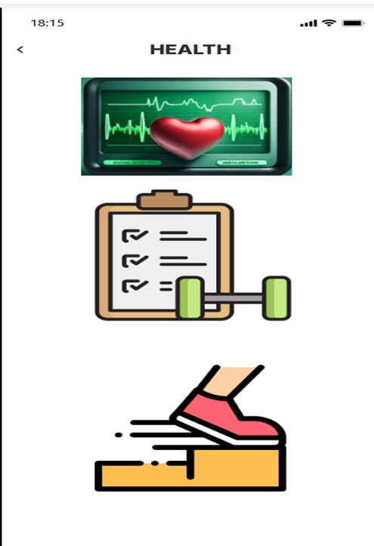
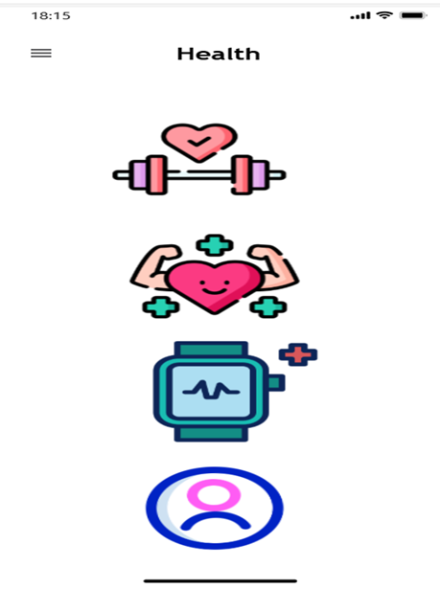
Results

Slide 20

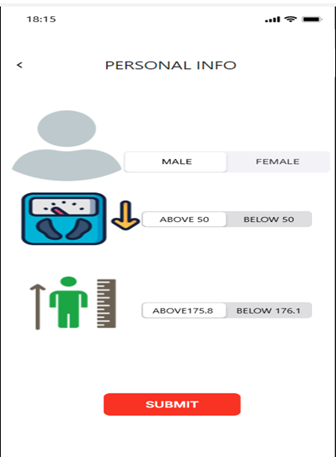
Results

Slide 21
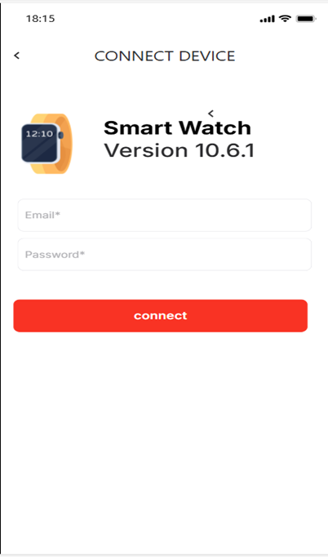
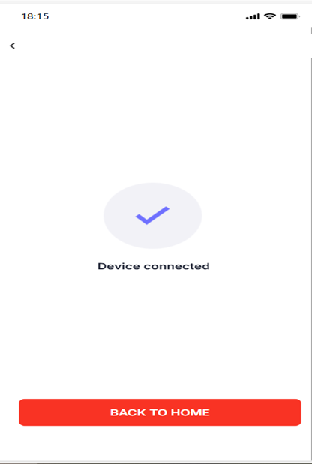
Results

Slide 22
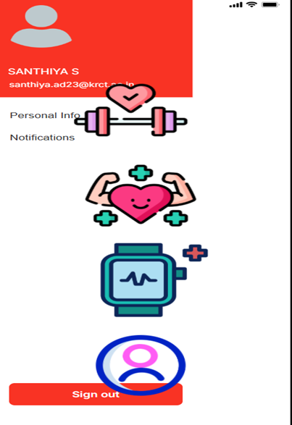
Results

Slide 23
Conclusion
In conclusion, health monitoring devices play a transformative role in modern healthcare by providing continuous, real-time tracking of vital health parameters, promoting early detection of potential health issues, and enabling proactive health management.
These devices address critical challenges such as limited accessibility, rising healthcare costs, and overburdened healthcare systems, making healthcare more efficient, personalized, and accessible.

Slide 24
Thank You

