Slide 1
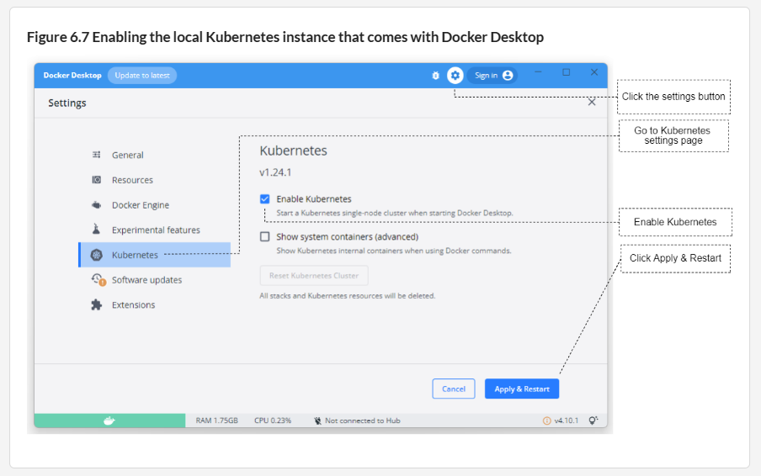

Slide 2
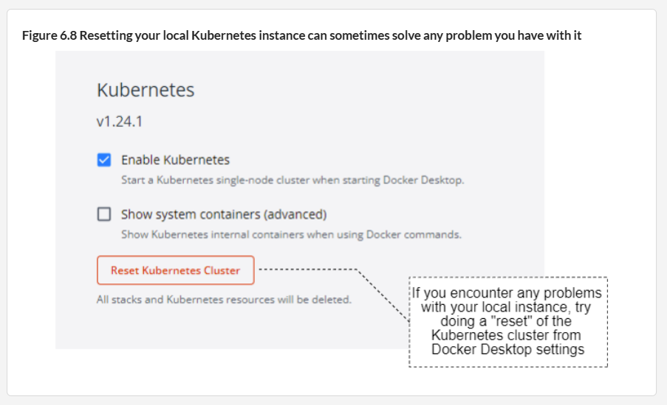

Slide 3
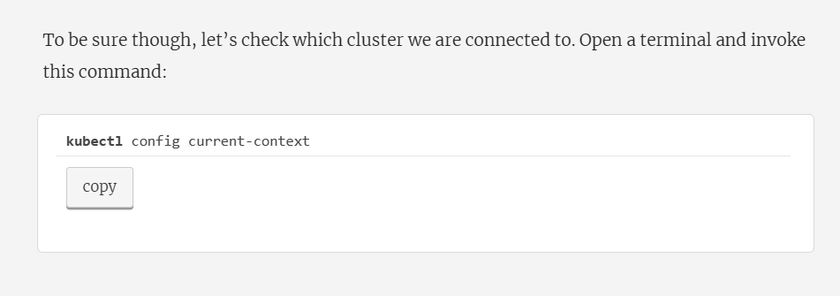
kubectl config current-context
To get all contexts
kubectl config get-contexts
To use docker desktop context
kubectl config use-context docker-desktop
Notes:
kubectl config current-context

